Slide 1
Cascade Style Sheets (CSS)
Web Authoring and Design
Benjamin Kenwright

Slide 2

Activity
Show examples of students Github websites
(5-10 Minutes)

Slide 3
Coursework Individual Project
Individual Project
`HTML & CSS Tutorial/Introductory Website’
Hosted on GitHub
Have 3+ Weeks of History/Evidence
Demonstrate
1 to 1 session discuss/explain your html/css
Design/layout/theme
Freedom is given to you
Allow you to be creative
Must be a tutorial website on HTML & CSS

Slide 4
Marking/Deliverables
Demonstration Sheet
Breakdown of the elements/criteria

Slide 5
Outline
Review
What are Cascade Style Sheets (CSS)?
How to add CSS sheets to your HTML
CSS Examples
Summary
Review/Discussion

Slide 6
Know `YOUR’ HTML

Slide 7
HTML Evolved
As HTML evolved, it came to encompass a wider variety of stylistic capabilities to meet the demands of web programmers
Split a web document into 3 layers:
content layer
presentation layer
behavior layer

Slide 8
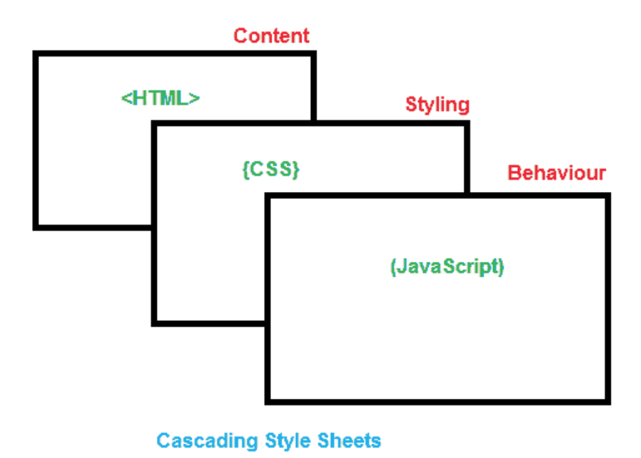
Standard
Sheets are now the official and standard mechanism for formatting text and page layouts

Slide 9
Divide and Conquer
While it’s possible to include all three layers within the same web document, but breaking them separate gives us one important advantage

Slide 10
Advantages of CSS

Slide 11
Why use CSS?
One of the primary advantages of CSS is that it allows developers to separate content from its presentation layer
Edit multiple HTML pages at one time by editing a single Style Sheet file
Reduces file sizes and bandwidth usage.
CSS enable you to lay out web pages exactly as you want them

Slide 12
Control
Cascading Style Sheet (CSS) is a separate language with its own syntax, which is enable you to lay out web pages exactly as you want them.

Slide 13
Compatibility

Slide 14
World Wide Web Consortium (W3C)
World Wide Web Consortium (W3C) controls the standard for defining the presentation of documents written in HTML.
CSS controls the presentation layer in a web document so that the web developer gains more degree of control over how the website would appears.

Slide 15
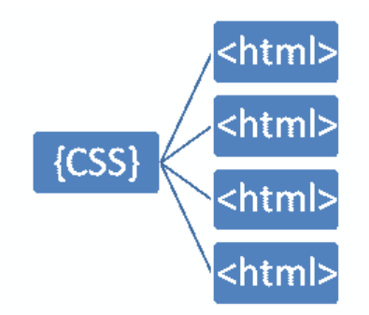
Separating Content & Presentation Layers
Style sheets (CSS) are designed primarily to enable the separation of HTML document content from document presentation layer

Slide 16
Fact
One single style sheet and it will reduces their size and bandwidth usage by more than 50% in many cases

Slide 17
File Extension
Cascade Style Sheets have a .css file extension . CSS has a simple syntax like HTML and uses a number of English keywords to specify the names of various style properties

Slide 18
CSS Versions
CSS Level 1 (CSS1) was officially released in 1996
CSS level 2 (CSS2) specification was developed by the W3C and published as a recommendation in 1998
The earliest CSS level 3 (CSS3) drafts were published in 1999
CSS level 3 is divided into several separate documents called modules
There is no single CSS4 specification (yet)

Slide 19
How does CSS Work?
Cascading Style Sheet (CSS) is a completely different approach to webpage styling and layout
Document`s HTML content must combine with style information
For example:
Content of a page goes into an HTML file, and the style information goes into a style sheet

Slide 20
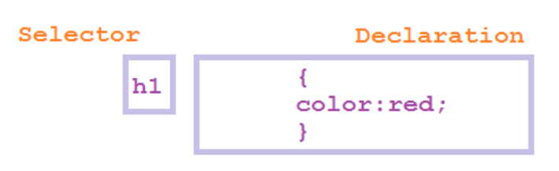
Linking
Cascading Style Sheet (CSS) works by allowing you to associate rules with the tags that appear in an HTML document

Slide 21
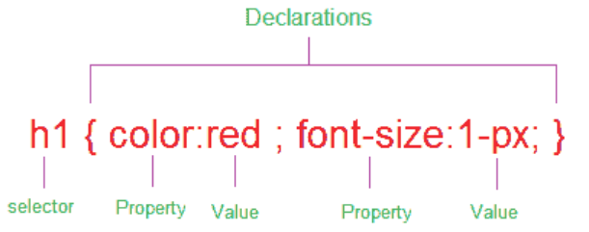
CSS Rules
Rules govern how the content of those elements should be rendered. A rule set consists of a selector followed by a declaration block

Slide 22
Declarations & Properties
CSS selectors are patterns used to select the elements you want to style:
h1 {color:red} - here h1 is the selector
Declarations, which sets out how the elements referred within the selector should be styled
h1 {color:red} - here color:red is declaration
Declaration is also split into two parts, separated by a colon : property and value

Slide 23
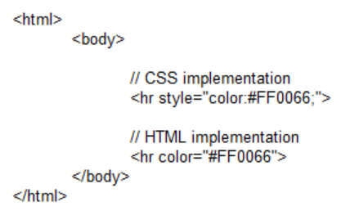
Example
A simple example Applying CSS and HTML tags in an HTML page

Slide 24

1. Inline Style

Slide 25

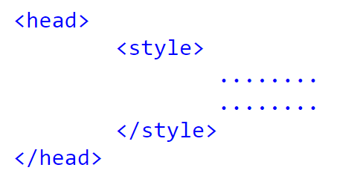
2. Embedded Style

Slide 26
Embedded Style Example
<html>
<head>
<title>Embedded Style Sample</title>
<style type="text/css">
h1{
color: #0000FF;
}
h2{
color: #00CCFF;
}
</style>
</head>
<body>
<h1>Embedded Style testing</h1>
<h2>Next Line</h2>
</body>
</html>

Slide 27
3. External Style
<link rel="stylesheet" type="text/css" href="styles.css" />

Slide 28
Example
.css File
h1{
color: #0000FF;
}
h2{
color: #00CCFF;
}s
.html File
<html>
<head>
<title>Embedded Style Sample</title>
<link rel="stylesheet" type="text/css"
href="styles.css" />
</head>
<body>
<h1>Embedded Style Example</h1>
<h2>Next Line</h2>
</body>
</html>

Slide 29

Question
What will happen in this case?
a) h1 heading becomes green
b) error
c) h1 heading disappears
d) nothing happens

Slide 30
Answer
Answer: c)

Slide 31
Question
Which of the following is the correct way to applying style to a document?
a) Use an external style sheet, either by importing it or by linking to it
b) Directly embed a document-wide style in the head element of the document
c) Set an inline style rule using the style attribute directly on an element
d) All of the above

Slide 32
Answer
Answer: d)

Slide 33

Question
What will happen in this case?
a) make that specific paragraph red.
b) error
c) nothing happens
d) none of the above

Slide 34
Answer
Answer: a)

Slide 35
Lengths and Units
Relative Units
Absolute Units
Percentages

Slide 36
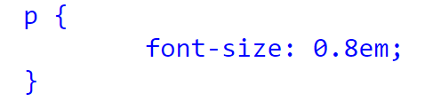
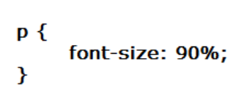
Examples
Relative units
e.g., `em’
Absolute units
e.g., ‘mm’, ‘cm’
Percentages
e.g., ‘%’

Slide 37
Question
Which of the following measurement defines a measurement in centimeters?
a) c
b) cm
c) centi
d) centimeter

Slide 38
Answer
Answer: b)
Example: div {margin-bottom: 1cm;}

Slide 39
Question
Which of the following measurement defines a measurement in points?
a) px
b) in
c) em
d) pt

Slide 40
Answer
Answer: d)
Explanation: Defines a measurement in points. A point is defined as 1/72nd of an inch. A point does not equate to a pixel unless there are 72 pixels per inch onscreen.

Slide 41
Question
The _______property is used to set the color of the text.
a) pallet
b) colour
c) color
d) text-decoration

Slide 42
Answer
Answer: c)

Slide 43
Question
Which style is this?
a) Inline Styles
b) External Style Sheet
c) External Style Stylist Sheet
d) None of the above

Slide 44
Answer
Answer: a)

Slide 45
Question
Is this correct way to apply css.State true or false.
a) True
b) False

Slide 46
Answer
Answer: a)

Slide 47
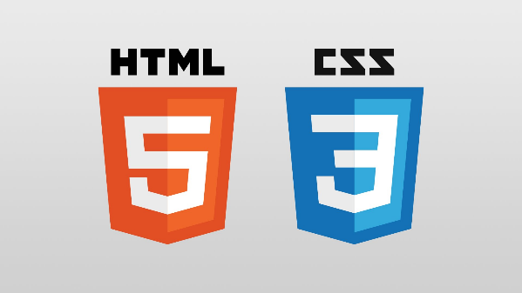
Summary
Overview of Cascade Style Sheets (CSS)
Advantages and implementation details for CSS in HTML
Important you understand why and how to use CSS
Examples
Hands-On/Practical

Slide 48
This Week
Review Slides
Read Associated Chapters
Online Quizzes
Additional quizzes each week
Do this weeks Tasks
Implement Style Sheet Examples
Update Github Website
Regularly make commits/updates
Structure your/folders/sections
Manage/demonstrate different features/techniques

Slide 49
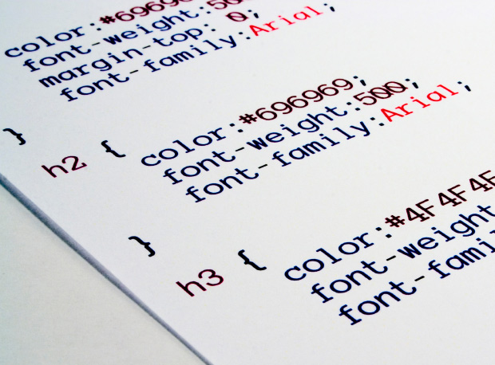
Questions/Discussion

Slide 50
Question
The __________ property specifies the type of positioning method used for an element.
a) align
b) float
c) position
d) padding

Slide 51
Answer
Answer: c

Slide 52
Question
Which of the following measurement defines a measurement relative to the height of a font in em spaces?
a) px
b) in
c) em
d) pt

Slide 53
Answer
Answer: c)
Explanation: Defines a measurement relative to the height of a font in em spaces. Because an em unit is equivalent to the size of a given font, if you assign a font to 12pt, each em unit would be 12pt, thus 2em would be 24pt.

Slide 54
Question
Which of the following measurement defines a measurement in pixels?
a) px
b) in
c) em
d) pt

Slide 55
Answer
Answer: a)

Slide 56
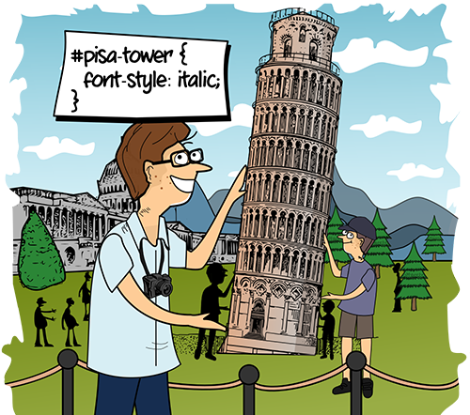
CSS `Styling’

Slide 57
Appreciate Challenges
Have faith in yourself
Have fun learning HTML/CSS/JS
Rewarding and exciting topic
Involves commitment and hard-work

