Slide 1
CSS Div Layouts
Web Authoring and Design
Benjamin Kenwright

Slide 2
Outline
Why use Div Layout instead of Tables?
How do we use the Div Tag?
How to create layouts using the CSS Div Tag?
Summary
Review/Discussion

Slide 3
Table vs Div Layouts
table
Pros: supported by all browsers
Cons: bind style to content; hard to maintain
div
Pros: easy to maintain
Cons: not supported by all browsers
We recommend – div, reasons:
CSS is to separate structure from content.
Supporting most common/popular browsers are enough. May be it’s time for some people to upgrade their browsers

Slide 4
What is Div Tag?
CSS Division (div) is a container element and it is used to group related items together
When ever there is a situation that you need to collect various objects into a larger container for scripting or styling purposes, div is the best solution
The use of <div> tag is straightforward

Slide 5
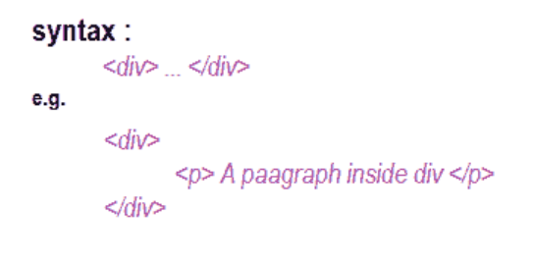
Div Syntax

Slide 6
CSS Division
CSS divisions to provide greater flexibility and mark out regions of the page.
You can use divs by referencing the selector in the opening tag using ID and CLASS
e,g. id="myContainer" or class="myContainer"

Slide 7
Div in an HTML document
<html>
<head>
<style type="text/css">
#box {
width: 420px;
height:120;
border-width: 2px;
border-style:solid;
border-color:red;
background: #CCC;
}
</style>
</head>
<body>
<div id="box">
<h1>Box Model</h1>
<p>
The Box model determines how elements are positioned within the
browser window. With the Box Model, a developer can control the
dimensions, margins, padding, and borders of an HTML element.
</p>
</div>
</body>
</html>
Output

Slide 8
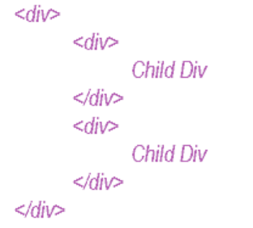
Nesting Div
The div element grouping a generic block of content that should be treated as a logical unit for scripting or styling purposes. A div can contain a number of other divs ( child div ) like HTML Tables. This is called Nesting Div

Slide 9
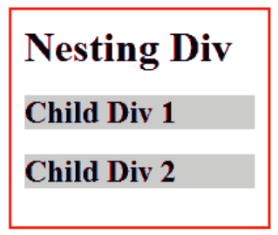
Nesting Div in an HTML page
<html>
<head>
<style type="text/css">
.parent {
width: 200px;
height:120;
border-width: 2px;
border-style:solid;
border-color:red;
padding:10px;
}
.child {
overflow : hidden;
background: #CCC;
}
</style>
</head>
<body>
<div class="parent">
<h1> Nesting Div</h1>
<div class="child">
<h2>Child Div 1</h2>
</div>
<div class="child">
<h2>Child Div 2</h2>
</div>
</div>
</body>
</html>
Output

Slide 10
Careful
Div elements very carefully and use only when it is necessary for logical structure or styling
Excessive use of Div tags can make a page difficult to manage/debug/extend

Slide 11
Div Layouts
Div tag to create your website layout
Common website layouts

Slide 12
Common Layouts
Variable width content:
2 columns - left menu
2 columns - right menu
3 columns
Centered (fixed width content):
2 columns
3 columns
4 columns (fluid/variable width)
Many other …

Slide 13
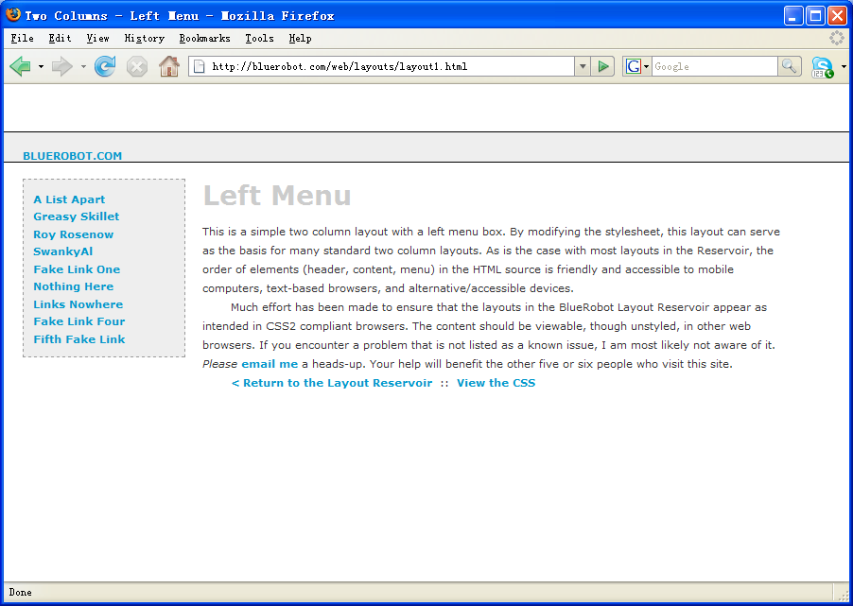
Two Columns - Left Menu

Slide 14
Two Columns - Left Menu
#Header {
margin:50px 0px 10px 0px;
padding:17px 0px 0px 20px;
border:1px dashed #999;
background-color:#eee;
}
#Content {
margin:0px 50px 50px 200px;
padding:10px;
border:1px dashed #999;
background-color: #eee;
}
#Menu {
position:absolute;
top:100px;
left:20px;
width:150px;
padding:10px;
background-color:#eee;
border:1px dashed #999;
}

Slide 15
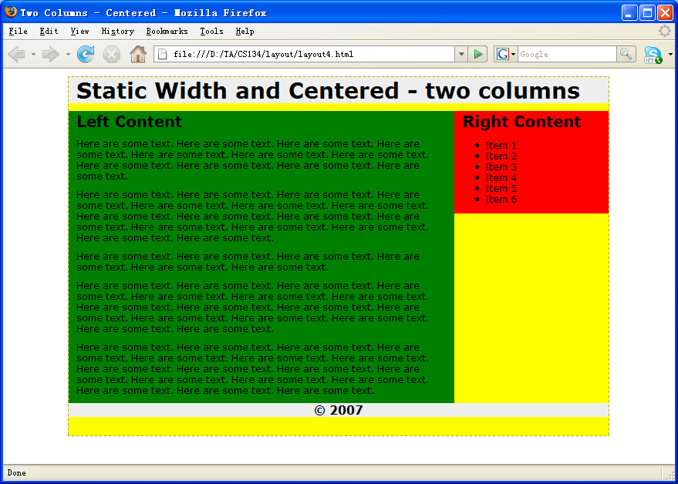
Two Columns Centered Fixed Width

Slide 16
Two Columns Centered Fixed Width
body {
margin:0px;
padding:0px;
text-align: center;
}
#Wrapper {
width:700px;
margin-right:auto;
margin-left:auto;
border:1px dashed #999;
}
#Header {
background: #eee;
}
#Menu {
float:right;
width:200px;
background: #eee;
}
#Content {
float:left;
width:500px;
background: #666;
}
#Footer {
clear: both;
background: #eee;
}

Slide 17
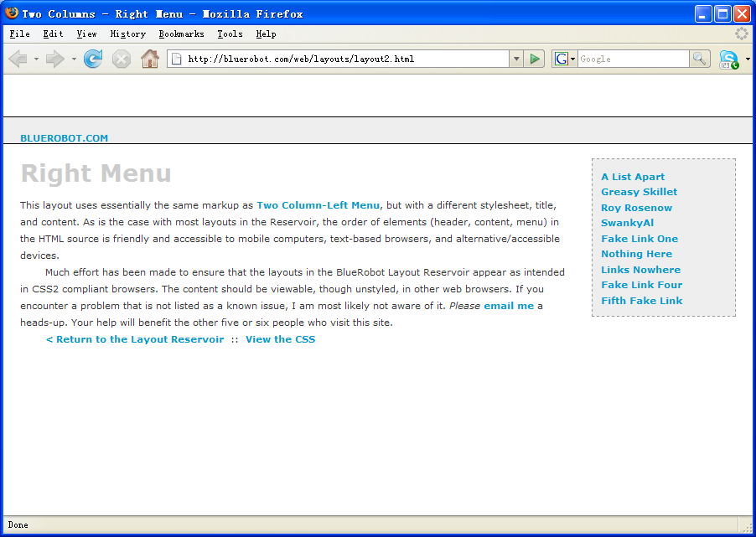
Two Columns - Right Menu

Slide 18
Two Columns - Right Menu
#Header {
margin:50px 0px 10px 0px;
padding:17px 0px 0px 20px;
border:1px dashed #999;
background-color:#eee;
}
#Content {
margin:0px 200px 50px 50px;
padding:10px;
border:1px dashed #999;
background-color: #eee;
}
#Menu {
position:absolute;
top:100px;
right:20px;
width:150px;
padding:10px;
background-color:#eee;
border:1px dashed #999;
}

Slide 19
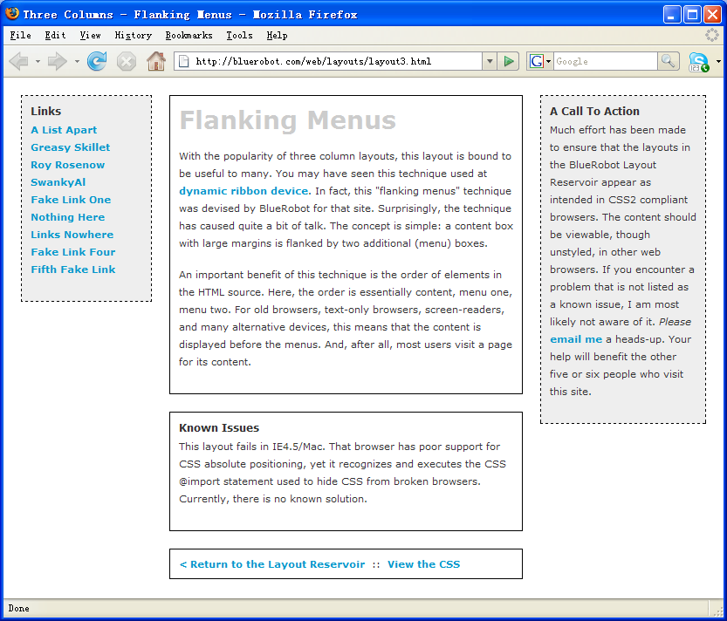
Three Columns Flanking Menu

Slide 20
Three Columns Flanking Menu
.content {
position:relative;
width:auto;
min-width:120px;
margin:0px 210px 20px 170px;
border:1px solid black;
padding:10px;
z-index:3; /* This allows the content to overlap the right menu in narrow windows in good browsers. */
}
#navAlpha {
position:absolute;
width:128px;
top:20px;
left:20px;
border:1px dashed black;
background-color:#eee;
padding:10px;
z-index:2;
}
#navBeta {
position:absolute;
width:168px;
top:20px;
right:20px;
border:1px dashed black;
background-color:#eee;
padding:10px;
z-index:1;
}

Slide 21
Z-Index (or Stack Level)
z-index: auto | <integer> | inherit
Z-axis positions are particularly relevant when boxes overlap visually.
In addition to their horizontal and vertical positions, boxes lie along a "z-axis" and are formatted one on top of the other.
Boxes with higher z-index stacked on top of the boxes with lower z-index.
Boxes with the z-index are stacked back-to-front according to document tree order.

Slide 22
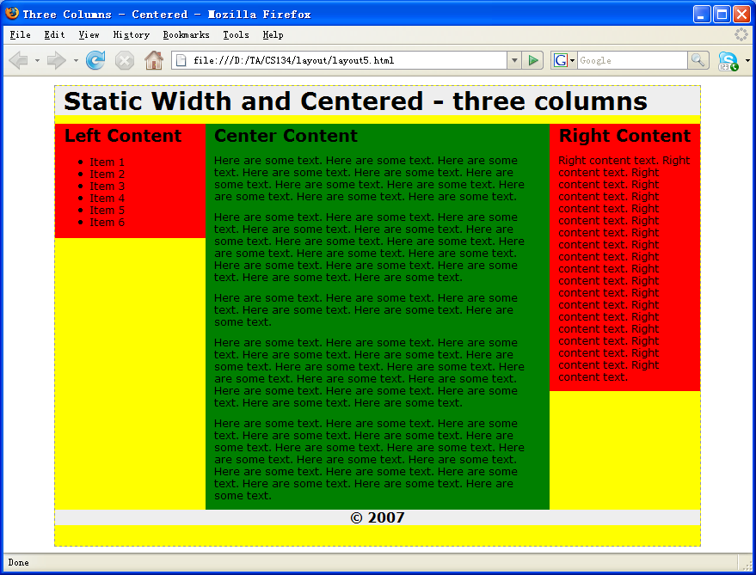
Three Columns Centered Fixed Width

Slide 23
Three Columns Centered Fixed Width
body {
text-align:center;
margin:0px;
padding:0px;
font:12px verdana, arial, helvetica, sans-serif;
}
#frame {
width:750px;
margin-right:auto;
margin-left:auto;
margin-top:10px;
text-align:left;
border:1px dashed #999;
background-color: yellow;
}
#topcontent {
background-color: #eee;
}
#centercontent {
float:left;
width:400px;
background-color: green;
}
#leftcontent {
float:left;
width:175px;
background-color: red;
}
#rightcontent {
float:left;
width:175px;
background-color: red;
}
#bottomcontent {
background-color:#eee;
text-align:center;
}

Slide 24
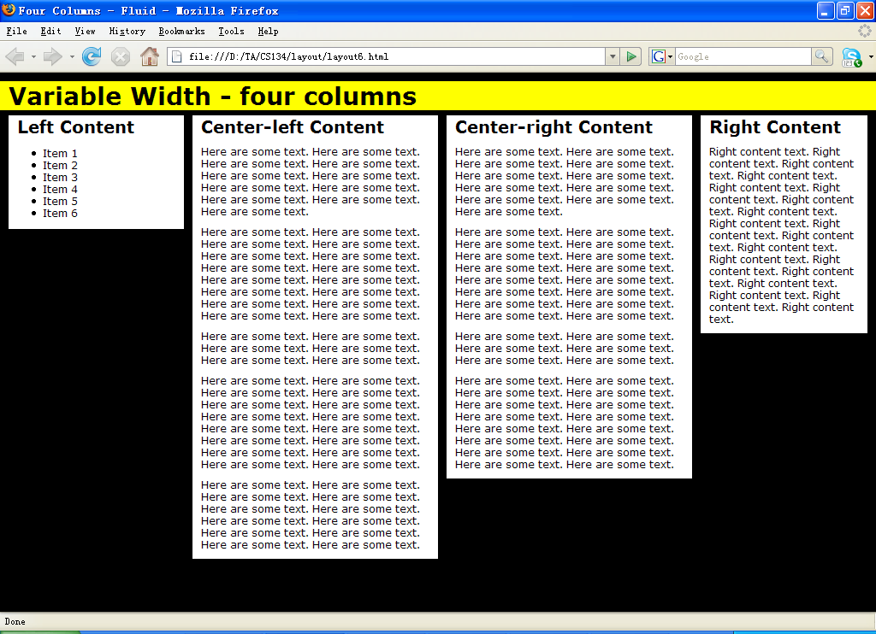
Four Columns Variable Width

Slide 25
Four Columns Variable Width
#topcontent {
background-color: yellow;
}
#leftcontent {
position: absolute;
left:1%;
width:20%;
top:50px;
background:#fff;
}
#centerleft {
position: absolute;
left:22%;
width:28%;
top:50px;
background:#fff;
}
#centerright {
position: absolute;
left:51%;
width:28%;
top:50px;
background:#fff;
}
#rightcontent {
position: absolute;
left:80%;
width:19%;
top:50px;
background:#fff;
}

Slide 26
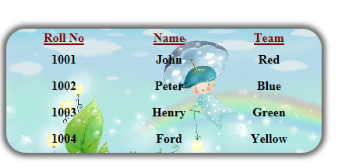
CSS Table
HTML table styling with CSS properties
CSS table properties offer better control of the presentational aspects of the Table

Slide 27
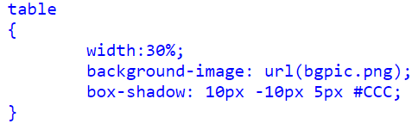
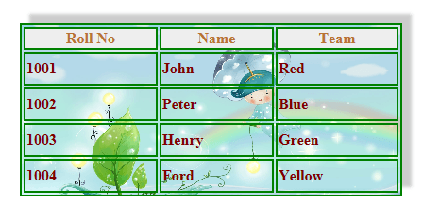
Example
CSS
Output

Slide 28
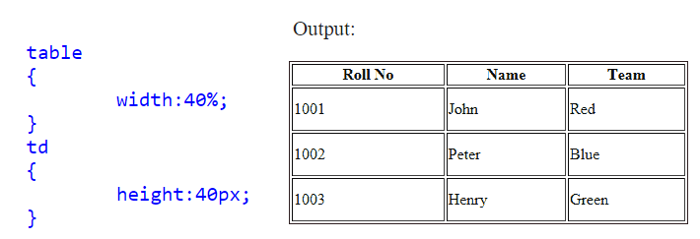
Table width and height in CSS
Table width and height, use CSS width, height properties
For example, table width as 30% and height of the td set to 40px

Slide 29
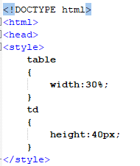
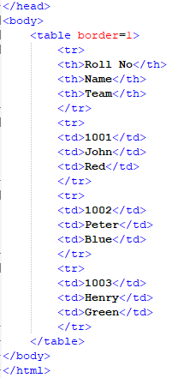

Slide 30
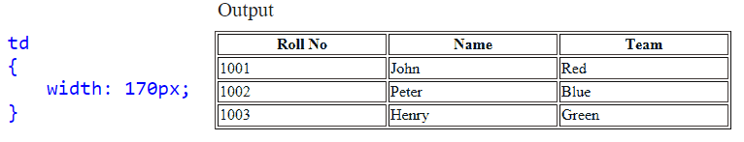
Table column width in CSS
Specify column width in CSS, use the width property to td

Slide 31
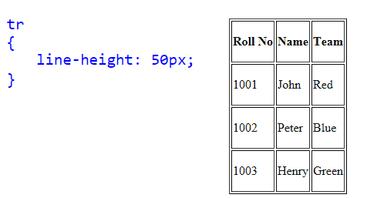
CSS Table Row height
Set Row Height through CSS line-height property it set to each tr.

Slide 32
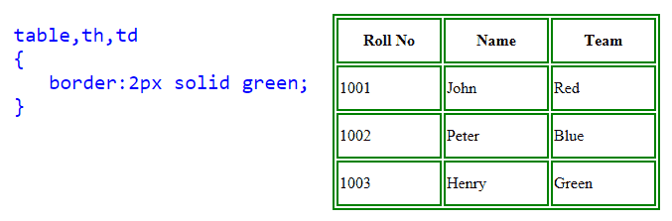
CSS Table border
Table border in CSS, use the CSS border property

Slide 33
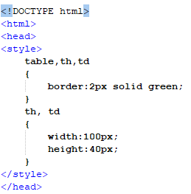
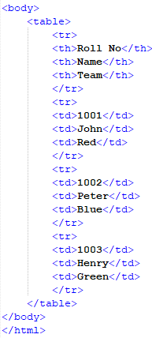

Slide 34
CSS Collapse Table borders
CSS Collapse property takes two values, separate and collapse
separate : The separate value forced all cells have their own independent borders and allow spaces between those cells.
collapse : This value collapse all spaces between table borders and cells, so you can see as a single line border

Slide 35
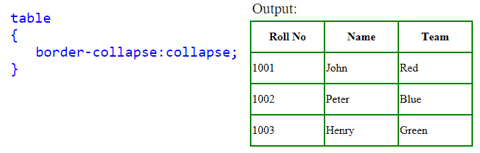

Slide 36
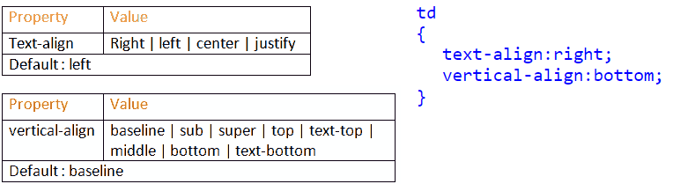
CSS Table Text Align
Align text horizontally and vertically in CSS.
Horizontal: text-align property
Vertically: vertical-align property

Slide 37
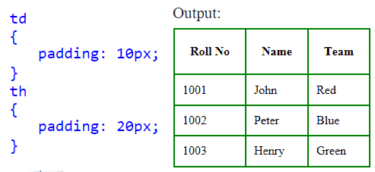
CSS Table Cell Padding
CellPadding is used to control the space between the contents of a Cell and the Cell borders

Slide 38
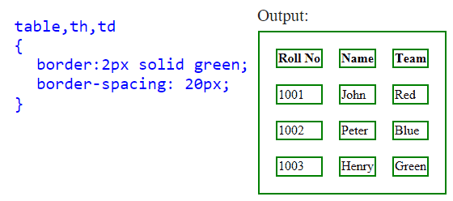
CSS Table Cell Spacing
Cellspacing attribute places space around each cell in the table. To specify cell Spacing in CSS, use the CSS border-spacing property

Slide 39
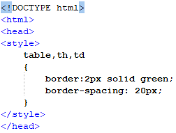
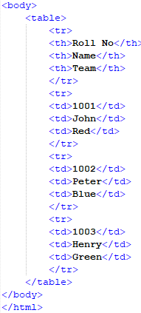

Slide 40
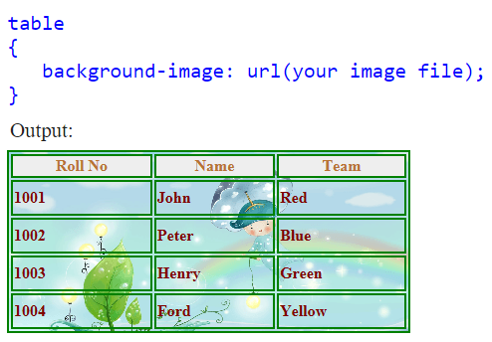
CSS Table background Image

Slide 41
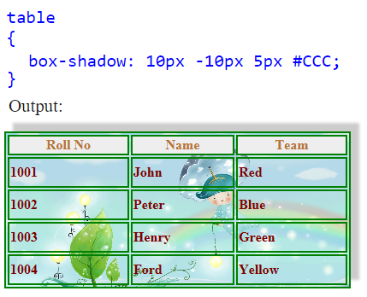
CSS Shadow on a Table

Slide 42
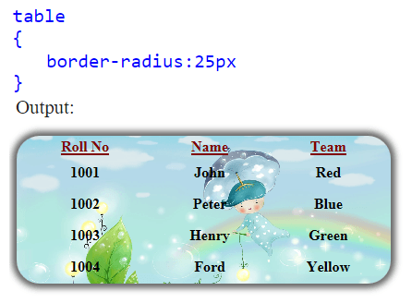
CSS Rounded Corners Table

Slide 43
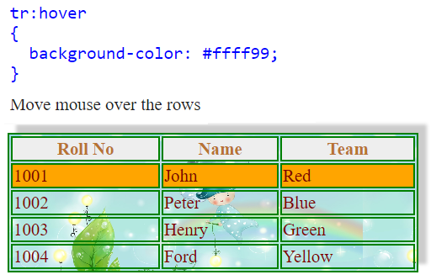
Highlight CSS Table Row on Hover

Slide 44
This Week
Review Slides
Read Associated Chapters
Weekly Tasks
Update GitHub Account/Webpage
Online Quizzes

Slide 45
Summary
Overview of CSS Div Layouts
Tables and CSS Styles
Hands-On/Practical

Slide 46
Questions/Discussion

Slide 47
