Slide 1
JavaScript Syntax
Web Authoring and Design
Benjamin Kenwright

Slide 2
Outline
Fundamental Syntax Javascript
Summary
Review/Discussion

Slide 3
JavaScript Data Types

Slide 4
Primary Data Types (Primitive)
String
Number
Boolean

Slide 5
Composite Data Types (reference)
Object
Array

Slide 6
Special Data Types
Null
Undefined

Slide 7
Overview of Types
String : A strings of any characters enclosed in quotes is a string primitive.
Number : A number by itself is a number primitive, all numbers in JavaScript are 64-bit floating-point numbers.
Boolean : It will store Variables or expressions which are either true or false.
Object: A collections of properties and methods. In Javascript, anything that is not a primitive is an Object.
Arrays : Arrays are regular objects, both objects and arrays can have properties and methods.
Null : It has only one value in JavaScript: null.
Undefined : It treated as a variable that has been declared, but has never had a value assigned to it.

Slide 8
Var in Javascript
var anyData;

Slide 9
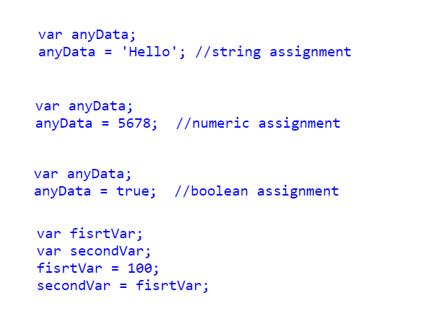
Example var

Slide 10

Combining Data Types
What would be in variable xyz?

Slide 11


Slide 12

Example
What would be in variable xyz this time?

Slide 13


Slide 14
Scope of JavaScript Variables
The Javascript variable has only two scopes, Global and Local.
When you declare a variable within your function , its scope is local, that means you can use that variable only inside that function.
If a variable declare outside the function, its scope is Global.

Slide 15

Constants
Javascript you can define read-only Constant variables with const keyword

Slide 16
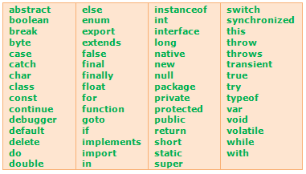
JavaScript keywords

Slide 17

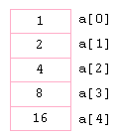
JavaScript Array Object

Slide 18
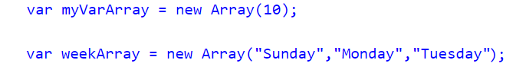
Constructors
Already know the number of items that would store in an array, you can pass the number to the constructor of an Array Object
Directly initialize the Array elements when declaring an Array Object

Slide 19
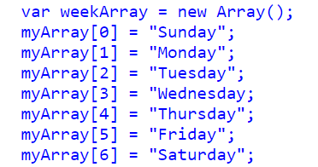
From 0...
JavaScript array indexes start from 0 (zero) and continue as 1,2,3 etc..

Slide 20

Displaying
Displaying Javascript Array elements
You can display Array elements in several ways. The following methods will show all elements from an Array.

Slide 21

Javascript Array Length
Length property of Javascript Array return the number of elements contains in an Array. Javascript Array index starts from 0 so the length of an array is equal to the last index + 1

Slide 22
Arrays Undefined Values
Arrays are automatically growing and dynamically sized to accommodate any type of data that is added to them. So, when you add or remove elements from an array, the length of the array will change as needed. When you declare an Array with constructor, each slot will be set to "undefined"

Slide 23
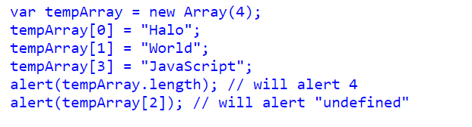
Example

Slide 24
Other Array Methods
Array.push()
Array.contains()
Array.sort()
Array.splice()
Array.slice()
Array.join()

Slide 25
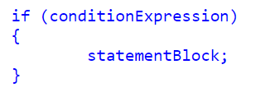
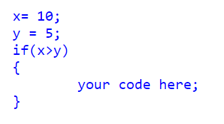
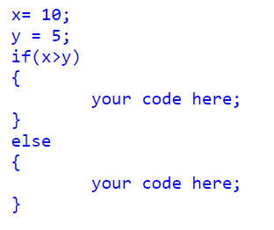
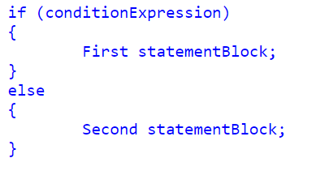
Conditional Statements

Slide 26
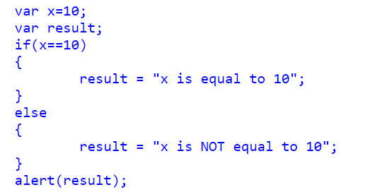
Alternative if..else Syntax (? Ternary Operator)

Slide 27
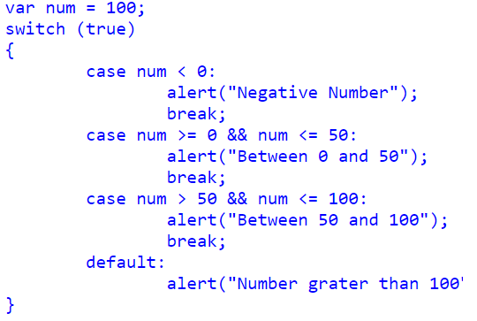
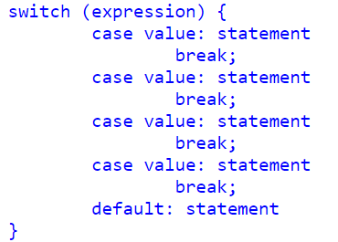
Switch Statements

Slide 28
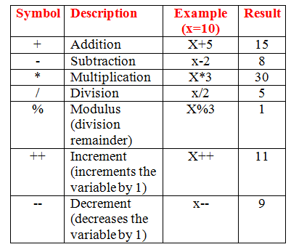
Arithmetic Operators

Slide 29
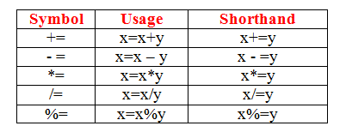
Assignment Operators

Slide 30
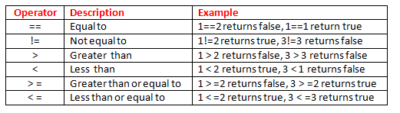
Comparison Operators

Slide 31
Logical Operators
AND (&&) : Allows you to check if both of two conditions are met
OR (||) : Allows you to check if one of two conditions are met
NOT (!) : Allows you to check if something is not the case

Slide 32
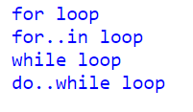
Loops in JavaScript

Slide 33
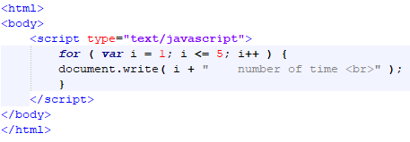
Javascript for loop

Slide 34
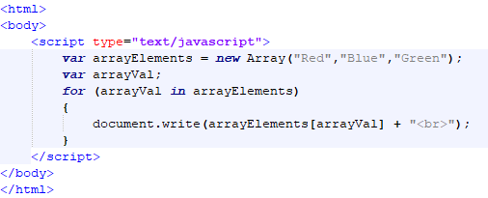
Javascript for..in Loop

Slide 35
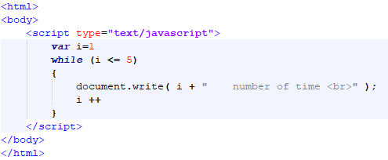
Javascript while Loop

Slide 36
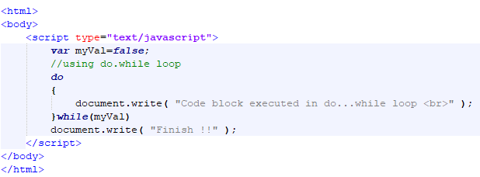
Javascript do..while loop

Slide 37
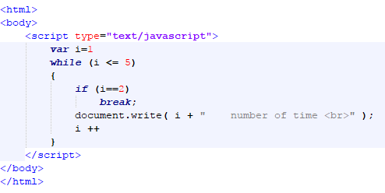
Javascript Break statement

Slide 38
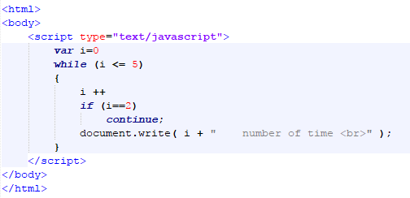
Continue statement

Slide 39
This Week
Review Slides
Read Associated Chapters
Work through Javascript Examples
Update GitHub Account/Webpage
Start Early

Slide 40
Summary
Overview of Javascript Syntax
Examples
Hands-On/Practical

Slide 41
Questions/Discussion

Slide 42
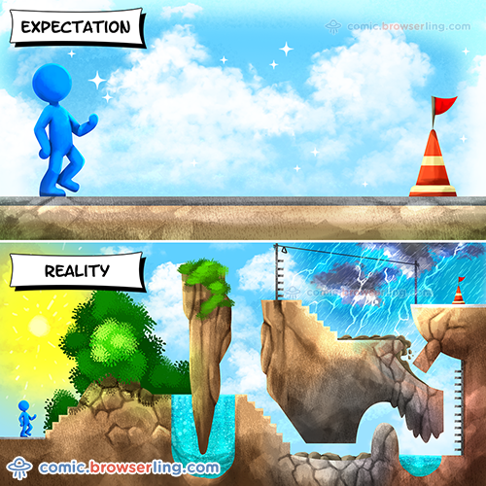
Learning JavaScript

