Slide 1
Javascript Forms
Web Authoring and Design
Benjamin Kenwright

Slide 2
Outline
What do we mean Javascript Forms?
Summary
Review/Discussion

Slide 3
Outline
What do we mean Javascript Forms?
Summary
Review/Discussion

Slide 4
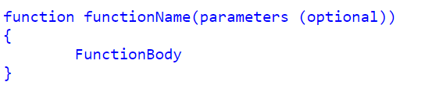
Defining functions
Function Declarations:

Slide 5
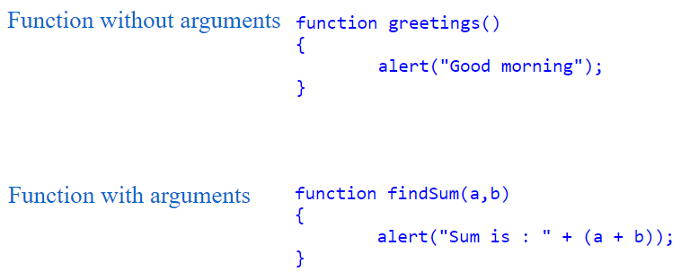
Arguments

Slide 6
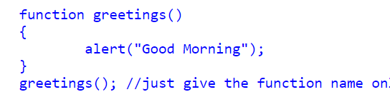
Calling a Function
You can call Javascript functions by simply call the function name

Slide 7
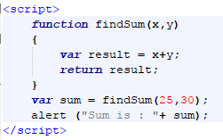
Return Values

Slide 8
Object Orientated
JavaScript is an object oriented programming language

Slide 9
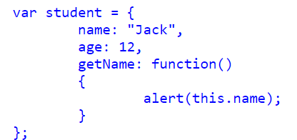
How to create and use objects in Javascript

Slide 10

Call Object function

Slide 11
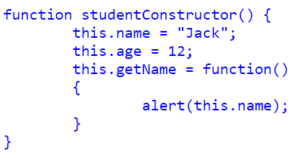
Object constructor

Slide 12

How to create a New Instance from a Constructor

Slide 13
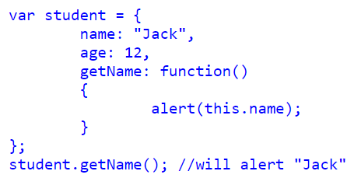
Literal notation in Javascript Object

Slide 14
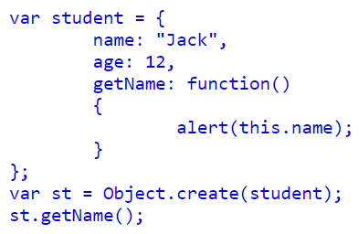
Object.create() in Javascript Object

Slide 15
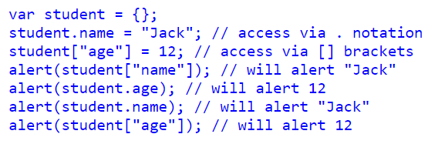
Accessing Object Properties in JavaScript
We can access Object Properties in JavaScript using either the dot(.) notation or the bracket[] notation

Slide 16
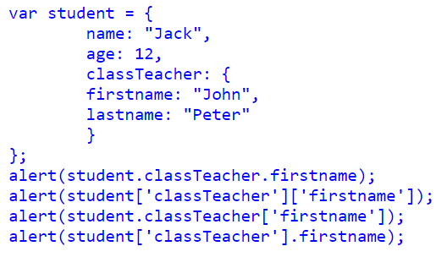
Object contain another Object

Slide 17
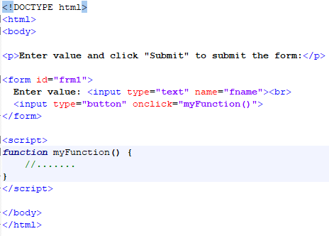
Forms Trigger/Call Javascript

Slide 18
This Week
Review Slides
Read Associated Chapters
Work through Javascript Examples
Update GitHub Account/Webpage
Start Early

Slide 19
Summary
Overview of Javascript Forms
Hands-On/Practical

Slide 20
Questions/Discussion

