Slide 1
Javascript Cookies
Web Authoring and Design
Benjamin Kenwright

Slide 2
Outline
What do we mean by Javascript Cookies?
What do we use Cookies for?
How do we load and save Cookies using Javascript
Examples
Summary
Review/Discussion

Slide 3
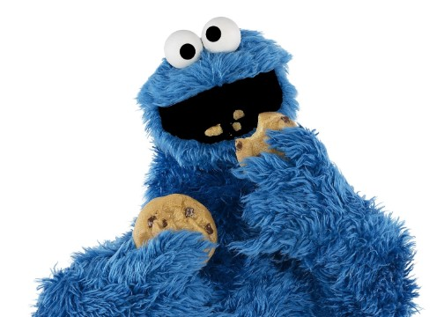
Do you like Cookies?
Who is this?

Slide 4
Cookie Monster (Sesame Street)

Slide 5
Getting Information About the Document
Several properties of the document object include information about the current document in general. For e.g. document.title represent the title of the current page, defined by the HTML < title > tag.

Slide 6
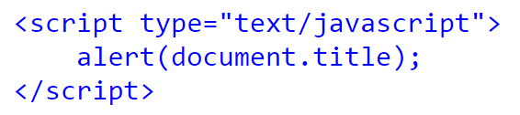
Title
The above code will alert "The DOM", the Title of the HTML page

Slide 7
Other important information about the document
document.URL : Represents the document's URL.
document.lastModified : The date which the document was last modified.
document.cookie : It enables you to read or set a cookie for the document.
document.images : It returns a collection of images used in the document

Slide 8
What are Cookies ?
Cookies is the most efficient method of remembering and tracking preferences, purchases, commissions, and other information required for better visitor experience or site statistics

Slide 9
How It Works ?
Your server sends some data to the visitor's browser in the form of a cookie
The browser may accept the cookie
If it does, it is stored as a plain text record on the visitor's hard drive
Now, when the visitor arrives at another page on your site, the browser sends the same cookie to the server for retrieval
Once retrieved, your server knows/remembers what was stored earlier

Slide 10
Cookies are a plain text data record of 5 variable-length fields
Expires − The date the cookie will expire. If this is blank, the cookie will expire when the visitor quits the browser.
Domain − The domain name of your site.
Path − The path to the directory or web page that set the cookie. This may be blank if you want to retrieve the cookie from any directory or page.
Secure − If this field contains the word "secure", then the cookie may only be retrieved with a secure server. If this field is blank, no such restriction exists.
Name=Value − Cookies are set and retrieved in the form of key-value pairs

Slide 11
Storing Cookies
The simplest way to create a cookie is to assign a string value to the document.cookie object, which looks like this
document.cookie = "key1=value1;key2=value2;expires=date";

Slide 12
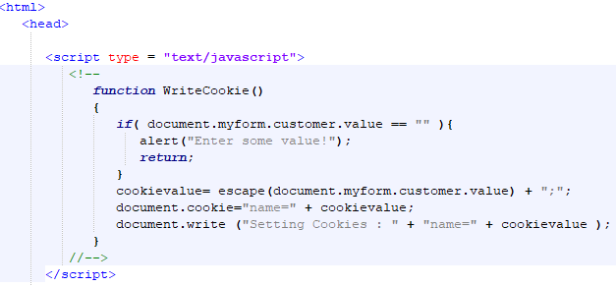
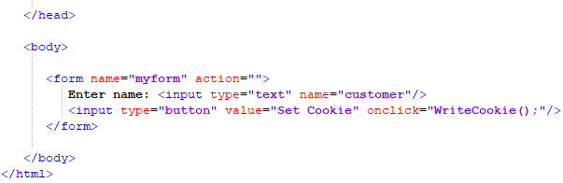
Example

Slide 13
Reading Cookies
Reading a cookie is just as simple as writing one, because the value of the document.cookie object is the cookie
So you can use this string whenever you want to access the cookie
The document.cookie string will keep a list of name=value pairs separated by semicolons, where name is the name of a cookie and value is its string value
You can use strings' split() function to break a string into key and values

Slide 14
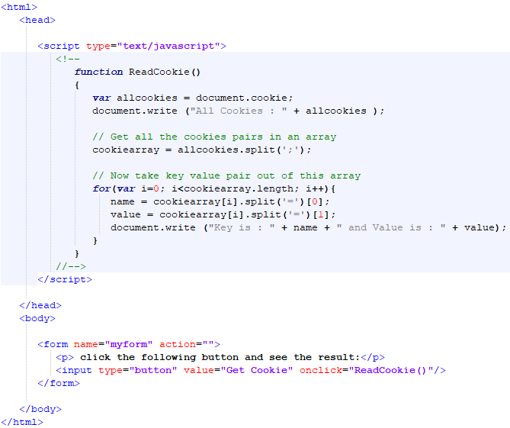
Example

Slide 15
Setting Cookies Expiry Date
You can extend the life of a cookie beyond the current browser session by setting an expiration date and saving the expiry date within the cookie.
This can be done by setting the ‘expires’ attribute to a date and time

Slide 16
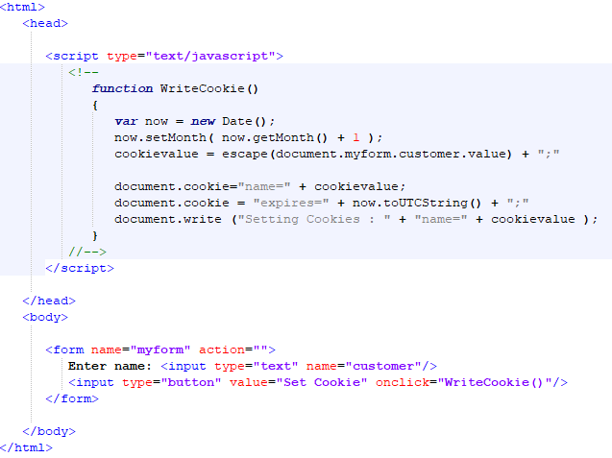
Example

Slide 17
Deleting a Cookie
Sometimes you will want to delete a cookie so that subsequent attempts to read the cookie return nothing.
To do this, you just need to set the expiry date to a time in the past.

Slide 18
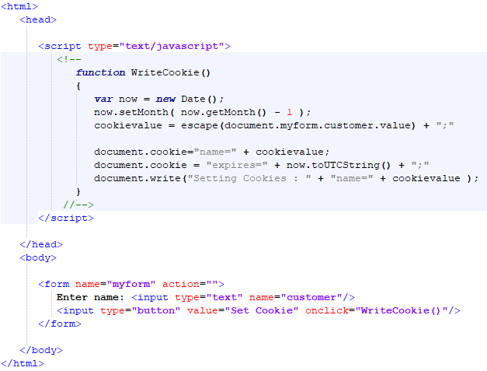
Example

Slide 19
This Week
Review Slides
Read Associated Chapters
Work through Javascript Examples
Update GitHub Account/Webpage
Start Early

Slide 20
Summary
Overview of Javascript and Cookies
Hands-On/Practical

Slide 21
Questions/Discussion

Slide 22
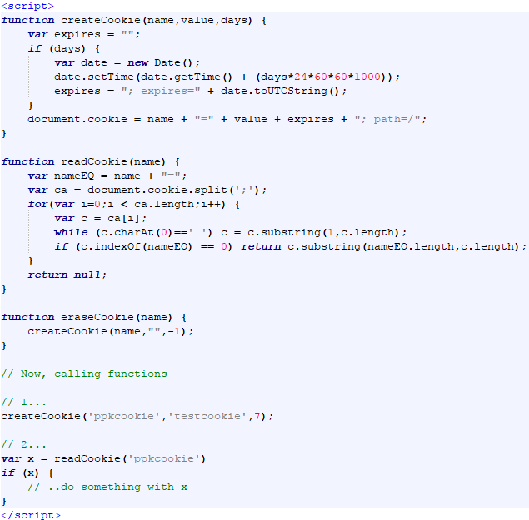
Example Cookie Helper Functions

