Slide 1
Objects and DOM
Web Authoring and Design
Benjamin Kenwright

Slide 2
Outline
What do we mean by Objects and DOM?
Summary
Review/Discussion

Slide 3
DOM
The DOM (Document Object Model) is an interface to the web document provided by the browser manufacturer. Within this model, each element in the HTML document becomes an Object. In order to work with the browser and documents, JavaScript uses a hierarchical tree structure of parent and child Objects. The main object is the Document Object, which in turn contains several other child objects. Each Object or element in the document is called a Node in the DOM

Slide 4
Tree Structure
The DOM represents a document as a hierarchical tree of nodes, which can have parents, children, and siblings and this determines by its position in the tree structure. There are several node types in the tree, each representing different information or markup in the HTML document. Each node type has different properties, methods, data, events, and each may have relationships with other nodes

Slide 5
HTML Document
The Document Object Model provides a uniform representation of the HTML document, and it achieves this by representing the entire HTML document as a tree structure. When a web page is loaded in the browser, it creates a Document Object Model of the web page. Each and every single element in the document will have a corresponding presence in the DOM.

Slide 6
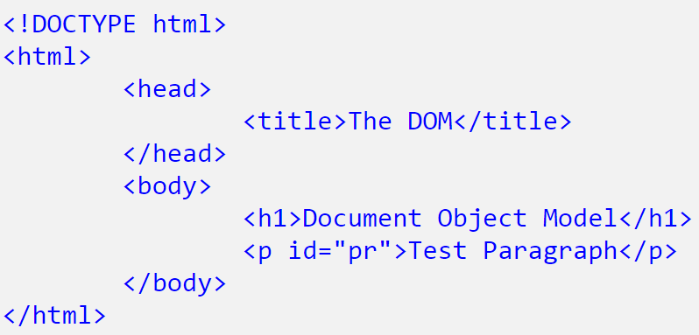
Example

Slide 7
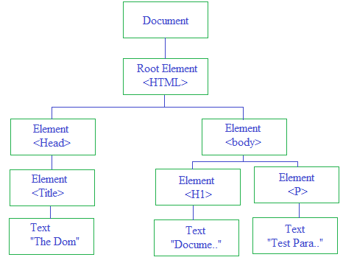
Document Object Model

Slide 8
Nodes
Nodes within the DOM are represented by array-like node lists and the individual nodes themselves can be accessed via their index. Using the above tree of nodes, you can access any element in the DOM

Slide 9
Example
document.childNodes[1]
represents the HTMLElment, that is < html > tag.
document.childNodes[1].childNodes[1]
represents HTMLBOdyElement, that is < body > tag.
document.childNodes[1].childNodes[1].childNodes[1]
represents HTMLHeadingElement, that is < h1 > tag

Slide 10
DOM Methods
The getElementById() and getElementsByTagName() were the two methods from DOM standard and the HTML5 specification adds three new methods for accessing elements, getElementsByClassName(), querySelector(), and querySelectorAll().

Slide 11
getElementbyId()
Typically you want to access an element within the DOM directly and try to do something with it. Javascript provides a document.getElementById() method, which is the easiest way to access an element from the DOM tree structure. It will return the element that has the ID attribute with the specified value.

Slide 12
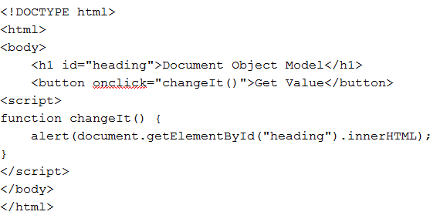
Example

Slide 13
getElementsByTagName()
The getElementsByTagName() is one of the method exposes for accessing nodes directly. This method takes a tag name as argument and returns a collection of all the nodes it finds in the document that are a sort of tag

Slide 14
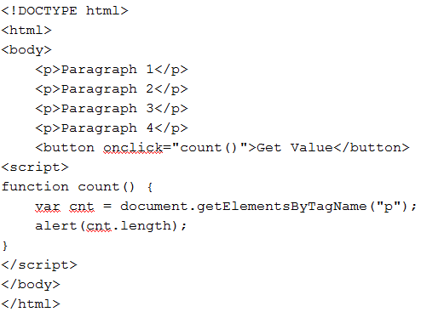
Example

Slide 15
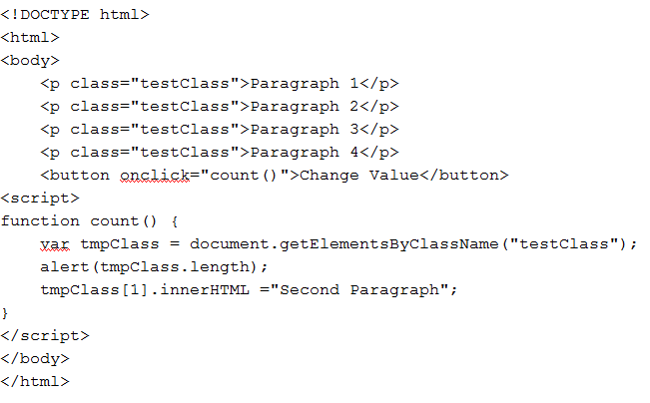
getElementsByClassName()

Slide 16
This Week
Review Slides
Read Associated Chapters
Work through Examples
Setup GitHub Account/Webpage
Start Early

Slide 17
Summary
Overview of Objects and DOM
Hands-On/Practical

Slide 18
Questions/Discussion

