Slide 1
Javascript Events
Web Authoring and Design
Benjamin Kenwright

Slide 2
Outline
Review
What do we mean by a Javascript Events?
Common Event Examples
Timer, Key Input, Mouse
Summary
Review/Discussion

Slide 3
Question
Write down a simple `forms’ html/javascript example – which will trigger (call) javascript function

Slide 4
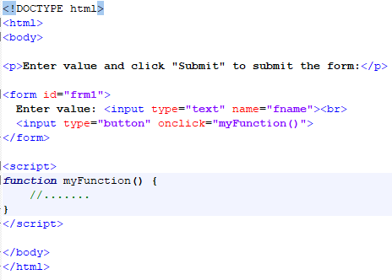
Answer

Slide 5
Question
Write down an example of a Javascript object – contains, a variable and a method

Slide 6
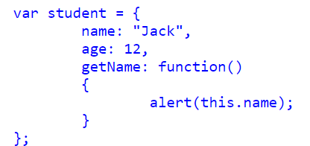
Answer

Slide 7
Question
Write a simple javascript program that would store a cookie

Slide 8
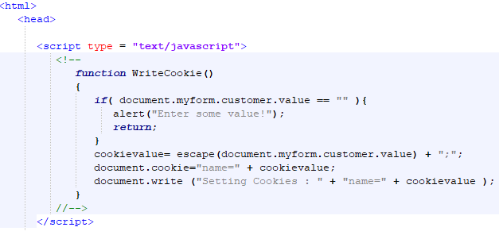
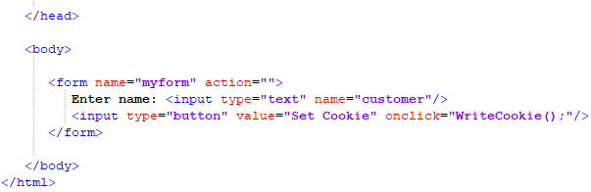
Answer

Slide 9
Question
Write a simple javascript program that would ‘read’ a cookie back in from storage

Slide 10
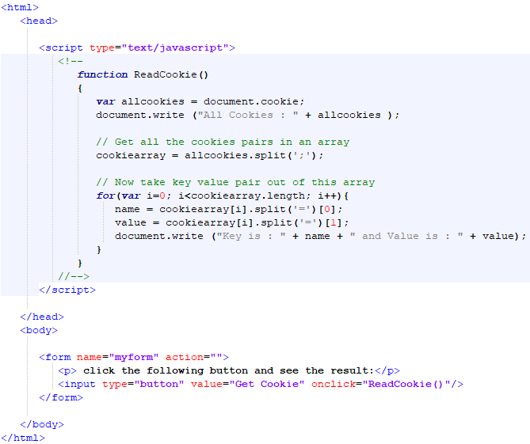
Answer

Slide 11
Event
What is an ‘event’ in Javascript?
Give some examples of events you might be interested in?
Where would you use events?

Slide 12
Events/Triggers
Javascript has callback functions that trigger when specific events occur
For example, timing triggers, mouse movement, mouse button presses, ...

Slide 13
Timer
Javascript timer is an element of code that triggers after a certain period of time has elapsed
There are two types of Timers you can create in JavaScrit
Triggers just once after a certain period of time
Long time firing timers, that continually triggers at set intervals

Slide 14
setInterval() Method
The setInterval() Method returns a unique ID with which the timer can be canceled at a later time
Syntax:
window.setInterval("functionname", time in milliseconds);
Example:
var intVal = setInterval(function(){alert('Timer Here')},4000);

Slide 15
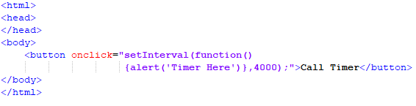
Example

Slide 16
Question
What is the name of the Javascript event timer?
a) SetInterval
b) setInterval
c) setTimeInterval
d) setTimer

Slide 17
Answer
b) setInterval

Slide 18
Stop setInterval() method
If you want to stop the execution of setInterval() method, call clearInterval() method and just pass the interval ID returned by the setInterval() method
Syntax:
clearInterval(intervalVariable)
Example:
var timeVar = setInterval(function(){alert('Timer Here')},4000); clearInterval(timeVar);

Slide 19
Question
Javascript event method to stop a timer is called:
a) stopTimer
b) clearInterval
c) resetInterval
d) killTimer

Slide 20
Answer
b) clearInterval

Slide 21
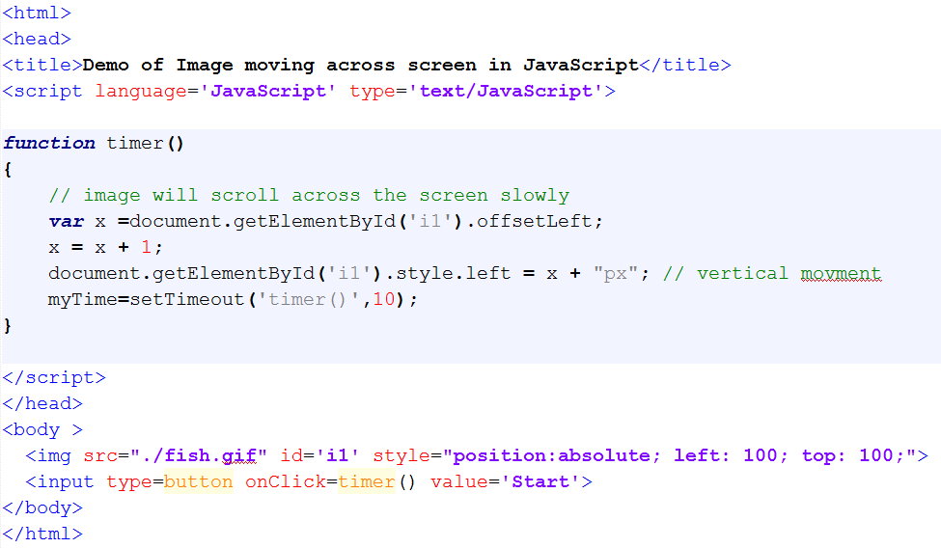
What does the following example do?

Slide 22
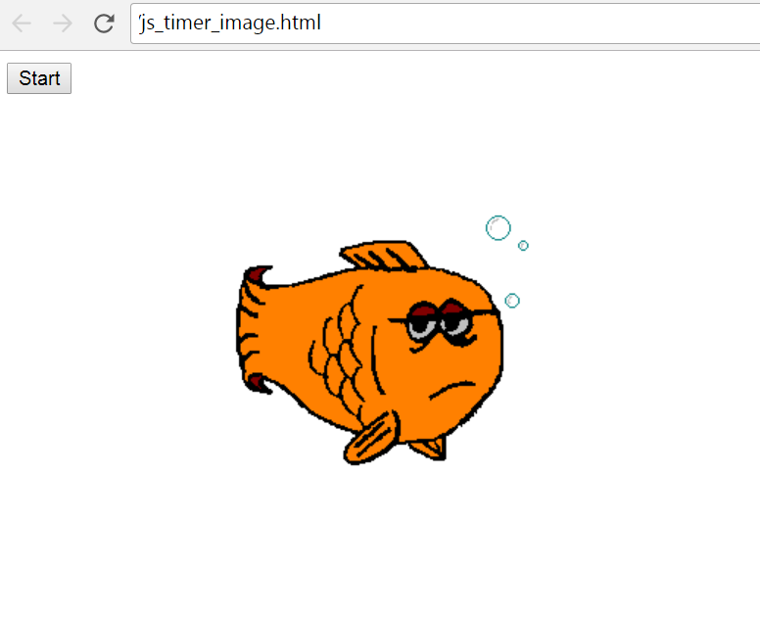
Answer
Scrolling Image
Image of a fish with identifier ‘i1’ will scroll across the screen when the timer is started

Slide 23
Key Press Events
Capture ‘key’ presses
// Add an event listener to the keypress event.document.addEventListener("keydown", KeyDown, false);

Slide 24
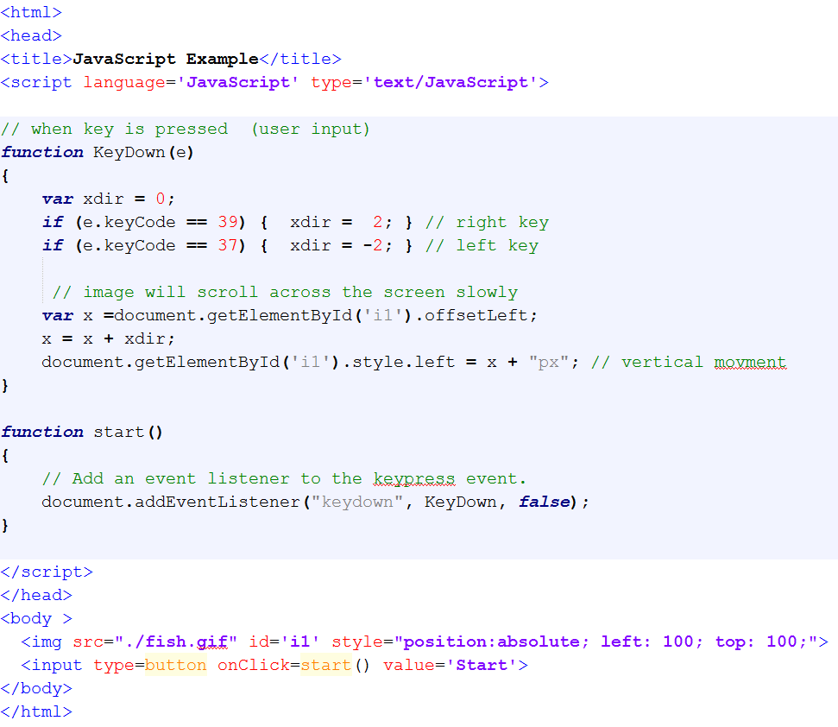
Example

Slide 25
Mouse Events
Mouse Movement
// Add an event listener to the mouse event.document.addEventListener('mousemove', MouseMove);

Slide 26
Example

Slide 27
Text Javascript
Place text on screen
e.g., feedback, warnings, ….
Move around/display feedback from Javascript
<div id=‘msg’>..</div>
document.getElementById("msg").innerHTML=‘..’

Slide 28
Example

Slide 29
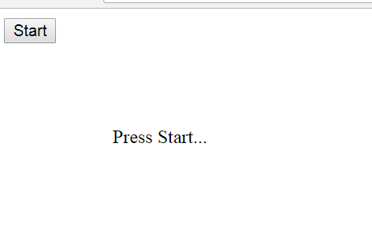
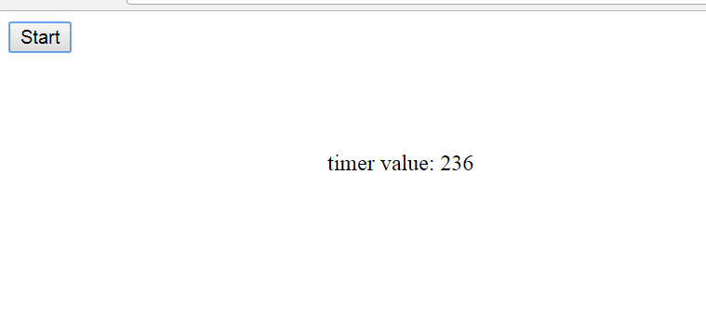
Output

Slide 30
Review Events
Timer
Keyboard Input
Mouse Input
Set Text (Move Around Screen)

Slide 31
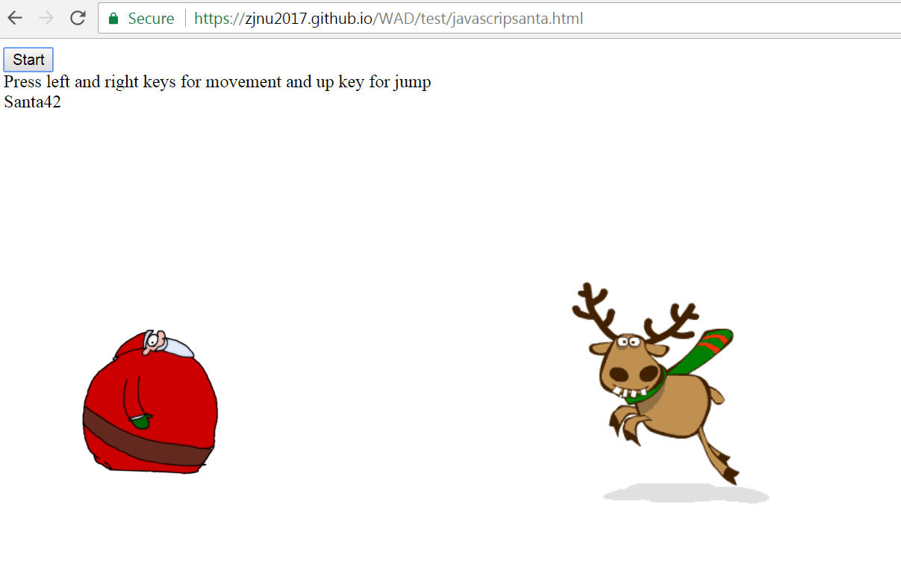
Example
https://zjnu2017.github.io/WAD/test/javascripsanta.html

Slide 32
Other Events
Other events for you to investigate and try out:
document.addEventListener('mousedown',startDrag,false);
document.addEventListener('mousemove',drag,false);
document.addEventListener('mouseup',stopDrag,false);
document.addEventListener("click“, mouseClick, false);
document.addEventListener("mouseover", overFunction);

Slide 33
Run Locally
Your website should work ‘offline’ locally if you download the html
e.g., not hardcoded to your github domain
For instance, if you upload it to a different domain

Slide 34
Professional Design
Consistency
Clean and Logical
Design and Plan First
Use HTML/CSS/Javascript to create your design/dream

Slide 35


Slide 36


Slide 37


Slide 38
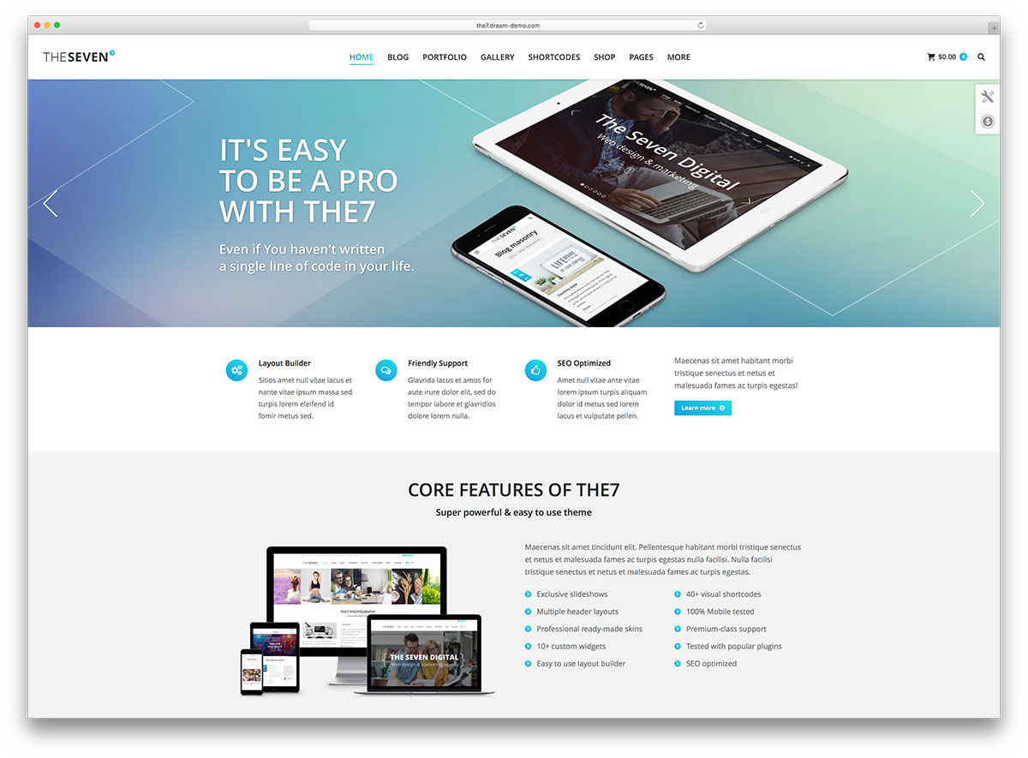

Slide 39
This Week
Review Slides
Read Associated Chapters
Group Project (Christmas Theme)
Website & Javascript Game
Video
Create a Simple Javascript Examples
Test it locally (e.g., local computer in Chrome or Explorer)
Experiment
Update GitHub Account/Webpage

Slide 40
Summary
Overview of Javascript Events
Javascript Game
Interactive and Dynamic
Hands-On/Practical

Slide 41
Questions/Discussion

