Slide 1
Examples
Object Orientated Analysis and Design
Benjamin Kenwright

Slide 2
Outline
Revision Questions
Group Project
Review Deliverables
Exam/Quizzes/Project Dates
Example System Problem
Case Studey

Slide 3
Milestone Dates
Demonstrate Date
Submission Deadline
Exam 3rd Jan 2017
2 Hours

Slide 4
25th December
Last Day – Quizzes
Grade Taken

Slide 5
Group Project
Report
Submission Date 25th December
Presentation/Demonstration
Marking Criteria/Deliverables
Submit single .zip
Student number, e.g., 20939302.zip
Report and any supporting material

Slide 6
Case Study Example
Online Ticket Reservation System

Slide 7

Exercise
Write down the steps you’d go through for a Online Ticket Reservation System
(5 Minutes)

Slide 8
Example Steps
Step 1
- Before entering the system, users have to login
- Get the username and password from existing users.
- Give new users the option to sign up.
Step 2
- Get the source and destination.
- Provide a dropdown box for the date.
- Check availability of tickets.
Step 3
- If tickets are available, get the number of passengers.
- Get the name and age of all passengers.
- If tickets are not available, reschedule.
Step 4
- Print the cost of the tickets.
- Get the payment details from the user.
- Confirm the details and the ticket.
- Display confirmed ticket to the user

Slide 9
Exercise
Given your steps, draw an Activity Diagram

Slide 10
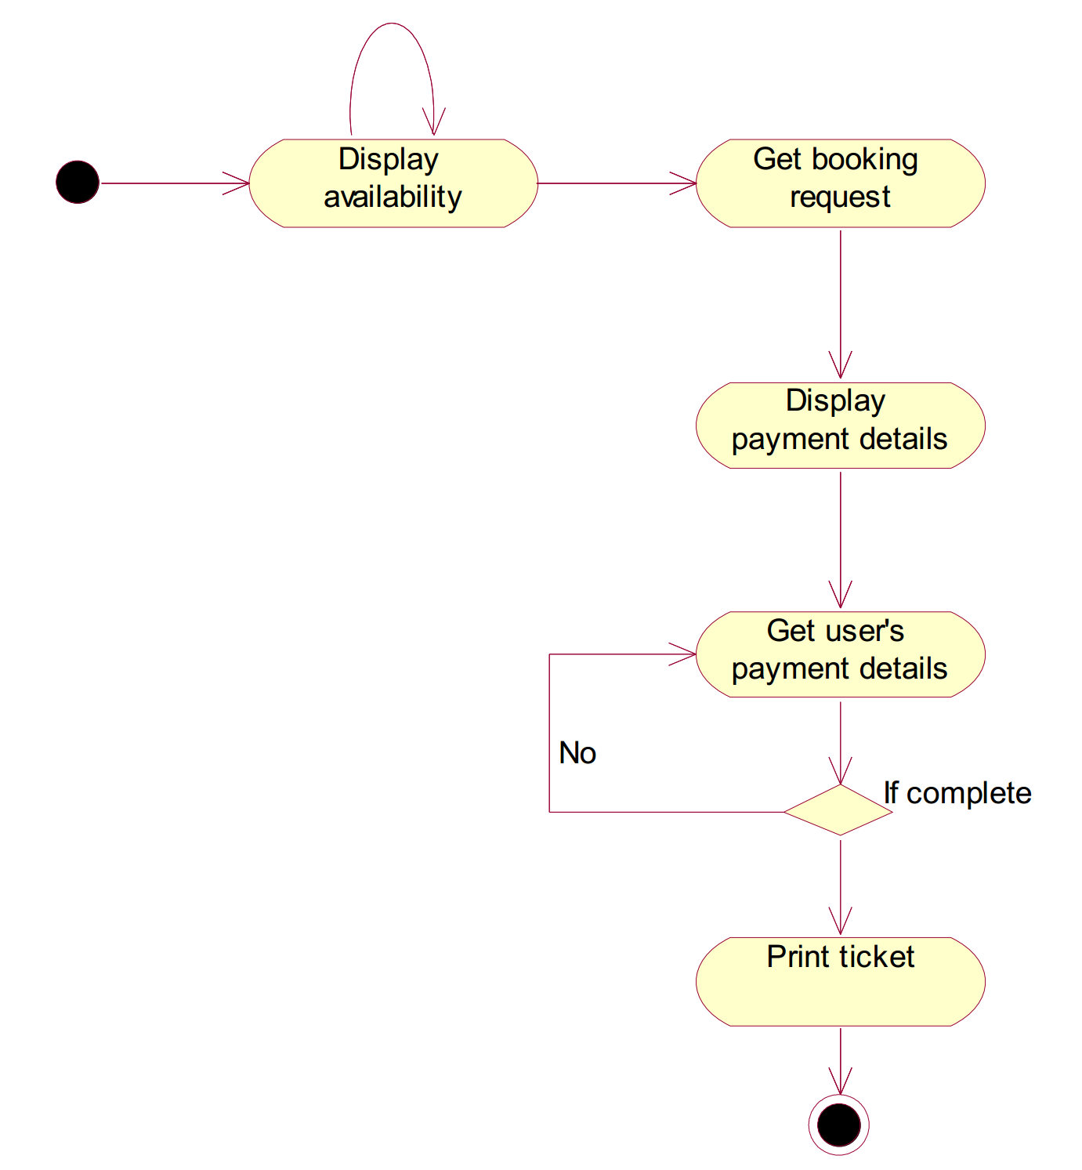
Activity Diagram

Slide 11
Exercise
Extend your understanding of the system to include a Class Diagram

Slide 12
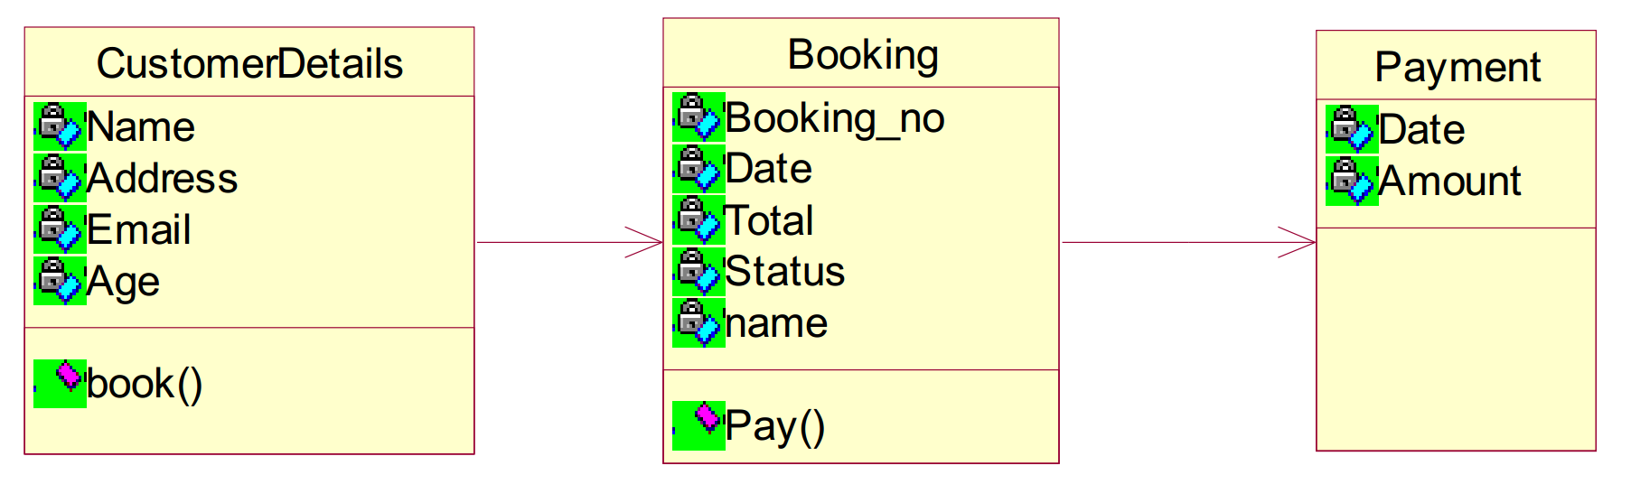
Class Diagram

Slide 13
Exercise
Draw a use case diagram of your solution

Slide 14
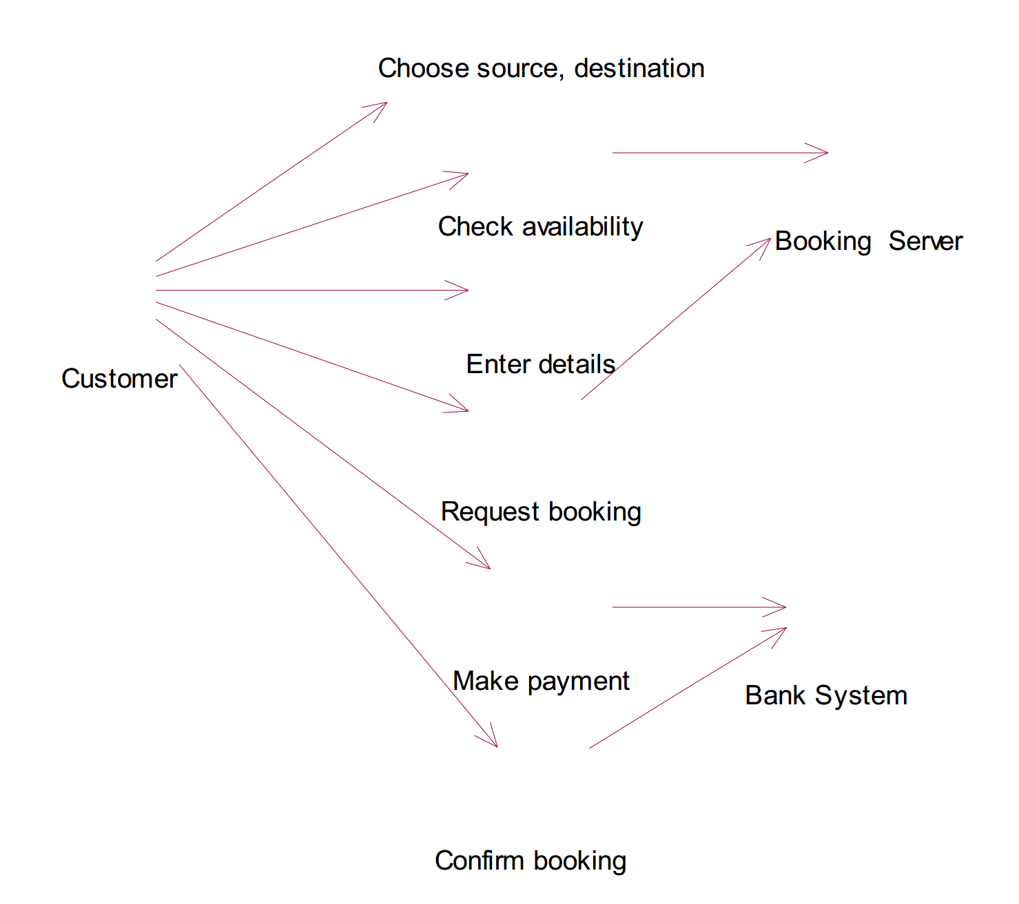
Use Case Diagram

Slide 15
Exercise
Draw a sequence diagram of your system

Slide 16
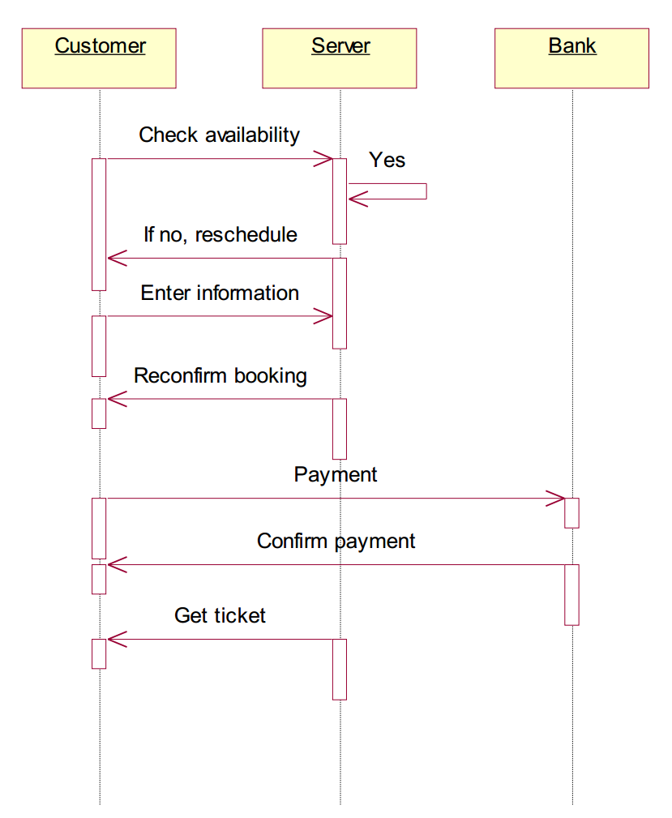
Sequence Diagram

Slide 17
Exercise
Draw a collaboration diagram of your system solution
Note collaboration diagram, also called a communication diagram or interaction diagram , is an illustration of the relationships and interactions among software objects

Slide 18
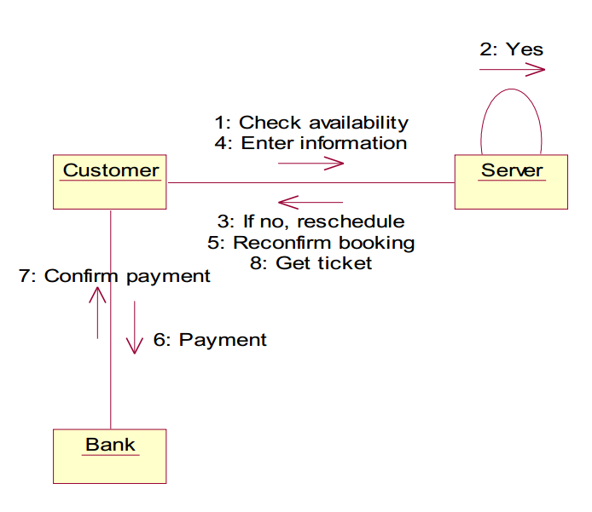
Collaboration Diagram

Slide 19
Exercise
Draw a state chart diagram of your system

Slide 20
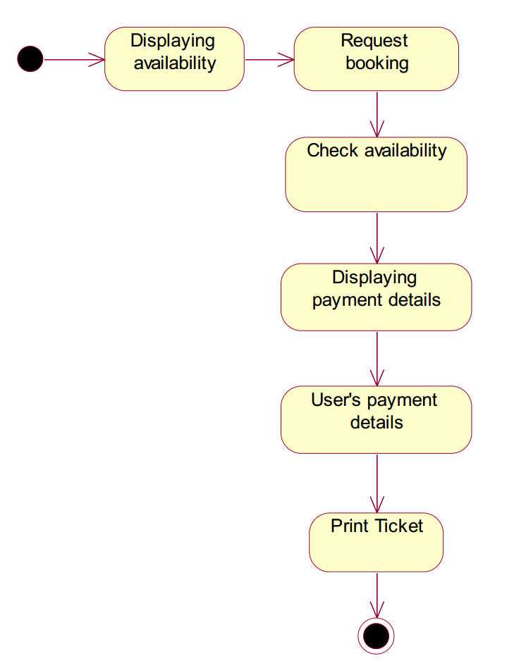
State Chart Diagram

Slide 21
Exercise
Draw a component diagram of your system

Slide 22
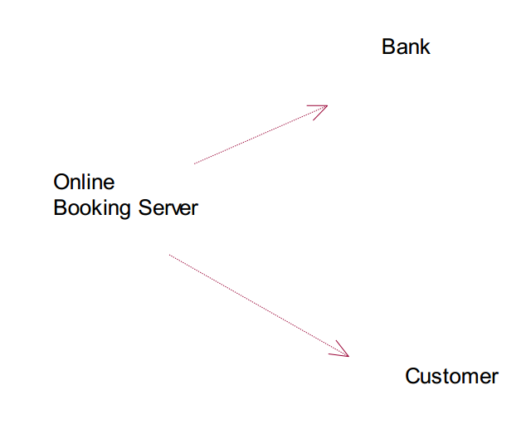
Component Diagram

Slide 23
Exercise
Draw a deployment diagram of your system

Slide 24
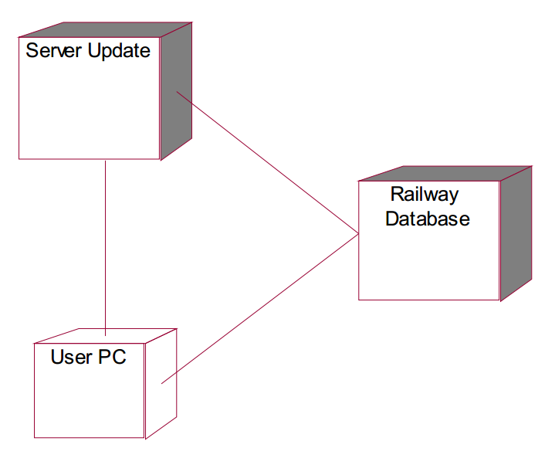
Deployment Diagram

Slide 25
Question
Write down the differences between Agile and Plan-Driven development
(5 Minutes)

Slide 26
Answer
Agile Plan-Driven
Project is small
Experienced teams with a wide range of abilities take part
Teams are self-starters, independent leaders and others who are self-directing
Project is an in-house project and the team co-located
System is new with lots of unknowns
Requirements must be discovered
Requirements and environment are volatile with high change rates
End-user environment is flexible
Relationship with customer is close and collaborative
Customer is readily available dedicated and co-located
High trust environment exists within the development teams and customer
Rapid value and high-responsiveness are required
Project is large
Teams include varied capabilities and skill sets
Teams are geographically distributed and/or outsourced
Project is of strategic importance
System is well understood (scope and features set)
Requirements are fairly stable
System is large and complex (critical safety/high reliability requirements)
Project stakeholders have a weak relationship with the development team
External legal concerns
Focus is on a strong, quantitative process improvement
Definition and management of process are important
Predictability and stability of process are important

Slide 27
Question
Briefly summarize the importance of using inheritance
(5 minutes)

Slide 28
Answer
Inheritance is one of the most powerful features of object oriented programming. Most important advantages of inheritance are:
Reusability
Saves times and efforts
Closeness with the real world
Easy modification
Transitive Nature of inheritance

Slide 29
Question
Write down what Use case diagrams are used for?

Slide 30
Answer
To model the context of a system by enclosing all the activities of a system within a rectangle and focusing on the actors outside the system by interacting with it
To model the requirements of a system from the outside point of view

Slide 31
Question
Write down what Interaction Diagrams and what are they used for?

Slide 32
Answer
Interaction diagrams depict interactions of objects and their relationships. They also include the messages passed between them.
Interaction diagrams are used for modeling −
the control flow by time ordering using sequence diagrams.
the control flow of organization using collaboration diagrams.

Slide 33
Question
There are two categories of elements in an object-oriented system
Major Elements & Minor Elements
Write down the the four major and three minor elements.

Slide 34
Answer
Major
Abstraction
Encapsulation
Modularity
Hierarchy
Minor
Typing
Concurrency
Persistence

Slide 35
Question
There are two types of typing are − write them down and explain them

Slide 36
Answer
Strong Typing − Here, the operation on an object is checked at the time of compilation, as in the programming language Eiffel
Weak Typing − Here, messages may be sent to any class. The operation is checked only at the time of execution, as in the programming language Smalltalk

Slide 37
Question
Write down the five phases of the XP lifecycle

Slide 38
Answer
Exploration: Determine feasibility, understand key “stories” for the first release, and develop exploratory prototypes
Planning: Agree on the date and stories for the first release
Iterations to release: Implement and test selected stories in a series of iterations. Refine the iteration plan
Productionizing: Prepare supporting materials (documentation, training, marketing), and deploy the operational system
Maintenance: Fix and enhance the deployed system

Slide 39
Question
Write down what the advantages and disadvantages of the Spiral Model

Slide 40
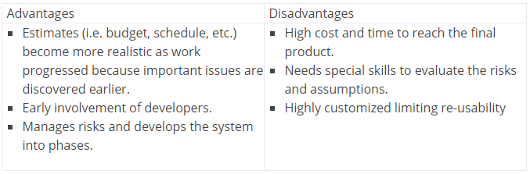
Answer

Slide 41
Question
Write down the advantages and disadvantages of the V-Shaped Model

Slide 42
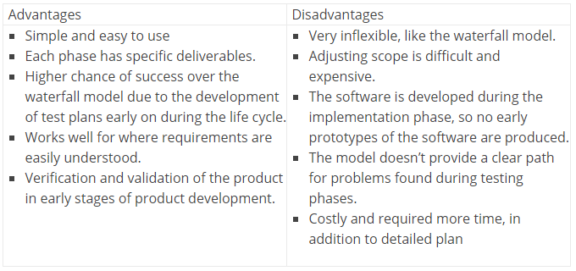
Answer

Slide 43
Discussion
When would you use an Iterative or Incremental approach?

Slide 44
Summary
Review
Case Study
Example Problems/Solutions
Final Exam (January)
Group Project
Review Questions

Slide 45
This Week
Review Slides
Coursework
Reviewing Quiz Questions
Reviewing Associated Chapter

Slide 46
Question
Deadline for final group project submission?

Slide 47
Answer
25th December
Also deadline for online quizzes

Slide 48
Questions/Discussion

