Slide 1
Network Programming
Object Orientated Programming in Java
Benjamin Kenwright

Slide 2
Outline
Essential Networking with Java
Introduction to Java networking features
It is much easier to write networking programs in Java than in C++
But less efficient
Today’s Practical
Review/Discussion

Slide 3
Today
Review
Networking basics
IP addresses, ports, protocols, client-server interaction
Socket-level programming
Writing a client (Socket)
Writing a server (ServerSocket)
Communicating with web servers
Retrieving information (URL, URLConnection)
Sending information

Slide 4
Exam
2nd January
Review
Quiz Questions
Crossword
Slides/Example Questions
Recommended Text

Slide 5
Exam
Mix
Written Exercises
Code Samples
Multiple Choice

Slide 6
Why is Networking Important?

Slide 7
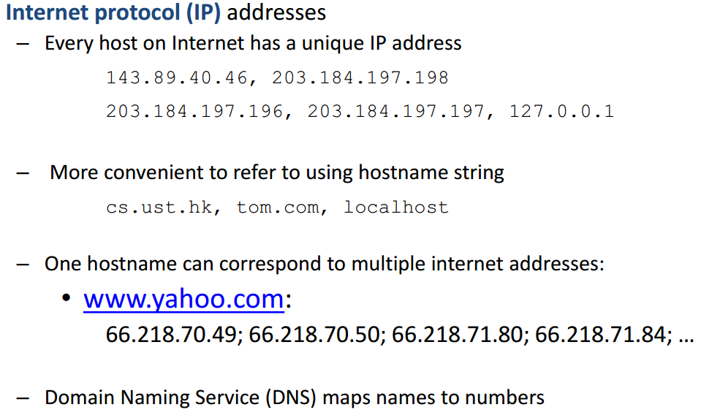
Networking Basics

Slide 8
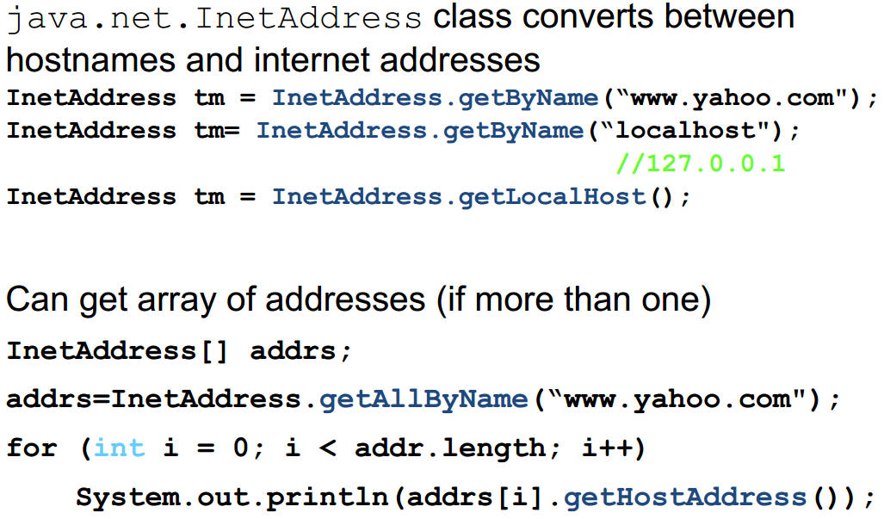
Networking Basics

Slide 9
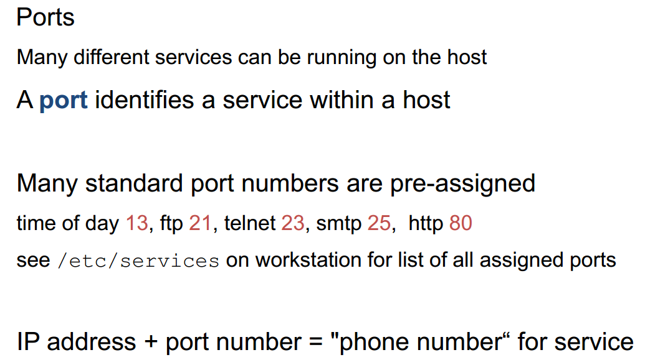
Networking Basics

Slide 10
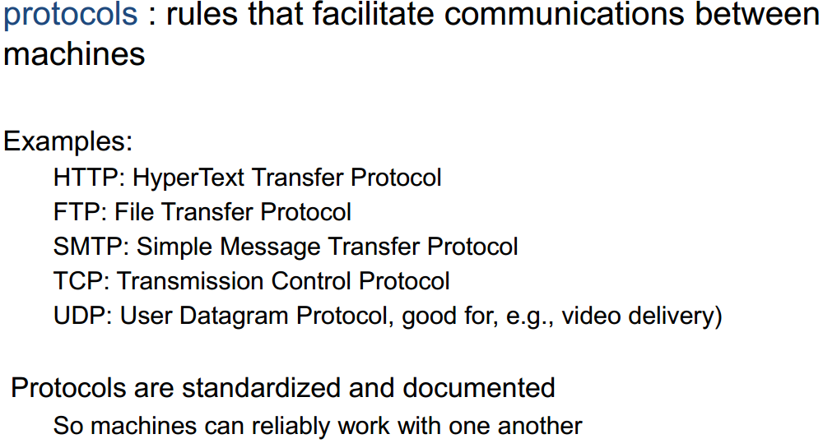
Networking Basics

Slide 11
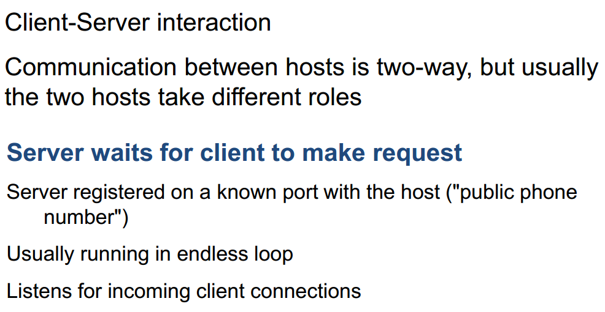
Networking Basics

Slide 12
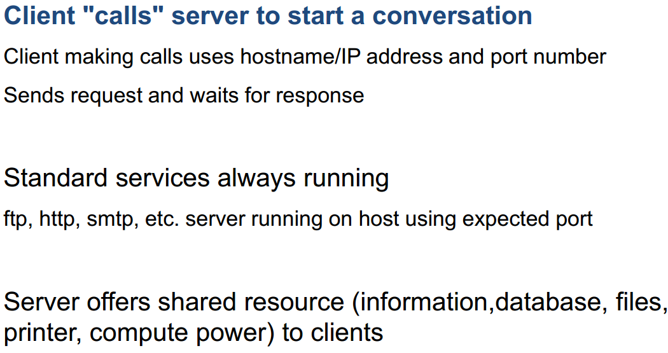
Networking Basics

Slide 13
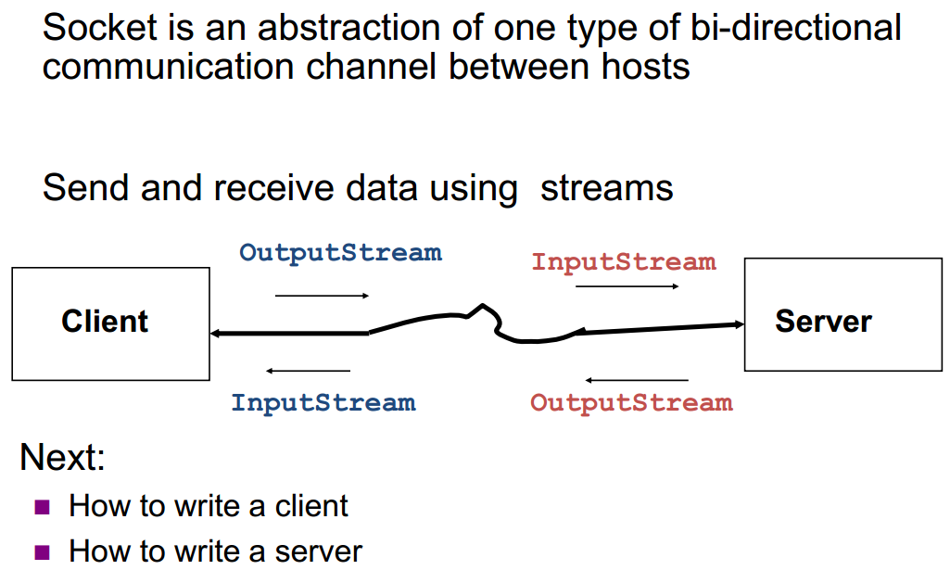
Socket-Level Programming

Slide 14
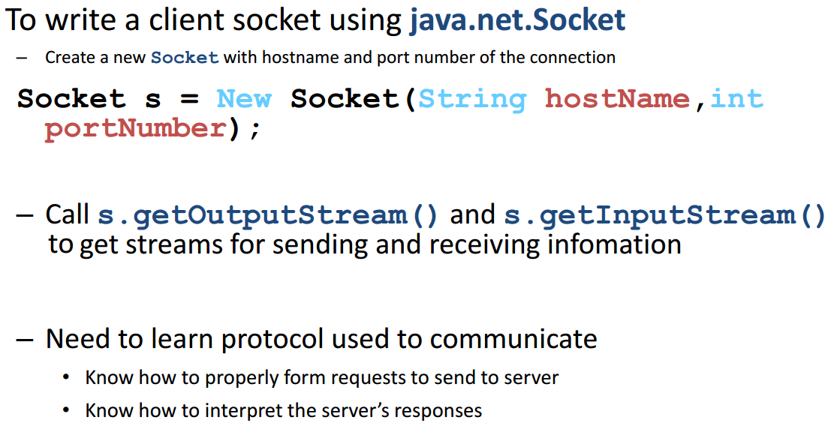
Writing Clients

Slide 15
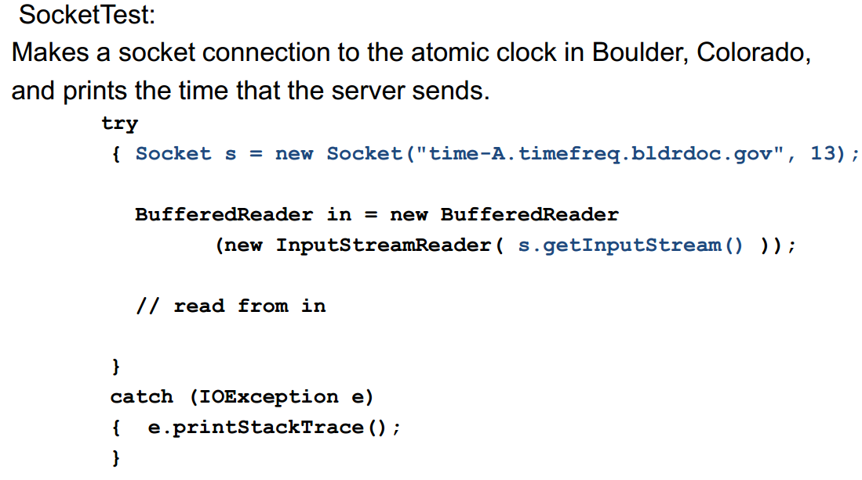
Writing Clients

Slide 16
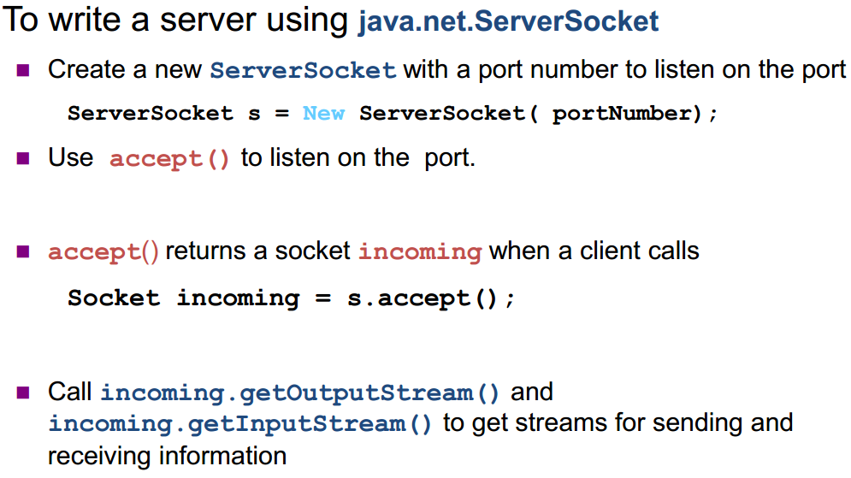
Writing Servers

Slide 17
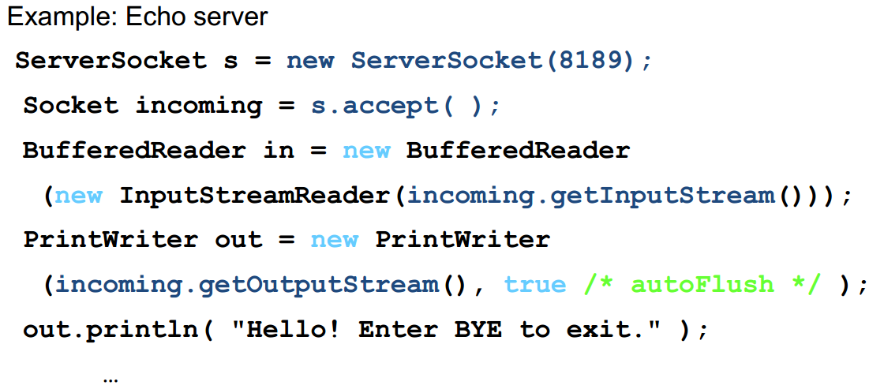
Writing Servers

Slide 18
Security Note
Many machines now refuse socket connections due to security considerations

Slide 19
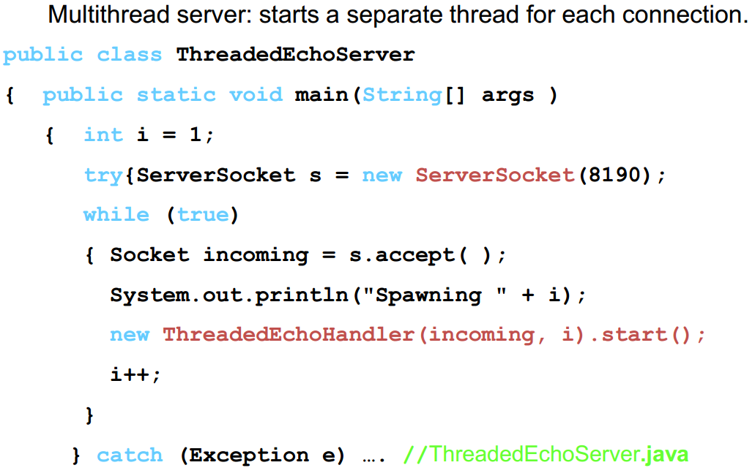
Writing Servers

Slide 20
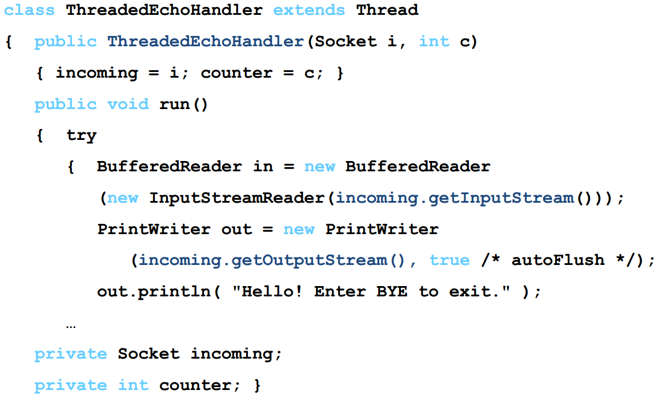
Writing Servers

Slide 21
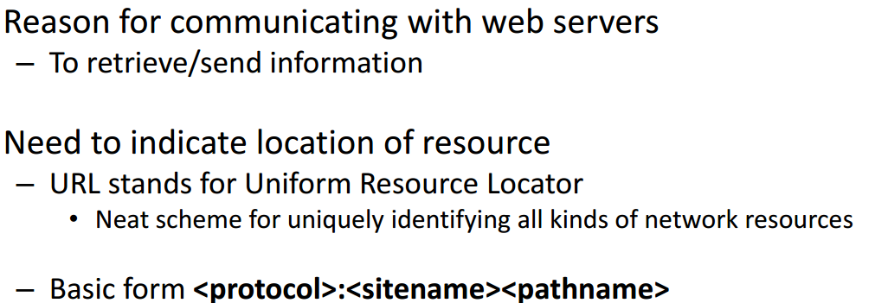
Communicating with Web Servers
http://www.zjnu.cn/index.html
ftp://ftp.zjnu/pub//test.java
file:/MyDisk/Letters/file.txt
Protocols include files, http, ftp, gopher, news, mailto, etc

Slide 22
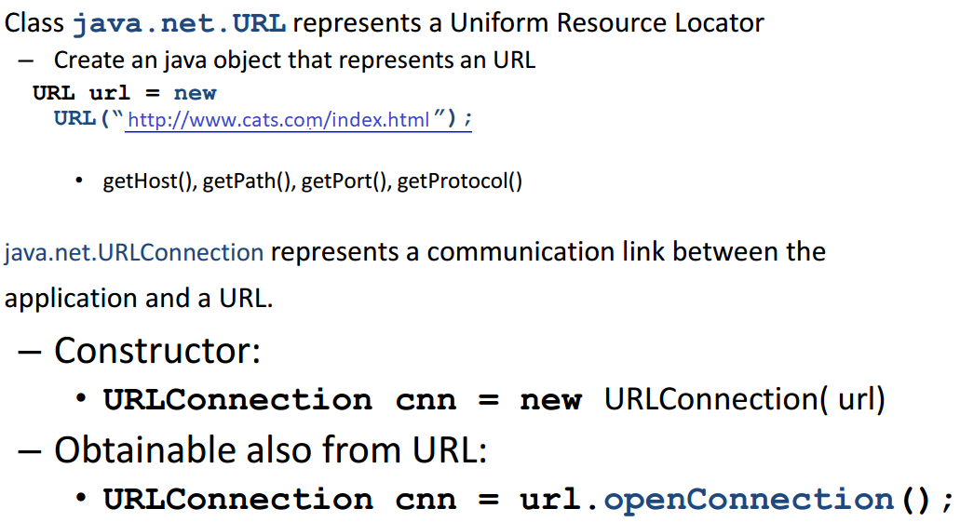
Communicating with web servers

Slide 23
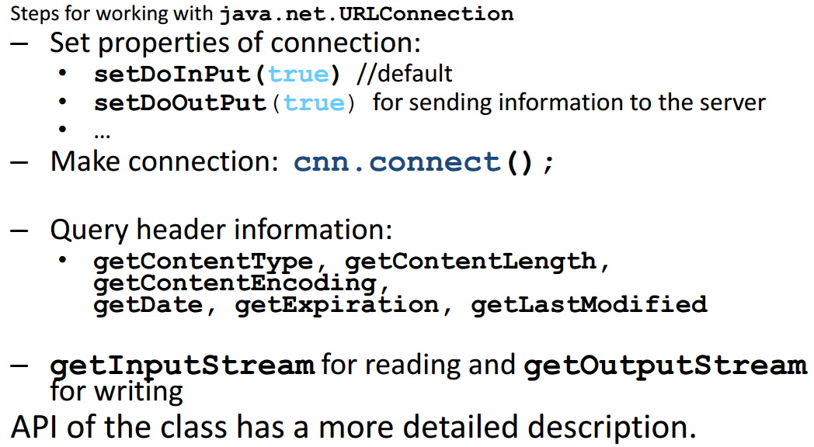
Communicating with web servers

Slide 24
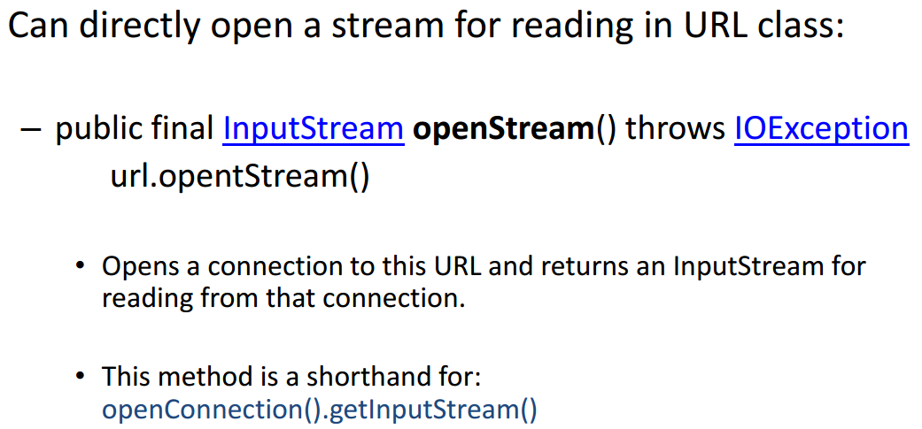
Communicating with web servers

Slide 25
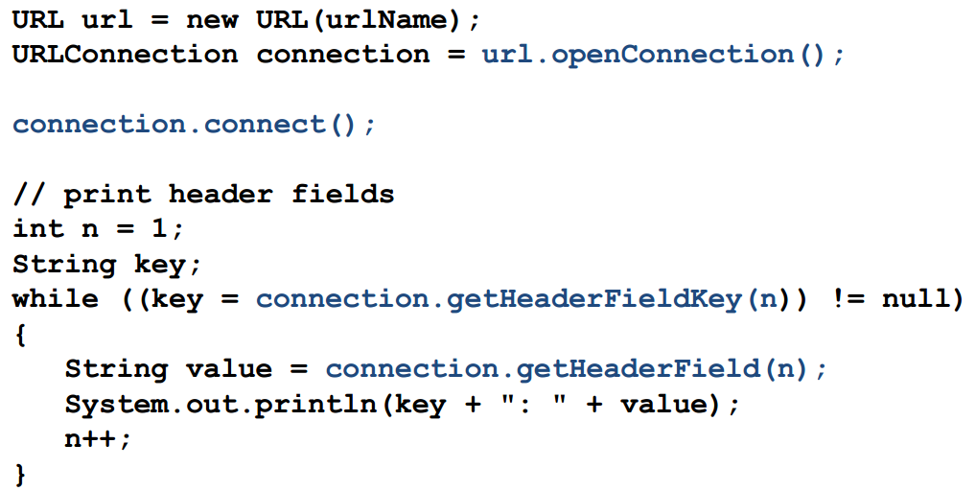
Retrieving Information

Slide 26
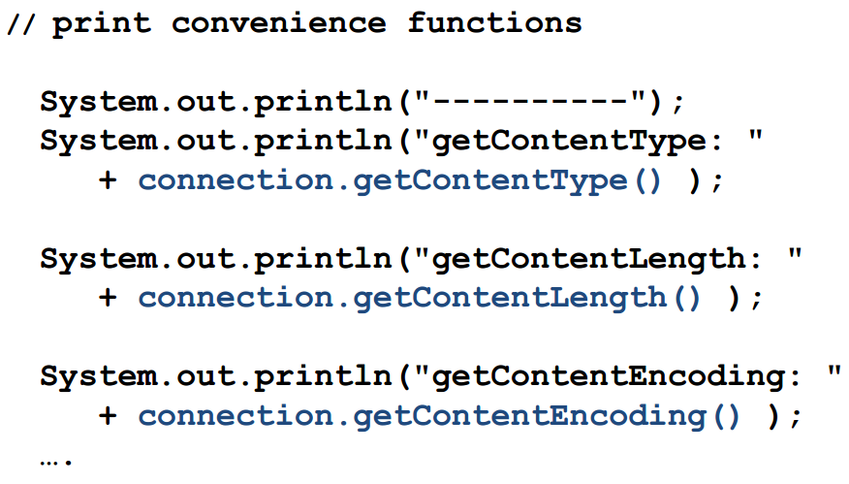
Retrieving Information

Slide 27
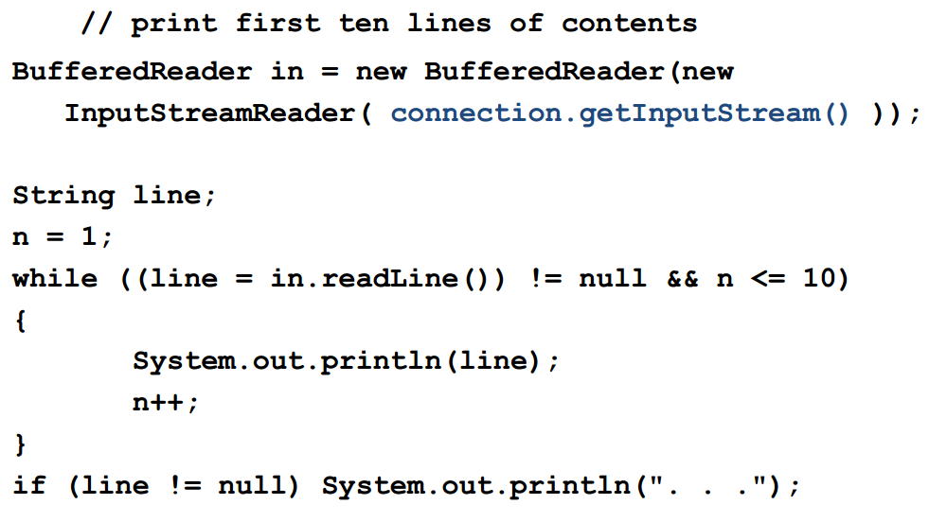
Retrieving Information

Slide 28
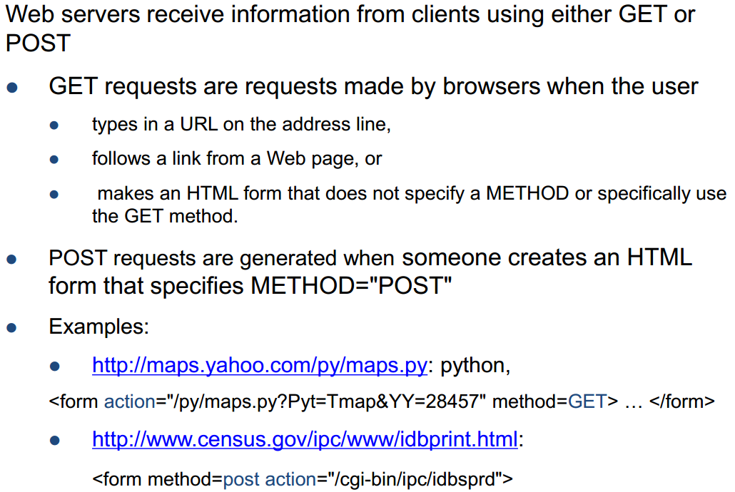
Sending Information

Slide 29
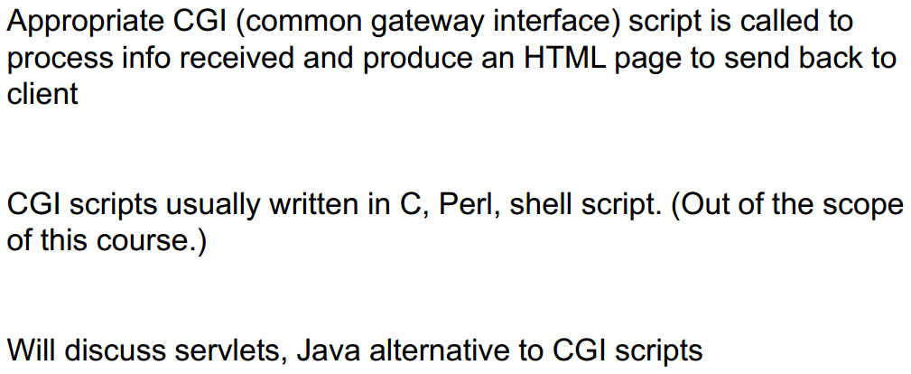
Sending Information

Slide 30
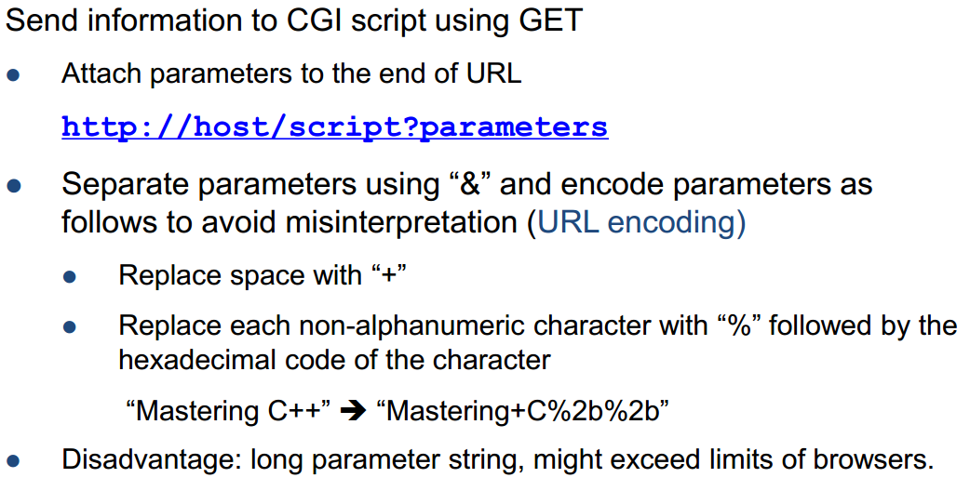
Sending Information

Slide 31
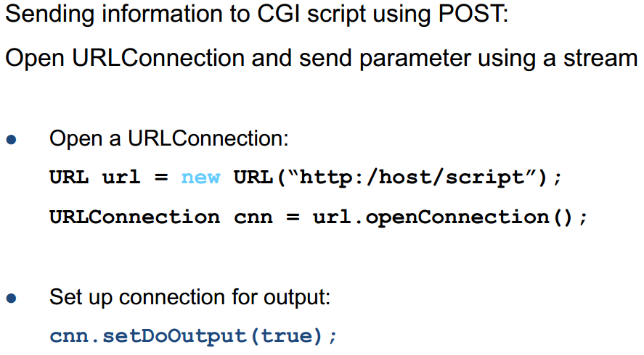
Sending Information

Slide 32
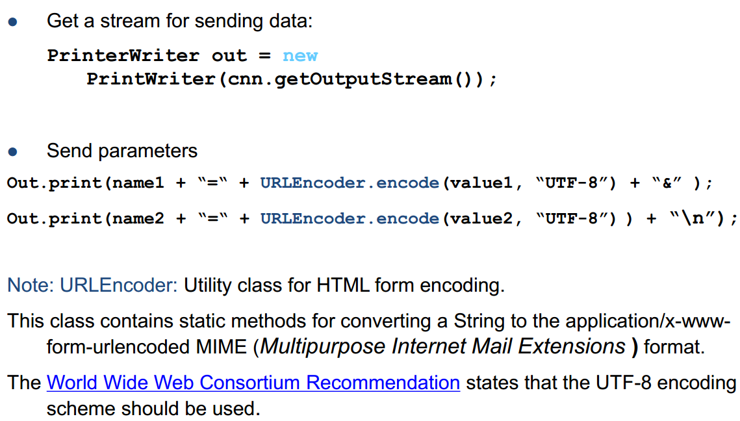
Sending Information

Slide 33
Summary
Essential Java Networking
Ports/IP/Sending/Receiving Data
Java Implementation Examples
Hands-On/Practical
Today is about becoming basic Java Networking

Slide 34
This Week
Read Associated Chapters
Review Slides
Java Exercises
Online Quizzes
25th December (Last Date)
Getting Ready Exam

Slide 35
Today’s Exercises
Chapter 30 – Exercise 30.1
Opportunity to review/revisit previous chapters
Solid understanding each of the concepts

Slide 36
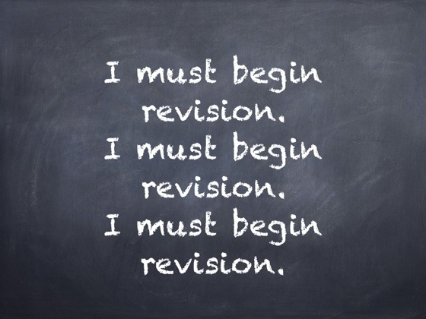
Warning

Slide 37
Questions/Discussion

