Slide 1
Introduction to Javascript
Web Authoring and Design
Benjamin Kenwright

Slide 2
Next Week
Revision Week
No Lectures

Slide 3
Outline
Review
What is Javascript?
Javascript Examples/Syntax
Summary
Review/Discussion
Example: http://www.schillmania.com/projects/snowstorm/

Slide 4
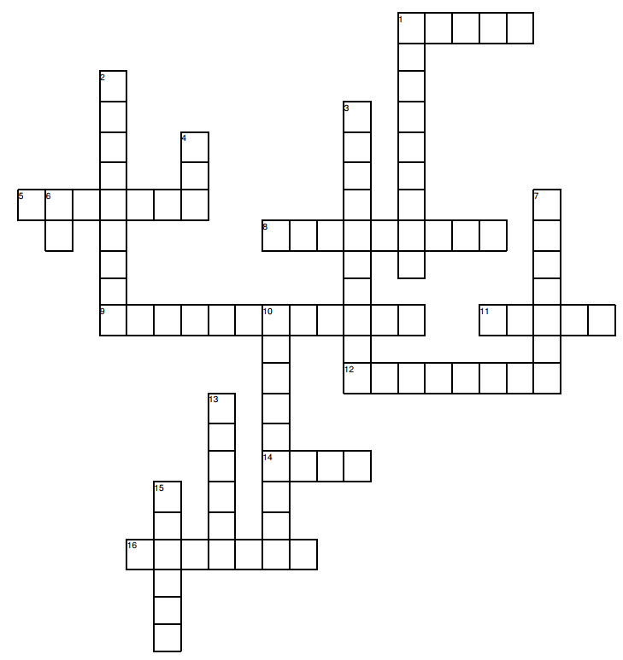
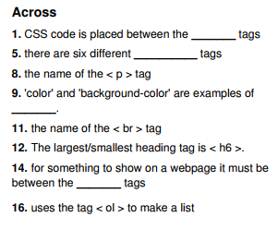
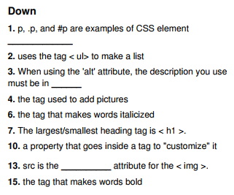
Solution Puzzle
Brought a copy with your answers to this lesson

Slide 5
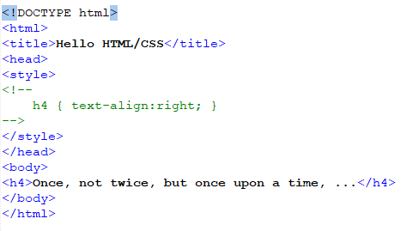
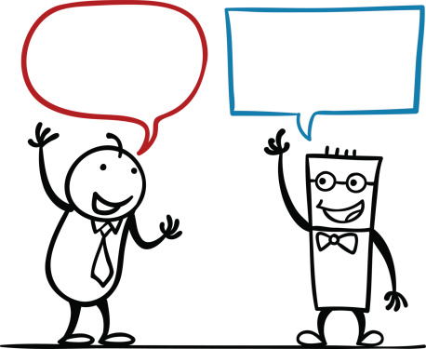
Question
What will the output be for the following HTML/CSS? (Why)

Slide 6
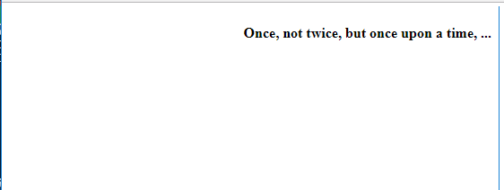
Answer
Right aligned text
Inside CSS Script, ...<!-- -->
(Ancient) browsers, which do not recognise <style> tags, will not show "weird" characters (CSS rules) because of the HTML comments.

Slide 7
Question
How do you comment in CSS Scripts?
e.g., Comment out lines?

Slide 8
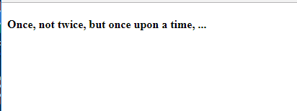
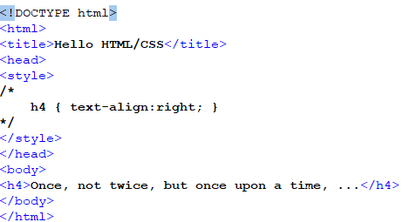
Answer

Slide 9
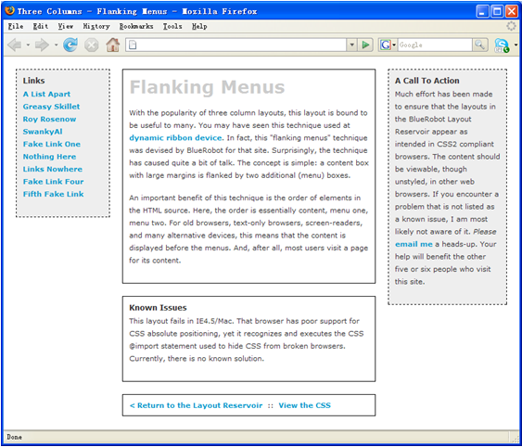
Activity
Write down on a piece of paper the CSS to display the following website design:
(5 Minutes)

Slide 10
Answer
Three Columns Flanking Menu
#navBeta {
position:absolute;
width:168px;
top:20px;
right:20px;
border:1px dashed black;
background-color:#eee;
padding:10px;
z-index:1;
}
.content {
position:relative;
width:auto;
min-width:120px;
margin:0px 210px 20px 170px;
border:1px solid black;
padding:10px;
z-index:3; /* This allows the content to overlap the right menu in narrow windows in good browsers. */
}
#navAlpha {
position:absolute;
width:128px;
top:20px;
left:20px;
border:1px dashed black;
background-color:#eee;
padding:10px;
z-index:2;
}

Slide 11
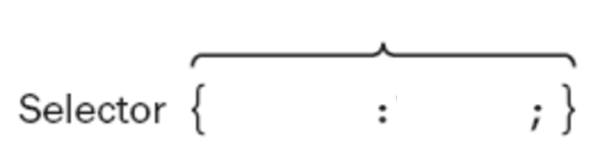
Question
What are the terms in CSS for the selector syntax:
?
?
?

Slide 12
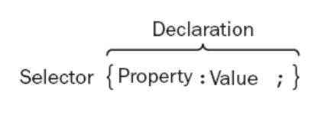
Answer
Selector Syntax

Slide 13
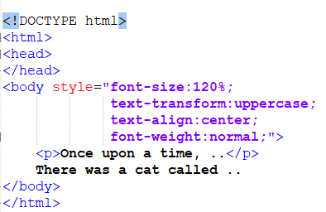
Question
What would the following HTML/CSS output?

Slide 14

Answer

Slide 15

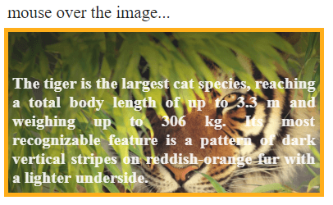
Question
Write the HTML/CSS to create an image hover text overlay

Slide 16
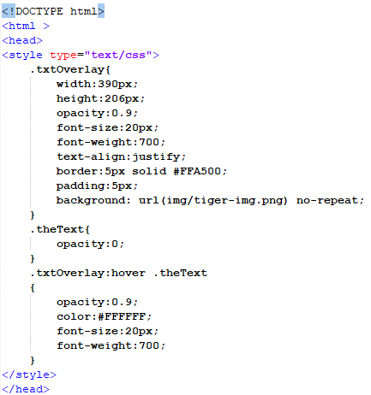
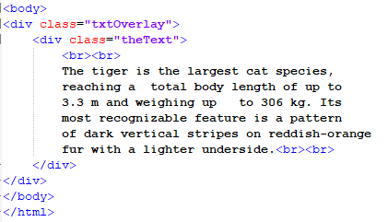
Answer

Slide 17
Review
Javascript between the tags
< script >
...
< /script >

Slide 18
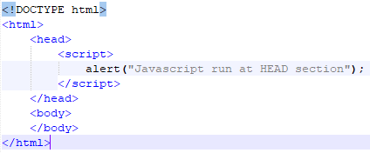
Review
Simple Javascript Example

Slide 19
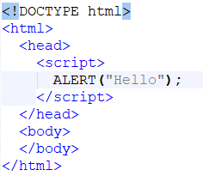
Question
What would the following HTML/JS output?

Slide 20
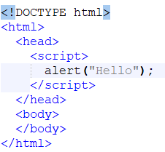
Answer
Nothing
Javascript is case-sensitive

Slide 21
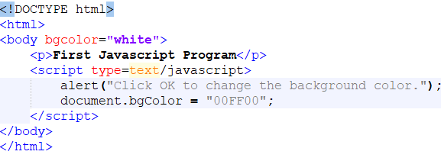
Question
What would the following HTML/JS do?

Slide 22
Answer
Popup, select OK, background changes to green

Slide 23

Popup boxes
JavaScript introduced three dialog boxes that work well enough for alerting, confirming and prompting for values

Slide 24
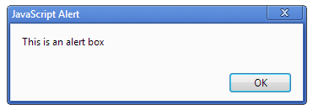

Alert Boxes
These dialog boxes are helpful to raise and alert, or to get confirmation on any type of input from the user

Slide 25
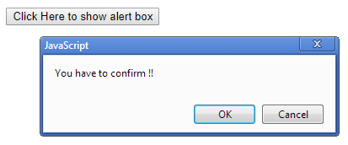
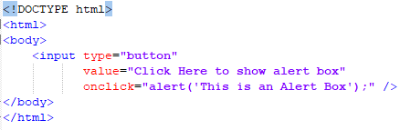
Button Triggers

Slide 26
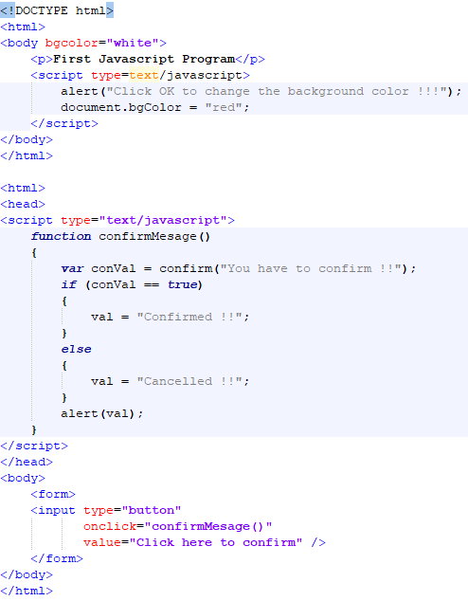
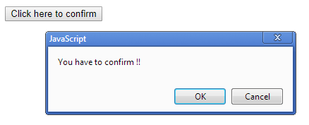
Confirm Dialog

Slide 27
Question
How do you declare a function in Javasscript? Write down an example HTML/JS program

Slide 28
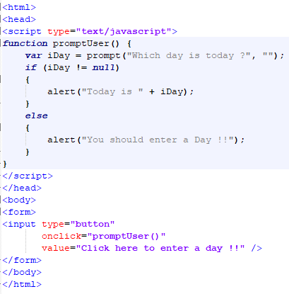
Answer

Slide 29
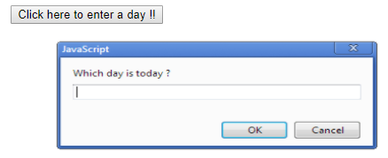
Prompt Box

Slide 30
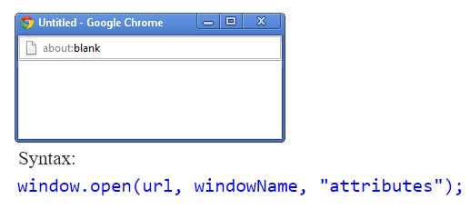
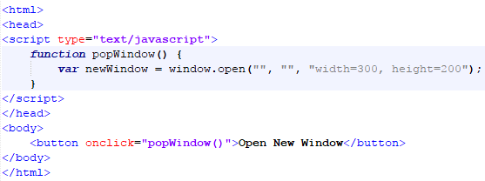
Javascript Popup Window

Slide 31
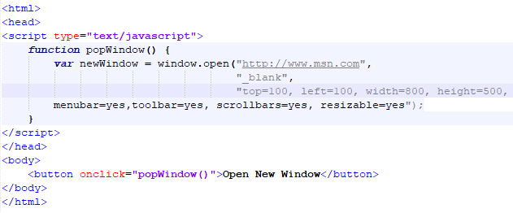
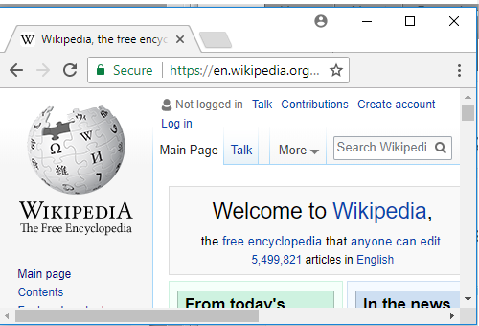
Parameters New Window

Slide 32
Question
Write a Javascript function which when called will open a new window

Slide 33
Answer

Slide 34
Question
How do you declare a variable in Javascript?

Slide 35
Answer
‘var’ keyword
e.g., var value = 0;

Slide 36
Question
Write a small HTML/JS example, which as:
1. Function
2. For loop
3. Confirm dialog
4. Triggered from the HTML
(e.g., when you click ‘go’)

Slide 37
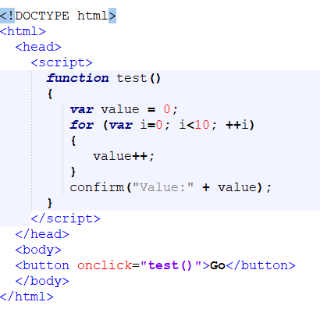

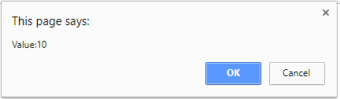
Answer

Slide 38
Question
Write a small HTML/JS script that shows a popup dialog asking you to enter a string

Slide 39
Answer

Slide 40
Summary
Overview of Javascript
Basic Formatting
Script, Functions, ...
Altering webpage operation (through Javascript)
Hands-On/Practical

Slide 41
This Week
*No Lecture Next Week
Revision Week
Review Slides
Read Associated Chapters
Weekly Tasks
Update GitHub Account/Webpage
Crossword
Online Quizzes

Slide 42
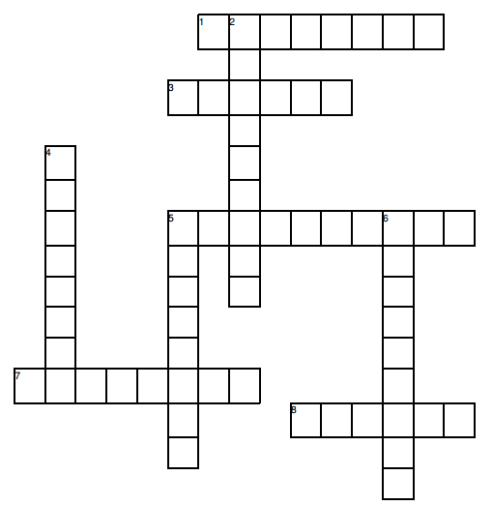
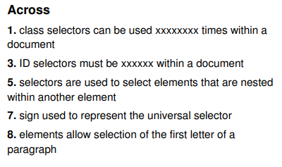
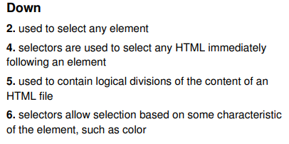
Crossword Puzzle Solve for Next Lesson
Print out the crossword with your solutions
and bring along to the next Lesson

Slide 43
Questions/Discussion

Slide 44
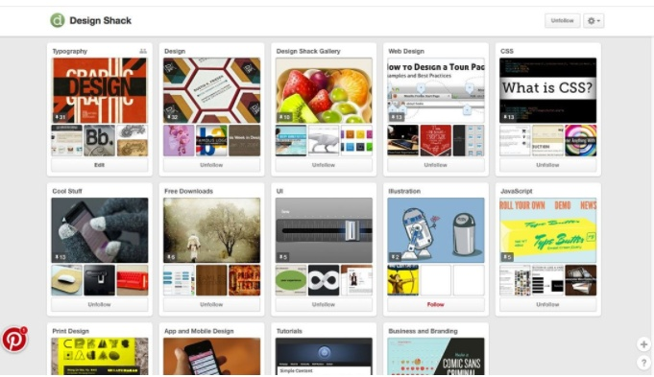
Challenge
Implement a Pinterest type website that uses cards for everything, including navigation, to help users move through the site. It’s one of the most effective outlines employing card-style design out there. Users of all ages seem to figure it out with ease.

Slide 45
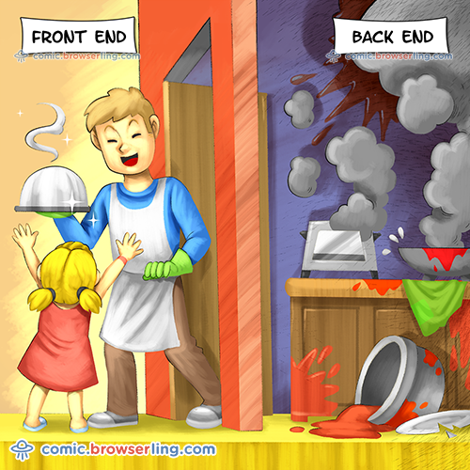
Modern Web Development

