Slide 1
JavaScript Syntax
Web Authoring and Design
Benjamin Kenwright

Slide 2
Outline
Fundamental Syntax Javascript
Summary
Review/Discussion

Slide 3
JavaScript Data Types

Slide 4
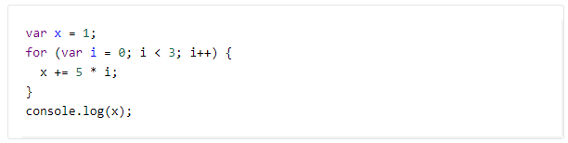
Question
What will the following code print?
a) 1
b) 10
c) 16
d) 31

Slide 5
Answer
c) 16

Slide 6
Primary Data Types (Primitive)
String
Number
Boolean

Slide 7
Composite Data Types (reference)
Object
Array

Slide 8
Special Data Types
Null
Undefined

Slide 9
Overview of Types
String : A strings of any characters enclosed in quotes is a string primitive.
Number : A number by itself is a number primitive, all numbers in JavaScript are 64-bit floating-point numbers.
Boolean : It will store Variables or expressions which are either true or false.
Object: A collections of properties and methods. In Javascript, anything that is not a primitive is an Object.
Arrays : Arrays are regular objects, both objects and arrays can have properties and methods.
Null : It has only one value in JavaScript: null.
Undefined : It treated as a variable that has been declared, but has never had a value assigned to it.

Slide 10
Var in Javascript
var anyData;

Slide 11
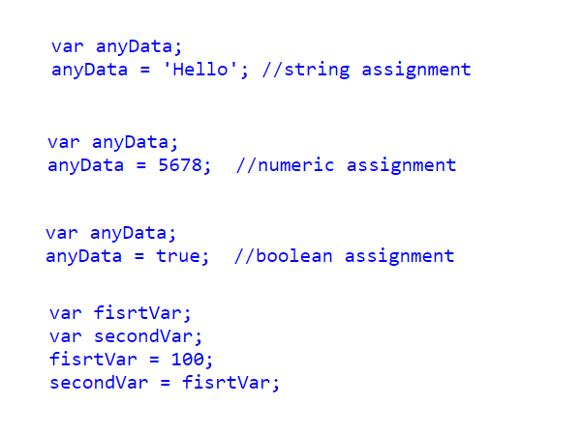
Example var

Slide 12

Combining Data Types
What would be in variable xyz?

Slide 13


Slide 14

Example
What would be in variable xyz this time?

Slide 15


Slide 16
Scope of JavaScript Variables
The Javascript variable has only two scopes, Global and Local.
When you declare a variable within your function , its scope is local, that means you can use that variable only inside that function.
If a variable declare outside the function, its scope is Global.

Slide 17

Constants
Javascript you can define read-only Constant variables with const keyword

Slide 18
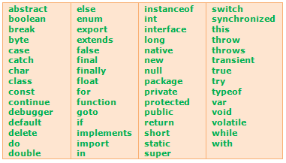
JavaScript keywords

Slide 19

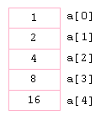
JavaScript Array Object

Slide 20
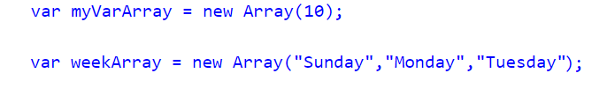
Constructors
Already know the number of items that would store in an array, you can pass the number to the constructor of an Array Object
Directly initialize the Array elements when declaring an Array Object

Slide 21
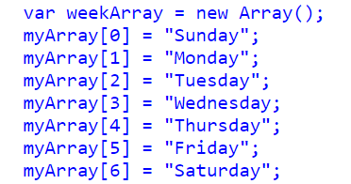
From 0...
JavaScript array indexes start from 0 (zero) and continue as 1,2,3 etc..

Slide 22

Displaying
Displaying Javascript Array elements
You can display Array elements in several ways. The following methods will show all elements from an Array.

Slide 23

Javascript Array Length
Length property of Javascript Array return the number of elements contains in an Array. Javascript Array index starts from 0 so the length of an array is equal to the last index + 1

Slide 24
Arrays Undefined Values
Arrays are automatically growing and dynamically sized to accommodate any type of data that is added to them. So, when you add or remove elements from an array, the length of the array will change as needed. When you declare an Array with constructor, each slot will be set to "undefined"

Slide 25
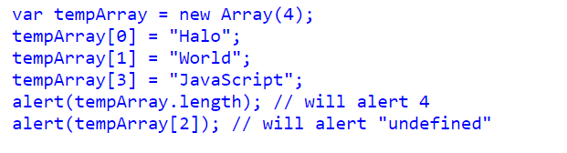
Example

Slide 26
Other Array Methods
Array.push()
Array.contains()
Array.sort()
Array.splice()
Array.slice()
Array.join()

Slide 27
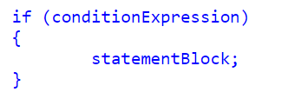
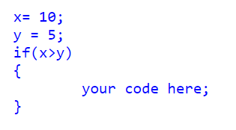
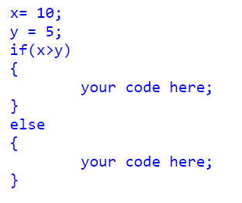
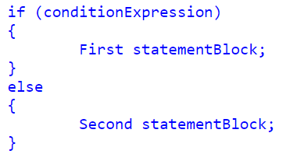
Conditional Statements

Slide 28
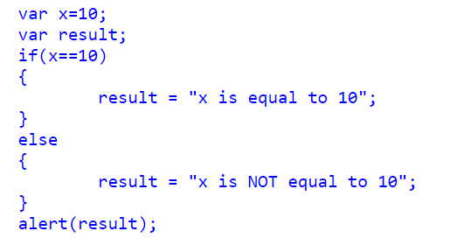
Alternative if..else Syntax (? Ternary Operator)

Slide 29
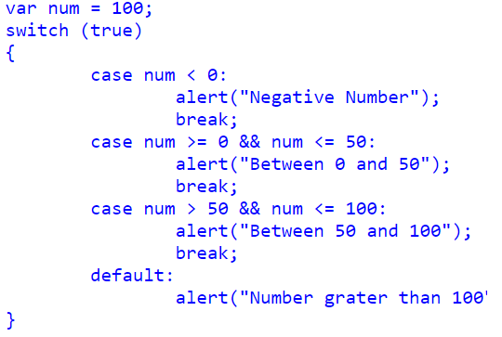
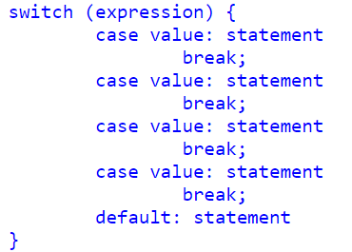
Switch Statements

Slide 30
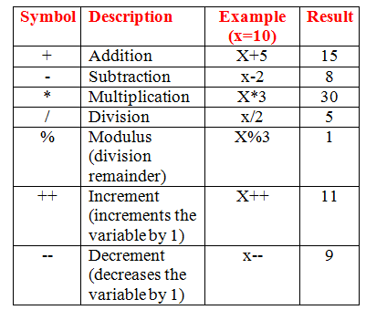
Arithmetic Operators

Slide 31
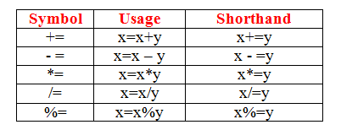
Assignment Operators

Slide 32
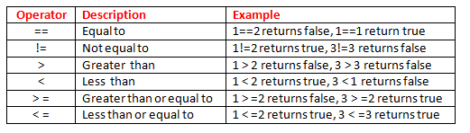
Comparison Operators

Slide 33
Logical Operators
AND (&&) : Allows you to check if both of two conditions are met
OR (||) : Allows you to check if one of two conditions are met
NOT (!) : Allows you to check if something is not the case

Slide 34
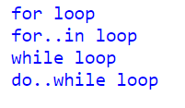
Loops in JavaScript

Slide 35
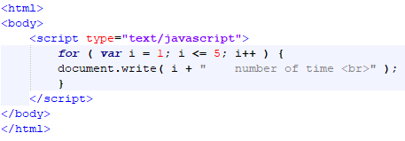
Javascript for loop

Slide 36
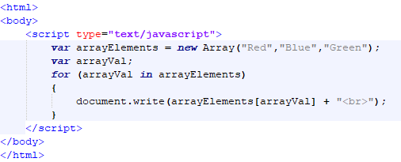
Javascript for..in Loop

Slide 37
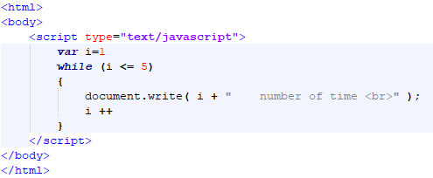
Javascript while Loop

Slide 38
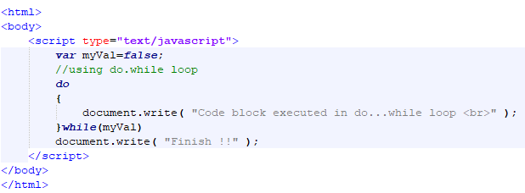
Javascript do..while loop

Slide 39
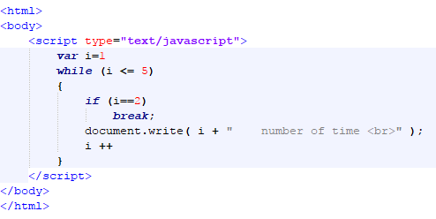
Javascript Break statement

Slide 40
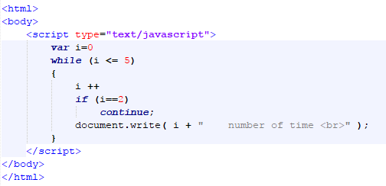
Continue statement

Slide 41
This Week
Review Slides
Read Associated Chapters
Work through Javascript Examples
Update GitHub Account/Webpage
Start Early

Slide 42
Summary
Overview of Javascript Syntax
Examples
Hands-On/Practical

Slide 43
Questions/Discussion

Slide 44
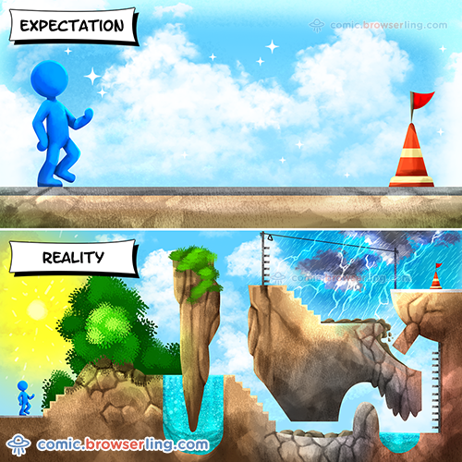
Learning JavaScript

Slide 45

Question
What order does f receive its arguments?
foo bar baz
foo baz bar
bar foo baz
foo baz

Slide 46
Question
Which of the following is correct about the expression 1==“1.0” in Javascript?
It returns false. The two values have different types.
It returns true. The two values are converted to strings and are equal.
It returns false. The two values are converted to strings and are not equal.
It returns true. The two values are converted to numbers and are equal.

Slide 47
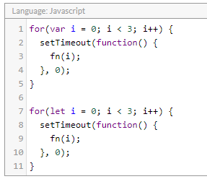
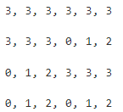
What arguments will fn receive, in order?
a)
b)
c)
d)

