Slide 1
Complexity
Object Orientated Analysis and Design
Benjamin Kenwright

Slide 2
Outline
Review Object Orientated Programming Concepts (e.g., encapsulation, data abstraction, ..)
What do we mean by Complexity?
How do we manage Complexity?
Design and Manage Complex Systems
Summary/Discussion

Slide 3
Last Week
Reviewed Concepts around Object Orientated Analysis and Design
Revised OOP Principles (e.g., Java)
Read Chapter 1

Slide 4
Question
Which of the following mechanisms is/are provided by Object Oriented Language to implement Object Oriented Model?
A. Encapsulation
B. Inheritance
C. Polymorphism
D. All of the mentioned

Slide 5
Answer
D. All of the mentioned

Slide 6
Question
Which of these is the functionality of ‘Encapsulation’?
A. Binds together code and data
B. Using single interface for general class of actions
C. Reduce Complexity
D. All of the mentioned

Slide 7
Answer
A. Binds together code and data
`Encapsulation' acts as protective wrapper that prevents code and data from being accessed by other code defined outside the wrapper

Slide 8
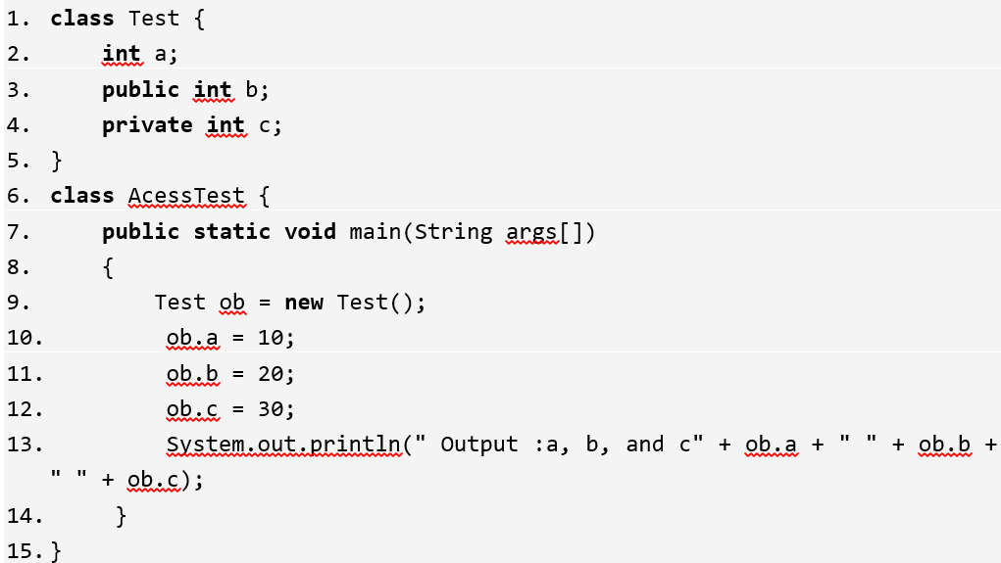
What is the output of this Program?
A. Compilation error
B. Run time error
C. Output : a, b and c 10 20 30
D. None of the mentioned

Slide 9
Answer
A. Compilation error
Explanation: Private members of a class cannot be accessed directly. In the above program, the variable c is a private member of class ‘Test’ and can only be accessed through its methods.

Slide 10
Question
Which of the following is a mechanism by which object acquires the properties of another object?
A. Encapsulation
B. Abstraction
C. Inheritance
D. Polymorphism

Slide 11
Answer
Answer: C. Inheritance
Explanation: ‘Inheritance’ is the mechanism provided by Object Oriented Language, which helps an object to acquire the properties of another object usually child object from parent object.

Slide 12
Why is Software Inherently Complex?
List the four elements
  Revision from Reading Chapter 1 Last Week

Slide 13
Why is Software Inherently Complex?
Inherent Complexity derives from four elements:
the complexity of the problem domain
the difficulty of managing the development process
the flexibility possible through software
problems of characterizing the behavior of discrete systems

Slide 14
1. Complexity of the Problem Domain
Requirements (functional and non-functional)
  e.g., electronic system of a multiengine aircraft, a cellular phone switching system, or an autonomous robot
  Usability, performance, cost, survivability, and reliability
Users may have only vague ideas of what they want in a software system
  generally lacks expertise in the domain
Difficult to express requirements
  e.g., large volumes of texts (difficult to comprehend, ambiguous ..)

Slide 15
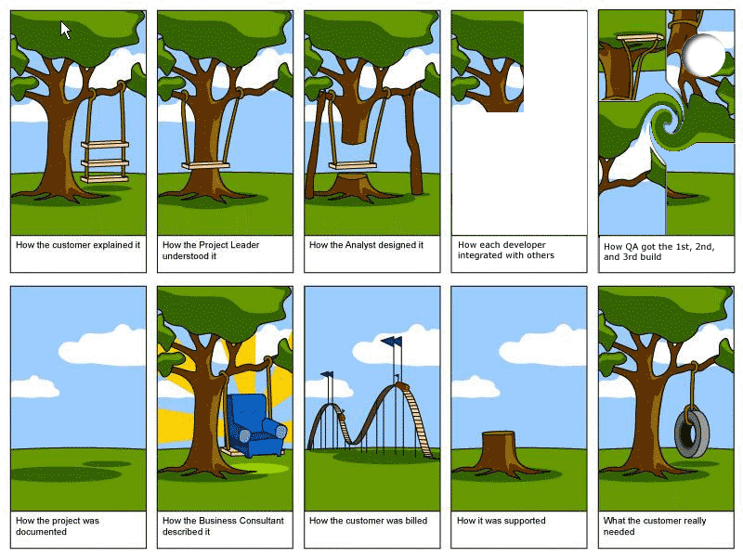


Slide 16
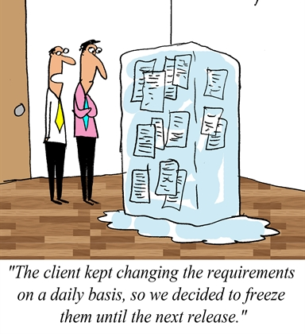
Complexity of the Problem Domain Cont.
Changing requirements during development
  early products, such as design documents and prototypes
  can lead users to better understand and articulate their real needs

Slide 17
Evolve Over Time
it is maintenance when we correct errors
it is evolution when we respond to changing requirements;
it is preservation when we continue to use extraordinary means to keep an ancient and decaying piece of software in operation

Slide 18
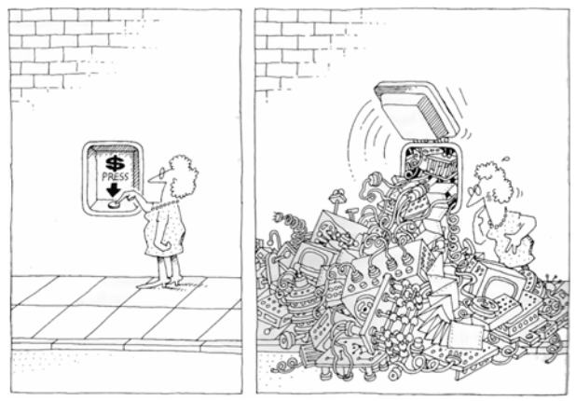
2. Difficulty of Managing the Development Process
Fundamental task of the software development team is to engineer the illusion of simplicity

Slide 19
Cont.
Strive to write less code
Reusing frameworks of existing designs and code
  Avoid reinventing wheel
Sheer volume of a system’s requirements is sometimes inescapable
Not unusual today to find systems whose size is measured in hundreds of thousands or even millions of lines of code
  More developers so more complex communication and hence more difficult coordination (location, skillset, attitude, synergy, ..)

Slide 20
3. Flexibility Possible through Software
Developer able to express almost any kind of abstraction
Flexibility incredibly seductive property
Few uniform rules, codes and standards for quality
  Makes developing software labor-intensive

Slide 21
4. Problems of Characterizing the Behavior of Discrete Systems
Large application, there may be hundreds or even thousands of variables and multiple control threads
Large systems, there is a combinatorial explosion of possibilities (states)
  Manage this by decomposing the behavior in one part of a system so it has a minimal impact on the behavior in another
However, worst circumstances, an external event may corrupt the state of a system (failed to take into account certain interactions)

Slide 22
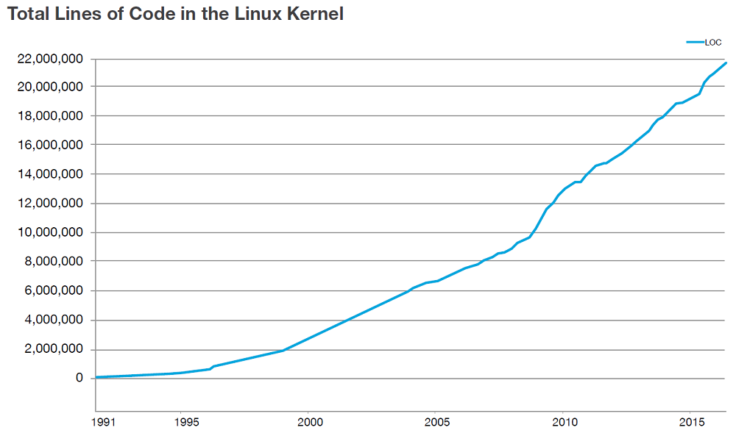


Slide 23
Question
What are the four elements that Inherent Complexity derives from?

Slide 24
Answer
Inherent Complexity derives from four elements:
complexity of the problem domain
difficulty of managing the development process
flexibility possible through software
problems of characterizing the behavior of discrete systems

Slide 25
What are the Five Attributes of a Complex System?

Slide 26
What are the Five Attributes of a Complex System?
Five attributes common to all complex systems
Hierarchic Structure
Relative Primitives
Separation of Concerns
Common Patterns
Stable Intermediate Forms

Slide 27
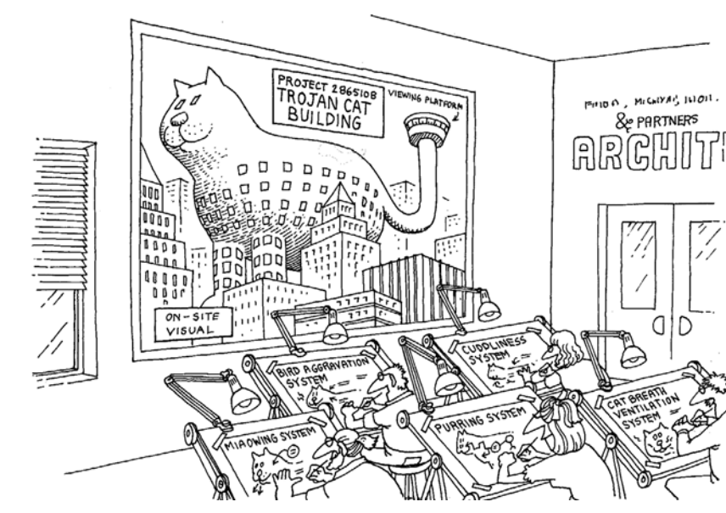
Hierarchic Structure
Frequently, complexity takes the form of a hierarchy, whereby a complex system is composed of interrelated subsystems that have in turn their own subsystems, and so on, until some lowest level of elementary components is reached

Slide 28
2. Relative Primitives
Components in a system are primitive and relatively arbitrary - largely up to the discretion of the observer of the system what they are

Slide 29
3. Separation of Concerns
Decomposable parts are not necessarily completely independent

Slide 30

4. Common Patterns
Composed of only a few different kinds of subsystems in various combinations and arrangements

Slide 31
5. Stable Intermediate Forms
Complex systems will evolve from simple systems
Never craft these primitive objects correctly the first time
Improve them over time as we learn more about the real behavior of the system

Slide 32
Question
Requirements change during development?
A. True
B. False

Slide 33
Answer
A. True

Slide 34
Question
Complex systems do not evolve from simple systems?

Slide 35
Answer
A. False
Complex systems will evolve from simple systems

Slide 36
Organized and Disorganized Complexity
Common abstractions and mechanisms greatly facilitates our understanding of complex systems

Slide 37
Canonical Form of a Complex System
Canonical Form of a Complex System
  Different hierarchies are usually present within the same complex system (perspective and requirements)
Successful complex software systems are those whose designs explicitly encompass well-engineered class and object structures and embody the five attributes of complex systems

Slide 38
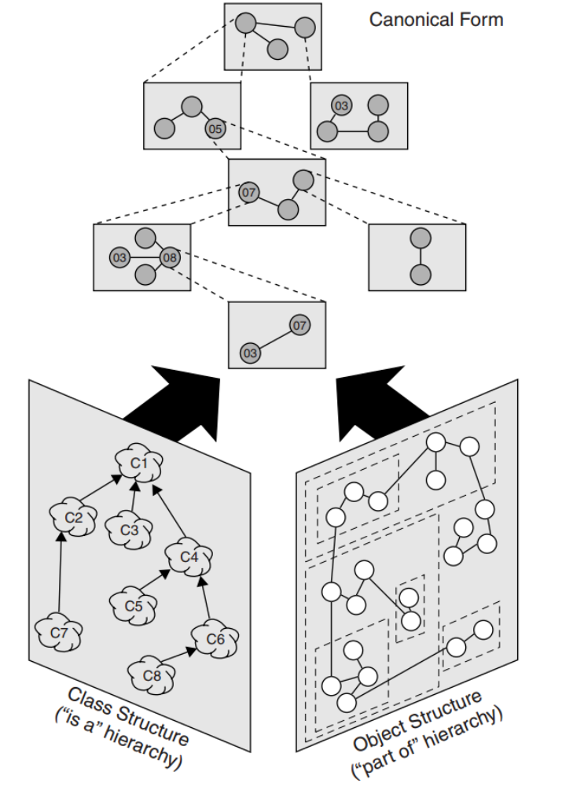
Canonical Form of a Complex System

Slide 39
Limitations of the Human Capacity for
Dealing with Complexity
We must think about many things at once
  cope with a fairly large, intricate, and sometimes nondeterministic state space
Maximum number of chunks of information that an individual can simultaneously comprehend is on the order of seven, plus or minus two
Relates to the capacity of short-term memory and speed to process data (e.g., five seconds to accept a new chunk of information)

Slide 40
Basic Limits on our Ability to Cope with Complexity.
How then do we Resolve this Predicament?

Slide 41
Solution
Order/Logic
Decomposition
Structure
Abstraction/Simplificiations

Slide 42
Objects or Processes
Complex systems can be viewed by focusing on either things or processes; there are compelling reasons for applying object-oriented decomposition, in which we view the world as a meaningful collection of objects that collaborate to achieve some higher-level behavior

Slide 43
Analysis & Design Methods
Dozens of design methods have been proposed. However, most methods can be categorized as one of three kinds:

Slide 44
Three Design Categories
Top-down structured design
Data-driven design
Object-oriented design

Slide 45
Cont.
Top-down structured design - applies
algorithmic decomposition
Data-driven design - mapping system inputs to outputs derives the structure of a software system
Object-oriented design - model software systems as collections of cooperating objects

Slide 46
Question
What is the maximum number of chunks of information that an individual can simultaneously comprehend?
A. 5 to 9 Chunks
B. 3 to 8 Chunks
C. 1 to 5 Chunks
D. 8 to 10 Chunks

Slide 47
Answer
A. 5 to 9 Chunks
Maximum number of chunks of information that an individual can simultaneously comprehend is on the order of seven, plus or minus two

Slide 48
What is the Role of Abstraction?

Slide 49
What is the Role of Abstraction?
Individual can comprehend only a few chunks of information
We have an exceptionally powerful technique for dealing with complexity
  We abstract from it
E.g., Unable to master the entirety of a complex object, we choose to ignore its inessential details, dealing instead with the generalized, idealized model of the object

Slide 50
Abstraction (Hierarchical)
Classifying objects into groups of related abstractions so we can explicitly distinguish common and distinct properties of different objects
  helps us to master/manage inherent complexity
Identifying the hierarchies within a complex software system
  simplify and embody tremendously complicated behavior

Slide 51
Question
What are the three Design Categories?
A. object-orientated, system-based, logic-driven
B. data-driven, top-down, object-orientated
C. structured, object-orientated, hierarchical
D. automated, object-orientated, synergetic-based
E. top-down, object-orientated, system-driven

Slide 52
Answer
B. data-driven, top-down, object-orientated

Slide 53
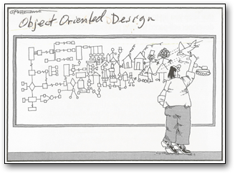
What is the Purpose of Design?

Slide 54
What is the purpose of Design?
Purpose of design is to construct a system that:
  Satisfies a given (perhaps informal) functional specification
  Conforms to limitations of the target medium
  Meets implicit or explicit requirements on performance and resource usage
  Satisfies implicit or explicit design criteria on the form of the artifact
  Satisfies restrictions on the design process itself, such as its length or cost, or the tools available for doing the design

Slide 55
Question
What are the Five Attributes of a Complex System?
A. Relative Primitives Separation of Concerns, Hierarchic Structure, Common Patterns, Stable Intermediate Forms
B. Hierarchic Structure, Common Primitives, Separation of Concerns, Stable Patterns, Dynamic Patterns
C. Hierarchic Structure, Primitive Structures, Separation Patterns, Stable Forms, Intermediate Attributes

Slide 56
Answer
Five Attributes of a Complex System:
A. Relative Primitives Separation of Concerns, Hierarchic Structure, Common Patterns, Stable Intermediate Forms

Slide 57
Question
Which of the following is the functionality of ‘Data Abstraction’?
A. Reduce Complexity
B. Binds together code and data
C. Parallelism
D. None of the mentioned

Slide 58
Answer
A. Reduce Complexity
Explanation: An essential element of Object Oriented Programming is ‘Data Abstraction’ which means hiding things. Complexity is managed through abstraction.

Slide 59
Summary
Complexity in Object Orientated Analysis and Design
Why Software is Inherently Complex
Human Intellectual Capacity
Engineer the Illusion of Simplicity
Evolve from stable intermediate forms
Manage complexity through decomposition, abstraction, and hierarchy
Focus on either things or processes
  view the world as a meaningful collection of objects

Slide 60
This Week
Review Slides
Read Chapter 2
Quizzes/Questions

Slide 61

Questions/Discussion

