Slide 1
Dynamic vs Static Websites
Web Authoring and Design
Benjamin Kenwright

Slide 2
Outline
Review
What do we mean by static and dynamic websites?
Content management systems
Summary
Review/Discussion

Slide 3
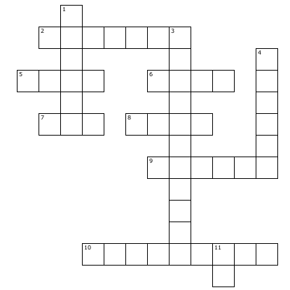
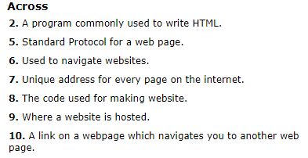
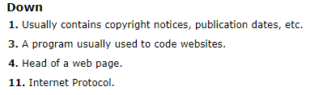
Crossword for Today
Have printed out/or copied out your answers and brought them with you for this lesson

Slide 4



Revision Question
Write down the HTML/CSS code to create an ‘Image’ Rollover Effect
(5 Minutes)

Slide 5
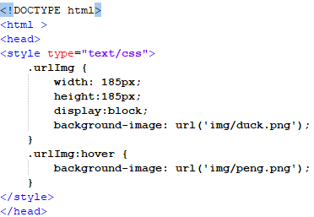

Answer

Slide 6
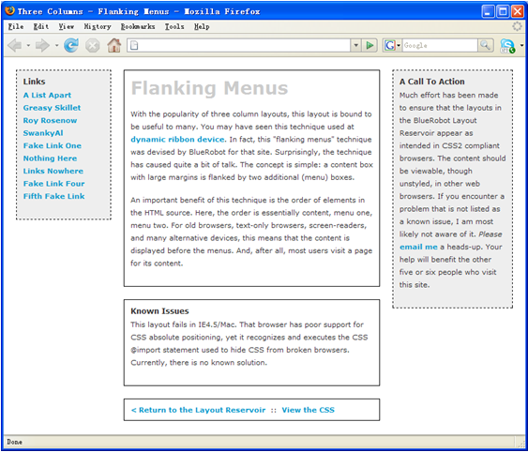

Activity
Write down on a piece of paper the HTML to display the following website design:
(5 Minutes)

Slide 7
Answer
Three Columns Flanking Menu
#navBeta {
position:absolute;
width:168px;
top:20px;
right:20px;
border:1px dashed black;
background-color:#eee;
padding:10px;
z-index:1;
}
.content {
position:relative;
width:auto;
min-width:120px;
margin:0px 210px 20px 170px;
border:1px solid black;
padding:10px;
z-index:3; /* This allows the content to overlap the right menu in narrow windows in good browsers. */
}
#navAlpha {
position:absolute;
width:128px;
top:20px;
left:20px;
border:1px dashed black;
background-color:#eee;
padding:10px;
z-index:2;
}

Slide 8
Content, Style and Behavior
HTML defines the structure and layout of a Web document by using a variety of tags and attributes.
Since its initial introduction in late 1991, it came to encompass a wider variety of stylistic and dynamic behavior capabilities to meet the demands of web developers.
Web page, we can find that, it can consist of up to three layers

Slide 9


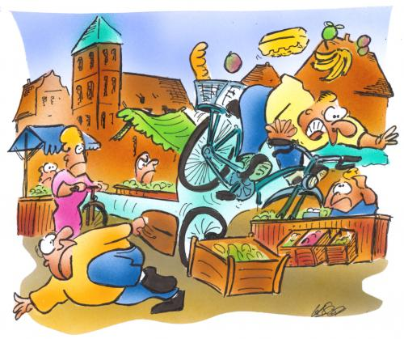
Three Types
Content
Style
Behavior

Slide 10

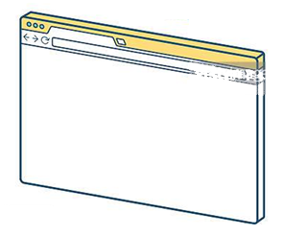
Content
Content or Structure is the base layer, we presented it through HTML (Hyper Text Markup Language) format and it describes text, graphics, and files containing other information are organized and linked together

Slide 11

Style
Style or Presentation, we can focus on making the site look attractive, by adding a layer of presentation information using CSS (Cascading Style Sheet)

Slide 12

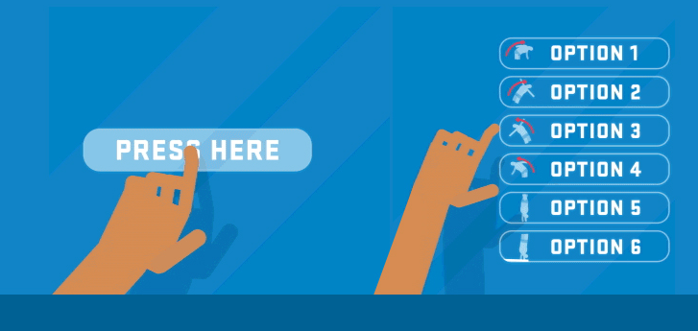
Behavior
Behavior, we can use JavaScript to introduce an added layer of user interaction and dynamic behavior, which will make the site easier to use in browsers equipped with JavaScript

Slide 13

Static vs Dynamic Websites

Slide 14
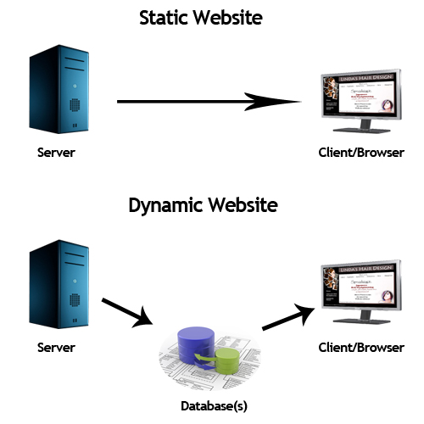

Slide 15
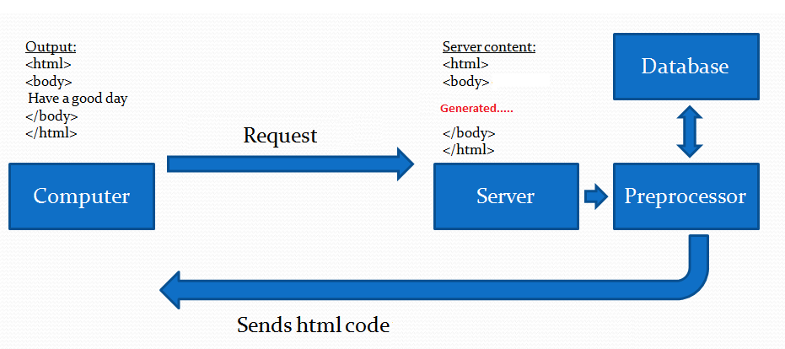

Slide 16


Slide 17
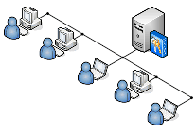
Client side vs Server side
web programming, there are two different types of programming models: Client side programming and Server side programming

Slide 18
Client
Client side programming considers to scripts that run within your web browser and these scripts has no interaction with a web server in order for the scripts to run
Javascript is the most popular client side scripting language

Slide 19
Server
Server-side programming refers to programs that run on the web server, which then sends results to your web browser
For example, PHP, Perl, Asp, .net, are the popular Server side programming languages

Slide 20
Question
Is Java the most popular client side scripting language?
True
False

Slide 21
Answer
b) False
Javascript is the most popular client side scripting language

Slide 22
Javascript
Javascript programs runs only in the web browsers and these scripts are read and executed by an interpreter (or engine) inside the web browser
The most common uses of JavaScript are interacting with clients, getting available information from them, and validating their actions

Slide 23
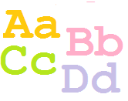
Javascript is Case-Sensitive
First and most important thing regarding Javascript is that it is case sensitive
Everything defined in the Javascript is case sensitive, that means a variable 'var' is different from a variable named 'Var'

Slide 24
Embedded in your HTML files
Javascript between the <script> ... </script> tags. When the browser encounters a <script> tag, it assumes that the script block is written in JavaScript
You can place these script blocks in the <head> or in the <body> section of HTML page or you can use both sections at the same time

Slide 25
Question
Is Javascript case sensitive?
True
False

Slide 26
Answer
a) True
Javascript is case sensitive

Slide 27
Question
The <script> blocks has to be in the <head> section of HTML page?
True
False

Slide 28
Answer
b) False
The <script> blocks can be in the <head> or in the <body> section of HTML

Slide 29
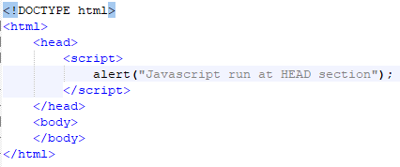
Javascript at Head section

Slide 30
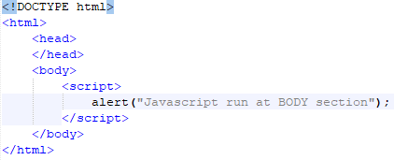
Javascript at Body Section

Slide 31

External script File
Either be embedded in your HTML files or placed in an external script file with a .js extension

Slide 32
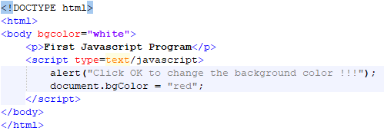
Simple First JavaScript Program
.html file and type the following code:

Slide 33
When you open the file in web browser, first you get a message box in a white background and then you press OK button you can see the background color is changed to RED color

Slide 34
Summary
Overview of Dynamic and Static Websites
Dynamic websites (Generated Content)
Getting started with scripting and Javascript
Hands-On/Practical

Slide 35
This Week
Review Slides
Read Associated Chapters
Weekly Tasks
Update GitHub Account/Webpage
Online Quizzes
Crossword Challenge

Slide 36
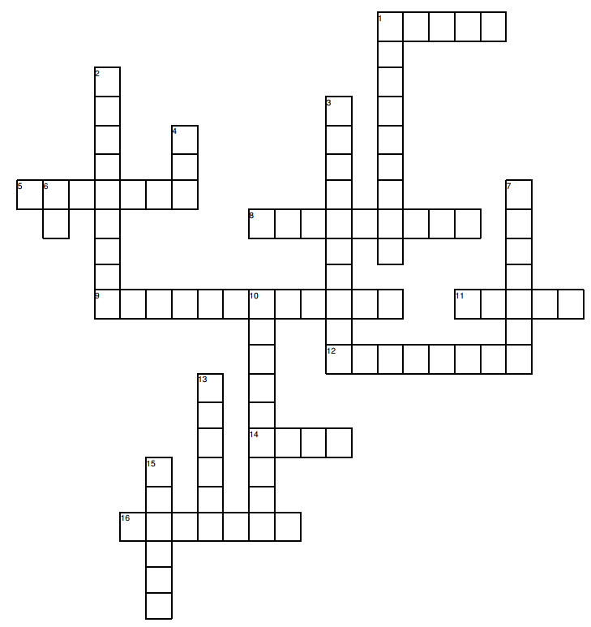
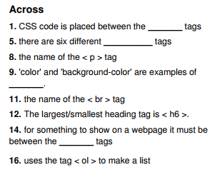
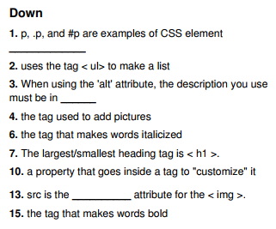
Puzzle to Solve for Next Week
Print out/or copy out your answers and bring them with you for next lesson

Slide 37
Questions/Discussion

Slide 38
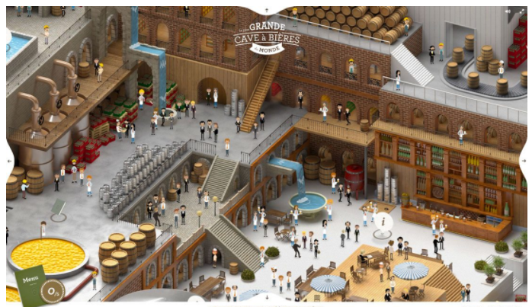
Challenge
Implement a similar website design
Navigation elements are within the image (e.g., people, tables, …)
Popup information, hover over images/text, …

Slide 39


