Slide 1
Table-Based
Web Pages
Web Authoring and Design
Benjamin Kenwright

Slide 2
Outline
What do we mean by Table-Based Web Sites?
Summary
Review/Discussion

Slide 3

ADDING BACKGROUND COLOR and IMAGE to TABLE

Slide 4
BACKGROUND COLOR
You can background color to your table and cells simply by using "bgcolor" attribute.

Slide 5
<center><table bgcolor="yellow" cellpadding="20" cellspacing="25" style="border:10 solid green">
<tr><td bgcolor="light blue" style="border:4 solid red">xxxxxxxxxxxx</td>
<td bgcolor="purple" style="border:5 dotted purple">xxxxxxxxxxxxx</td></tr>
<tr><td style="border:5 solid blue">xxxxxxxxxxxxxx</td>
<td bgcolor="pink">xxxxxxxxxxxxxxxxxxx</td></tr>
</table>

Slide 6
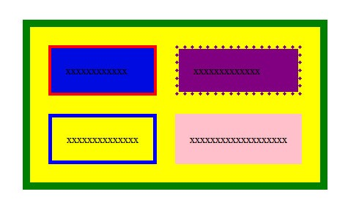

Slide 7
Cellpadding and Cellspacing
If you want to give different border size and color to each cell, then separately use "style" attribute with <td> tag.

Slide 8
Cellpadding and Cellspacing
Cellpadding:
  Cellpadding is an attribute of <table> tag. By using cellpadding attribute you can set the amount of space between the contents of the cell and the cell wall.
Ex:- <table cellpadding="4">
Cellspacing:
  Cellspacing is also an attribute of <table> tag. By using cellspacing attribute you can set the amount of space between the table cells.
Ex:- <table cellspacing="4">

Slide 9
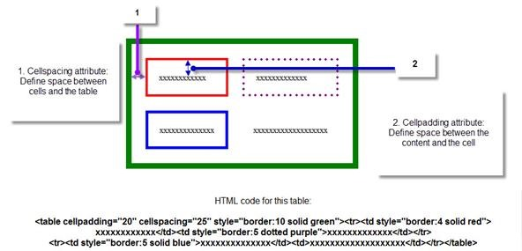

Slide 11
BACKGROUND IMAGE
Background attribute to add any images as background of your table or to each cell separately
<table>
<tr>
<td style="background: url(tree.jpg);">
..
</table>

Slide 12
This Week
Review Slides
Read Associated Chapters
Practical Tasks
Online Quizzes

Slide 13
Summary
Overview of Table-Based HTML Techniques
Hands-On/Practical

Slide 14

Questions/Discussion

