Slide 1
CSS Selectors
Web Authoring and Design
Benjamin Kenwright

Slide 2
Outline
Review
What are CSS Selectors?
Different types of Selectors and Syntax
Examples of how to use Selectors
Summary
Review/Discussion

Slide 3
CSS Selectors
CSS selectors are HTML tags to which a CSS style is applied.
  This could be any tag like < p > or < h1 >
These are patterns used to select the HTML tags that you want to style.
These patterns may range from simple element names to rich contextual patterns

Slide 4

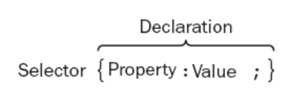
Selector Syntax

Slide 5
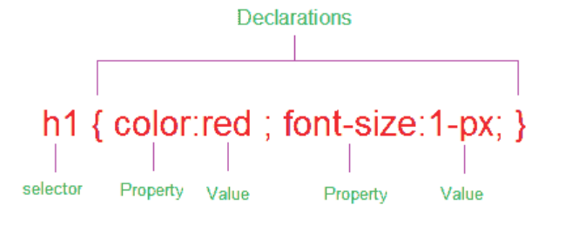
Details
In the following sections, looking at how you can use different types of a selectors to specify which elements a style sheet rule can apply to

Slide 6
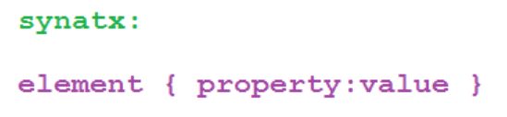

Element Selector or
Type Selector
The CSS element Selector or the type selector matches occurrences of those tags specified in the list
e.g.,
Above CSS code sets all paragraph font size as 32.

Slide 7
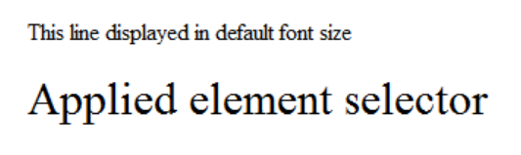
Example Selector
<html>
<head>
<style type="text/css">
p {font-size:32px;}
</style>
</head>
<body>
This line displayed in default font size
<p> Line formated with element selector </p>
</body>
</html>

Slide 8
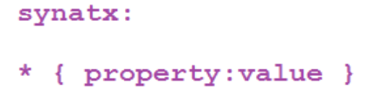

Universal Selector
The universal selector set a value for all elements in the HTML document
e.g.,
Above CSS code set font size =14px to the whole HTML document

Slide 9
Example Universal Selector
<html>
<head>
<style type="text/css">
* {font-size:32px;}
</style>
</head>
<body>
Universal selector set all font size as 22 in this document
</body>
</html>

Slide 10
Grouped Selectors
Whenever a situation that you need to apply the same style property to a number of selectors, then you can group those selectors into one rule by separating them with commas. The selector rule has the same effect to more than one selector at a time

Slide 11
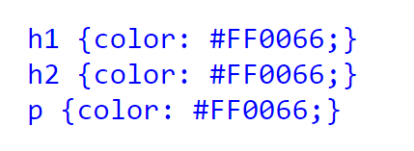

Example Grouped Selectors
Instead of above multiple selectors you can group them as follows:

Slide 12
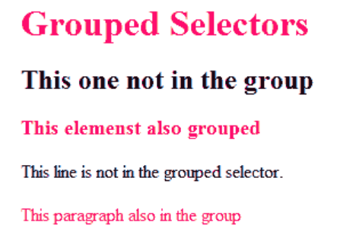
<html>
<head>
<style type="text/css">
h1,h3,p {color: #FF0066;}
</style>
</head>
<body>
<h1>Grouped Selectors</h1>
<h2>This one not in the group</h2>
<h3>This elements also grouped</h3>
This line is not in the grouped selector.
<p>This paragraph also in the group </p>
</body>
</html>

Slide 13
This Week
Review Slides
Read Associated Chapters
Weekly Tasks
  Update GitHub Website
Online Quizzes

Slide 14
Summary
Overview of CSS Selectors
Different Selectors
  E.g., Universal, Grouped, ..
Hands-On/Practical

Slide 15

Questions/Discussion

