Slide 1
Introduction to Javascript
Web Authoring and Design
Benjamin Kenwright

Slide 2
Outline
What is Javascript?
Summary
Review/Discussion

Slide 3
Review
Javascript between the tags
< script >
...
< /script >

Slide 4
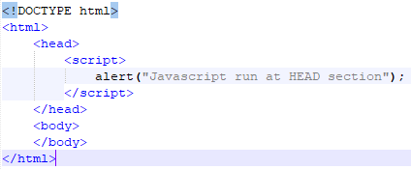
Review
Simple Javascript Example

Slide 5

Popup boxes
JavaScript introduced three dialog boxes that work well enough for alerting, confirming and prompting for values

Slide 6
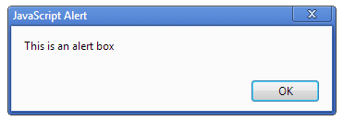

Alert Boxes
These dialog boxes are helpful to raise and alert, or to get confirmation on any type of input from the user

Slide 7
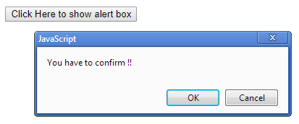
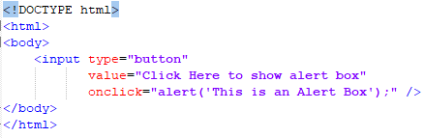
Button Triggers

Slide 8
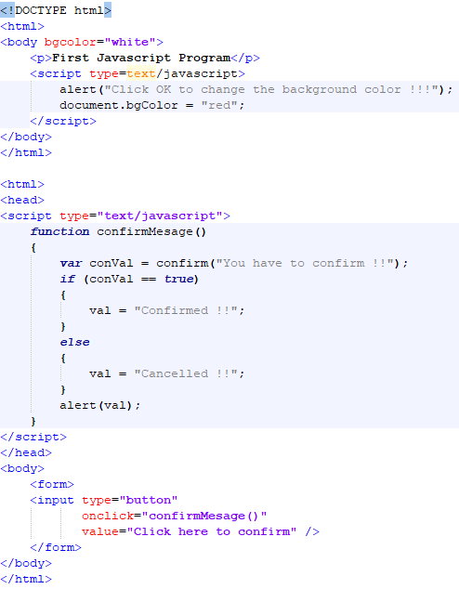
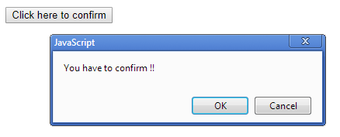
Confirm Dialog

Slide 9
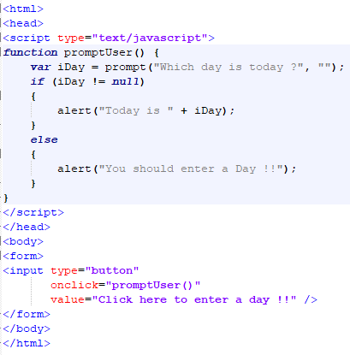
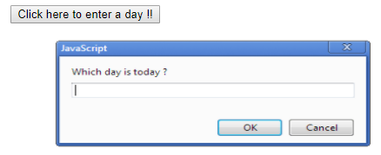
Prompt Box

Slide 10
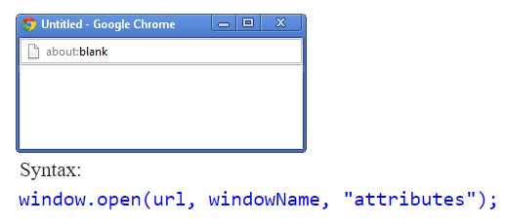
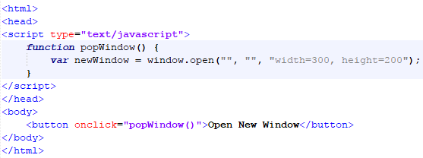
Javascript Popup Window

Slide 11
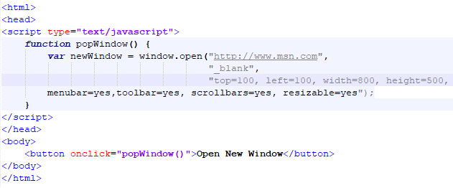
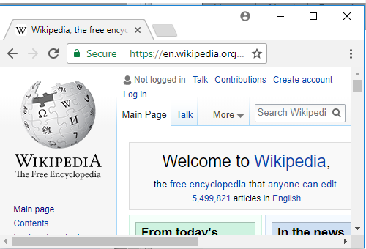
Parameters New Window

Slide 12
This Week
Review Slides
Read Associated Chapters
Weekly Tasks
Update GitHub Account/Webpage
Online Quizzes

Slide 13
Summary
Overview of Javascript
Basic Formatting
Script, Functions, ...
Altering webpage operation (through Javascript)
Hands-On/Practical

Slide 14
Questions/Discussion

Slide 15
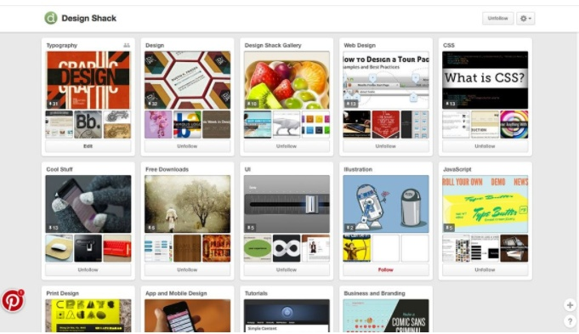
Challenge
Implement a Pinterest type website that uses cards for everything, including navigation, to help users move through the site. It’s one of the most effective outlines employing card-style design out there. Users of all ages seem to figure it out with ease.

Slide 16
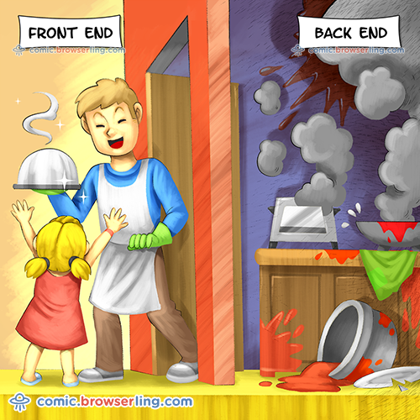
Modern Web Development

