Slide 1
Generic Types and Collections
Object Orientated Programming in Java
Benjamin Kenwright

Slide 2
Outline
Review
Essential Generic Type Concepts
Collections with Java
Today’s Practical
Review/Discussion

Slide 3
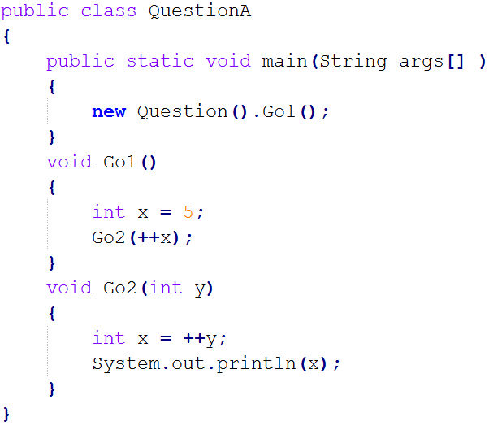
Question
Does the following code compile? What would the output be?

Slide 4

Answer
7

Slide 5
Question
Does the following code compile? What would the output be?

Slide 6

Answer
val:12
3:val

Slide 7
Question
What will the following code print?
a) 1
b) 10
c) 16
d) 31

Slide 8
Answer
c) 16

Slide 9
Question
Does the following code compile? What would the output be?

Slide 10

Answer
96

Slide 11
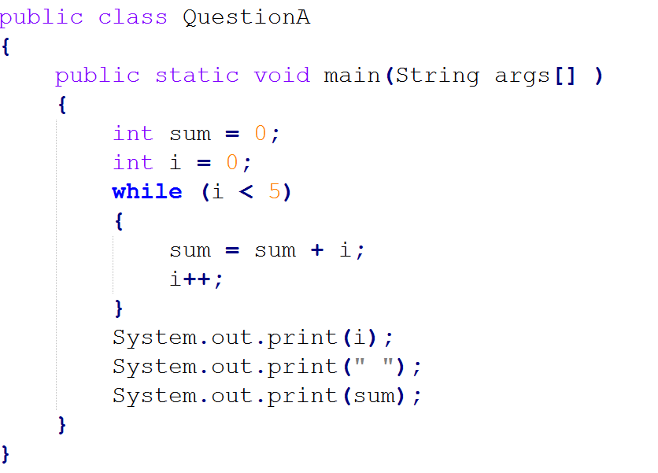
Question
Does the following code compile? What would the output be?

Slide 12
Answer
5 10

Slide 13
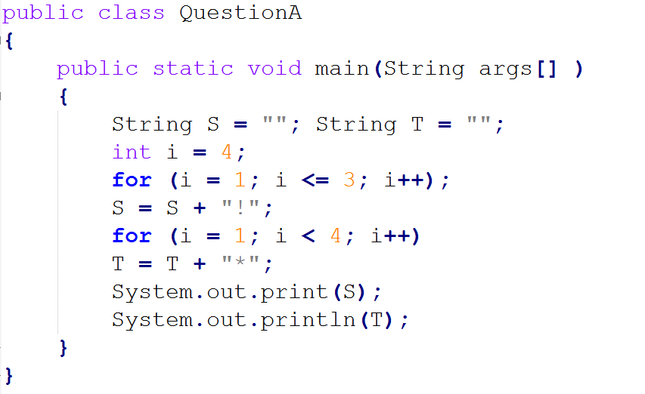
Question
Does the following code compile? What would the output be?
a) (that is, the empty string, printed twice) b) * c) !*** d) !**** e) !!!***

Slide 14
Answer
c) !***

Slide 15
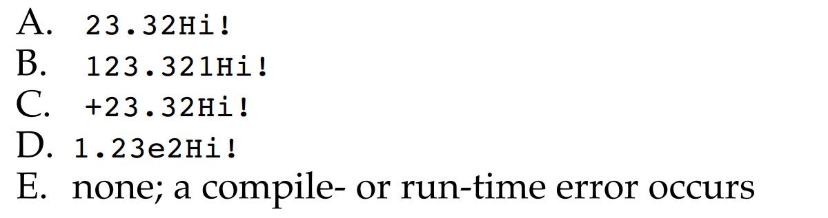
Question
What is the output of the following program?

Slide 16
Answer
B) 123.321Hi!

Slide 17
Generic Types
Generics is the capability to parameterize types
Flexibility to define a class or a method with generic types that the compiler can replace with concrete types

Slide 18
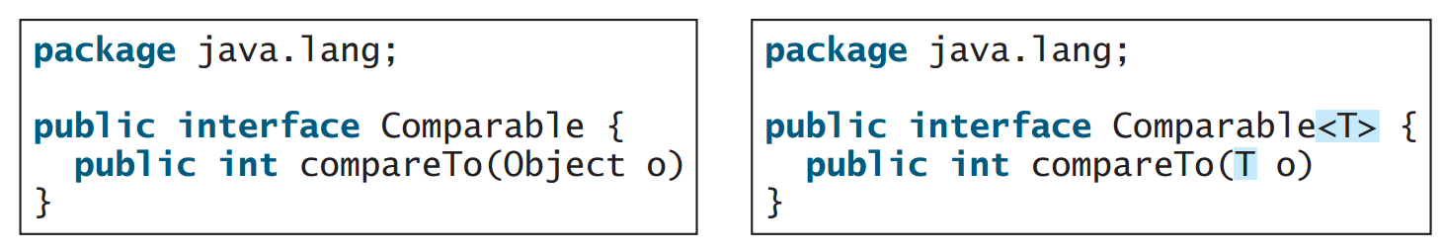
Example
<T> represents the formal generic type
Replaced by an actual concrete type

Slide 19
Why use Generic Types?

Slide 20
Why use Generics?
Identify errors at compile time
Explicit type checking
Robust and reliable programs

Slide 21
Example
Arrays
Create array for `strings':
Only add `strings’ to the array

Slide 22
Example

Slide 23
Writing Generic Class
Specify the ‘Type’ in the class definition
e.g., <E>, <T>, …
Use the Type as needed

Slide 24
Example

Slide 25
Example cont.
Generic Type ‘Integer’
Output 1

Slide 26
Summary
Generic Types with Java
Advantages of Generic Types
Flexibility/Robustness
Incorporate Generic Types into your implementations
Examples

Slide 27
This Week
Read Associated Chapters
Review Slides
Java Exercises

Slide 28
Exercises
Exercises 21.1 to 21.2 (Generics)
25.1 to 25.2 (Arrays/Lists)

Slide 29
Questions/Discussion

