Slide 1
Javascript Forms
Web Authoring and Design
Benjamin Kenwright

Slide 2
Outline
Review
What do we mean Javascript Forms?
Object Orientated Concepts
Summary
Review/Discussion

Slide 3
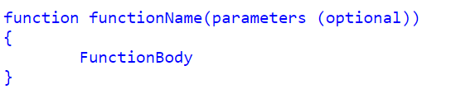
Defining functions
Function Declarations:

Slide 4
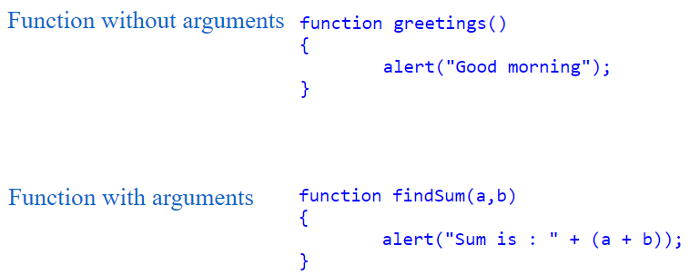
Arguments

Slide 5
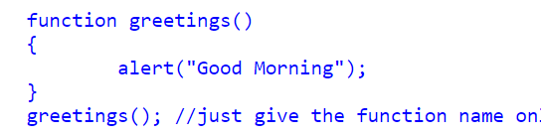
Calling a Function
You can call Javascript functions by simply call the function name

Slide 6
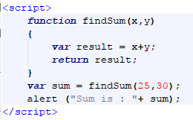
Return Values

Slide 7
Question
Is Javascript an Object Orientated Language?
a) Yes
b) No

Slide 8
Answer
a) Yes
JavaScript is an object oriented programming language

Slide 9
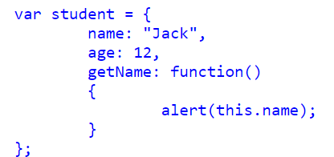
How to create and use objects in Javascript

Slide 10

Call Object function

Slide 11
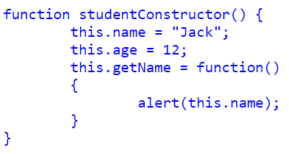
Object constructor

Slide 12

How to create a New Instance from a Constructor

Slide 13
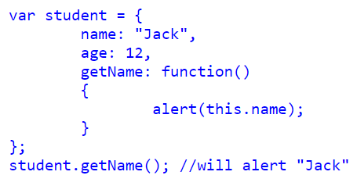
Literal notation in Javascript Object

Slide 14
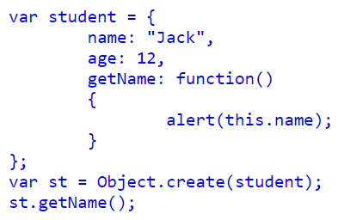
Object.create() in Javascript Object

Slide 15
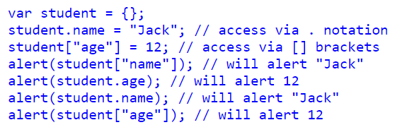
Accessing Object Properties in JavaScript
We can access Object Properties in JavaScript using either the dot(.) notation or the bracket[] notation

Slide 16
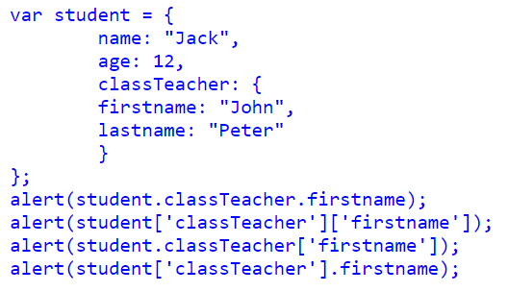
Object contain another Object

Slide 17
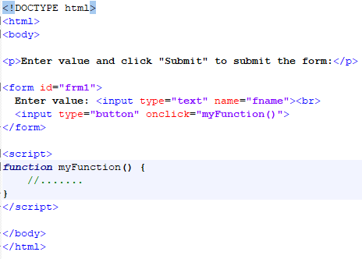
Forms Trigger/Call Javascript

Slide 18
This Week
Review Slides
Read Associated Chapters
Work through Javascript Examples
Update GitHub Account/Webpage
Group Project (Christmas Theme)
Website & Javascript Game
Demonstrate Individual Projects

Slide 19
Summary
Overview of Objects in Javascript
Javascript Forms
Hands-On/Practical

Slide 20
Questions/Discussion

