Slide 1
Javascript Forms
Web Authoring and Design
Benjamin Kenwright

Slide 2
Outline
Review
Javascript and Object Orientated Concepts
Javascript and Forms
Summary
Review/Discussion

Slide 3
25th December
Last Day – Quizzes
Grade Taken

Slide 4
Presentation/Demonstration (Individual Project)
1pm – 6pm
Room 24-401
Presentation (slides)
Answer questions

Slide 5
Question
How can you create an Array in JavaScript?

Slide 6
Answer
You can define arrays using the array literal as follows −
var x = [];
var y = [1, 2, 3, 4, 5];

Slide 7
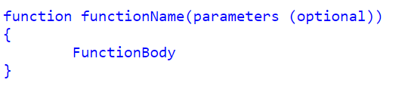
Defining functions
Function Declarations:

Slide 8
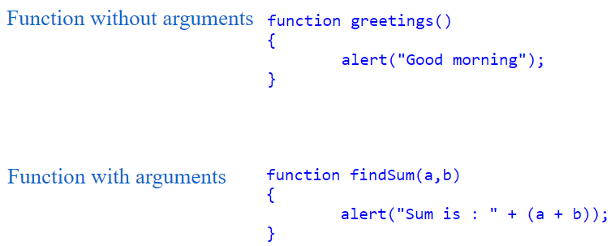
Arguments

Slide 9
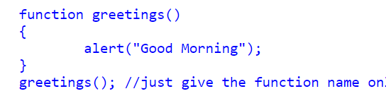
Calling a Function
You can call Javascript functions by simply call the function name

Slide 10
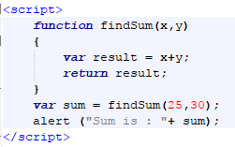
Return Values

Slide 11
Question
Is Javascript an Object Orientated Language?
a) Yes
b) No

Slide 12
Answer
a) Yes
JavaScript is an object oriented programming language

Slide 13
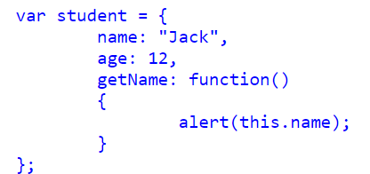
How to create and use objects in Javascript

Slide 14

Call Object function

Slide 15
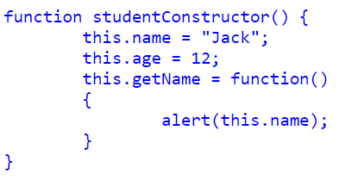
Object constructor

Slide 16

How to create a New Instance from a Constructor

Slide 17
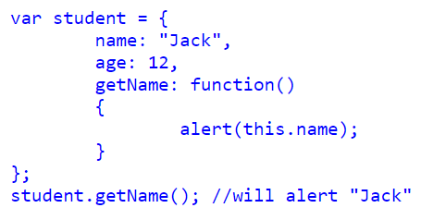
Literal notation in Javascript Object

Slide 18
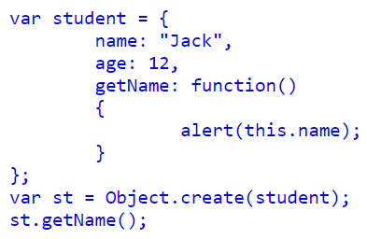
Object.create() in Javascript Object

Slide 19
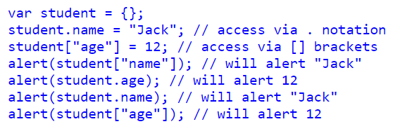
Accessing Object Properties in JavaScript
We can access Object Properties in JavaScript using either the dot(.) notation or the bracket[] notation

Slide 20
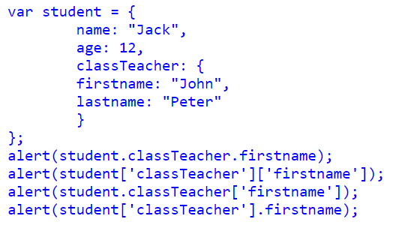
Object contain another Object

Slide 21
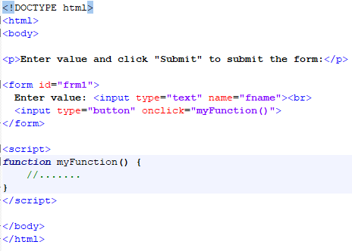
Forms Trigger/Call Javascript

Slide 22
This Week
Review Slides
Read Associated Chapters
Work through Javascript Examples
Update GitHub Account/Webpage
Group Project (Christmas Theme)
Website & Javascript Game
Demonstrate Individual Projects

Slide 23
Summary
Overview of Objects in Javascript
Javascript Forms
Hands-On/Practical

Slide 24
Questions/Discussion

