Slide 1
Processes
Object Orientated Analysis and Design
Benjamin Kenwright

Slide 2
Outline
Review
What are Processes?
Why are they important in Object Orientated Analysis and Design
Conclusion and Discussion
Summary

Slide 3
Revision Question
An object is an entity that has:
a) state, action, dependencies
b) behavior, state, identity
c) behaviour, action, state
d) class, state, memory

Slide 4
Answer
b) behavior, state, identity

Slide 5
Revision Question
Write down the four elements that Inherent Complexity derives from?
(5 Minutes)

Slide 6
Answer
Inherent Complexity derives from four elements:
complexity of the problem domain
difficulty of managing the development process
flexibility possible through software
problems of characterizing the behavior of discrete systems

Slide 7
Revision Question
Which of the following is the functionality of ‘Data Abstraction’?
A. Reduce Complexity
B. Binds together code and data
C. Parallelism
D. None of the mentioned

Slide 8
Answer
A. Reduce Complexity
Explanation: An essential element of Object Oriented Programming is ‘Data Abstraction’ which means hiding things. Complexity is managed through abstraction.

Slide 9
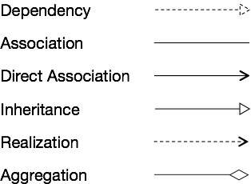

Revision Question
Draw the notations for the different types of relationships

Slide 10
Answer

Slide 11
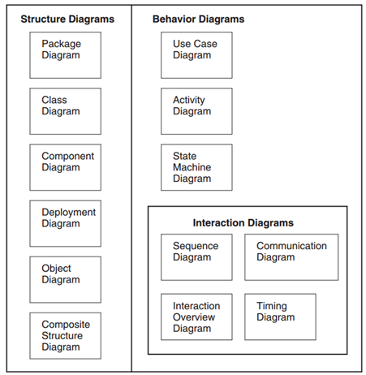
Revision Question
List the various UML Diagram Types

Slide 12
Answer

Slide 13

Question
Draw an example of a State Machine Diagram

Slide 14
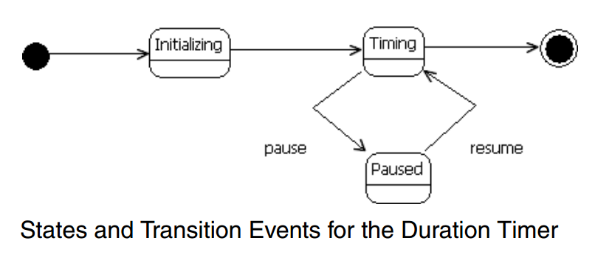
Answer
A state machine diagram expresses behavior as a progression through a series of states, triggered by events, and the related actions that may occur

Slide 15
Question
Does a method or tool exist which promises to make software development a trivial task?
True
False

Slide 16
Answer
b) False
A professional software engineer know that no such panacea exists.

Slide 17
Traits of Successful Projects
Existence of a strong architectural vision
Application of a well-managed iterative and incremental development lifecycle
Note there are other traits of a successful project – however, we focus on just two main principles

Slide 18
Strong Architectural Vision
Fundamental organization of a system embodied in its components, their relationships to each other, and to the environment, and the principles guiding its design and evolution
Conceptual integrity
Clean internal structure
Understandability

Slide 19
Attributes of Good Software Architectures
Well-defined layers of abstraction
Each layer representing a coherent abstraction
Provides well-defined and controlled interface
Built on well-defined and controlled facilities at lower levels of abstraction
Clear separation of concerns between the interface and implementation of each layer
Makes it possible to change the implementation of a layer without violating the assumptions made by its clients
Architecture is simple
Common behavior is achieved through common abstractions and common mechanisms

Slide 20
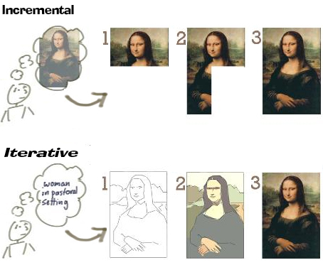
Iterative and Incremental Lifecycle

Slide 21
Incremental Approach
The Incremental Approach uses a set number of steps and development goes from start to finish in a linear path of progression.

Slide 22
Incremental
Incremental development is done in steps from design, implementation, testing/verification, maintenance. These can be broken down further into sub-steps but most incremental models follow that same pattern. The Waterfall Model is a traditional incremental development approach.

Slide 23
Iterative Approach
Iterative Approach has no set number of steps, rather development is done in cycles

Slide 24
Iterative
Iterative development is less concerned with tracking the progress of individual features. Instead, focus is put on creating a working prototype first and adding features in development cycles where the Increment Development steps are done for every cycle. Agile Modeling is a typical iterative approach.

Slide 25
Analogy of Incremental vs Iterative
If you were writing an essay under the Incremental Model, you'd attempt to write it perfectly from start to finish one sentence at at time. If you wrote it under the Iterative Model, you'd bang out a quick rough draft and work to improve it through a set of revision phases

Slide 26
Question
Which development approach is the the waterfall model?
a) incremental development approach
b) iterative development approach
c) static development approach
d) behavioral development approach

Slide 27
Answer
a) incremental development approach

Slide 28
Heart of Software Engineering
Iterative and incremental approach are at the heart of most modern software development methods, including agile methods like:
Extreme Programming (XP)
SCRUM
Most importantly are extremely well suited to the object-oriented paradigm and offers a number of benefits relative to risk management

Slide 29
Trends
Iterative approach is common practice because it better fits the natural path of progression in software development
Instead of investing a lot of time/effort chasing the 'perfect design' based on assumptions, the iterative approach is all about creating something that's 'good enough' to start and evolving it to fit the user's needs

Slide 30
Discussion
When would you use an Iterative or Incremental approach?

Slide 31
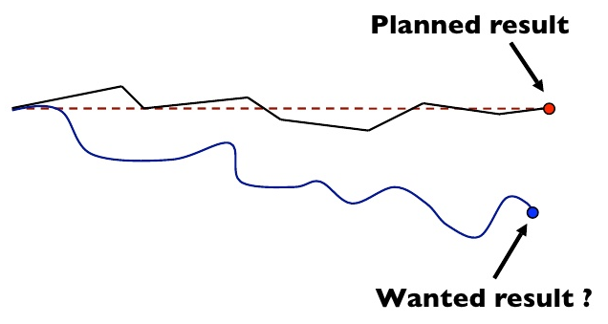
Plan-Driven vs Agile

Slide 32
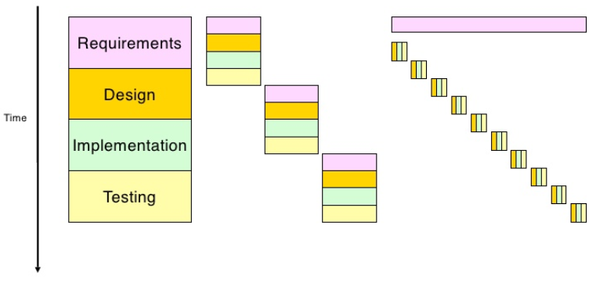
Agile Tight Cycles and Small Increment
Waterfall
(Plan-Driven)
Incremental
Agile-XP

Slide 33
Agile Processes
Primary goal is to deliver a system to the customer that meets their current needs in the shortest amount of time

Slide 34
Agile Characteristics
Lightweight and sparse, less ceremony
Reliant on the tacit knowledge of the team members
Tactically focused rather than strategic
Iterative and incremental
Heavily reliant on customer collaboration
Self-organizing and managing
Emergent as opposed to predetermined

Slide 35
Plan-Driven Characteristics
More heavyweight, more ceremony
Reliant on well-documented processes
Strategically focused rather than tactically focused
Reliant on a customer contract
Managed and controlled
Defined up front and then continually improved

Slide 36
Agile Plan-Driven
Project is small
Experienced teams with a wide range of abilities take part
Teams are self-starters, independent leaders and others who are self-directing
Project is an in-house project and the team co-located
System is new with lots of unknowns
Requirements must be discovered
Requirements and environment are volatile with high change rates
End-user environment is flexible
Relationship with customer is close and collaborative
Customer is readily available dedicated and co-located
High trust environment exists within the development teams and customer
Rapid value and high-responsiveness are required
Project is large
Teams include varied capabilities and skill sets
Teams are geographically distributed and/or outsourced
Project is of strategic importance
System is well understood (scope and features set)
Requirements are fairly stable
System is large and complex (critical safety/high reliability requirements)
Project stakeholders have a weak relationship with the development team
External legal concerns
Focus is on a strong, quantitative process improvement
Definition and management of process are important
Predictability and stability of process are important

Slide 37
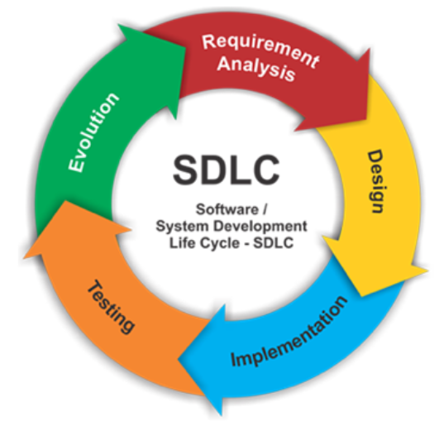
Software Development Lifecycle (SDLC)

Slide 38
Software Development Lifecycle
Controlling framework
Guide for the overall development of the system
ultimately leading to the final product

Slide 39
Selection
Plethora of software development lifecycle styles available
For example, Rational Unified Process (RUP), XP, SCRUM, Crystal, ...
Selection of a lifecycle style directly affects the size and shape of the process

Slide 40
Five Process Areas
1. Requirements
2. Analysis and Design
3. Implementation
4. Testing
5. Deployment

Slide 41
Throughout the Lifecycle
Project Management
Manage the software development project, including:
planning, staffing, and monitoring the project, as well as managing the risks
Configuration and Change Management
Identify and control change
Environment
Software development environment, including teams, tools, and support

Slide 42
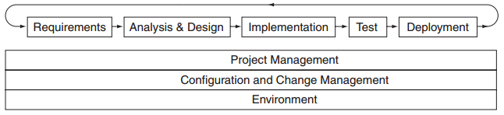
Process Disciplines
Relative Order
Iterative Nature

Slide 43
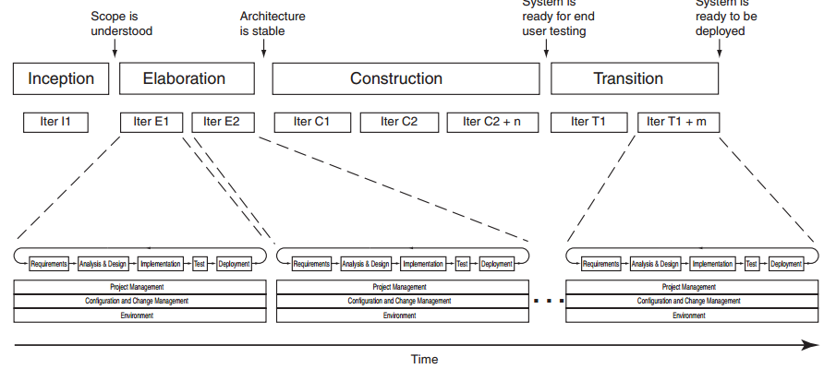
Process Milestones, Phases and Iterations

Slide 44
Phases in Agile Methods
The XP lifecycle includes five phases
Exploration: Determine feasibility, understand key “stories” for the first release, and develop exploratory prototypes
Planning: Agree on the date and stories for the first release
Iterations to release: Implement and test selected stories in a series of iterations. Refine the iteration plan
Productionizing: Prepare supporting materials (documentation, training, marketing), and deploy the operational system
Maintenance: Fix and enhance the deployed system

Slide 45
Phases in Agile Methods
SCRUM lifecycle includes four phases.
Planning: Establish the vision, set expectations, secure funding, and develop exploratory prototypes
Staging: Prioritize and plan for the first iteration. Develop exploratory prototypes
Development: Implement requirements in a series of sprints, and refine the iteration plan
Release: Prepare supporting materials (documentation, training, marketing), and deploy the operational system

Slide 46
Duration
Iteration is pretty much the same across most software development methods
XP recommends that iterations be one or two weeks long, if possible
SCRUM specifies that all iterations (sprints) should be 30 days long
RUP recommends that iterations be two to six weeks long

Slide 47
Micro Process
Overall software development process (the macro process)
Micro Process covers the analysis and design process by looking at what activities are performed and what work products are produced

Slide 48
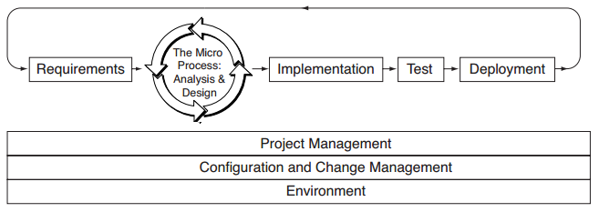
Micro Process within Macro Process

Slide 49
Levels of Abstraction
Micro process, the traditional phases of analysis and design are intentionally blurred and instead are performed at different levels of abstraction along a continuum

Slide 50
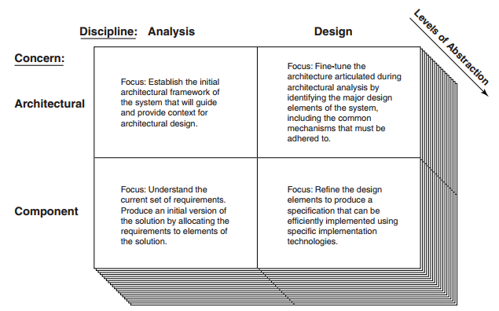
Vary Focus of Analysis and Design Depending on Perspective

Slide 51
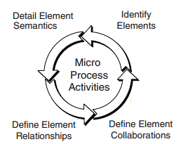
Activities
Identify the elements
Define the collaborations between the elements
Define the relationship between elements
Define the semantics of the elements

Slide 52
Review
Review Six Common Software Development Lifecycles (SDLC)
Waterfall Model
V-Shaped Model
Evolutionary Prototyping Model
Spiral Method (SDM)
Iterative and Incremental Method
Agile development

Slide 53
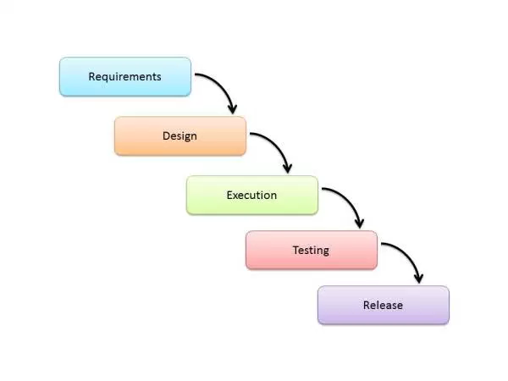
Waterfall Model
Linear sequential flow
Projects which do not have changing requirements

Slide 54
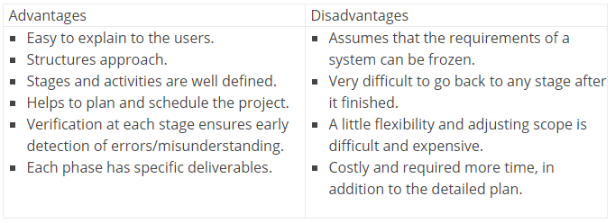

Slide 55
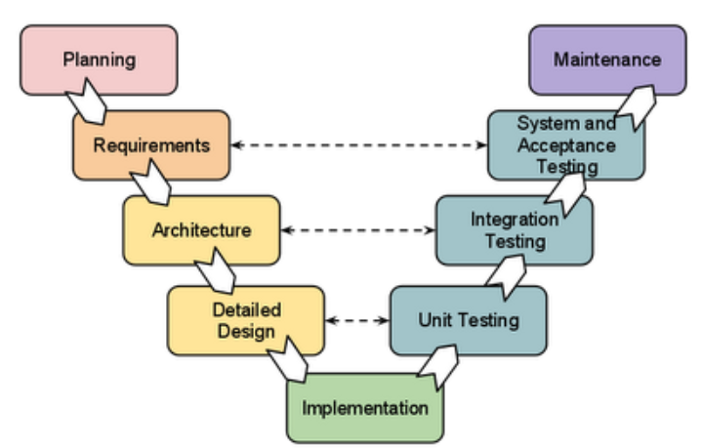
V-Shaped Model
Difference between V-shaped model and waterfall model is the early test planning in the V-shaped model

Slide 56
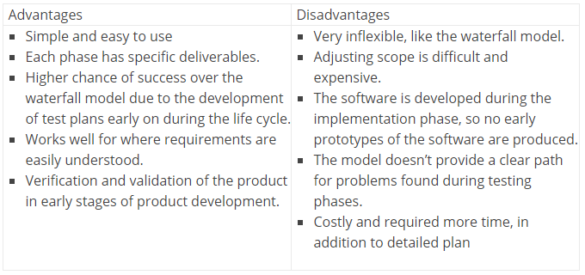

Slide 57
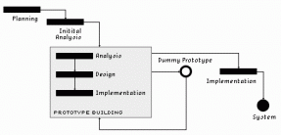
Prototyping Model
Activity of creating prototypes
(Throwaway prototyping)

Slide 58
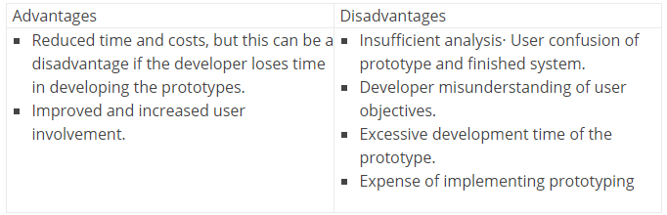

Slide 59
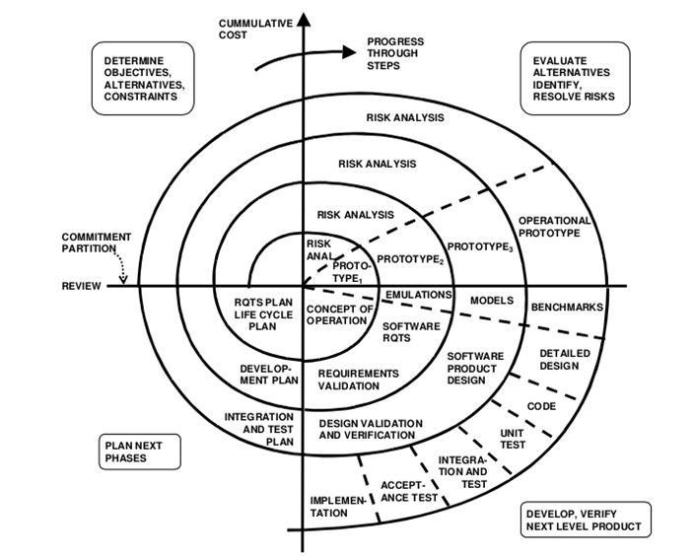
Spiral Model (SDM)
Combines elements of both design and prototyping-in-stages
Features from prototyping model and the waterfall model
Favored for large, expensive, and complicated projects

Slide 60
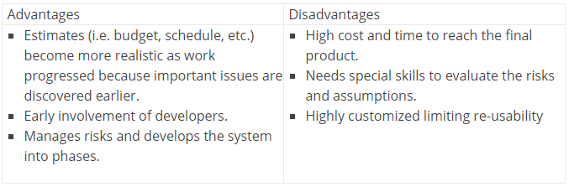

Slide 61
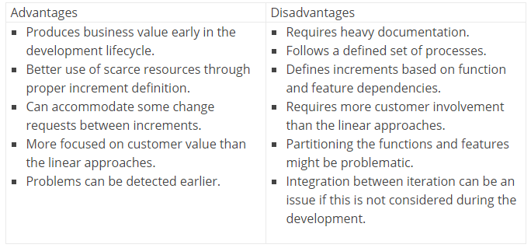
Iterative and Incremental Model
Starts with an initial planning and ends with deployment with the cyclic interactions in between

Slide 62
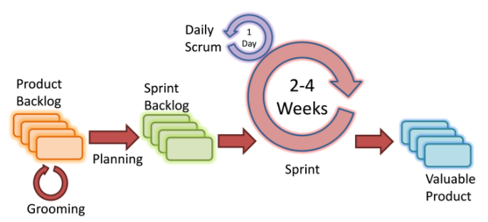
Agile Model
Based on iterative and incremental development, where requirements and solutions evolve through collaboration between cross-functional teams

Slide 63
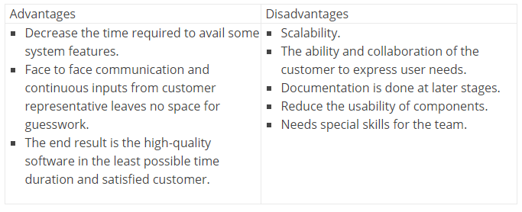

Slide 64
Summary
Clear idea of Processes in Object Orientated Analysis and Design
Iterative and incremental development lifecycle
Software development process framework (Software Development Lifecycle)
waterfall, iterative, agile, plan-driven, and so on

Slide 65
This Week
Review Slides
Read Chapter 7
Online Quizzes
Crossword Challenge

Slide 66
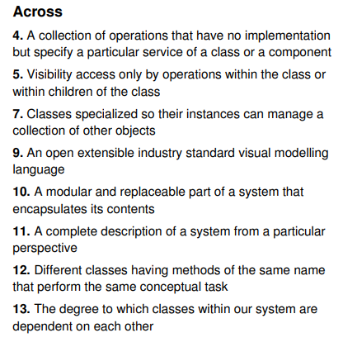
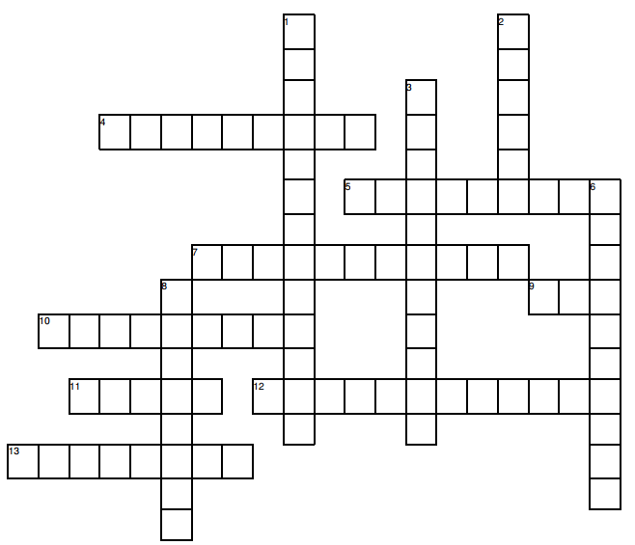
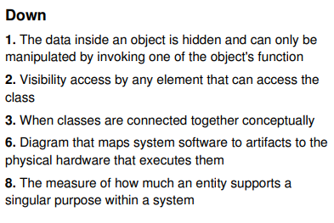
Crossword Challenge

Slide 67
Questions/Discussion

Slide 68
Question
Having the most suitable process model will justify success of the project
(Explain your answer)
True
False

Slide 69
Answer
b) False
There are a lot of factors that need to be considered for a successful software project, for example, requirement analysis is the most critical phase of software life-cycle, the skills of the project team and project manager, the quality of the deliverables, the used technologies, and so forth

