Slide 1
HTML Fundamentals
Web Authoring and Design
Benjamin Kenwright

Slide 2
Outline
Review Last Week
What do we mean by HTML Fundamentals
Essential Tags/Formatting
Examples
Summary
Review/Discussion

Slide 3
Last Week
Read Chapters 1, 2 and 3
Created a Simple Webpage
  E.g., notepad to create hello.html
  Test it locally (e.g., local computer in Chrome or Explorer)
  Experiment (e.g., different tags, typing mistakes, mobile browser, …)
  Setup GitHub Account/Webpage
    (submit URL today)

Slide 4
Question
What type of webpage would you like to be able to create at the end of this course?

Slide 5
HTML Documents
HTML source document
  A text-only document
  Consists of (1) actual text, and (2) tags
A tag is an html code that is enclosed in angel brackets <>; used to lay out the web page.
XHTML is a simple, more standardized version of HTML
XHTML/HTML can be created using a simple text editor like notepad
File extension must be .html or .htm

Slide 6
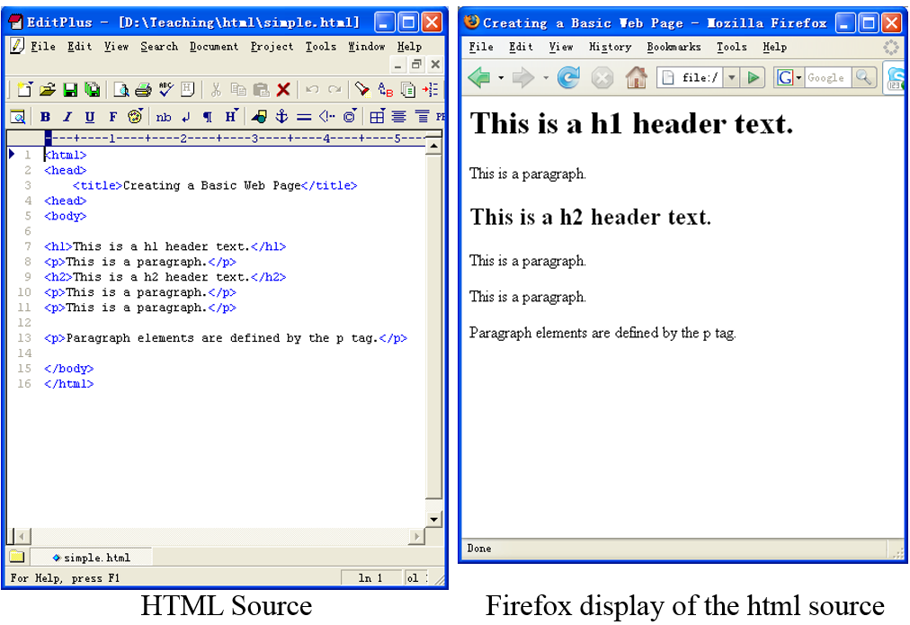


Slide 7
HTML, XML, XHTML
XML (eXtensible Markup Language):
  Is a set of rules that lets web designers classify their data in a way customized to their needs.
  Extendable by creating new types of tags.
XHTML (eXtensible HyperText Markup Language):
  A new version of HTML based on XML
  Inherits strict syntax rules of XML

Slide 8
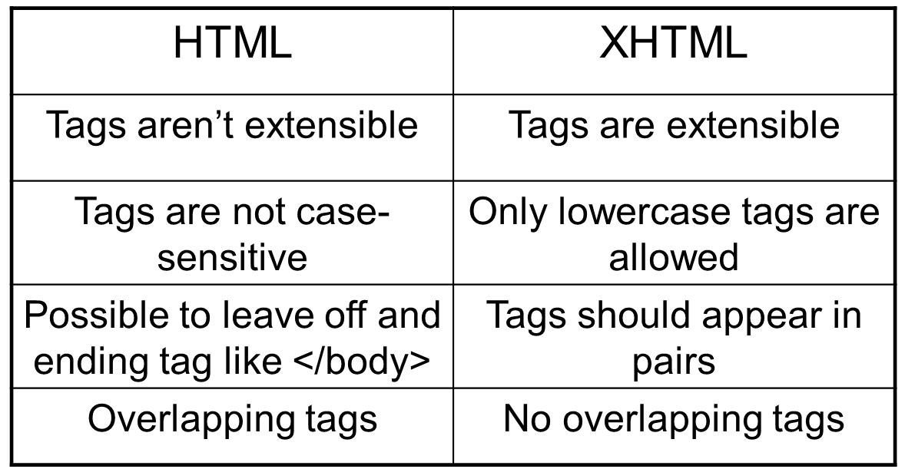
HTML vs XHTML
Some comparisons of HTML vs. XHTML

Slide 9
HTML & XHTML
Note
Single `tags’
  E.g., <br /> doesn’t require a closing </br> tag
  HTML 4 does not require the `/’ in empty tags, XHTML does

Slide 10
Tags (Elements)
Tags are also called elements
An attribute is a special code that can enhance or modify a tag. They are generally located in the starting tag after the tag name.
Basic syntax for xhtml tags and attributes
  <tag attribute="value"> </tag>
  All tags must be lower case
  all values of attributes need to surrounded by quotes

Slide 11
Blocks of Text
<h1>, .. <h5> 6 levels of headings available, ranging from <h1> to <h6>, 1 being the most important one
<blockquote> .. </blockquote> Blockquotes are used to identify a citation.
<p>..</p> Paragraphs

Slide 12
Small parts within a
Block of Text
Paragraphs and lists are meant to identify whole blocks of text, we sometimes want to provide meaning to a word (or a few words) within a text
default, <strong> elements are displayed in bold
default, <em> elements are displayed in italic
<abbr> element
  I just bought a <abbr title="Compact Disc">CD</abbr>

Slide 13
Small parts within a
Block of Text (Cont)
Inline quotes
  He said <q>“Hello World”</q> and just left
Plenty of other inline semantic elements
  See HTML element reference documentation for a comprehensive list

Slide 14
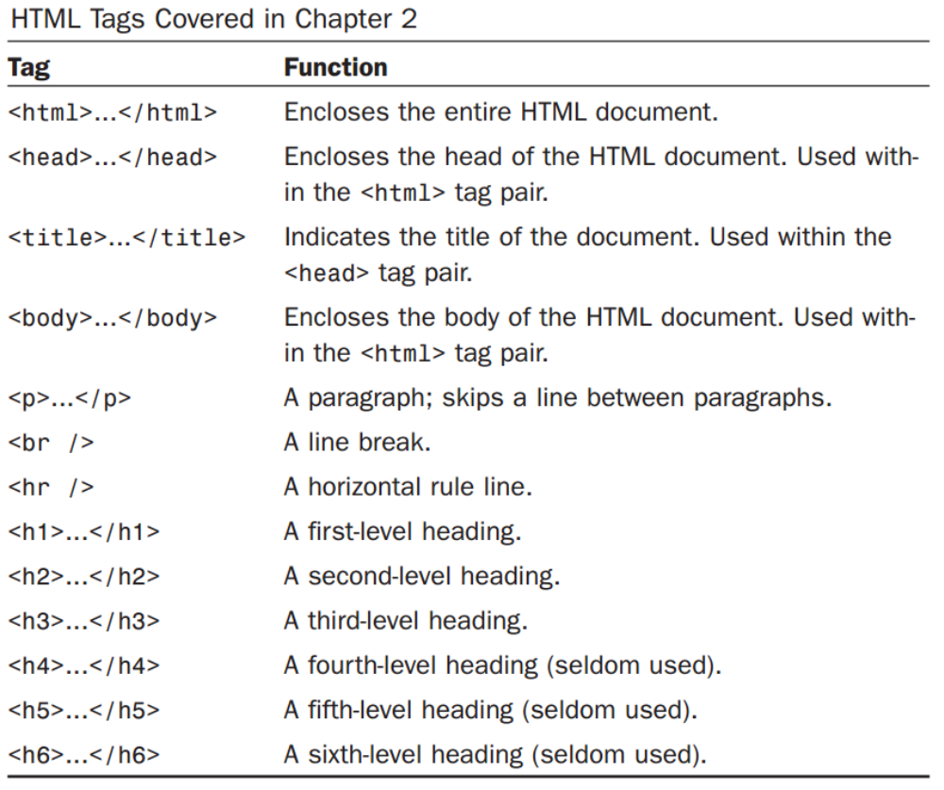
Review Basic Tags

Slide 15
Power of Links
The true power of WWW comes with hyperlinks
Surfer click on a specially marked word or image on a web page and automatically be jumped to another web page or another place in the same web page.
  Another web page – External link
  Another place – Internal link
Use <a> (anchor) tag to create a link

Slide 16
Hyperlinks
To search for something, visit
<a href="http://www.bing.com">Bing</a>
There are 3 types of target you can define.
anchor targets, to navigate within the same page
relative URLs, usually to navigate within the same website
absolute URLs, usually to navigate to another website

Slide 17
Anchor targets
Anchor target to navigate within the same page. By prepending your href with #, you can target an HTML element with a specific id attribute.
For example, <a href="#footer"> will navigate to the <div id="footer"> within the same HTML document. This type of href is often used to navigate back to the top of the page.

Slide 18
Relative URLs
If you want to define a link to another page of the same website, you can use relative URLs
But relative to what? Well, relative to the current page
Go to the <a href="contact.html">contact page</a>

Slide 19
Absolute URLs
This URL can be segmented in 3 parts:
protocol http://
domain ireallylovecats.com
file path gallery.html
This absolute URL is self-sufficient: no matter where you use the link form, it contains all the information required to find the correct file, on the correct domain, with the correct protocol
Cats on my page <a href="http://www.cats.com/index.html"> Link</a>

Slide 20
Images
Images use the <img> element
<img src="spacecraft.jpg">
Also specify attributes:
<img src="spacecraft.jpg " alt=“SpaceShip" height="42" width="42">
If you use `animated’ .gif files – the animations will play in the browser

Slide 21
Tables <table>
HTML tables are meant for tabular data only, which is any type of content that can be semantically arranged in rows and columns
Syntax - Building a table in HTML requires a specific structure:
  open a <table>
  add rows with <tr>
  add regular cells with <td> or heading cells with <th>

Slide 22
Tables <table>
Tables used not only for displaying data in tabular format
A table (<table>) in HTML
  Consists of rows (<tr>)
  Each row consists of rectangular boxes called cells (<td>)
  <table>
  <tr><td>R1,Cell1</td><td>R1,Cell2</td></tr>
  <tr><td>R2,Cell1</td><td>R2,Cell2</td></tr>
  </table>

Slide 23

Table Example
<table>
<tr>
<td>John Lennon</td>
<td>Rhythm Guitar</td>
</tr>
<tr>
<td>Paul McCartney</td>
<td>Bass</td>
</tr>
</table>

Slide 24
thead, tfoot and tbody
Just like a webpage can have a header and a footer, a table can have a head, a body, and a foot

Slide 25
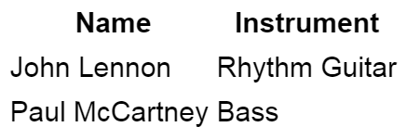
thead, tfoot and tbody
<table>
<thead>
<tr>
<th>Name</th>
<th>Instrument</th>
</tr>
</thead>
<tbody>
<tr>
<td>John Lennon</td>
<td>Rhythm Guitar</td>
</tr>
<tr>
<td>Paul McCartney</td>
<td>Bass</td>
</tr>
</tbody>
</table>

Slide 26
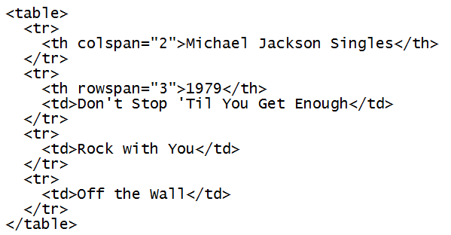
colspan and rowspan
You can merge columns or rows by using the rowspan and colspan respectively

Slide 27
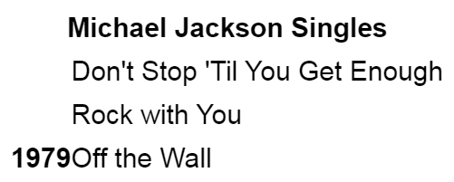
colspan and rowspan
The “Michael Jackson Singles” cell spans across 2 columns, so the following row includes two cells.
Because the cell “1979” spans across 3 rows, the 2 following rows only include a one cell, to allow space for the “1979” column.

Slide 28
Attributes (Revisited)
An attribute is a special code that can enhance or modify a tag. They are generally located in the starting tag after the tag name.
Basic syntax for xhtml tags and attributes
  <tag attribute="value"> </tag>
  All tags must be lower case
  all values of attributes need to be surrounded by quotes

Slide 29
Common Attributes
id
  unique identifier for elements
class
  the class of the element, used to specify similar attributes for dissimilar elements by putting them in the same class
style
  an inline style definition
title
  a text to display in a tool tip

Slide 30
Example Attributes
Examples 1
  <p id=“firstParag” class=“indent” title=“This paragraph introduces html attributes”>
  Assuming style sheet contains
  .indent { margin-right: 5%; margin-left: 5%;}
Example 2
  <p id=“firstParag” style=“margin-right: 5%; margin-left: 5%;” title=“This paragraph introduces html attributes”>

Slide 31
Attributes Cont.
lang
  sets the language code; “en”: English, “fr”: French, “es”: Spanish, “de”: German etc.
dir
  sets the text direction, left to right or right to left
<p lang=“fr” dir=“ltr”>bonjour!</p>
accesskey
  assigns an access key to an element. An access key is a single character from the document character set.
tabindex
  Sets the tab order of an element

Slide 32
Deprecated Attributes
In order to separate structure from presentation many HTML attributes/tags used for presentation were deprecated, starting from HTML version 4
Some deprecated attributes
  font, <font size=“5” color=“red”>Text</font>
  align, <p align=“center”>Centered text</p>
  bgcolor, width, height, etc.

Slide 33
List
Ordered lists & Unordered lists
  <ol> for ordered
  <ul> for unordered
  <li> for each item inside the list
Browser inserts a blank line before & after the list (block-level element)
Example
  <ol> <li>Item 1</li> <li>Item 2</li> <li>Item3</li> </ol>

Slide 34
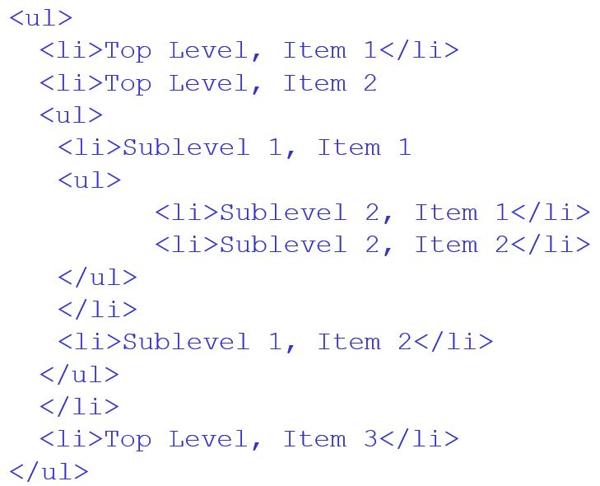
Nested lists

Slide 35
Customizing List Display
List numbers or marks can be customized
  “type” attribute
Example
  <ul type=“square”>
  <ol type=“A”>
  <ol type=“a”>
  <ol type=“I”>
  <ol type=“i”>
“type” attribute is not allowed in XHTML 1.0 Strict, so use style sheets instead

Slide 36
Definition Lists
<dl> for “list element”;
<dt> for “definition terms”;
<dd> for “definition data”
Example
  <dl>
  <dt><strong>CPU</strong></dt>
  <dd>Central Processing Unit</dd>
  <dt><strong>ALU</strong></dt>
  <dd>Arithmetic Logic Unit</dd>
  <dt><strong>GHz</strong></dt>
  <dd>Gigahertz</dd>
  </dl>

Slide 37
Summary
Overview of HTML Fundamentals
Hands-On/Practical
Thinking about Designing your Website
  Multiple .html documents, content, structure, …. (works and doesn’t work on a webpage) – easy to for the user to navigate/understand

Slide 38
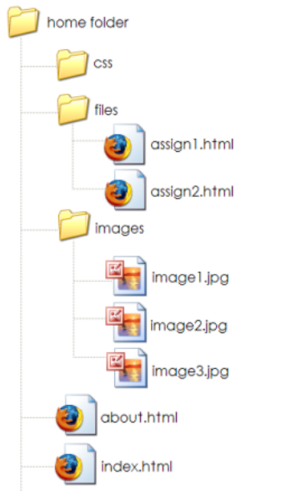
This Week
Read Chapters 5, 6, 7
Github Webpage
  xxxxx.github.io
  Multiple file/structure
Review Slides
Experiment and implementing various HTML features (e.g., multiple pages, images, tables, formatting, …)
Quizzes

Slide 39
Questions/Discussion
Revision Questions

Slide 40
Question
1. Which of the following is an example of an IP address?
a. www.whitehouse.gov
b.http://www.whitehouse.gov/history/index.htm
c. .gov
d. 216.43.187.162

Slide 41
Answer
Answer: d

Slide 42
Question
When you are browsing the Web and viewing web pages, your computer is
acting as a:
a. telent
b. client
c. server
d. packet

Slide 43
Answer
Answer: b

Slide 44
Question
Basic syntax for XHTML tags and attributes is:
a. <tag attribute=value> </tag>
b. <tag attribute=value> <tag>
c. <tag attribute=”value”> <tag>
d. <tag attribute=”value”> </tag>

Slide 45
Answer
Answer: d

Slide 46
Question
The XHTML code <a href=“http://www.zjnu.cn /”>CS Department at School</a> will create a _________ to CS web page:
a. internal link
b. external link
c. anchor
d. combination link

Slide 47
Answer
Answer: b

Slide 48
Question
What does HTML stand for?
a. Hyperlinks and Text Markup Language
b. Home Tool Markup Language
c. Hyper Text Markup Language

Slide 49
Answer
Answer: c

Slide 50
Question
Choose the correct HTML tag for the largest heading
a. <head>
b. <heading>
c. <h6>
d. <h1>

Slide 51
Answer
Answer: d

Slide 52
Question
What is the correct HTML tag for inserting a line break?
a. <lb>
b. <break>
c. <br>

Slide 53
Answer
Answer: c

Slide 54
Question
Choose the correct HTML tag to make a text bold
a. <btext>
b. <bold>
c. <b>
d. <strong>

Slide 55
Answer
Answer: d

Slide 56
Question
Choose the correct HTML tag to make a text italic
a. <italics>
b. <i>
c. <it>
d. <em>

Slide 57
Answer
Answer: d

Slide 58
Question
What is the correct HTML for making a hyperlink to ZJNU Computer Science website?
a. <a name="http://www.zjnu.edu"> ZJNU CS</a>
b. <a href="http://www. zjnu.edu"> ZJNU CS</a>
c. <a url="http://www. zjnu.edu"> ZJNU CS</a>
d. <a src="http://www. zjnu.edu">ZJNU CS</a>

Slide 59
Answer
Answer: b

Slide 60
Question
How can you make a list that lists the items with numbers?
a. <ol>
b. <ul>
c. <dl>
d. <list>

Slide 61
Answer
Answer: a

Slide 62
Question
What is the correct HTML for inserting an image?
a. <img href="image.gif>
b. <image src="image.gif">
c. <img>image.gif</img>
d. <img src="image.gif">

Slide 63
Answer
Answer: d

Slide 64
Question
A browser is a software program which interprets the HTML documents and displays it on the user’s screen.
True
False

Slide 65
Answer
True

Slide 66
Question
A tag is an html code that is enclosed in angel brackets (<>), and it's used to lay out the web page.
True
False

Slide 67
Answer
Answer: True

Slide 68
Question
In XHTML, both uppercase and lowercase tags are allowed for tag names.

Slide 69
Answer
Answer: False

Slide 70
Question
The following XHTML code will display all the lowercase English characters on screen:
<!-- abcdefghijklmnopqrstuvwxyz-->

Slide 71
Answer
Answer: False

Slide 72
Question
The following is a legitimate XHTML code:
<em><h2>Bold and italic</h2></em>

Slide 73
Answer
Answer: False

Slide 74
Question
Domain Name System (DNS) translates the IP address of a host into its human-readable name (domain name).

Slide 75
Answer
Answer: False

Slide 76
Class Quiz
Class Quiz
  30 Questions/30 Minutes
  Multiple Choice

