Slide 1
Introduction to Javascript
Web Authoring and Design
Benjamin Kenwright

Slide 2
Next Week
Revision Week
No Lectures

Slide 3
Outline
Review
What is Javascript?
Javascript Examples/Syntax
Summary
Review/Discussion

Slide 4
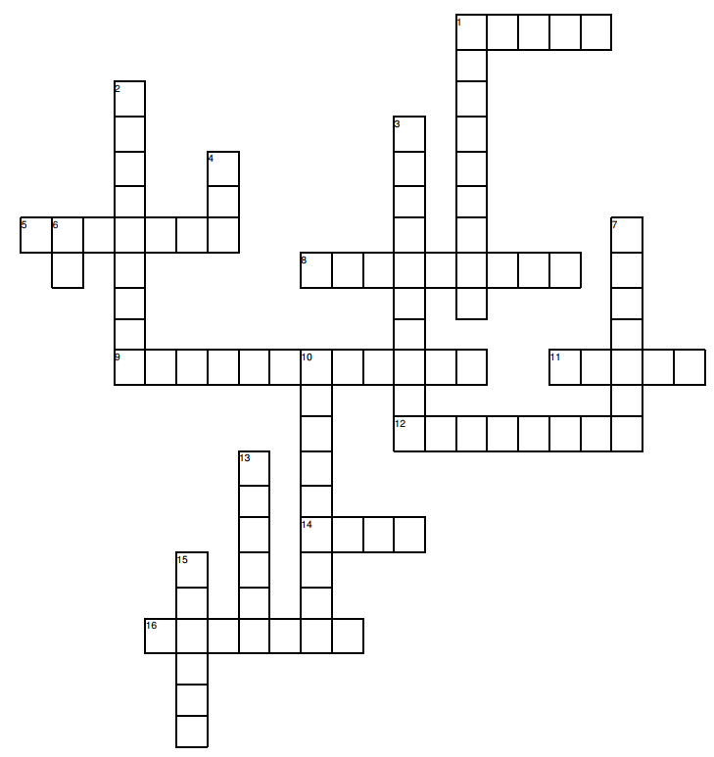
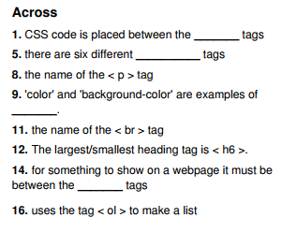
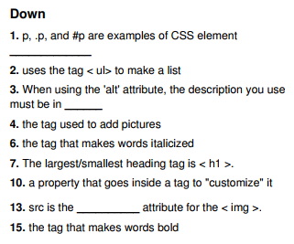
Solutions Puzzle
Print out/or copy out your answers and bring them with you for this lesson

Slide 5
Review
Javascript between the tags
< script >
...
< /script >

Slide 6
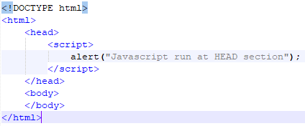
Review
Simple Javascript Example

Slide 7

Popup boxes
JavaScript introduced three dialog boxes that work well enough for alerting, confirming and prompting for values

Slide 8
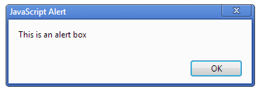

Alert Boxes
These dialog boxes are helpful to raise and alert, or to get confirmation on any type of input from the user

Slide 9
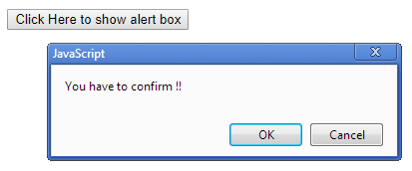
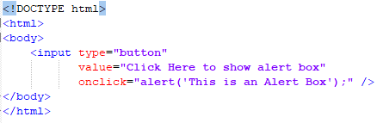
Button Triggers

Slide 10
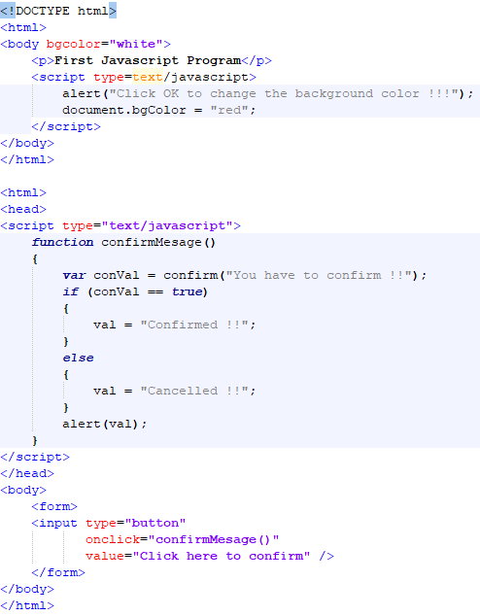
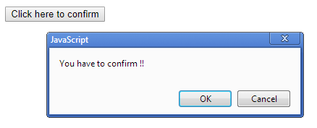
Confirm Dialog

Slide 11
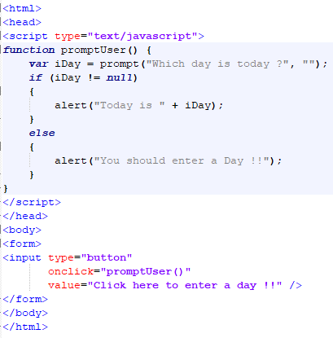
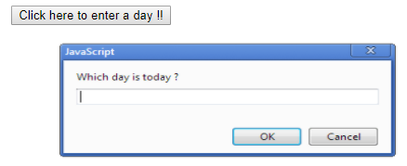
Prompt Box

Slide 12
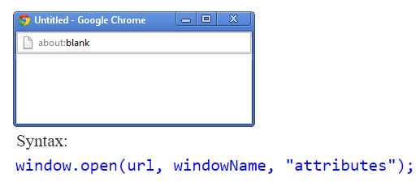
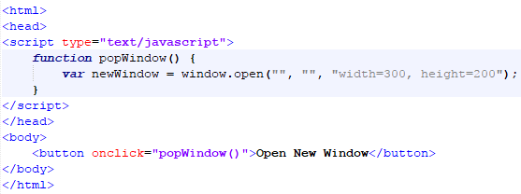
Javascript Popup Window

Slide 13
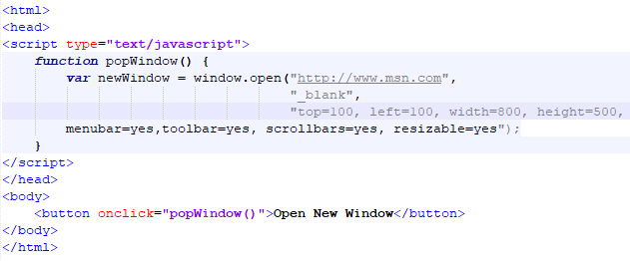
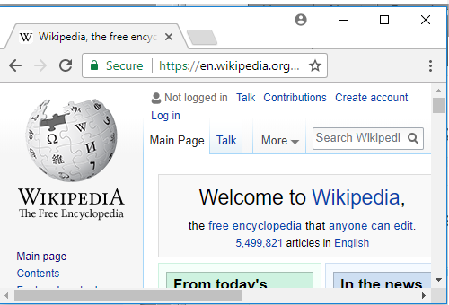
Parameters New Window

Slide 14
This Week
Review Slides
Read Associated Chapters
Weekly Tasks
Update GitHub Account/Webpage
Online Quizzes

Slide 15
Summary
Overview of Javascript
Basic Formatting
Script, Functions, ...
Altering webpage operation (through Javascript)
Hands-On/Practical

Slide 16
Questions/Discussion

Slide 17
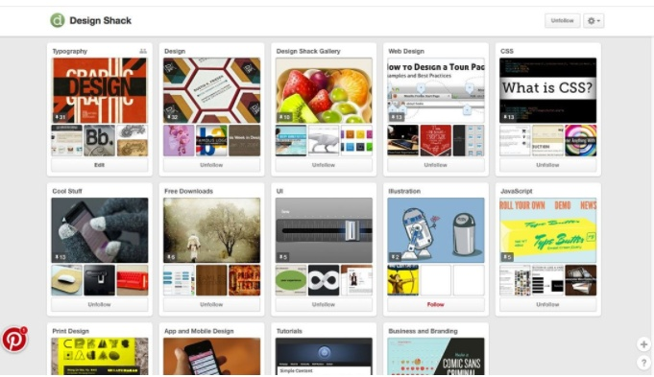
Challenge
Implement a Pinterest type website that uses cards for everything, including navigation, to help users move through the site. It’s one of the most effective outlines employing card-style design out there. Users of all ages seem to figure it out with ease.

Slide 18
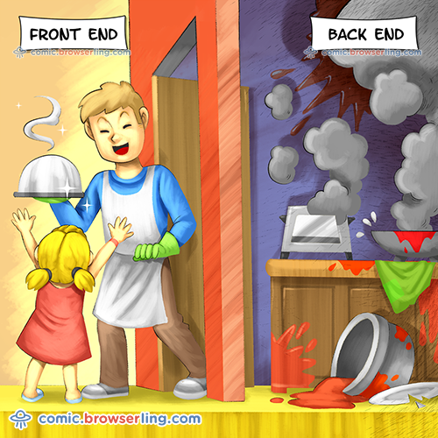
Modern Web Development

