Slide 1
Introduction
Web Authoring and Design
Benjamin Kenwright

Slide 2
Outline
What do we mean by Web Authoring and Design?
What is HTML, CSS and Javascript
Structure of the Course
Assessment/Marking
Review/Discussion

Slide 3
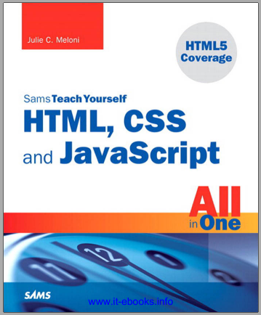
Recommended Reading
SamsTeachYourself HTML, CSS and JavaScript All in One
  Ebook Available
  https://zjnu2017.github.io/WAD
Chapter 1, 2 and 3
  Read This Week

Slide 4
Recommended
Also read around the subject to gain a broad/comprehensive understanding of the topic
  Articles, books, online-tutorials, …
Huge number of examples/tutorials online to complement this course

Slide 5
Grading
1. Attendance: 5%
2. Quiz: 15%
3. Individual Project: 10%
4. Group Project: 20%
5. Final Exam: 50%

Slide 6
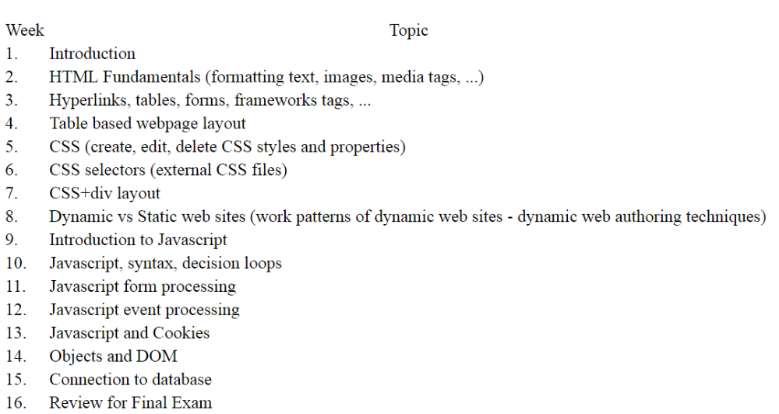

Structure

Slide 7
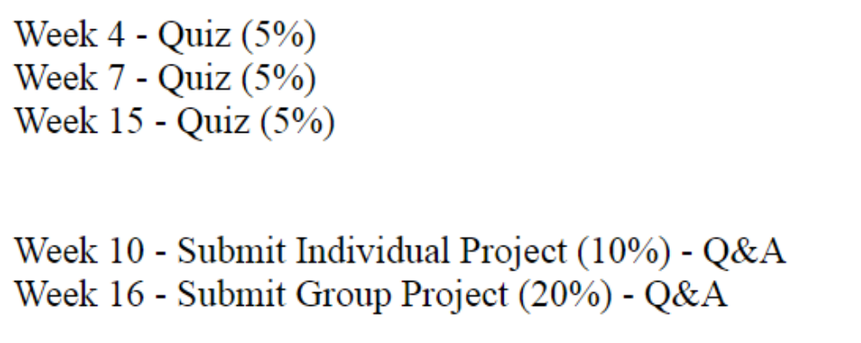
Submission Dates

Slide 8
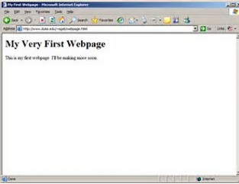
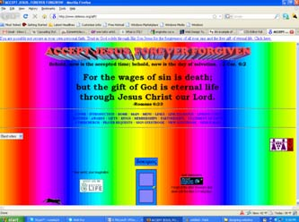
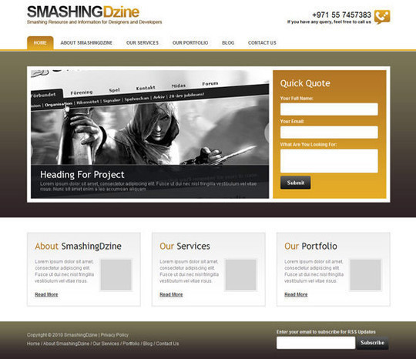
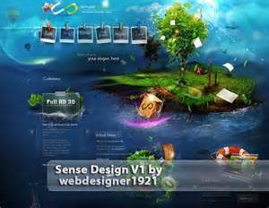
Expect

Slide 9

What is a Web Browser?

Slide 10
What is a Web Browser?
A browser is a document viewer. What kind of document? Webpages

Slide 11
What is a Webpage?

Slide 12
What is a Webpage?
Webpages are just text files with a .html extension
Webpages are HTML documents, like other files on your computer (e.g., .doc, .jpg, ..)
HTML is like MS Word but for the Web
Webpages follow a predefined file format
Learn this file format so you can create your own webpages

Slide 13

What does HTML look like?
HTML code looks like this:
The browser sees the <p> and </p> tags and understands that Hello World is a paragraph
`Tag’ based language

Slide 14
As any language,
HTML has rules
HTML stands for HyperText Markup Language:
HyperText means that it uses the HTTP part of the Internet
Markup means the code you write is annotated with keywords
Language means it can be read by both a human and a computer
Like any language, HTML comes with a set of rules. These rules are relatively simple. It comes down to defining boundaries, to know where something starts and where something ends.

Slide 15
Brackets
Here is a sample paragraph in HTML:
<p>Once upon a time…</p>
What you see in angle brackets < and > are HTML tags. They define where something starts and where it ends
p stands for paragraph

Slide 16
Start – End Tags
Tags usually go in pairs:
For example, with the paragraph:
  the opening tag <p> defines the start of the paragraph
  the closing tag </p> defines its end
Only difference between an opening and closing tag is the slash / that precedes

Slide 17
First Webpage
Create empty text file (e.g., .txt but you’ll change the extension to .html)
Type the following:
  <p>This is my firstwebpage!</p>
Save the file as ‘hello.html’
Open the file in your browser (e.g., Chrome or Explorer)

Slide 18
Tag Attributes
Tags can have additional information
For example, the href attribute is used to define the target of a link (which uses an anchor tag)
<a href="http://www.cats.com">Cats</a>

Slide 19
Comments
Write text or information that is ignored by the browser (i.e., comments)
A comment starts with <!-- and ends with -->
<!-- This sentence ignored by the browser -->
<p>Hello World!</p>

Slide 20
Self-Enclosing Elements
<br> <!-- line-break -->
<img src=“./cat.jpg" alt="Description"> <!-- image -->
<input type="text"> <!-- text input -->

Slide 21
Errors
Order/Hierarchy
<!-- This is INVALID code! :-( -->
<p>This HTML code won't work because I the "strong" tag is opened here <strong>but is only closed after the paragraph.</p></strong>

Slide 22
Why?
Because the <strong> was opened after the <p> (and is thus considered a child of <p>), the <strong> element must be closed before its parent <p>
<!-- This is valid code. :-) -->
<p>This HTML code will work because I the "strong" tag is opened <strong>and closed</strong> properly.</p>

Slide 23
Important Note
Whitespaces and newlines don’t matter
i.e.,
  line-breaks
  empty lines
  tabulations (or indentation)
Use tags to control the formatting

Slide 24
A valid HTML document
Previously looked at isolated snippets
HTML document (or webpage, it means the same thing) requires a specific structure in order to be valid document

Slide 25
Complete Valid HTML Document
<!DOCTYPE html>
<html>
<head>
<meta charset="utf-8">
<title>MarkSheet</title>
<meta name="description" content="A simple HTML and CSS page">
</head>
<body>
<p>Hello World!</p>
</body>
</html>

Slide 26
Details
<DOCTYPE html>
  tell the browser the HTML document is a HTML 5 document (version details)
<html>
  all your HTML document must be wrapped inside
<head>
  Attributes/information for the whole webpage (metadata not meant to be displayed anywhere)
<body>
  Everything inside the <body> will be displayed in the browser window

Slide 27
Question
Which of the following are essential tags for a complete Valid HTML Document?
<html>,<body>,<hr>,<p>
<body>,<html>,<head>
<html>,<p>,<img>
<meta>,<title>,<doctype>

Slide 28
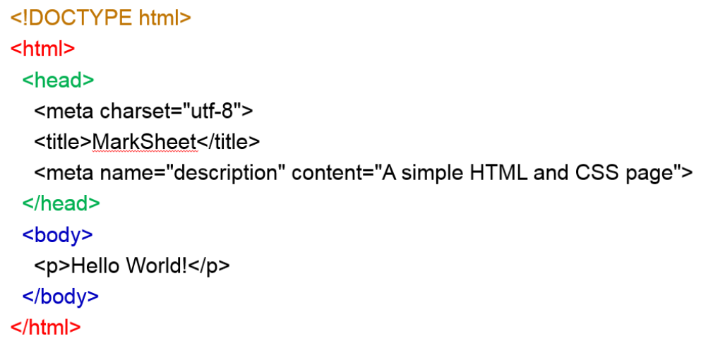
Answer
b) <body>,<html>,<head>

Slide 29

GitHub
Websites for you and your projects.
https://pages.github.com/
Free and Public
Track Changes
Useful for `Group’ Assessment
Research Setting Up GitHub Account this Week

Slide 30
For Example
Course notes/page for WAD are on a GitHub page:
zjnu2017.github.io

Slide 31
Question
How many marks are the quizzes worth?
5%
10%
15%
20%

Slide 32
Answer
c) 15%
3 class quizzes – each worth 5% each over the duration of the course

Slide 33
Summary
Overview of the Course/Plan
Hands-On/Practical
Assessment (Breakdown of Marks)
Self Study (Can’t learn from just attending)
Today is about `Getting Started’

Slide 34


This Week
Review Slides
Read Chapters 1, 2 and 3
Create a Simple Webpage
  E.g., notepad to create hello.html
  Test it locally (e.g., local computer in Chrome or Explorer)
  Experiment (e.g., different tags, typing mistakes, mobile browser, …)
  Setup GitHub Account/Webpage
Start Early

Slide 35


Contact
Questions/Issues
  Benjamin Kenwright
  email: bkenwright@ieee.org
Open Door Policy
  Problems/Help
  Within Reason

Slide 36
Question
What does HTML stand for?
Hypertext Markup Language
Hyper Tag Mark Language
Hypertext Makeup Language
Hot Moodle Language
Non of the above

Slide 37
Answer
a) Hypertext Markup Language
Hypertext Markup Language (HTML), a standardized system for tagging text files to achieve font, color, graphic, and hyperlink effects on World Wide Web pages.

Slide 38
What the Web is all about
The Web was created to share documents via Internet, and HTML is the language in which these documents are written
While text has always been the primary medium, HTML evolved to incorporate other types of content like images and videos
HTML content is 90% text

Slide 39
Questions/Discussion
Next Week
  Attendance
  Submit GitHub Page URL
  Questions on Chapters 1-3
  Scratched surface get you started
    Interactive pages, animations, forms, …
    Next week the real work starts
    Creating `amazing’ websites very soon

Slide 41
Experiment
What are good sites to quickly experiment with JavaScript/CSS/HTML on a browser?
http://dabblet.com/

