Slide 1
Introduction
Computer Graphics with Vulkan
Benjamin Kenwright

Slide 2
Outline
History of Computer Graphics
Why Vulkan API?
Structure of the Course
Assessment/Marking
Today’s Practical
Review/Discussion

Slide 3
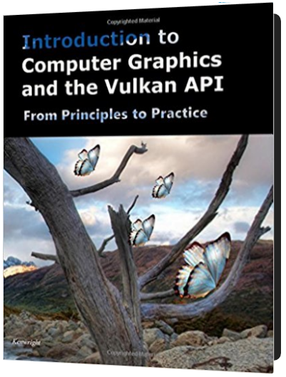
Recommended Reading
Introduction to Computer Graphics and the Vulkan API
  https://zjnu2017.github.io/CGV
Chapter 1 & 2
  Read This Week

Slide 4

Why Computer Graphics?

Slide 6
Summary
Overview of the Course/Plan
Hands-On/Practical
Assessment (Breakdown of Marks)
Self Study
  Can’t learn from just attending
Today is about `Getting Started’

Slide 7

Questions/Discussion

