Slide 1
Cascade Style Sheets (CSS)
Web Authoring and Design
Benjamin Kenwright

Slide 2
Outline
Review
What are Cascade Style Sheets (CSS)?
How to add CSS sheets to your HTML
CSS Examples
Summary
Review/Discussion

Slide 3
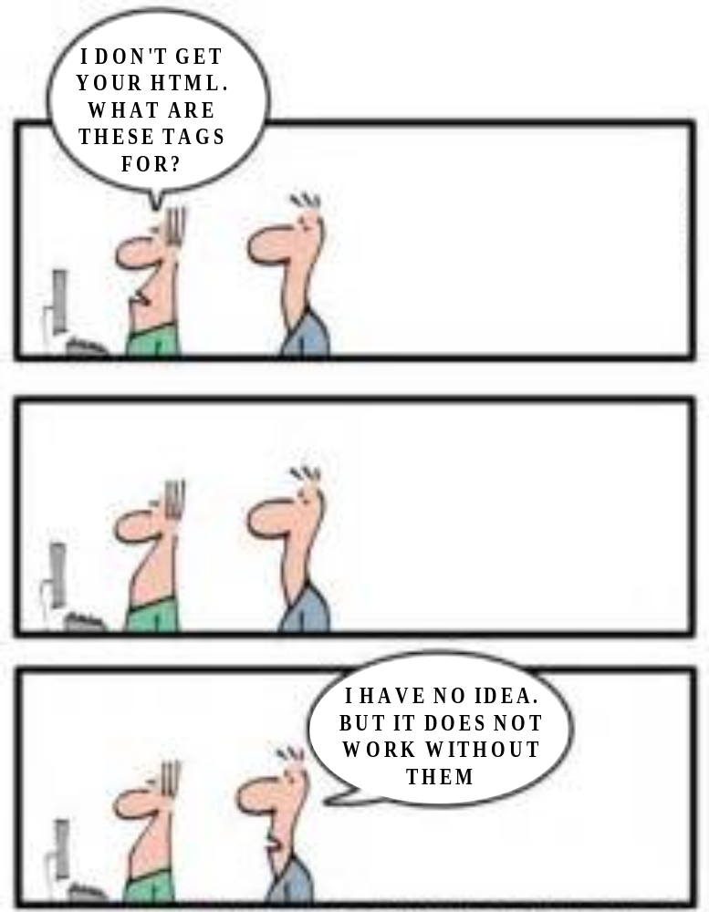

Know `YOUR’ HTML

Slide 4
HTML Evolved
As HTML evolved, it came to encompass a wider variety of stylistic capabilities to meet the demands of web programmers
Split a web document into 3 layers:
  content layer
  presentation layer
  behavior layer

Slide 5
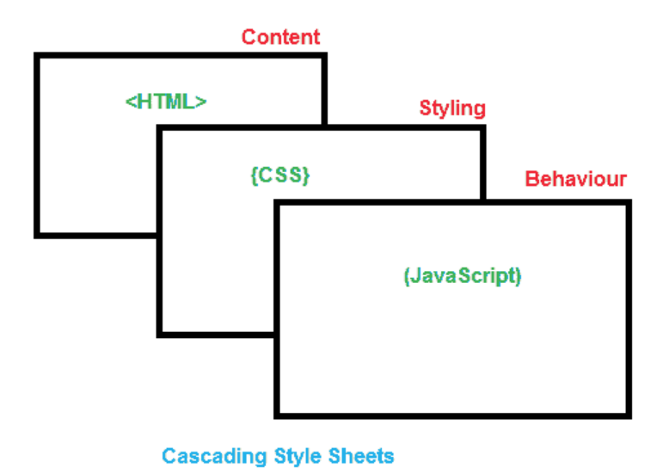
Standard
Sheets are now the official and standard mechanism for formatting text and page layouts

Slide 6
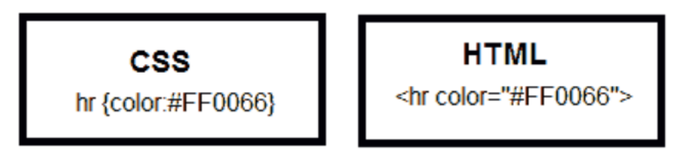
Divide and Conquer
While it’s possible to include all three layers within the same web document, but breaking them separate gives us one important advantage

Slide 7
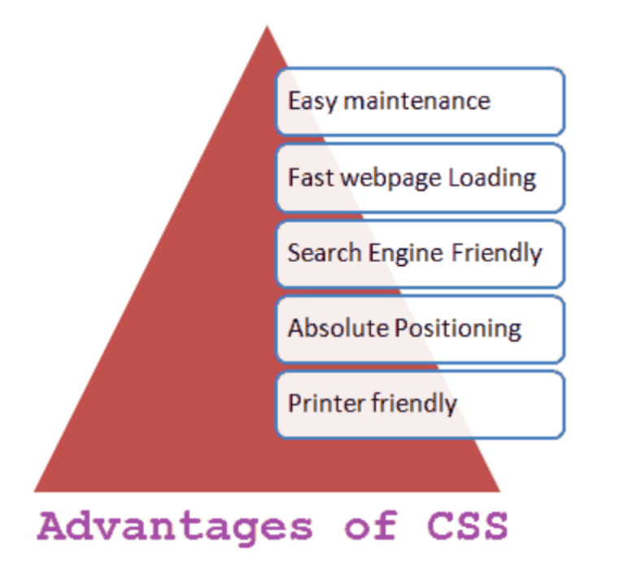
Advantages of CSS

Slide 8
Why use CSS?
One of the primary advantages of CSS is that it allows developers to separate content from its presentation layer
Edit multiple HTML pages at one time by editing a single Style Sheet file
Reduces file sizes and bandwidth usage.
CSS enable you to lay out web pages exactly as you want them

Slide 9
Control
Cascading Style Sheet (CSS) is a separate language with its own syntax, which is enable you to lay out web pages exactly as you want them.

Slide 10

Compatibility

Slide 11
World Wide Web Consortium (W3C)
World Wide Web Consortium (W3C) controls the standard for defining the presentation of documents written in HTML.
CSS controls the presentation layer in a web document so that the web developer gains more degree of control over how the website would appears.

Slide 12
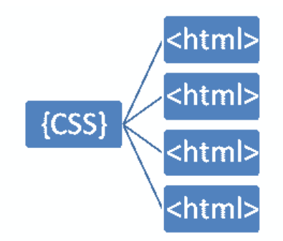
Separating Content & Presentation Layers
Style sheets (CSS) are designed primarily to enable the separation of HTML document content from document presentation layer

Slide 13
Fact
One single style sheet and it will reduces their size and bandwidth usage by more than 50% in many cases

Slide 14
File Extension
Cascade Style Sheets have a .css file extension . CSS has a simple syntax like HTML and uses a number of English keywords to specify the names of various style properties

Slide 15
CSS Versions
CSS Level 1 (CSS1) was officially released in 1996
CSS level 2 (CSS2) specification was developed by the W3C and published as a recommendation in 1998
The earliest CSS level 3 (CSS3) drafts were published in 1999
  CSS level 3 is divided into several separate documents called modules
There is no single CSS4 specification (yet)

Slide 16
How does CSS Work?
Cascading Style Sheet (CSS) is a completely different approach to webpage styling and layout
Document`s HTML content must combine with style information
For example:
  Content of a page goes into an HTML file, and the style information goes into a style sheet

Slide 17
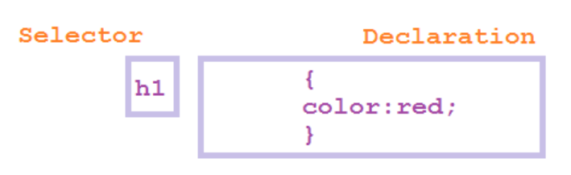
Linking
Cascading Style Sheet (CSS) works by allowing you to associate rules with the tags that appear in an HTML document

Slide 18
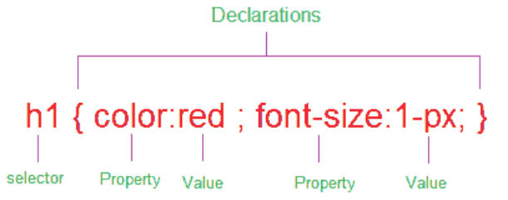
CSS Rules
Rules govern how the content of those elements should be rendered. A rule set consists of a selector followed by a declaration block

Slide 19
Declarations & Properties
CSS selectors are patterns used to select the elements you want to style:
  h1 {color:red} - here h1 is the selector
Declarations, which sets out how the elements referred within the selector should be styled
  h1 {color:red} - here color:red is declaration
Declaration is also split into two parts, separated by a colon : property and value

Slide 20
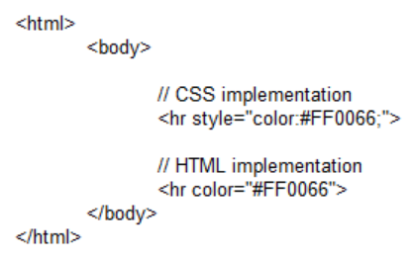
Example
A simple example Applying CSS and HTML tags in an HTML page

Slide 21

1. Inline Style

Slide 22

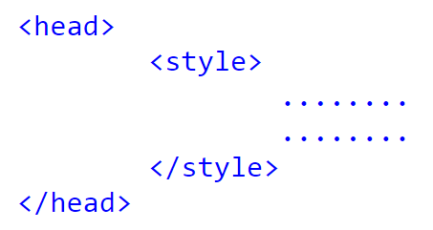
2. Embedded Style

Slide 23
Embedded Style Example
<html>
<head>
<title>Embedded Style Sample</title>
<style type="text/css">
h1{
color: #0000FF;
}
h2{
color: #00CCFF;
}
</style>
</head>
<body>
<h1>Embedded Style testing</h1>
<h2>Next Line</h2>
</body>
</html>

Slide 24
3. External Style
<link rel="stylesheet" type="text/css" href="styles.css" />

Slide 25
Example
.css File
h1{
color: #0000FF;
}
h2{
color: #00CCFF;
}s
.html File
<html>
<head>
<title>Embedded Style Sample</title>
<link rel="stylesheet" type="text/css"
href="styles.css" />
</head>
<body>
<h1>Embedded Style Example</h1>
<h2>Next Line</h2>
</body>
</html>

Slide 26
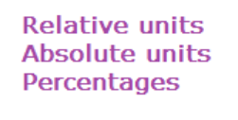
Lengths and Units

Slide 27
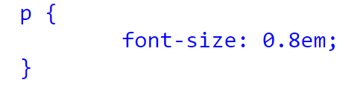
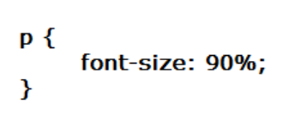
Examples
Relative units
  e.g., `em’
Absolute units
  e.g., ‘mm’, ‘cm’
Percentages
  e.g., ‘%’

Slide 28
Summary
Overview of Cascade Style Sheets
Advantages and implementation of CSS in HTML
Examples
Hands-On/Practical

Slide 29
This Week
Review Slides
Read Associated Chapters
Do this weeks Tasks
  Update Online GitHub Website
Online Quizzes

Slide 30


Questions/Discussion

Slide 31
