Slide 1
Introduction to Javascript
Web Authoring and Design
Benjamin Kenwright

Slide 2
Next Week
Revision Week
No Lectures

Slide 3
Outline
Review
What is Javascript?
Javascript Examples/Syntax
Summary
Review/Discussion

Slide 4
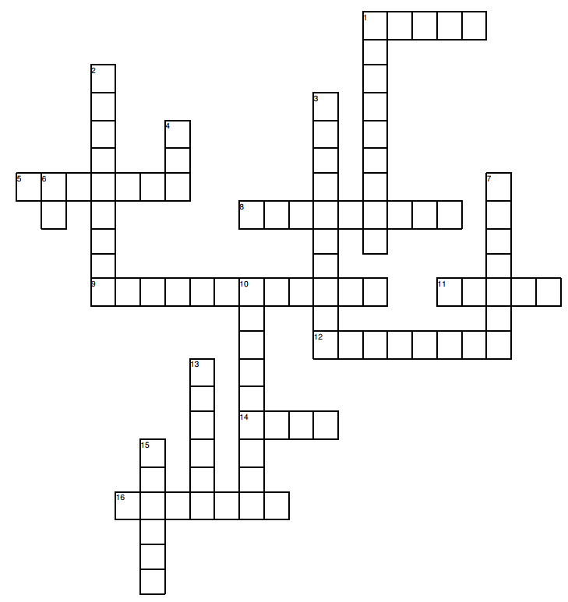
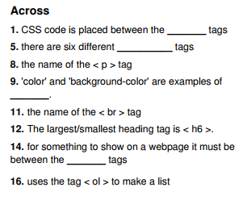
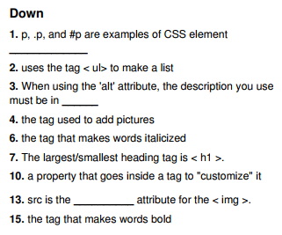
Solution Puzzle
Brought a copy with your answers to this lesson

Slide 5
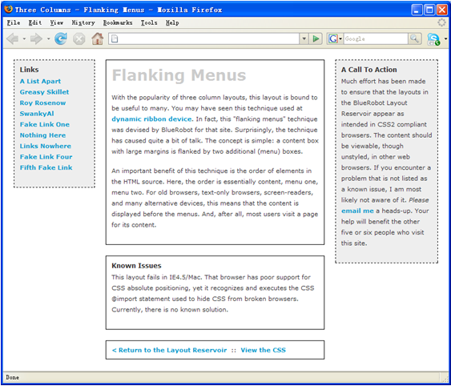
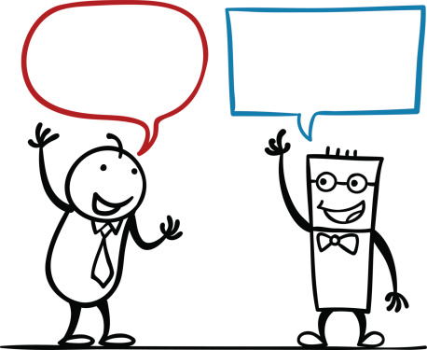
Activity
Write down on a piece of paper the CSS to display the following website design:
(5 Minutes)

Slide 6
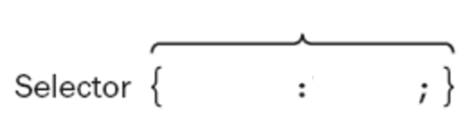
Question
What are the terms in CSS for the selector syntax:
?
?
?

Slide 7
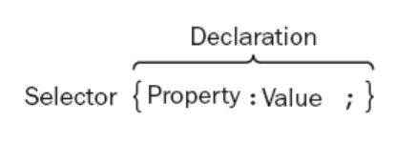
Answer
Selector Syntax

Slide 8
Answer
Three Columns Flanking Menu
#navBeta {
position:absolute;
width:168px;
top:20px;
right:20px;
border:1px dashed black;
background-color:#eee;
padding:10px;
z-index:1;
}
.content {
position:relative;
width:auto;
min-width:120px;
margin:0px 210px 20px 170px;
border:1px solid black;
padding:10px;
z-index:3; /* This allows the content to overlap the right menu in narrow windows in good browsers. */
}
#navAlpha {
position:absolute;
width:128px;
top:20px;
left:20px;
border:1px dashed black;
background-color:#eee;
padding:10px;
z-index:2;
}

Slide 9
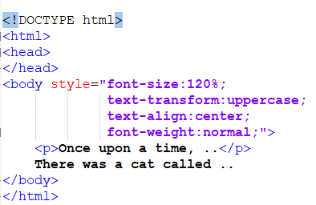
Question
What would the following HTML/CSS output?

Slide 10

Answer

Slide 11

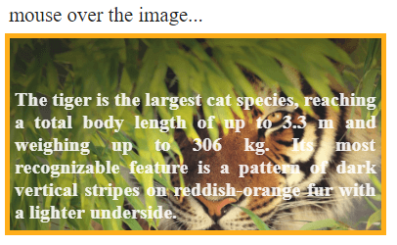
Question
Write the HTML/CSS to create an image hover text overlay

Slide 12
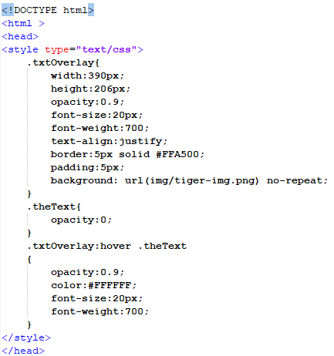
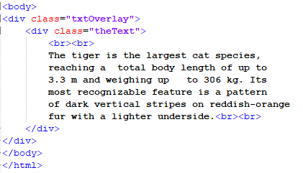
Answer

Slide 13
Review
Javascript between the tags
< script >
...
< /script >

Slide 14
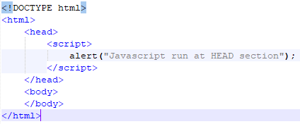
Review
Simple Javascript Example

Slide 15
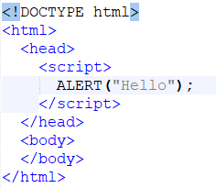
Question
What would the following HTML/JS output?

Slide 16
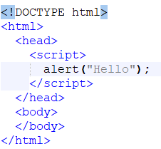
Answer
Nothing
Javascript is case-sensitive

Slide 17
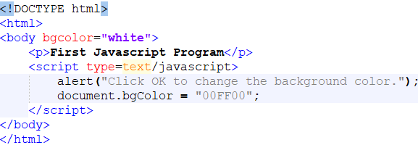
Question
What would the following HTML/JS do?

Slide 18
Answer
Popup, select OK, background changes to green

Slide 19

Popup boxes
JavaScript introduced three dialog boxes that work well enough for alerting, confirming and prompting for values

Slide 20
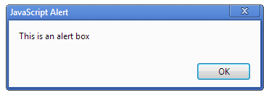

Alert Boxes
These dialog boxes are helpful to raise and alert, or to get confirmation on any type of input from the user

Slide 21
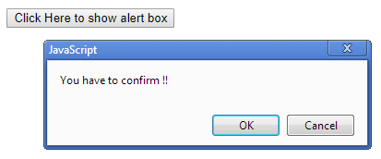
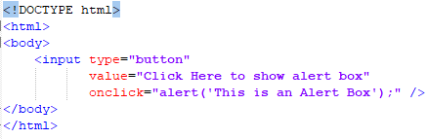
Button Triggers

Slide 22
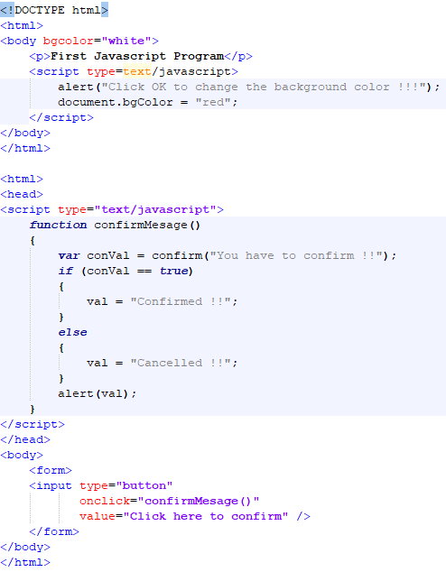
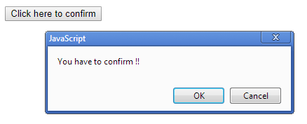
Confirm Dialog

Slide 23
Question
How do you declare a function in Javasscript? Write down an example HTML/JS program

Slide 24
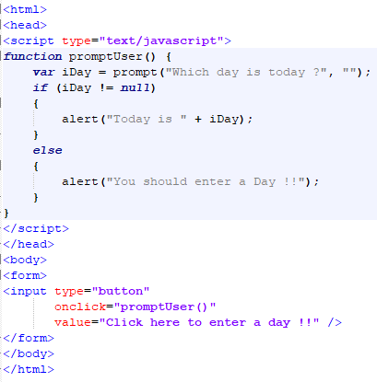
Answer

Slide 25
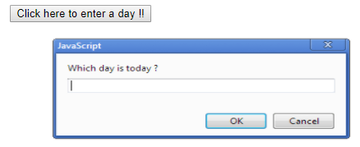
Prompt Box

Slide 26
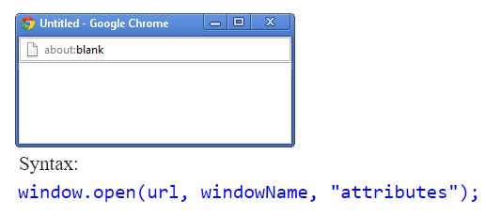
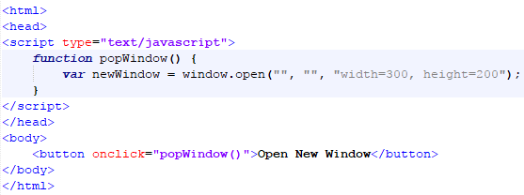
Javascript Popup Window

Slide 27
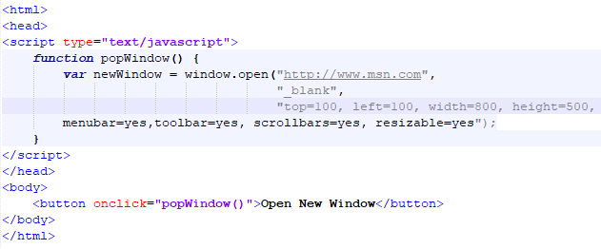
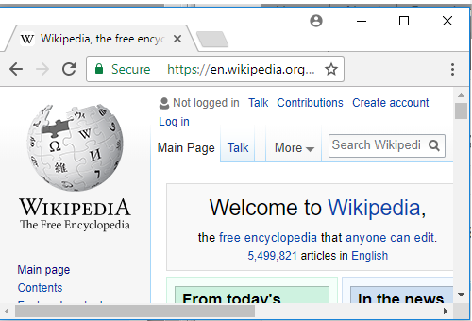
Parameters New Window

Slide 28
Question
Write a Javascript function which when called will open a new window

Slide 29
Answer

Slide 30
Question
How do you declare a variable in Javascript?

Slide 31
Answer
‘var’ keyword
e.g., var value = 0;

Slide 32
Question
Write a small HTML/JS example, which as:
1. Function
2. For loop
3. Confirm dialog
4. Triggered from the HTML
(e.g., when you click ‘go’)

Slide 33
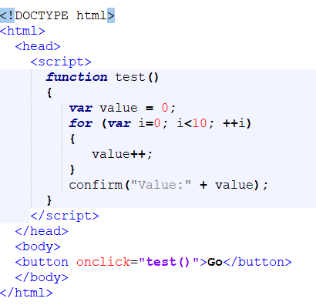

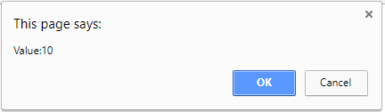
Answer

Slide 34
Question
Write a small HTML/JS script that shows a popup dialog asking you to enter a string

Slide 35
Answer

Slide 36
Summary
Overview of Javascript
Basic Formatting
Script, Functions, ...
Altering webpage operation (through Javascript)
Hands-On/Practical

Slide 37
This Week
*No Lecture Next Week
Revision Week
Review Slides
Read Associated Chapters
Weekly Tasks
Update GitHub Account/Webpage
Crossword
Online Quizzes

Slide 38
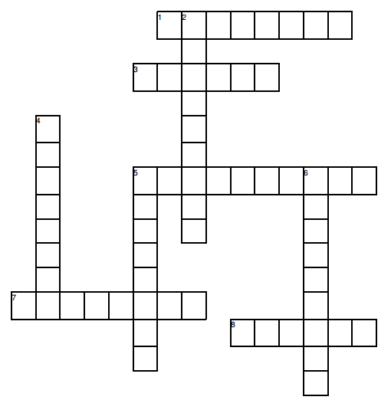
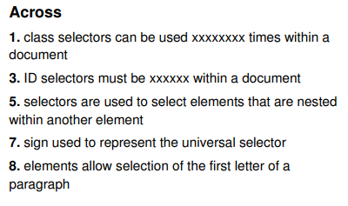
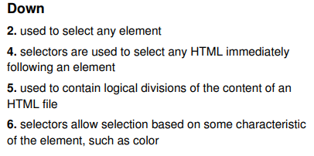
Crossword Puzzle Solve for Next Lesson
Print out the crossword with your solutions
and bring along to the next Lesson

Slide 39
Questions/Discussion

Slide 40
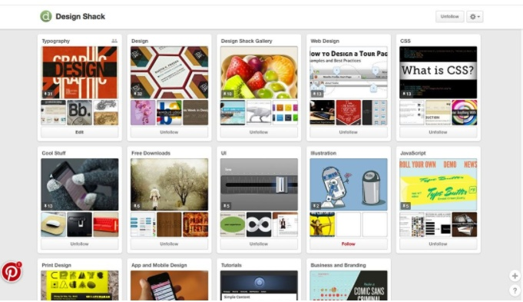
Challenge
Implement a Pinterest type website that uses cards for everything, including navigation, to help users move through the site. It’s one of the most effective outlines employing card-style design out there. Users of all ages seem to figure it out with ease.

Slide 41
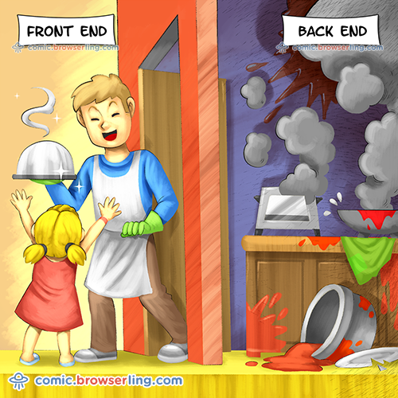
Modern Web Development

