Slide 1
CSS Div Layouts
Web Authoring and Design
Benjamin Kenwright

Slide 2
Outline
Review
Why use Div Layout instead of Tables?
How do we use the Div Tag?
How to create layouts using the CSS Div Tag?
Summary
Review/Discussion

Slide 3
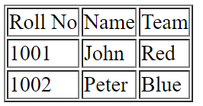
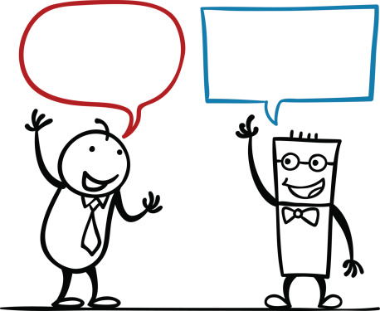
Activity
Write down on a piece of paper the HTML to display the following table:
(5 Minutes)

Slide 4
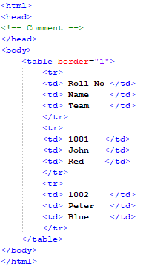
Answer

Slide 5
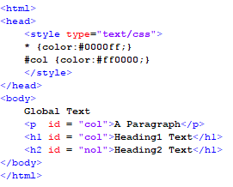
Question
What will the output be for the following HTML/CSS?

Slide 6
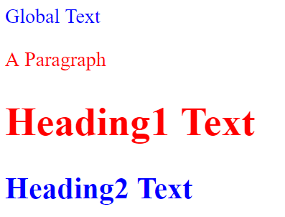
Answer

Slide 7

Question
What will happen in this case?
a) make that specific paragraph green
b) error
c) blank screen
d) none of the above

Slide 8
Answer
Answer: d)
Text will be displayed without style formatting (i.e., ‘Text’) – as the ‘colon :’ is missing

Slide 9

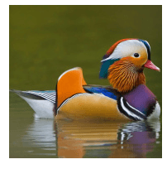
Revision Question
Write down the HTML/CSS code to create an ‘Image’ Rollover Effect
(5 Minutes)

Slide 10
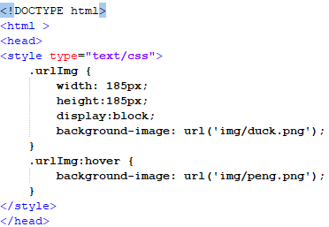

Answer

Slide 11
Table vs Div Layouts
table
Pros: supported by all browsers
Cons: bind style to content; hard to maintain
div
Pros: easy to maintain
Cons: not supported by all browsers
Commonly recommend – div, reasons:
CSS is to separate structure from content.
Supporting most common/popular browsers are enough. May be it’s time for some people to upgrade their browsers

Slide 12
What is Div Tag?
CSS Division (div) is a container element and it is used to group related items together
When ever there is a situation that you need to collect various objects into a larger container for scripting or styling purposes, div is the best solution
The use of <div> tag is straightforward

Slide 13
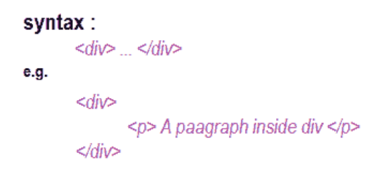
Div Syntax

Slide 14
CSS Division
CSS divisions to provide greater flexibility and mark out regions of the page.
You can use divs by referencing the selector in the opening tag using ID and CLASS
e,g. id="myContainer" or class="myContainer"

Slide 15
Div in an HTML document
<html>
<head>
<style type="text/css">
#box {
width: 420px;
height:120;
border-width: 2px;
border-style:solid;
border-color:red;
background: #CCC;
}
</style>
</head>
<body>
<div id="box">
<h1>Box Model</h1>
<p>
The Box model determines how elements are positioned within the
browser window. With the Box Model, a developer can control the
dimensions, margins, padding, and borders of an HTML element.
</p>
</div>
</body>
</html>
Output

Slide 16
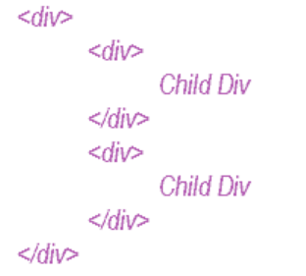
Nesting Div
The div element grouping a generic block of content that should be treated as a logical unit for scripting or styling purposes. A div can contain a number of other divs ( child div ) like HTML Tables. This is called Nesting Div

Slide 17
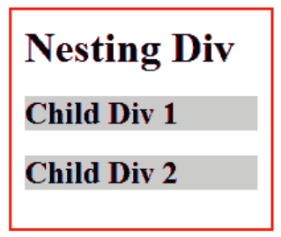
Nesting Div in an HTML page
<html>
<head>
<style type="text/css">
.parent {
width: 200px;
height:120;
border-width: 2px;
border-style:solid;
border-color:red;
padding:10px;
}
.child {
overflow : hidden;
background: #CCC;
}
</style>
</head>
<body>
<div class="parent">
<h1> Nesting Div</h1>
<div class="child">
<h2>Child Div 1</h2>
</div>
<div class="child">
<h2>Child Div 2</h2>
</div>
</div>
</body>
</html>
Output

Slide 18
Careful
Div elements very carefully and use only when it is necessary for logical structure or styling
Excessive use of Div tags can make a page difficult to manage/debug/extend

Slide 19
Div Layouts
Div tag allows you control over the appearance of your website
Commonly used for website layouts
(instead of tables)

Slide 20
Examples of Common Layouts
Variable width content:
2 columns - left menu
2 columns - right menu
3 columns
Centered (fixed width content):
2 columns
3 columns
4 columns (fluid/variable width)
Many other …

Slide 21
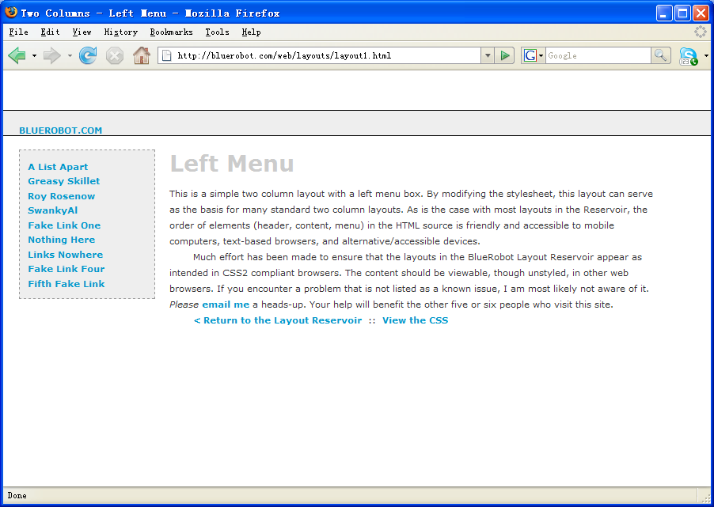
Two Columns - Left Menu

Slide 22
Two Columns - Left Menu
#Header {
margin:50px 0px 10px 0px;
padding:17px 0px 0px 20px;
border:1px dashed #999;
background-color:#eee;
}
#Content {
margin:0px 50px 50px 200px;
padding:10px;
border:1px dashed #999;
background-color: #eee;
}
#Menu {
position:absolute;
top:100px;
left:20px;
width:150px;
padding:10px;
background-color:#eee;
border:1px dashed #999;
}

Slide 23
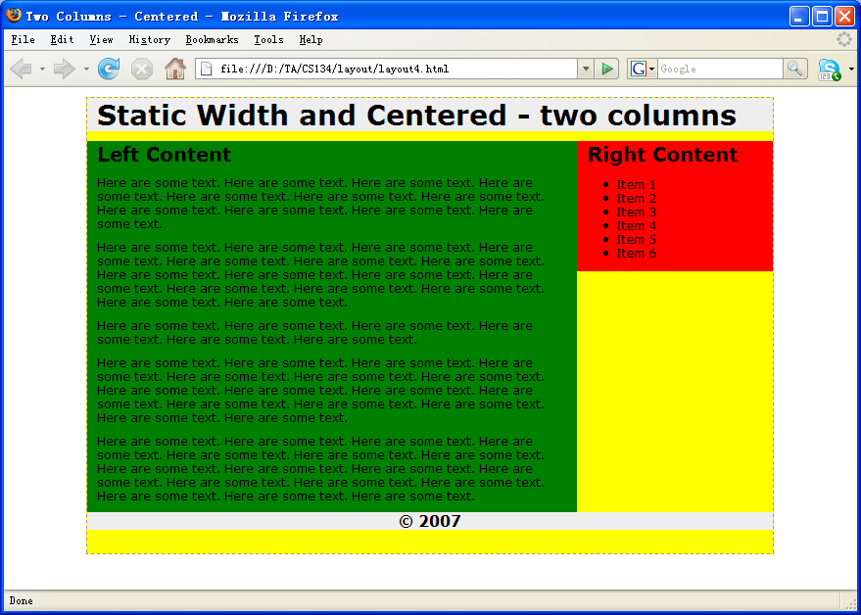
Two Columns Centered Fixed Width

Slide 24
Two Columns Centered Fixed Width
body {
margin:0px;
padding:0px;
text-align: center;
}
#Wrapper {
width:700px;
margin-right:auto;
margin-left:auto;
border:1px dashed #999;
}
#Header {
background: #eee;
}
#Menu {
float:right;
width:200px;
background: #eee;
}
#Content {
float:left;
width:500px;
background: #666;
}
#Footer {
clear: both;
background: #eee;
}

Slide 25
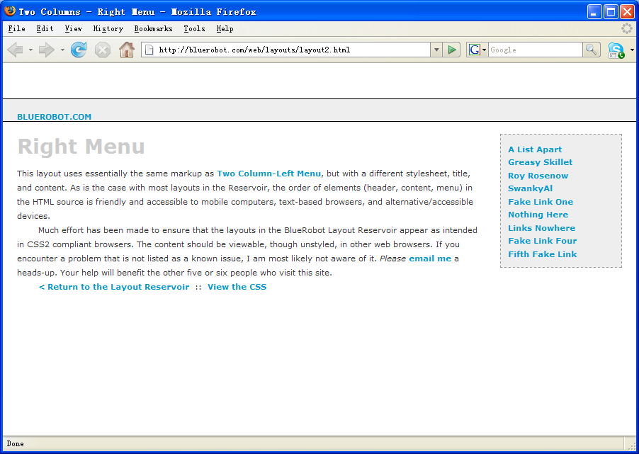
Two Columns - Right Menu

Slide 26
Two Columns - Right Menu
#Header {
margin:50px 0px 10px 0px;
padding:17px 0px 0px 20px;
border:1px dashed #999;
background-color:#eee;
}
#Content {
margin:0px 200px 50px 50px;
padding:10px;
border:1px dashed #999;
background-color: #eee;
}
#Menu {
position:absolute;
top:100px;
right:20px;
width:150px;
padding:10px;
background-color:#eee;
border:1px dashed #999;
}

Slide 27
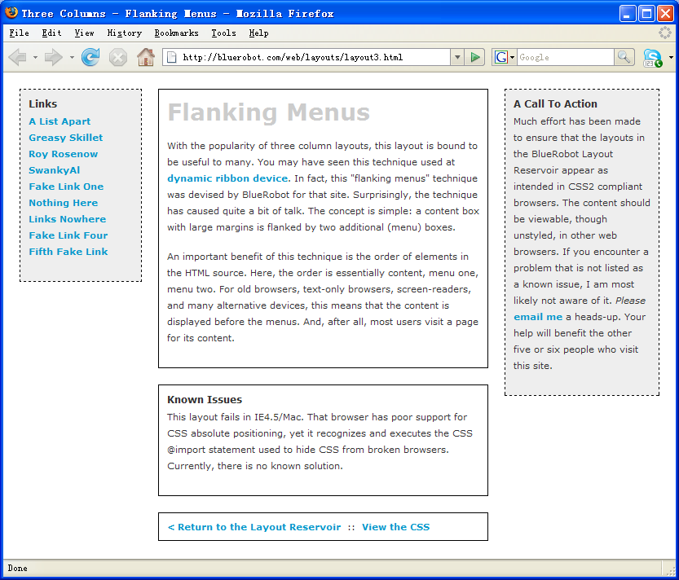
Three Columns Flanking Menu

Slide 28
Three Columns Flanking Menu
.content {
position:relative;
width:auto;
min-width:120px;
margin:0px 210px 20px 170px;
border:1px solid black;
padding:10px;
z-index:3; /* This allows the content to overlap the right menu in narrow windows in good browsers. */
}
#navAlpha {
position:absolute;
width:128px;
top:20px;
left:20px;
border:1px dashed black;
background-color:#eee;
padding:10px;
z-index:2;
}
#navBeta {
position:absolute;
width:168px;
top:20px;
right:20px;
border:1px dashed black;
background-color:#eee;
padding:10px;
z-index:1;
}

Slide 29
Z-Index (or Stack Level)
z-index: auto | <integer> | inherit
Z-axis positions are particularly relevant when boxes overlap visually.
In addition to their horizontal and vertical positions, boxes lie along a "z-axis" and are formatted one on top of the other.
Boxes with higher z-index stacked on top of the boxes with lower z-index.
Boxes with the z-index are stacked back-to-front according to document tree order.

Slide 30
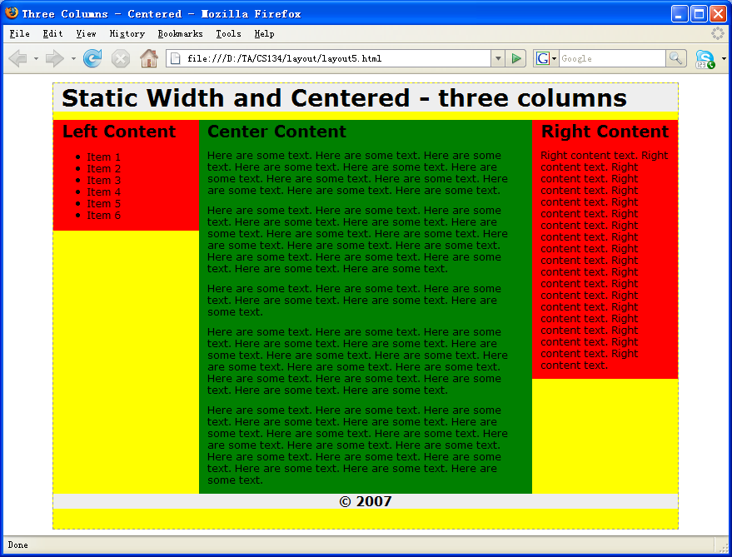
Three Columns Centered Fixed Width

Slide 31
Three Columns Centered Fixed Width
body {
text-align:center;
margin:0px;
padding:0px;
font:12px verdana, arial, helvetica, sans-serif;
}
#frame {
width:750px;
margin-right:auto;
margin-left:auto;
margin-top:10px;
text-align:left;
border:1px dashed #999;
background-color: yellow;
}
#topcontent {
background-color: #eee;
}
#centercontent {
float:left;
width:400px;
background-color: green;
}
#leftcontent {
float:left;
width:175px;
background-color: red;
}
#rightcontent {
float:left;
width:175px;
background-color: red;
}
#bottomcontent {
background-color:#eee;
text-align:center;
}

Slide 32
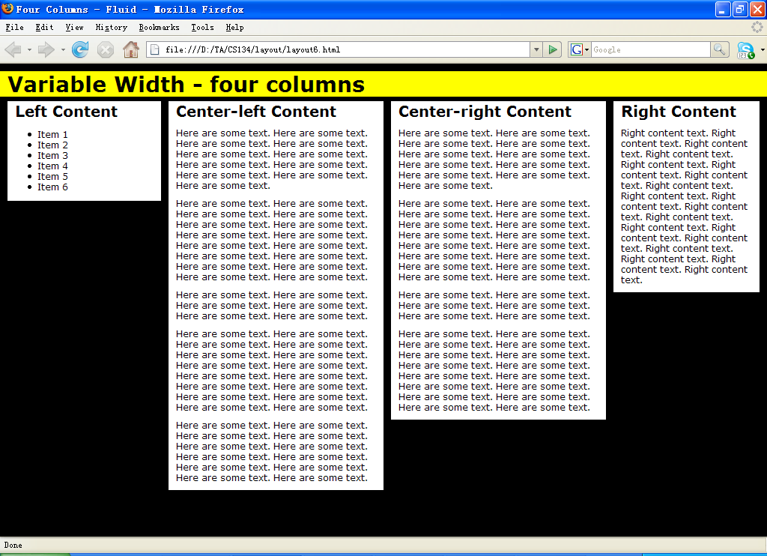
Four Columns Variable Width

Slide 33
Four Columns Variable Width
#topcontent {
background-color: yellow;
}
#leftcontent {
position: absolute;
left:1%;
width:20%;
top:50px;
background:#fff;
}
#centerleft {
position: absolute;
left:22%;
width:28%;
top:50px;
background:#fff;
}
#centerright {
position: absolute;
left:51%;
width:28%;
top:50px;
background:#fff;
}
#rightcontent {
position: absolute;
left:80%;
width:19%;
top:50px;
background:#fff;
}

Slide 34
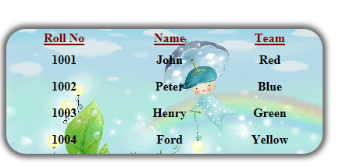
CSS Table
HTML table styling with CSS properties
CSS table properties offer better control of the presentational aspects of the Table

Slide 35
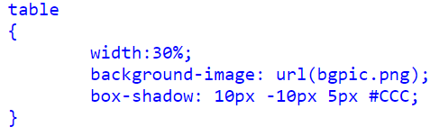
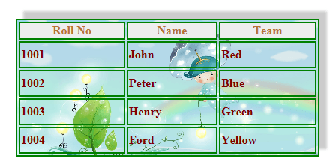
Example
CSS
Output

Slide 36
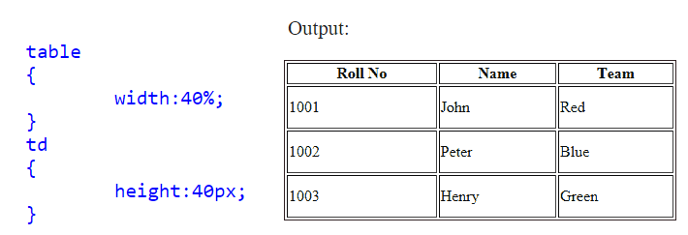
Table width and height in CSS
Table width and height, use CSS width, height properties
For example, table width as 30% and height of the td set to 40px

Slide 37
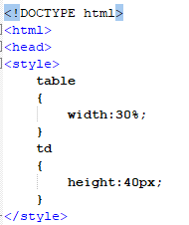
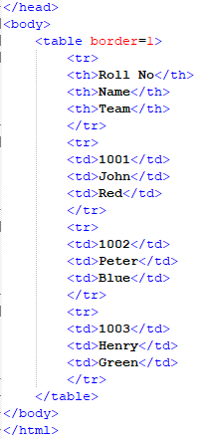

Slide 38
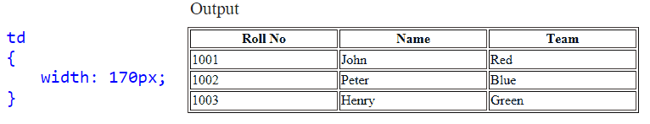
Table column width in CSS
Specify column width in CSS, use the width property to td

Slide 39
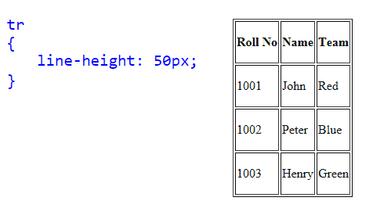
CSS Table Row height
Set Row Height through CSS line-height property it set to each tr.

Slide 40
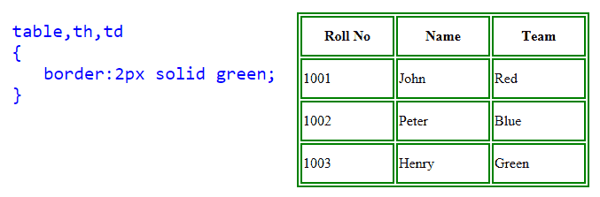
CSS Table border
Table border in CSS, use the CSS border property

Slide 41
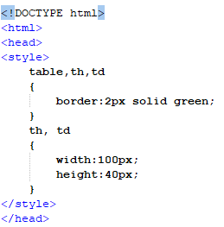
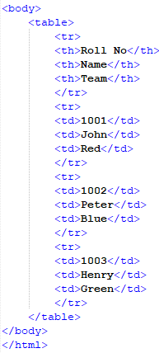

Slide 42
CSS Collapse Table borders
CSS Collapse property takes two values, separate and collapse
separate : The separate value forced all cells have their own independent borders and allow spaces between those cells.
collapse : This value collapse all spaces between table borders and cells, so you can see as a single line border

Slide 43
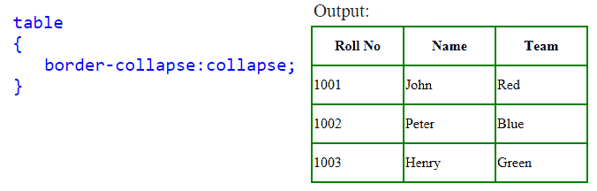

Slide 44
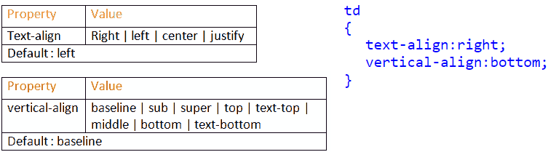
CSS Table Text Align
Align text horizontally and vertically in CSS.
Horizontal: text-align property
Vertically: vertical-align property

Slide 45
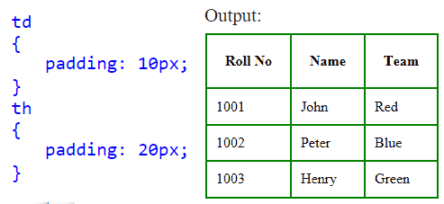
CSS Table Cell Padding
CellPadding is used to control the space between the contents of a Cell and the Cell borders

Slide 46
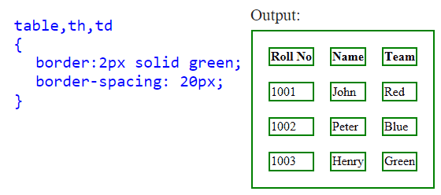
CSS Table Cell Spacing
Cellspacing attribute places space around each cell in the table. To specify cell Spacing in CSS, use the CSS border-spacing property

Slide 47
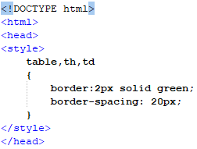
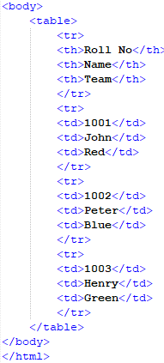

Slide 48
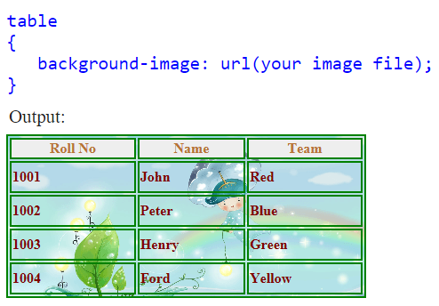
CSS Table background Image

Slide 49
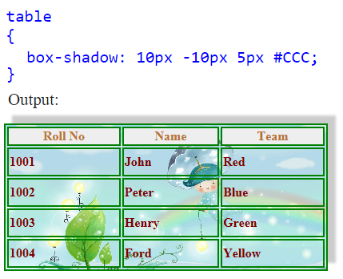
CSS Shadow on a Table

Slide 50
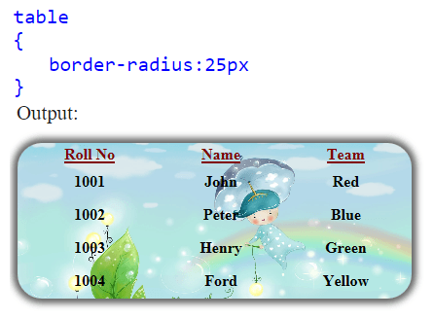
CSS Rounded Corners Table

Slide 51
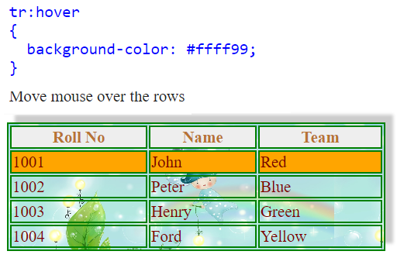
Highlight CSS Table Row on Hover

Slide 52
This Week
Review Slides
Read Associated Chapters
Online Quizzes
Additional quizzes each week
Do this weeks Tasks
Implement Style Sheet Examples
Update Github Website
Regularly make commits/updates
Structure your/folders/sections
Manage/demonstrate different features/techniques

Slide 53
Summary
Overview of CSS Div Layouts
Tables and CSS Styles
Hands-On/Practical

Slide 54
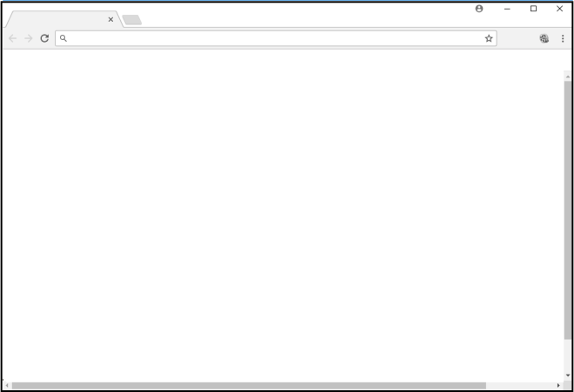

Questions/Discussion
Research Task:
Adding ‘Icon’ to your webpages
Challenge
Create website like this
Rollover Images
(select areas/items)
Animations
(water/clouds/rain)

Slide 55
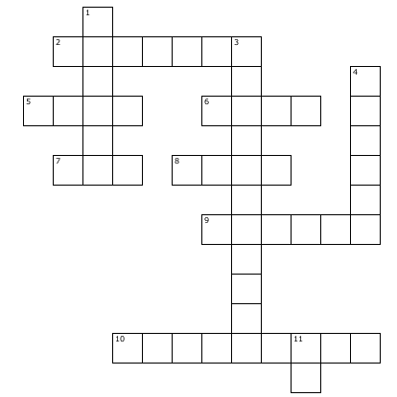
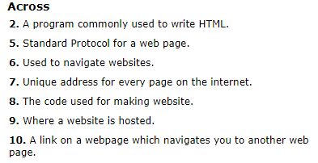
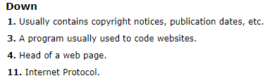
Puzzle to Solve for Next Week
Print out/or copy out your answers and bring them with you for next lesson

Slide 56
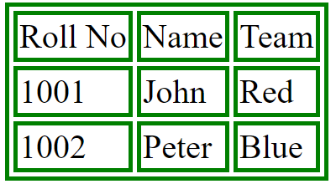
Question
Write down the html/css to create the following output:
(5 minutes)

Slide 57
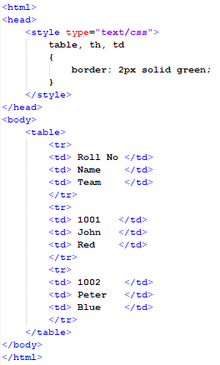
Answer

Slide 58
