Slide 1
Pragmatics
Object Orientated Analysis and Design
Benjamin Kenwright

Slide 2
Next Week
Revision Week
No Lecture

Slide 3
Outline
Review
What do we mean by Pragmatics?
Management and Planning
Benefits and Risks of Object Orientated Methods
Testing
Conclusion & Discussion

Slide 4

"That's a great question. Come to
think of it, I'm not sure what it
is I'm trying to design."

Slide 5
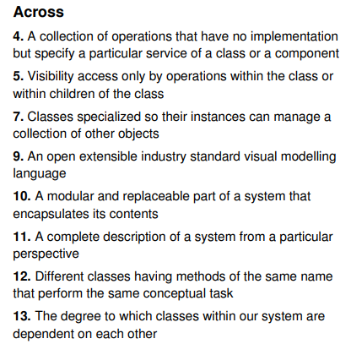
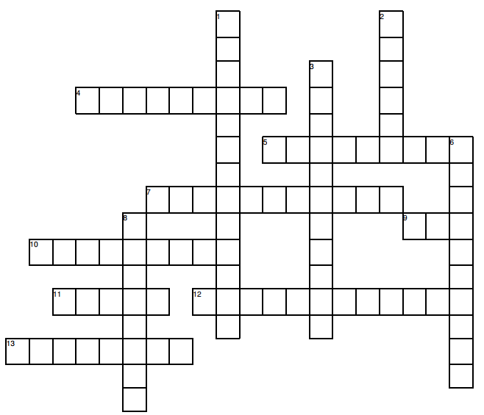
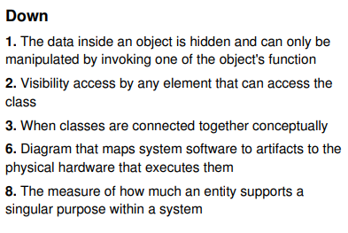
Crossword Challenge

Slide 6
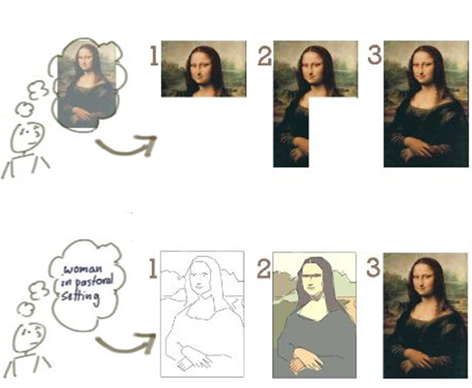
Question
Which is incremental and iterative?

Slide 7
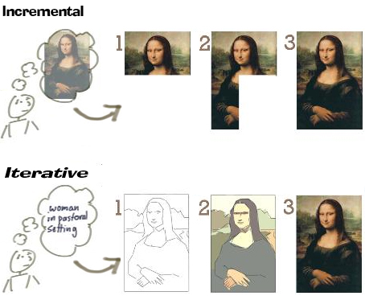
Answer

Slide 8
Question
The difference between V-shaped model and waterfall model is the early test planning in the V-shaped model
True
False

Slide 9
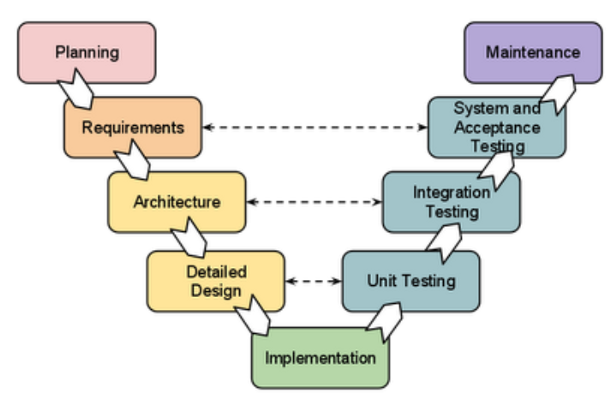
Answer
a) True
V-Shaped Model
Difference between V-shaped model and waterfall model is the early test planning in the V-shaped model

Slide 10
Question
Which development approach is the waterfall model?
a) iterative development approach
b) static development approach
c) behavioral development approach
d) incremental development approach

Slide 11
Answer
d) incremental development approach

Slide 12

Question
What are the four lifecycle phases for SCRUM?

Slide 13
Answer
SCRUM lifecycle includes four phases:
Planning
Staging
Development
Release

Slide 14
Question
Write down the differences between Agile and Plan-Driven development
(5 Minutes)

Slide 15
Answer
Agile Plan-Driven
Project is small
Experienced teams with a wide range of abilities take part
Teams are self-starters, independent leaders and others who are self-directing
Project is an in-house project and the team co-located
System is new with lots of unknowns
Requirements must be discovered
Requirements and environment are volatile with high change rates
End-user environment is flexible
Relationship with customer is close and collaborative
Customer is readily available dedicated and co-located
High trust environment exists within the development teams and customer
Rapid value and high-responsiveness are required
Project is large
Teams include varied capabilities and skill sets
Teams are geographically distributed and/or outsourced
Project is of strategic importance
System is well understood (scope and features set)
Requirements are fairly stable
System is large and complex (critical safety/high reliability requirements)
Project stakeholders have a weak relationship with the development team
External legal concerns
Focus is on a strong, quantitative process improvement
Definition and management of process are important
Predictability and stability of process are important

Slide 16
Management and Planning
Strong project leadership
Actively manages and directs a project’s activities
Avoid project going astray
lack of focus
Ignoring problems

Slide 17
Risk Management
Software development is responsible for non-technical risks
supervising the timely delivery of software from a third-party vendor
Technical risks are typically the responsibility of the project architect
selection of an inheritance structure that offers the best compromise between usability and flexibility
choice of mechanisms that yield acceptable performance while simplifying the system’s architecture

Slide 18
Task Planning
Periodic team meetings
discuss work completed
activities for the coming work period
Too many meetings
destroys productivity
sign that the project has lost its way
Developers require unscheduled time
allows them to think, innovate, develop, share knowledge with other teams/individuals

Slide 19
Schedules
Avoid overly optimising the schedule/plan
at the mercy of overly optimistic planning
Schedules/tasks change
Require fine-tuning
Milestones within the schedule to monitor the project

Slide 20
Question
What happens when schedules/plans are overly optimised? (Explain)
(5 Minutes)

Slide 21
Answer
Change
Unknowns (approximations)
‘Human’ factor
Flexibility
Risk
...

Slide 22
Staffing
Timing of resources within the development cycle
Different skillsets/abilities at different times during the project
Account for ‘change’
Staff leaving/changing/training

Slide 23
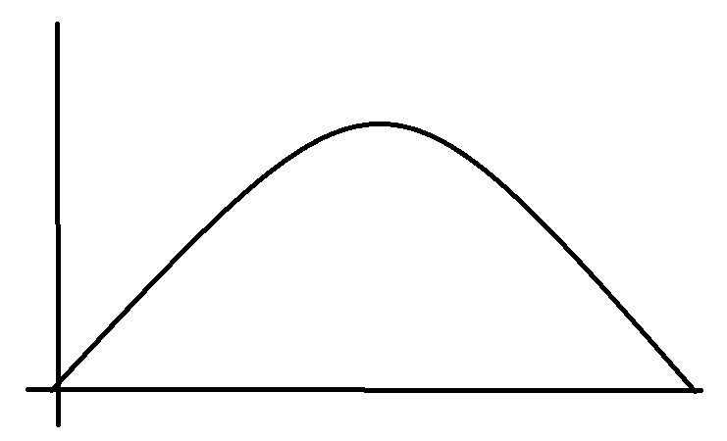
Staff Resource Allocation
Design, Development, Testing, …
Lifecycle Costs

Slide 24
Development Team Roles
Software development is ultimately a human endeavour
Developers are not interchangeable parts
Complex system requires the unique and varied skills of a focused team of people

Slide 25
Question
Software development is ultimately a human endeavour
a) True
b) False

Slide 26
Answer
a) True
Software development is ultimately a human endeavour

Slide 27
Central
Three roles to be central to the technical development team for an object-oriented project
1. Project architect 2. Component lead 3. Application engineer

Slide 28
Challenges
Breakdown of skills addresses the staffing problem faced by most software development organizations
Handful of really skilled experienced individuals and many more less-experienced ones
Opportunity to learn/gain experience

Slide 29
Configuration Management and Version Control
Interfacing components
Keeping track of different versions
stable, debug, testing, …
features, …
compatible components
build 03929, 03930, ..
Avoid ‘halting’ work while newer versions of components are developed

Slide 30
Integration
Integration events
Each marking the creation of another prototype or architectural release
Generally incremental in nature
(i.e., not big-bang)

Slide 31
Testing
Testing should encompass at least three dimensions:
1. Unit testing 2. Component testing
3. System testing

Slide 32
Unit Testing
Involves testing individual classes and mechanisms and is the responsibility of the application engineer who implemented the structure

Slide 33
Component Testing
Involves integration testing a complete component and is the responsibility of the component lead.
Component tests can be used as regression tests for each newly released version of the component
Note that the term component is generic and can mean a single component in a small project or a collection of components, sometimes referred to as a subsystem, in a larger project

Slide 34
System Testing
Involves integration testing the system as a whole and is the responsibility of the quality assurance team
System tests are also typically used as regression tests by the integration team when assembling new releases

Slide 35
Question
Testing should encompass which three dimensions?
a) Component testing, Unit testing, System testing
b) Unit testing, System Components, Quality testing
c) Unit testing, System testing, Compound testing

Slide 36
Answer
a) Component testing, Unit testing, System testing

Slide 37
Reuse
Acclaimed benefits of object-oriented development is reuse
Depends on management
Realize the benefits of reusing the many artifacts of the development process

Slide 38
Elements of Reuse
Any artifact of software development can be reused
Any stage, e.g., requirement, development and testing
For example, design, code and documentation
reuse patterns of classes, objects, and designs in the form of idioms, mechanisms, and frameworks

Slide 39
Question
Documentation should drive the development process
True
False

Slide 40
Answer
b) False
Documentation should never drive the development process

Slide 41
Institutionalizing Reuse
Reuse within a project or even within an entire organization doesn’t just happen
WHY?

Slide 42
Institutionalizing Reuse
Encouraged
Opportunities for reuse must be actively sought out and rewarded
Pattern scavenging as an explicit activity in the development process
Making specific individuals responsible for leading the reuse activity

Slide 43
Long Term
Reuse costs resources in the short term but pays off in the long term
Organization that takes a long-term view of software development and optimizes resources

Slide 44
Quality Assurance and Metrics
Systematic activities providing evidence of the fitness for use of the total software product

Slide 45
Software Quality
Software quality as the fitness for use of the total software product
Software quality doesn’t just happen: It must be engineered into the system

Slide 46
Object-Oriented Metrics
Lord Kelvin:
“When you can measure what you
are speaking about, and express it into numbers, you know something about it...

Slide 47
Process & Product Metrics
Metrics to assist us in this endeavor fall into one of two categories, process metrics or product metrics
Process metrics, sometimes called project metrics, assist the management team in assessing progress with respect to the object-oriented development process being used

Slide 48
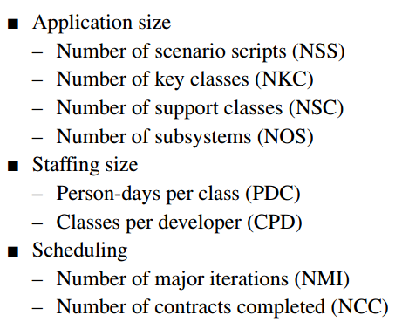
Process Metrics

Slide 49
Documentation
Development artifacts that are critical to the complete lifecycle of a software system (other than code)
Example, requirements and design, must be documented to support the development process and the operation and maintenance of the system

Slide 50
Tools
Trying to build a large software system with a minimal tool set is equivalent to building a multi-story building with stone hand tools
Examples
visual modeling tool supporting the UML notation
version control

Slide 51
Benefits of Object-Oriented Development
Appeals to the working of human cognition
Leads to systems that are more resilient to change
Encourages the reuse of software components
Reduces development risk
Exploits the expressive power of object-oriented programming languages

Slide 52
Risks of Object-Oriented Development
A unique way to define architecture and data structure instances
Information hiding through abstraction and encapsulation
Inheritance to organize related elements
Polymorphism to perform operations that can automatically adapt to the type of structure they operate on
Specialized analysis and design methods
Object-oriented languages
Environments that facilitate the creation of object-oriented systems
Design by contract, a powerful technique to circumvent module boundary and interface problems

Slide 53
8 Software Risks
1. Personnel shortfalls
2. Unrealistic schedules, budgets, or processes
3. Shortfalls in commercial off-the-shelf products, external components, or legacy software
4. Mismatches in requirements or user interface
5. Shortfalls in architecture, performance, or quality
6. Continuing stream of requirements changes
7. Shortfalls in externally performed tasks
8. Straining computer science

Slide 54
Summary
Clear idea of Pragmatics in Object Orientated Analysis and Design
See bigger picture (i.e., much more than just generating code)
Reuse must be institutionalized to be successful

Slide 55
This Week
Review Slides
Read Chapter 8
No Lecture Next Week
(Revision Week)

Slide 56
Questions/Discussion

Slide 57
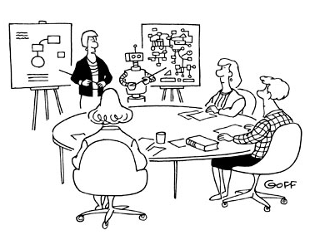
“Would you like the technical
or non-technical explanation?”

Slide 58
Question
There are many benefits to object-oriented technology and no risks
True
False

Slide 59
Answer
b) False

