Slide 1
Examples
Object Orientated Analysis and Design
Benjamin Kenwright

Slide 2
Outline
Revision Questions
Group Project
Review Deliverables
Example System Problem
Case Studey

Slide 3
Milestone Dates
Demonstrate Date
Submission Deadline
Exam 3rd Jan 2017
2 Hours
NOT Multiple Choice

Slide 4
25th December
Last Day – Quizzes
Grade Taken

Slide 5
Group Project
Report
Submission Date 25th December
Presentation/Demonstration
Marking Criteria/Deliverables
Submit single .zip
Student number, e.g., 20939302.zip
Report and any supporting material

Slide 6
Case Study Example
Design Library Management System

Slide 7

Exercise
Write down the steps you’d go through for a Library Management System
(5 Minutes)

Slide 8
Operation Steps
Step 1
Provide a user interface for getting the user’s login details
Verify login ID and if correct, provide access to the library database
Step 2
Provide a search mechanism to search for a particular book
Input the book name and author’s name
Step 3
Get the book details from the database
Display the book details on screen
Step 4
Allow the user to select the book for checking out
Issue the book

Slide 9
Formulate UML Diagrams
Sketch a simple Sequence Diagram for your steps
(5 Mins)

Slide 10
Sequence Diagram

Slide 11
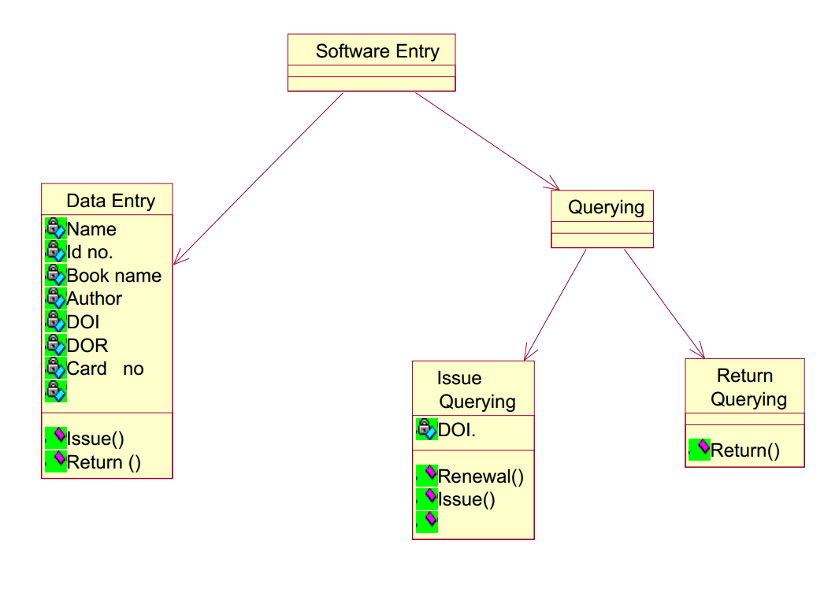
Class Diagram

Slide 12
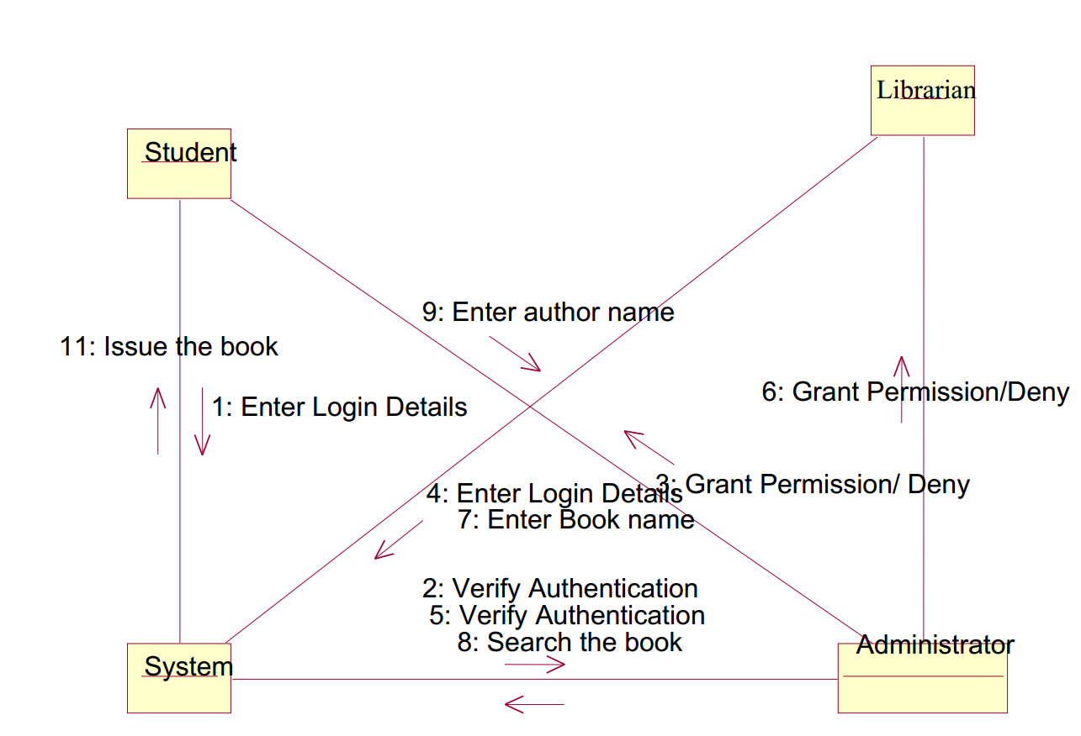
Collaboration Diagram

Slide 13
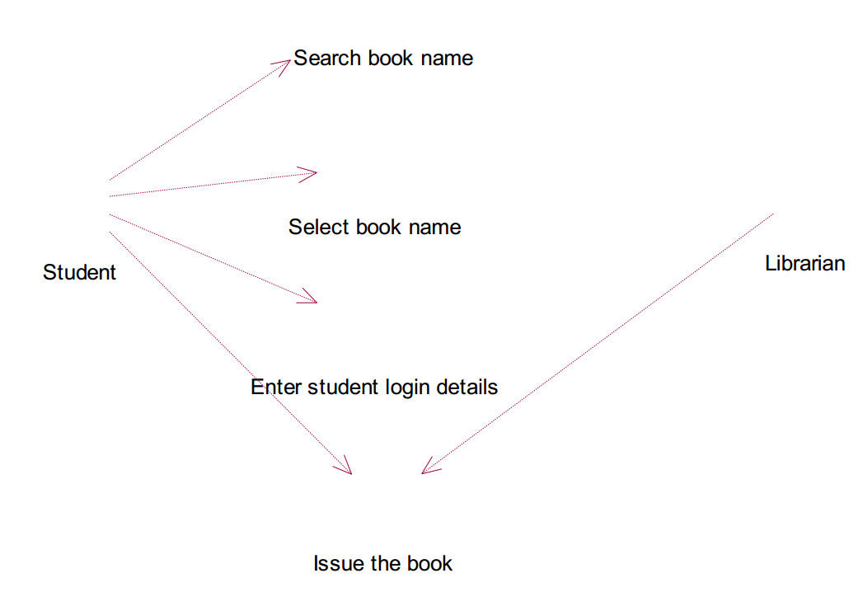
Use Case Diagram

Slide 14
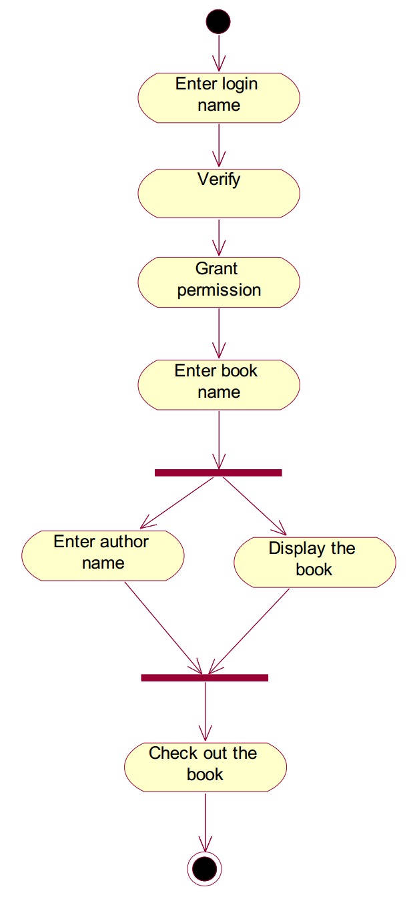
Activity Diagram

Slide 15
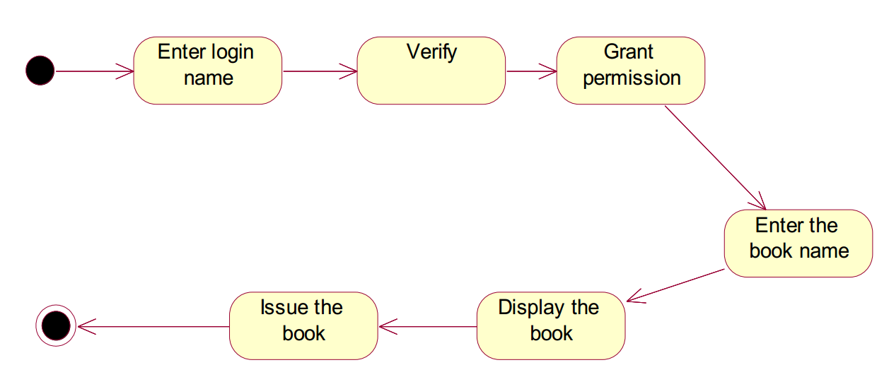
State Chart Diagram

Slide 16
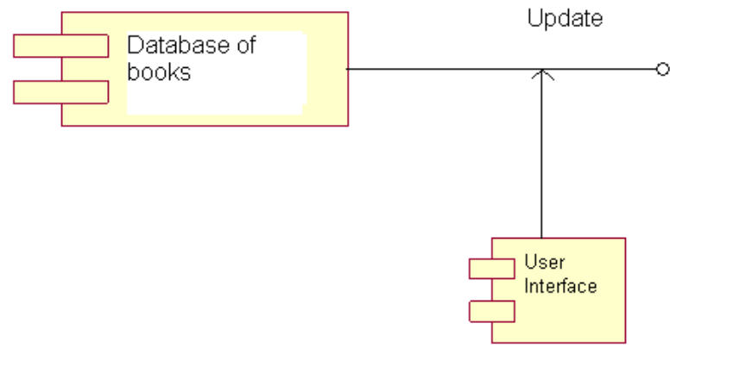
Component Diagram

Slide 17
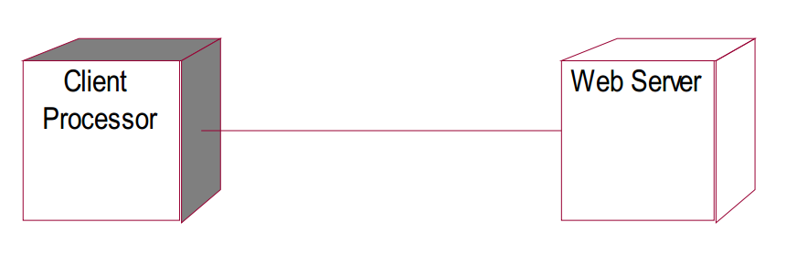
Deployment Diagram

Slide 18
Testing/Validation
Library Management System would be verified and validated against the original design specification

Slide 19
Revision Question

Slide 20
Question
Briefly summarize the importance of using inheritance
(5 minutes)

Slide 21
Answer
Inheritance is one of the most powerful features of object oriented programming. Most important advantages of inheritance are:
Reusability
Saves times and efforts
Closeness with the real world
Easy modification
Transitive Nature of inheritance

Slide 22
Question
What do you mean by overloading of a function? When do you use this concept? Give an example of function overloading?

Slide 23
Answer
Function overloading is a technique where several function declarations are specified with a same name that can perform similar tasks, but on different data types (distinguished by their number and type of arguments)
Example
int add (int a, int b);
int add (int a, int b, int c);
float add (float a, float b);
Hence, overloaded functions perform different activities depending upon the kind of data sent to them

Slide 24
Question
List the difference between Polymorphism and Overloading?

Slide 25
Answer
Polymorphism
Polymorphism is an important concept of OOPS.
Polymorphism means ability of one object to take many different forms.
Two main types of polymorphism:
Runtime polymorphism
Compile time polymorphism
Overloading
Overloading is the mechanism to implement polymorphism.
Overloading is the mechanism to use the same thing for different purposes.

Slide 26
Question
Which development approach is the waterfall model?
a) incremental development approach
b) iterative development approach
c) static development approach
d) behavioral development approach

Slide 27
Answer
a) incremental development approach

Slide 28
Question
What are the four lifecycle phases for SCRUM?

Slide 29
Answer
SCRUM lifecycle includes four phases:
Planning
Staging
Development
Release

Slide 30
Question
Write down the differences between Agile and Plan-Driven development
(5 Minutes)

Slide 31
Answer
Agile Plan-Driven
Project is small
Experienced teams with a wide range of abilities take part
Teams are self-starters, independent leaders and others who are self-directing
Project is an in-house project and the team co-located
System is new with lots of unknowns
Requirements must be discovered
Requirements and environment are volatile with high change rates
End-user environment is flexible
Relationship with customer is close and collaborative
Customer is readily available dedicated and co-located
High trust environment exists within the development teams and customer
Rapid value and high-responsiveness are required
Project is large
Teams include varied capabilities and skill sets
Teams are geographically distributed and/or outsourced
Project is of strategic importance
System is well understood (scope and features set)
Requirements are fairly stable
System is large and complex (critical safety/high reliability requirements)
Project stakeholders have a weak relationship with the development team
External legal concerns
Focus is on a strong, quantitative process improvement
Definition and management of process are important
Predictability and stability of process are important

Slide 32
Question
List some of the benefits of Object Model?

Slide 33
Answer
It helps in faster development of software
It is easy to maintain. Suppose a module develops an error, then a programmer can fix that particular module, while the other parts of the software are still up and running
It supports relatively hassle-free upgrades
It enables reuse of objects, designs, and functions
It reduces development risks, particularly in integration of complex systems

Slide 34
Summary
Case Study
Example Problems/Solutions
Final Exam (January)
Group Project
Review Questions

Slide 35
This Week
Review Slides
Coursework
Reviewing Quiz Questions
Reviewing Associated Chapter

Slide 36
Question
Deadline for final group project submission?

Slide 37
Answer
25th December
Also deadline for online quizzes

Slide 38
Questions/Discussion

