Slide 1
GUI Basics
Object Orientated Programming in Java
Benjamin Kenwright

Slide 2
Outline
Essential Graphical User Interface (GUI) Concepts
Libraries, Implementation, Mechanics, ..
Abstract Windowing Toolkit (AWT)
Java Foundation Classes (JFC)
Today’s Practical
Review/Discussion

Slide 3
Graphical User Interfaces (GUI)
Note this is a huge area
Many books are devoted solely to this topic
Today we will provide an overview on getting started with Java GUIs

Slide 4
Why is the Graphical User Interface (GUI) Important?
What software packages have GUIs?
What does the GUI offer?
What are the different types of GUI?

Slide 5
Why is the Graphical User Interface (GUI) Important?
Visual feedback/input
Allows higher productivity
Faster learning curve/usability
Intuitive to the user
Display/show more information/details
Picture is worth a thousand words
Allows colour/animations
Provides more opportunities (e.g., video/games)
…

Slide 6
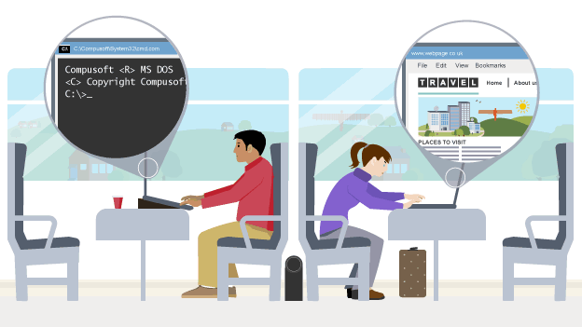
What is a ‘User Friendly’ GUI?
What makes a GUI friendly?
What makes a GUI unfriendly?

Slide 7
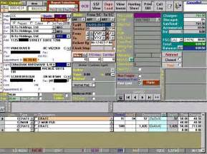
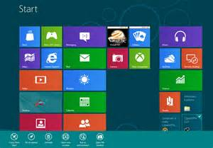
What is a ‘User Friendly’ GUI?
Intuitive
Efficient
Pleasant, easy-to-navigate
Adheres to standards
Presents information in a clear form

Slide 8
Question
What does GUI stand for?
a) Graphical User Interface
b) Gimme Ur Internet
c) Grand User Interface
d) Graphical Useful Interface

Slide 9
Answer
a) Graphical User Interface

Slide 10
GUI Overview
To create a Java GUI, you need to understand
Containers
Event
Event Handlers
Layout managers
Components
Special features

Slide 11
AWT and JFC/Swing
Early Java development used graphic classes defined in the Abstract Windowing Toolkit (AWT)
See the java.awt packages.
Java 2 introduced the JFC/Swing classes
See the javax.swing packages
Many AWT components have similar Swing counterparts
An example, the AWT Button class corresponds to a more versatile Swing class called JButton.
Swing does not generally replace the AWT; still use AWT for events and the underlying AWT event processing model

Slide 12
Question
Java development classes ‘AWT’ stands for:
a) Amazing Work Tower
b) Action Window Thread
c) Abstract Worker Thread
d) Abstract Windowing Toolkit

Slide 13
Answer
d) Abstract Windowing Toolkit

Slide 14
Standard GUI Components used to Create User Interfaces (Swing)

Slide 15
Containers
A container is a special component that can hold other components
The AWT class, as well as the Swing class, are containers
Other containers include
Frames
A frame is a container that is free standing and can be positioned anywhere on the screen.
Frames give the ability to do graphics and GUIs through applications
Dialog boxes
Panels
Panes
Toolbars

Slide 16
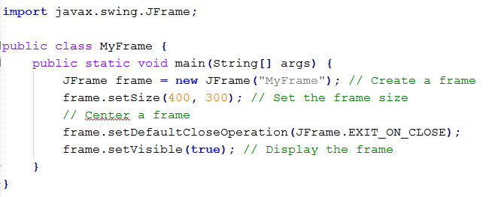
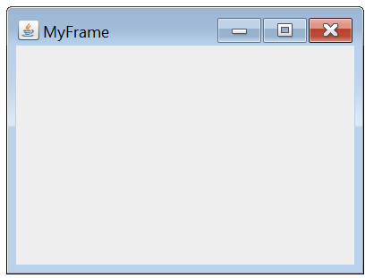
Example
Creating a Simple Frame
javac MyFrame.java
java MyFrame.class

Slide 17
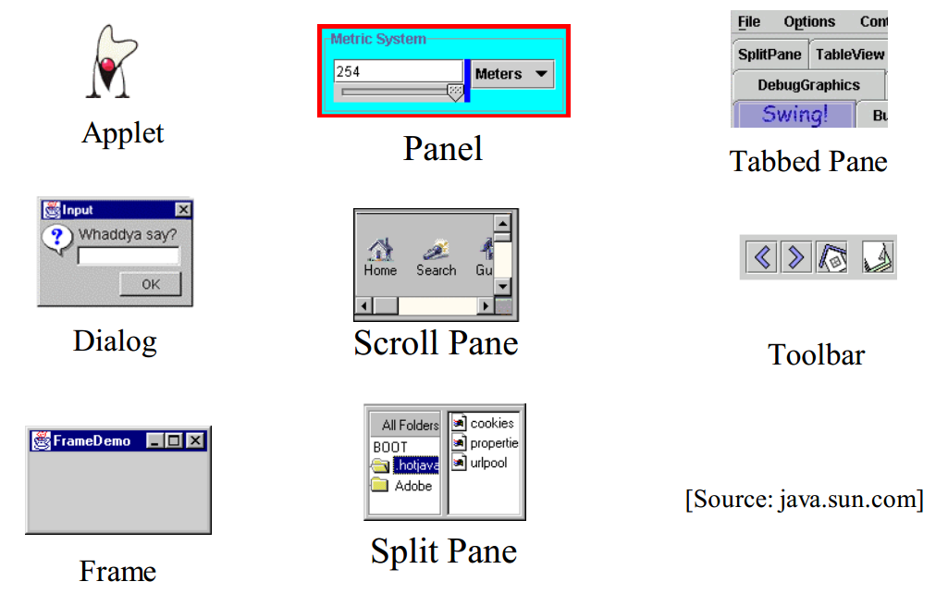
Example Containers (Top Level and General)

Slide 18
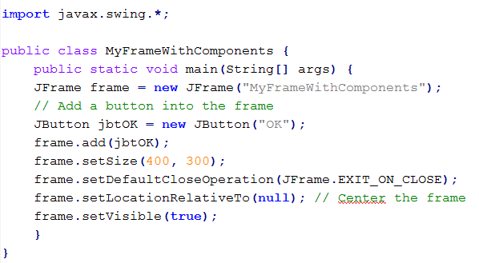
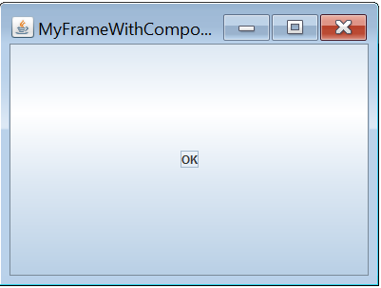
Example
Adding Components
javac MyFrameWithComponents.java
java MyFrameWithComponents.class

Slide 19
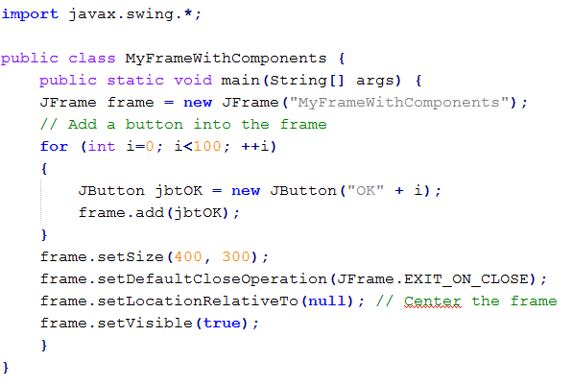
Question
What would the following output?

Slide 20
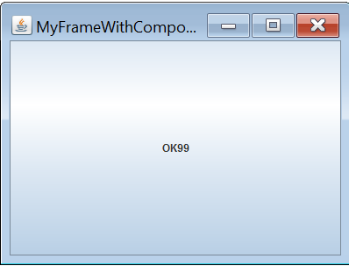
Answer
Buttons are all placed overlapping
(i.e., set the position for each button if you want to see all 100 buttons)

Slide 21
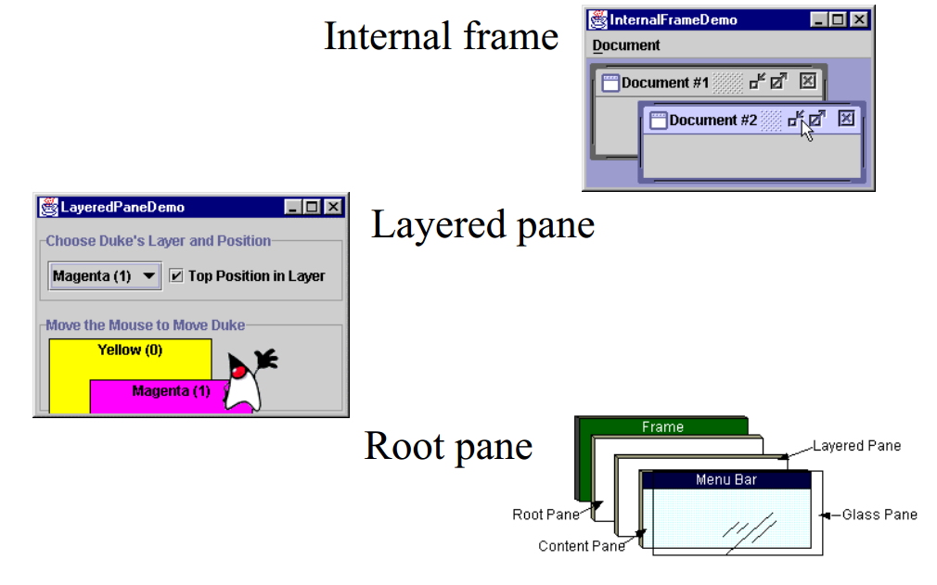
Example Special Containers

Slide 22
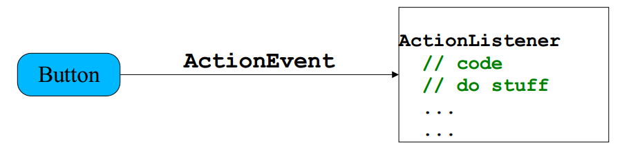
Events
Every time the user types a character or pushes a mouse button, an event occurs
Any object can be notified of the event
All the objects have to do implement the appropriate interface and be registered as an event listener on the appropriate event source

Slide 23
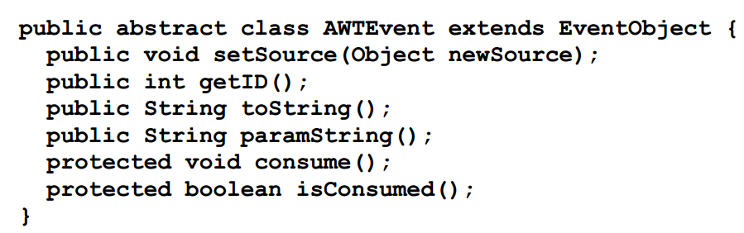
Events, cont.
Several events implemented in java.awt.AWTEvent subclasses (java.awt.Event is deprecated)
Defines a lot of constants

Slide 24
Events Handlers
In the declaration for the event handler class, one line of code specifies that the class either implements a listener interface (or extends a class that implements a listener interface).
public class MyClass implements ActionListener
In the event handler class the method(s) in the listener interface must be implemented
public void actionPerformed(ActionEvent e) { /* code that "reacts" to the event */ }
Register an instance of the event handler class as a listener on one or more components.
myComponent.addActionListener(myClassInstance)

Slide 25
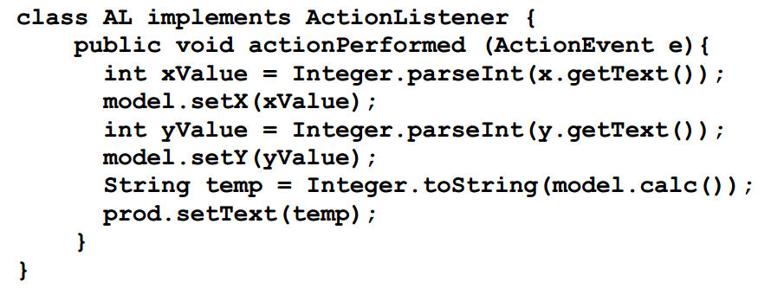
Events Handlers, cont.
Often an event handler that has only a few lines of code is implemented using an anonymous inner class.

Slide 26
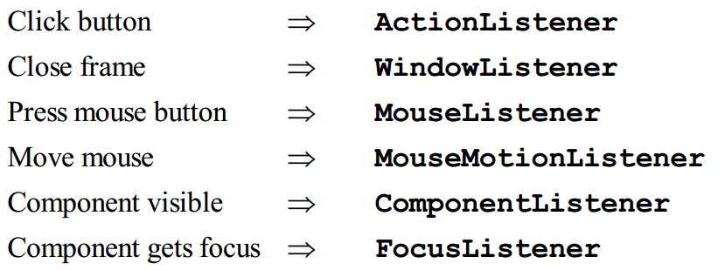
Events Handlers, cont.
SwingApplication has two event handlers.
Window closing (window events).
frame.setDefaultCloseOperation (JFrame.EXIT_ON_CLOSE);
Button clicks (action events).
see previous slide.
Types of events (listeners defined in java.awt.event)

Slide 27
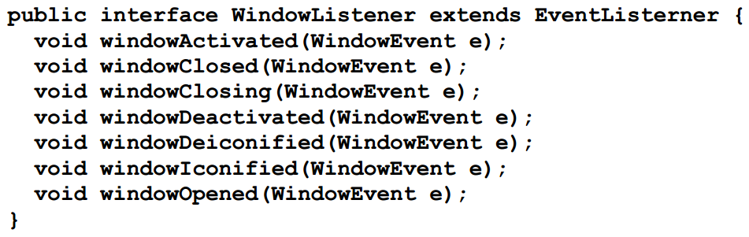
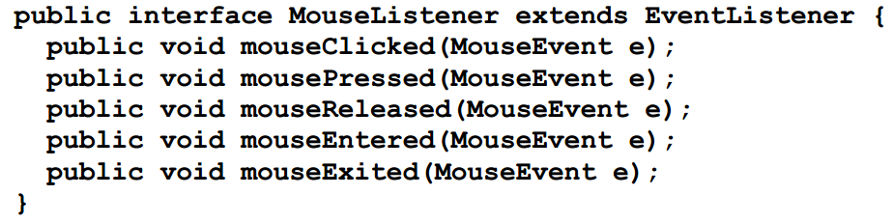
WindowListener and MouseListener

Slide 28
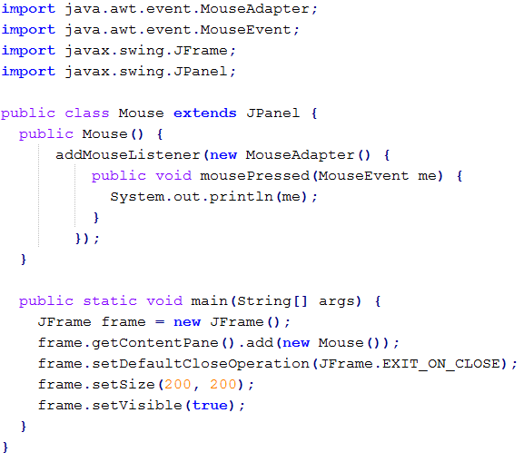
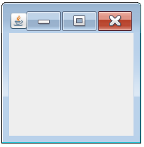
Example
Button Pressed: java.awt.event.MouseEvent[MOUSE_PRESSED,(123,43),absolute(134,87),button=1,modifiers=Button1,extModifiers=Button1,clickCount=1] on Mouse[,0,0,178x145,layout=java.awt.FlowLayout,alignmentX=0.0,alignmentY=0.0,border=,flags=9,maximumSize=,minimumSize=,preferredSize=]
javac Mouse.java
java Mouse.class

Slide 29
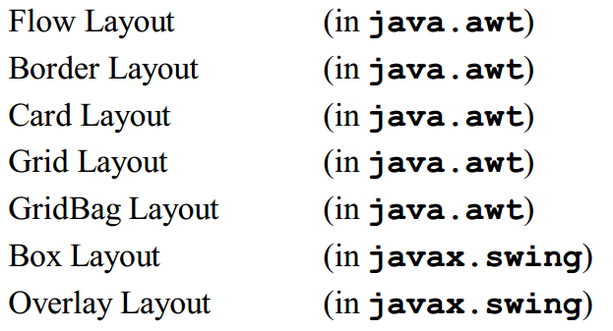
Layout Managers
A layout manager is an object that determines the manner in which components are displayed in a container
There are several predefined layout managers defined in the Java standard class library

Slide 30
Layout Managers, cont.
Every container has a default layout manager, but we can also explicitly set the layout manager for a container
Each layout manager has its own particular rules governing how the components will be arranged
Some layout managers pay attention to a component's preferred size or alignment, and others do not
The layout managers attempt to adjust the layout as components are added and as containers are resized

Slide 31
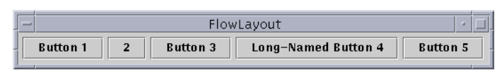
Flow Layout
A flow layout puts as many components on a row as possible, then moves to the next row
Rows are created as needed to accommodate all of the components
Components are displayed in the order they are added to the container
The horizontal and vertical gaps between the components can be explicitly set
Default for JPanel

Slide 32
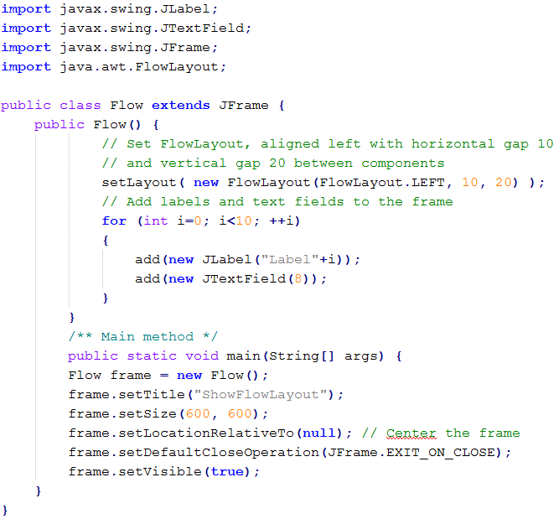
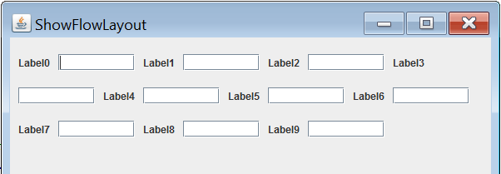
FlowLayout Example

Slide 33
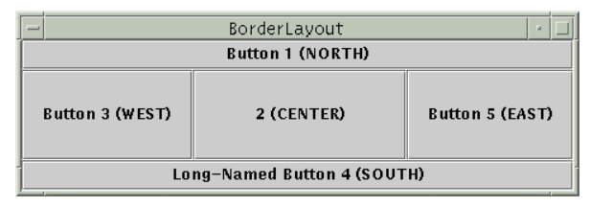
Border Layout
A border layout defines five areas into which components can be added
The default for most GUIs

Slide 34
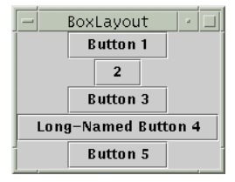
Box Layout
A box layout organizes components either horizontally (in one row) or vertically (in one column)
Special rigid areas can be added to force a certain amount of spacing between components
By combining multiple containers using box layout, many different configurations can be created
Multiple containers with box layouts are often preferred to one container that uses the more complicated gridbag layout manager

Slide 35
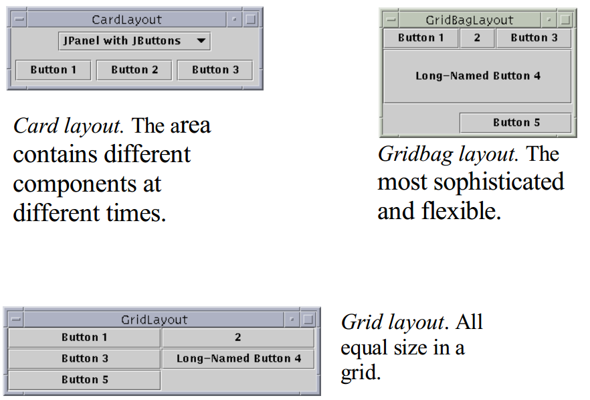
Other Layout Managers

Slide 36
"Atomic" Components
The root in the component hierarchy is JComponent.
The JComponent provides the following functionality to its descendants, e.g., JLabel, JRadioButton, and JTextArea
Tool tips
Borders
Keyboard-generated actions
Application-wide pluggable look and feel
Various properties
Support for layout
Support for accessibility
Double buffering

Slide 37
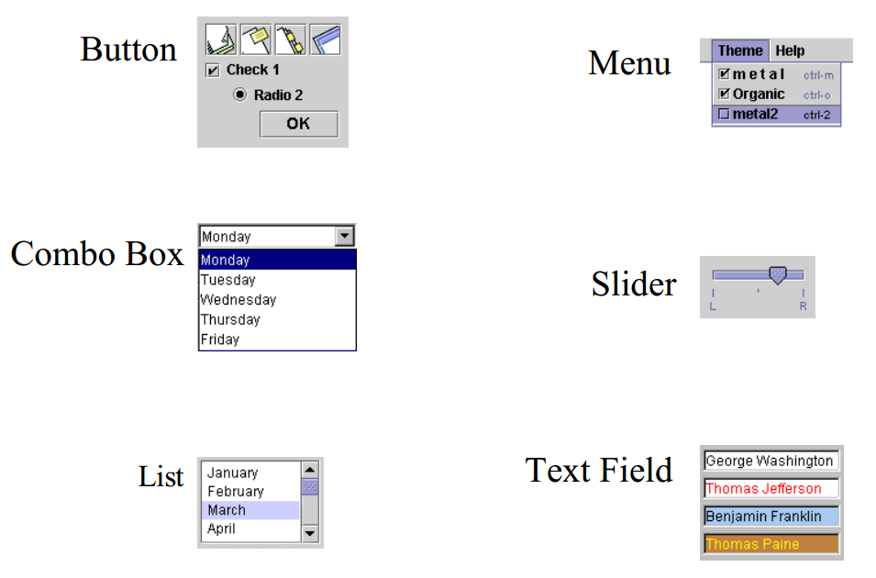
Basic Components

Slide 38
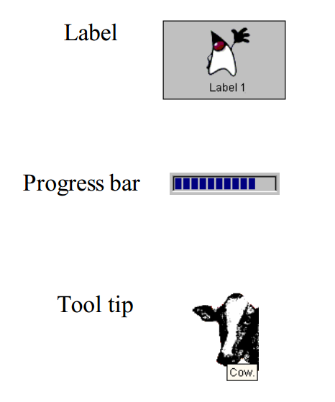
Non-Editable Displays

Slide 39
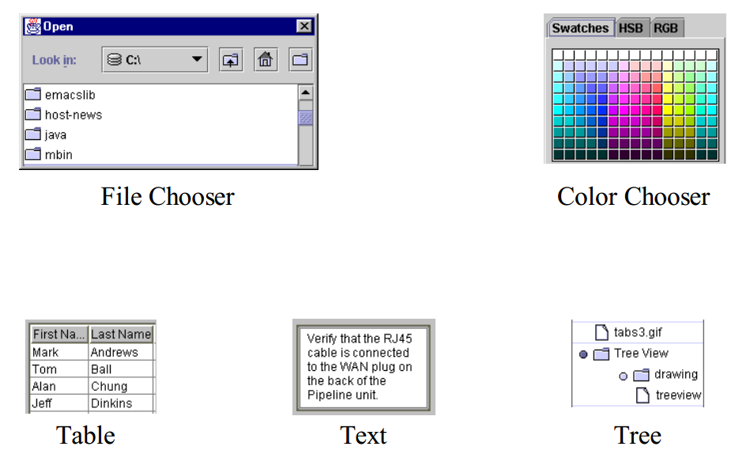
Editable Displays

Slide 40
Summary
Overview Basic GUI Principles
Abstract Windowing Toolkit (AWT)
Java Foundation Classes (JFC)
Apply Hands-On/Practical Understanding of GUIs

Slide 41
This Week
Read Associated Chapters
Regularly reviewing the material
Reading around the subject
Experimenting (Trial & Error)
Review Slides
Online Quizzes
Java Exercises
Typing Java Code Regularly
Intuitive/Natural
Avoid `Copy-Pasting’

Slide 42
Today’s Practical
Programming Exercises (Book):
Chapter 12.1-12.5
(Only code not UML)
Upload single .zip file containing all your java files (only java files).
www.zjnu.xyz
zip file name should be your student number, e.g., 29392929.zip
Remember to comment your code, name/student number at the top of files.
Organise your files so it’s clear to identify each exercise (e.g., file names/folders)
ch12_1.java, ch12_2.java, …

Slide 43
Questions/Discussion
Dynamic GUIs
Add/remove buttons on-the-fly
Painting/artistic control
`Customizable’ GUIs
User can move buttons around and the positions are saved in external files/scripts
Usability Testing
Performance
Languages
Multi-language menus
Menu text is loaded from external files depending upon the country/language

