Slide 1
JavaScript Syntax
Web Authoring and Design
Benjamin Kenwright

Slide 2
Milestone Dates
Demonstrate Coursework 1
Friday?
10-20 Minutes Each?
Coursework 2 (Group Project)
Website (XMAS)
Javascript Game (xmas theme)
Team 2-3 People
29th December (Friday)
Demonstrate/Present Group Work

Slide 3
Outline
Review
Fundamental Syntax Javascript
Summary
Review/Discussion

Slide 4
JavaScript Data Types

Slide 5
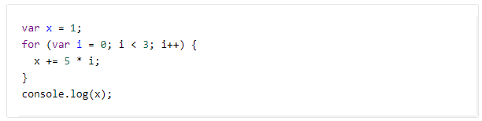
Question
What will the following code print?
a) 1
b) 10
c) 16
d) 31

Slide 6
Answer
c) 16

Slide 7
Primary Data Types (Primitive)
String
Number
Boolean

Slide 8
Composite Data Types (reference)
Object
Array

Slide 9
Special Data Types
Null
Undefined

Slide 10
Overview of Types
String : A strings of any characters enclosed in quotes is a string primitive.
Number : A number by itself is a number primitive, all numbers in JavaScript are 64-bit floating-point numbers.
Boolean : It will store Variables or expressions which are either true or false.
Object: A collections of properties and methods. In Javascript, anything that is not a primitive is an Object.
Arrays : Arrays are regular objects, both objects and arrays can have properties and methods.
Null : It has only one value in JavaScript: null.
Undefined : It treated as a variable that has been declared, but has never had a value assigned to it.

Slide 11
Var in Javascript
var anyData;

Slide 12
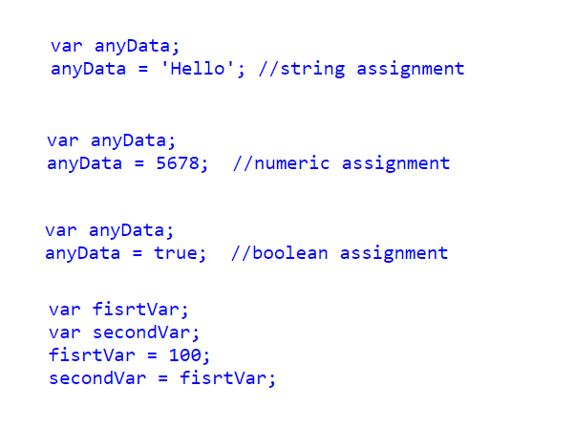
Example var

Slide 13

Combining Data Types
What would be in variable xyz?

Slide 14


Slide 15

Example
What would be in variable xyz this time?

Slide 16


Slide 17
Scope of JavaScript Variables
The Javascript variable has only two scopes, Global and Local.
When you declare a variable within your function , its scope is local, that means you can use that variable only inside that function.
If a variable declare outside the function, its scope is Global.

Slide 18

Constants
Javascript you can define read-only Constant variables with const keyword

Slide 19
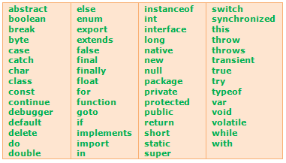
JavaScript keywords

Slide 20

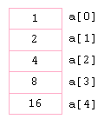
JavaScript Array Object

Slide 21
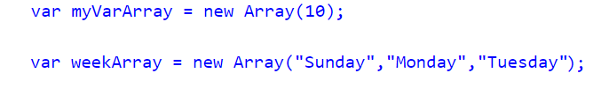
Constructors
Already know the number of items that would store in an array, you can pass the number to the constructor of an Array Object
Directly initialize the Array elements when declaring an Array Object

Slide 22
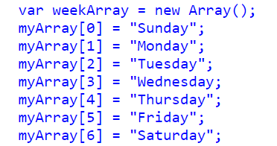
From 0...
JavaScript array indexes start from 0 (zero) and continue as 1,2,3 etc..

Slide 23

Displaying
Displaying Javascript Array elements
You can display Array elements in several ways. The following methods will show all elements from an Array.

Slide 24

Javascript Array Length
Length property of Javascript Array return the number of elements contains in an Array. Javascript Array index starts from 0 so the length of an array is equal to the last index + 1

Slide 25
Arrays Undefined Values
Arrays are automatically growing and dynamically sized to accommodate any type of data that is added to them. So, when you add or remove elements from an array, the length of the array will change as needed. When you declare an Array with constructor, each slot will be set to "undefined"

Slide 26
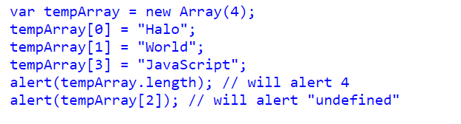
Example

Slide 27
Other Array Methods
Array.push()
Array.contains()
Array.sort()
Array.splice()
Array.slice()
Array.join()

Slide 28
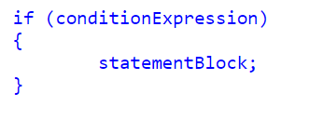
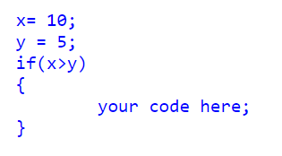
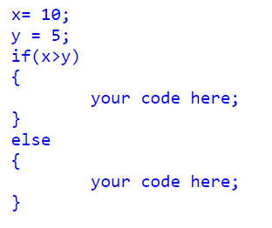
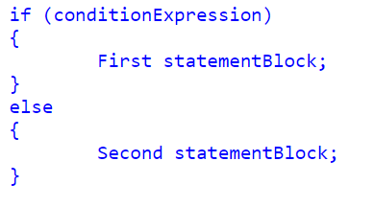
Conditional Statements

Slide 29
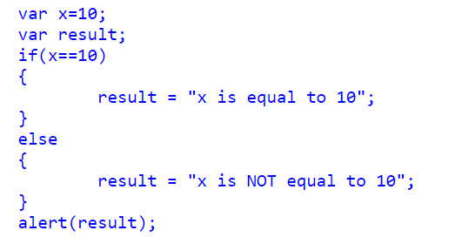
Alternative if..else Syntax (? Ternary Operator)

Slide 30
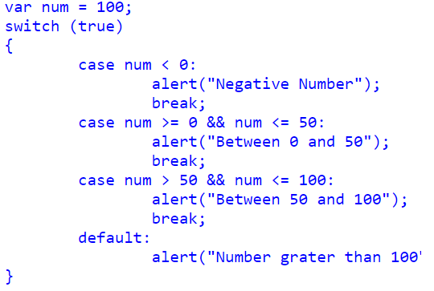
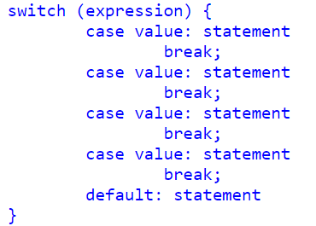
Switch Statements

Slide 31
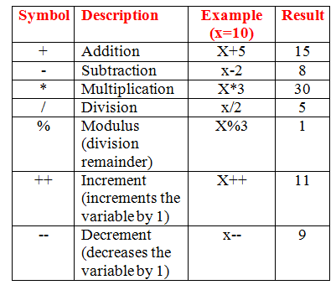
Arithmetic Operators

Slide 32
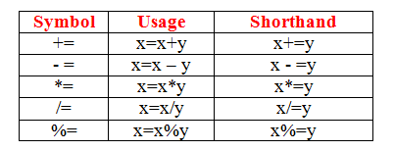
Assignment Operators

Slide 33
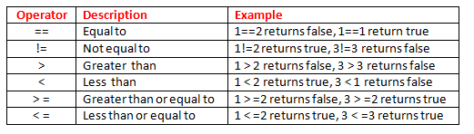
Comparison Operators

Slide 34
Logical Operators
AND (&&) : Allows you to check if both of two conditions are met
OR (||) : Allows you to check if one of two conditions are met
NOT (!) : Allows you to check if something is not the case

Slide 35
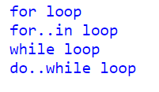
Loops in JavaScript

Slide 36
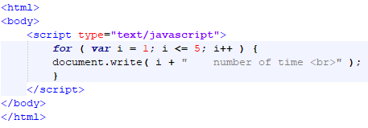
Javascript for loop

Slide 37
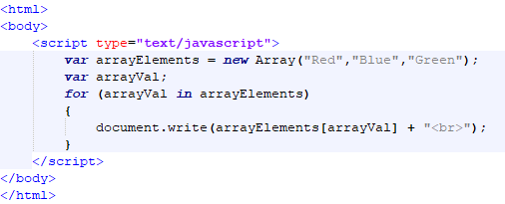
Javascript for..in Loop

Slide 38
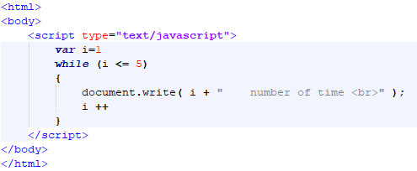
Javascript while Loop

Slide 39
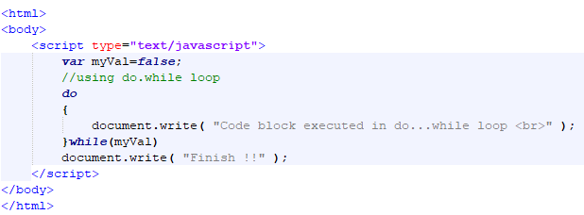
Javascript do..while loop

Slide 40
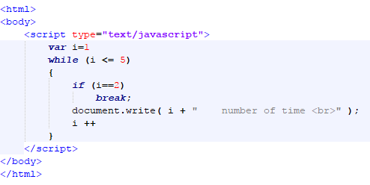
Javascript Break statement

Slide 41
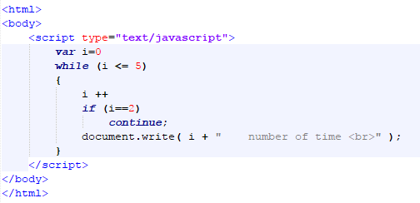
Continue statement

Slide 42
This Week
Review Slides
Read Associated Chapters
Work through Javascript Examples
Update GitHub Account/Webpage
Start Early

Slide 43
Summary
Overview of Javascript Syntax
Examples
Hands-On/Practical

Slide 44
Questions/Discussion

Slide 45
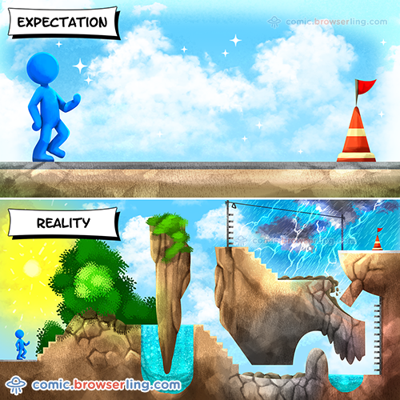
Learning JavaScript

Slide 46
Questions Next Week
Questions to Investigate for Next Week

Slide 47

Question
What order does f receive its arguments?
foo bar baz
foo baz bar
bar foo baz
foo baz

Slide 48
Question
Which of the following is correct about the expression 1==“1.0” in Javascript?
It returns false. The two values have different types.
It returns true. The two values are converted to strings and are equal.
It returns false. The two values are converted to strings and are not equal.
It returns true. The two values are converted to numbers and are equal.

Slide 49
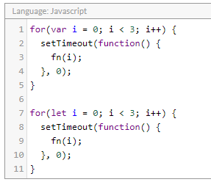
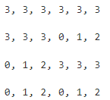
What arguments will fn receive, in order?
a)
b)
c)
d)

