Slide 1
MultiThreading
Object Orientated Programming in Java
Benjamin Kenwright

Slide 2

Outline
Review
Essential Java Multithreading
Examples
Today’s Practical
Review/Discussion

Slide 3
Question
Does the following code compile? What would the output be?

Slide 4

Answer

Slide 5
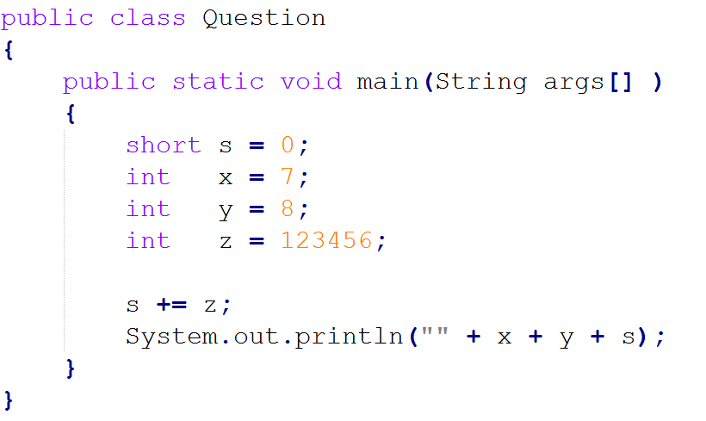
Question
Does the following code compile? What would the output be?

Slide 6
Answer
78-7616
Explain why?

Slide 7
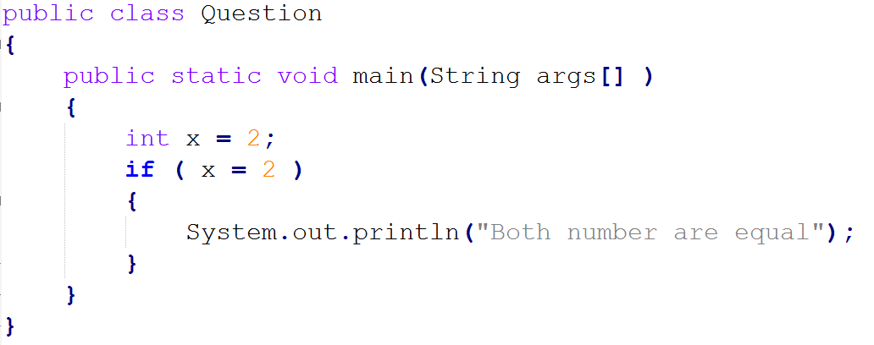
Question
Does the following code compile? What would the output be?

Slide 8

Answer

Slide 9
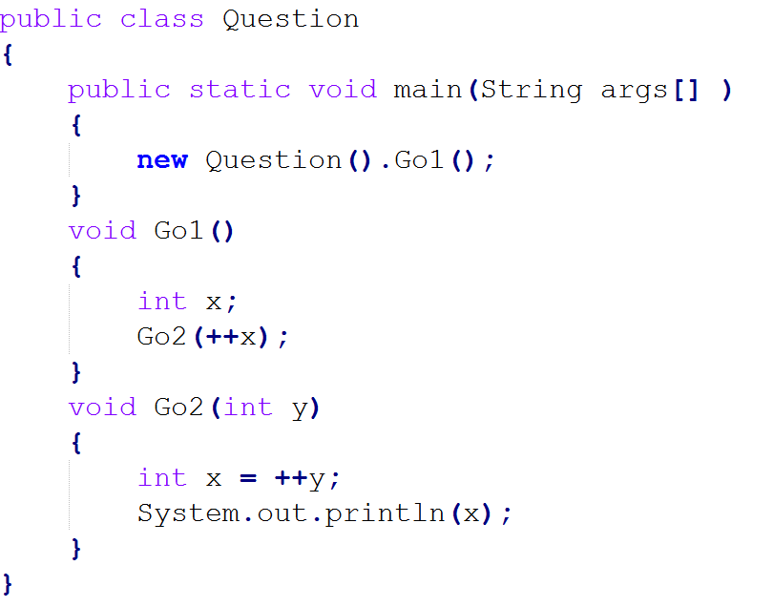
Question
Does the following code compile? What would the output be?

Slide 10

Answer

Slide 11
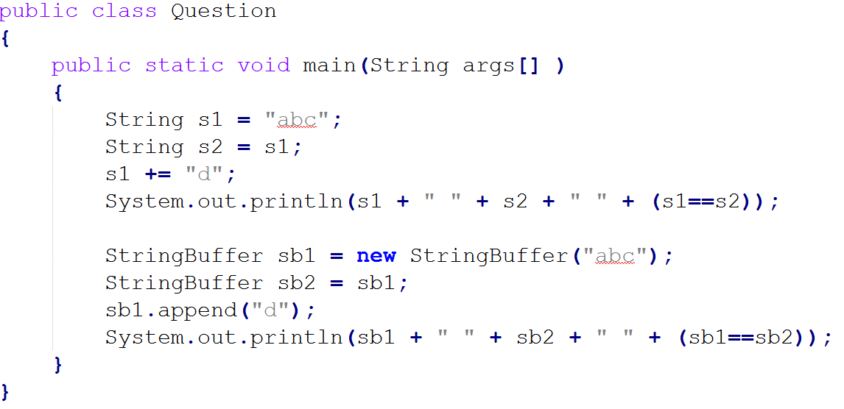
Question
Does the following code compile? What would the output be?

Slide 12
Answer
Yes
abcd abc false
abcd abcd true

Slide 13
Why Multithreading?
What is the rational?
Why make things complicated?
What would happen if we didn’t have multithreading?

Slide 14


Slide 15
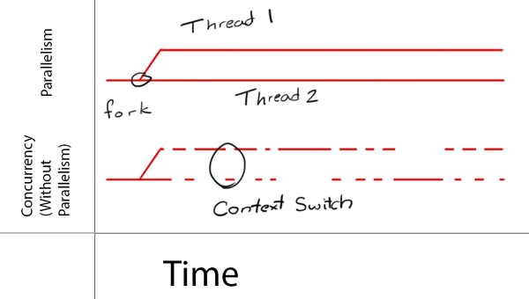
Concurrency & Parallelism

Slide 16
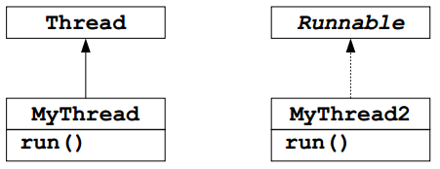
Threading
Advantages & Disadvantages of Threads
Java Threads
Class: java.lang.Thread
Interface: java.lang.Runnable
Multithreaded Programming

Slide 17
Thread Definition
Definition: A thread is a single sequential flow of control within a program (also called lightweight process)

Slide 18
Thread
Each thread acts like its own sequential program
Underlying mechanism divides up CPU between multiple threads
Two types of multithreaded applications
Make many threads that do many tasks in parallel, i.e., no communication between the threads (GUI)
Make many threads that do many tasks concurrently, i.e., communication between the threads (data access)

Slide 19
Advantages/Disadvantages
Advantages
Responsiveness, e.g., of user interfaces
Resource sharing
Economy
Utilization of multiprocessor hardware architectures
Disadvantages
More complicated code
Deadlocks (very hard to debug logical program errors)

Slide 20
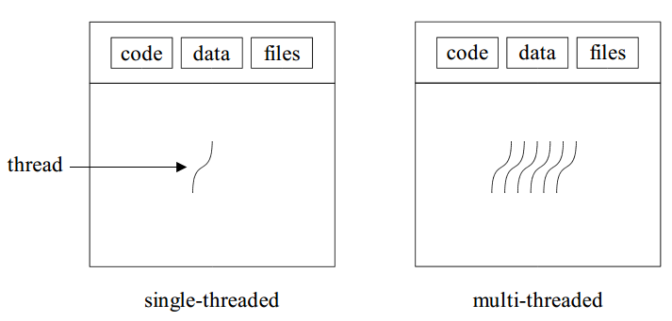
Single & Multithreaded Processes

Slide 21
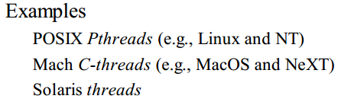
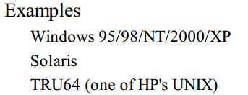
User and Kernel Threads
Thread management done by user-level threads library
Supported by the kernel

Slide 22
Java Threads
Java threads may be created by
Extending Thread class
Implementing the Runnable interface

Slide 23
Class Thread
The simplest way to make a thread
Treats a thread as an object
Override the run() method, i.e., the thread’s “main”
Typically a loop
Continues for the life of the thread
Create Thread object, call method start()
Performs initialization, call method run()
Thread terminates when run() exits

Slide 24
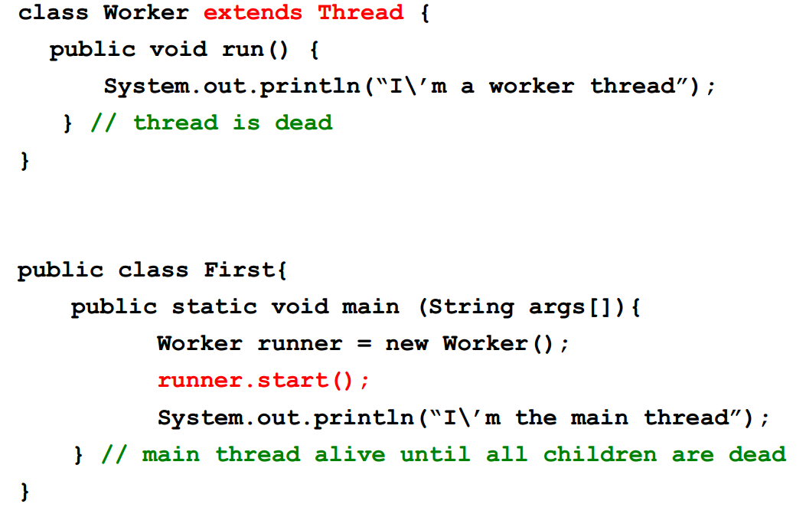
Extending the Thread Class

Slide 25
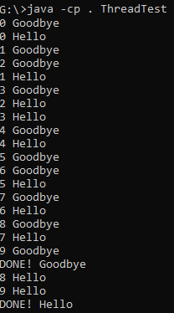
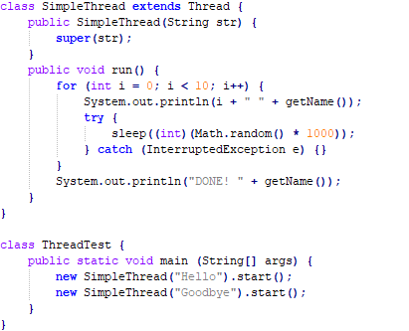
Extending the Thread Class Example
javac ThreadTest.java
java -cp . ThreadTest

Slide 26
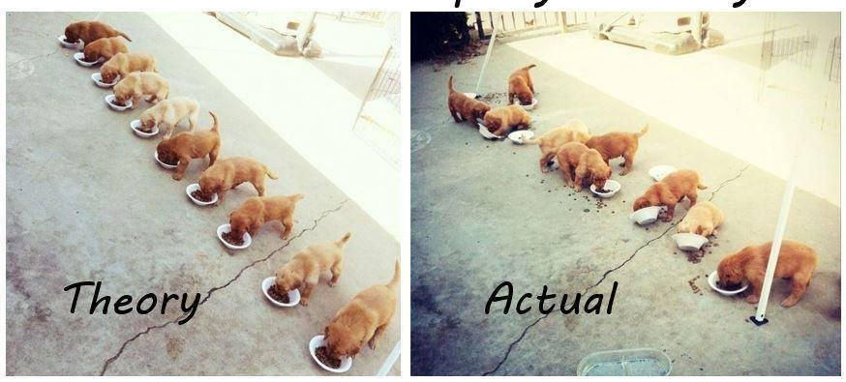
Multithreaded Programming

Slide 27
Sharing Resources
Single threaded programming: you own everything, no problem with sharing
Multi-threaded programming: more than one thread may try to use a shared resource at the same time
Add and withdraw from a bank account
Using the speakers at the same time, etc.
Java provides locks, i.e., monitors, for objects, so you can wrap an object around a resource
First thread that acquires the lock gains control of the object, and the other threads cannot call synchronized methods for that object

Slide 28
Locks
One lock pr. object for the object’s methods
One lock pr. class for the class’ static methods
Typically data is private, only accessed through methods
Must be private to be protected against concurrent access
If a method is synchronized, entering that method acquires the lock
No other thread can call any synchronized method for that object until the lock is released

Slide 29
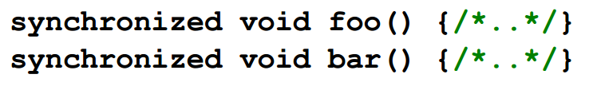
Sharing Resources, cont.
Only one synchronized method can be called at any time for a particular object

Slide 30
Sharing Resources, cont.
Efficiency
Memory: Each object has a lock implemented in Object
Speed and Overhead (e.g., calling)
Older standard Java libraries used synchronized a lot, did not provide any alternatives

Slide 31
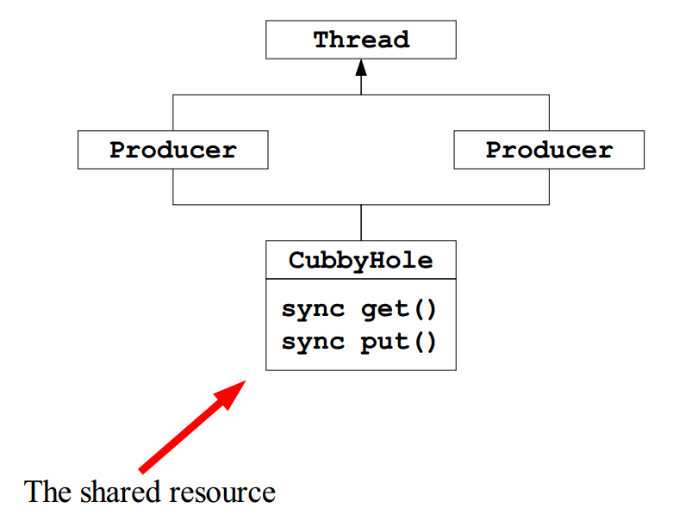
Sharing Resources, Example

Slide 32
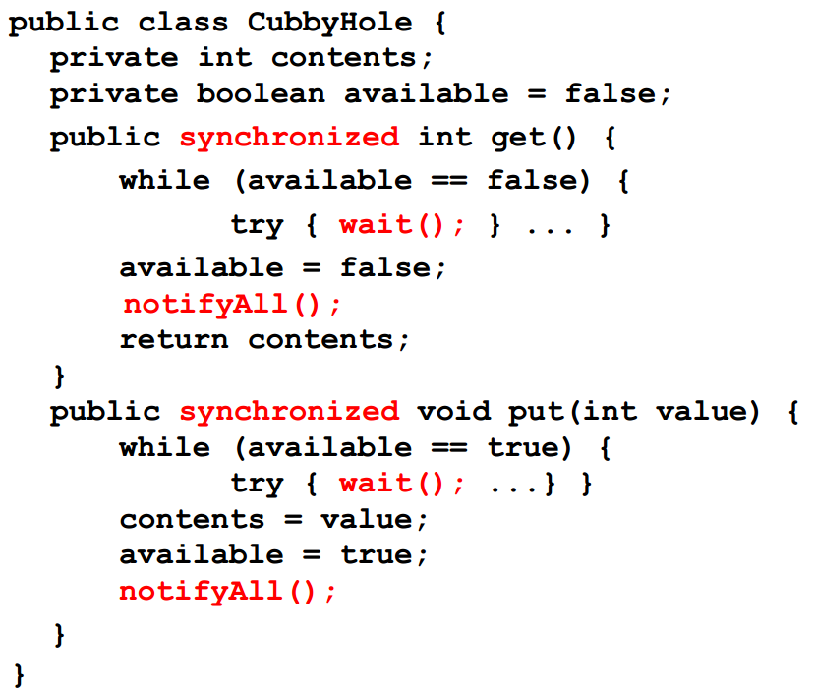
Sharing Resources, Example

Slide 33
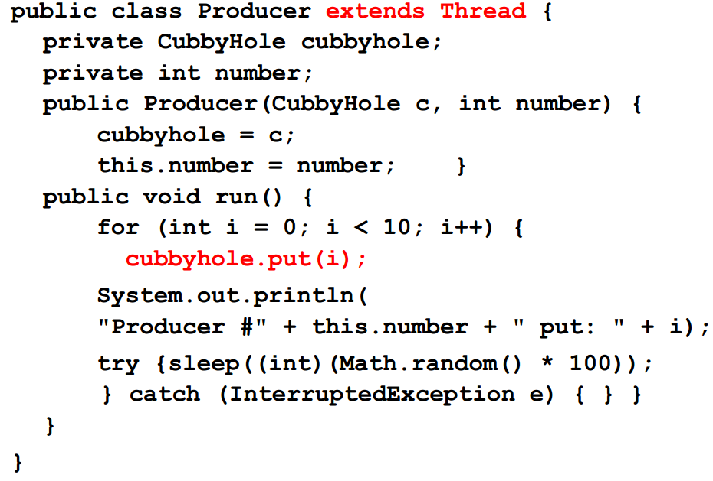
Sharing Resources, Example cont.

Slide 34
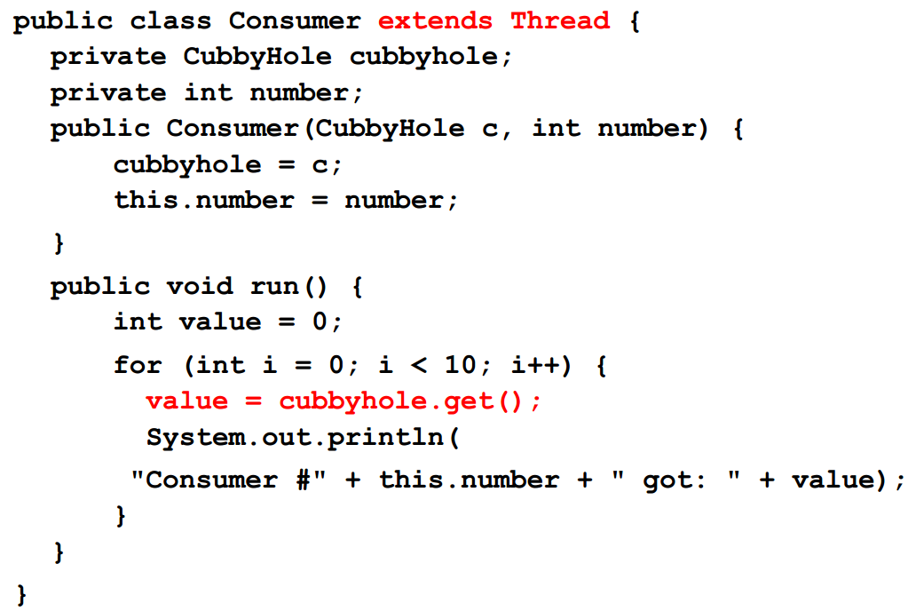
Sharing Resources, Example cont.

Slide 35
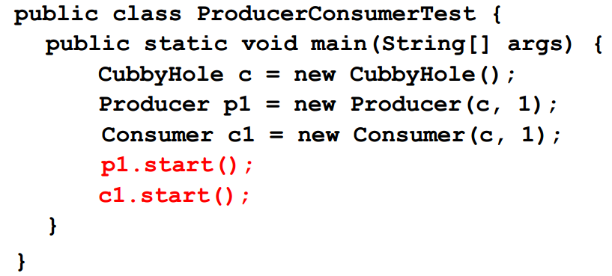
Sharing Resources, Example cont.

Slide 36
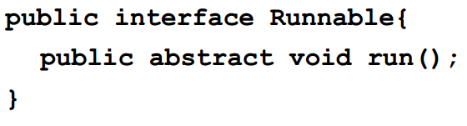
The Runnable Interface
To inherit from an existing object and make it a thread, implement the Runnable interface
A more classical, function-oriented way to use threads

Slide 37
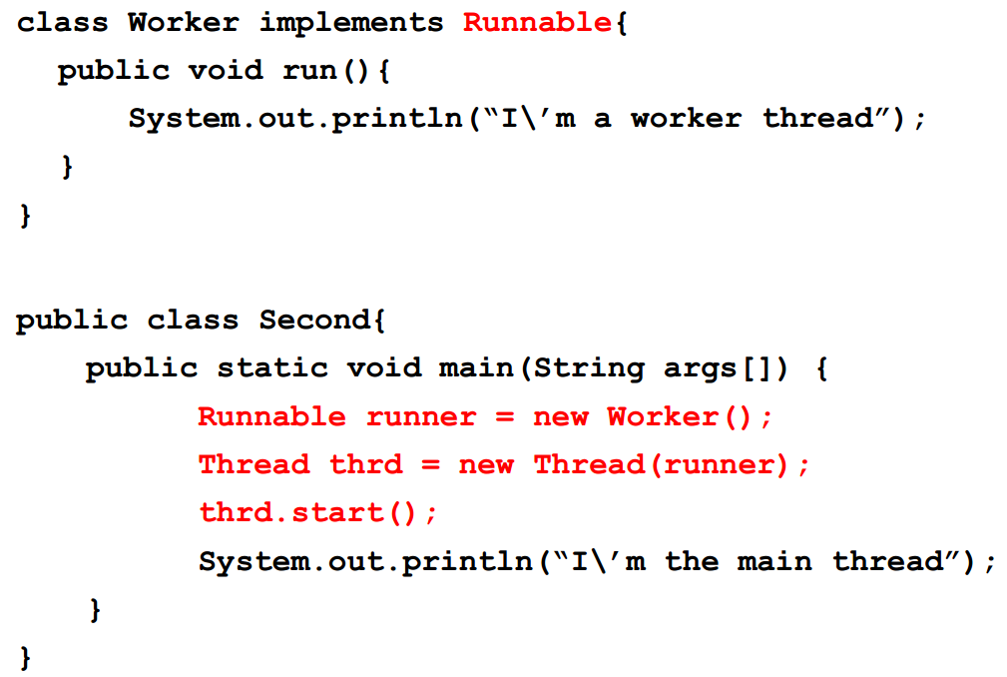
The Runnable Interface, cont .

Slide 38
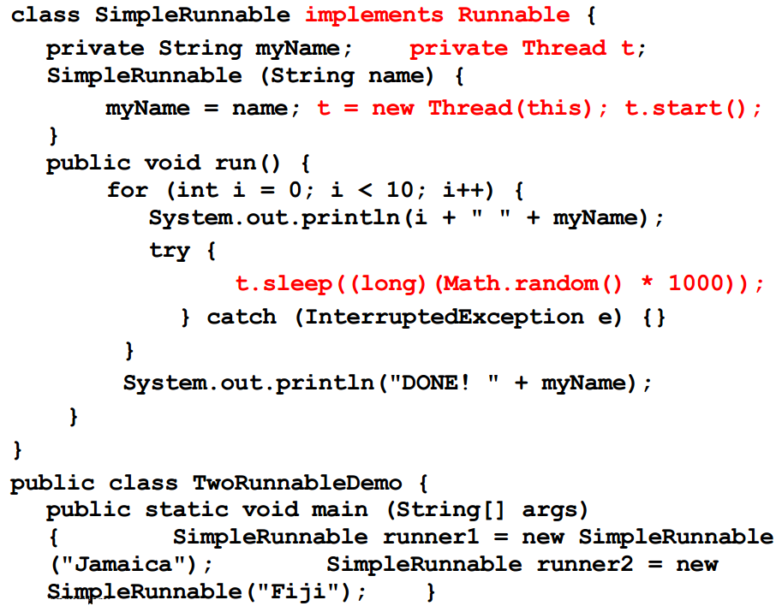
The Runnable Interface, cont.

Slide 39
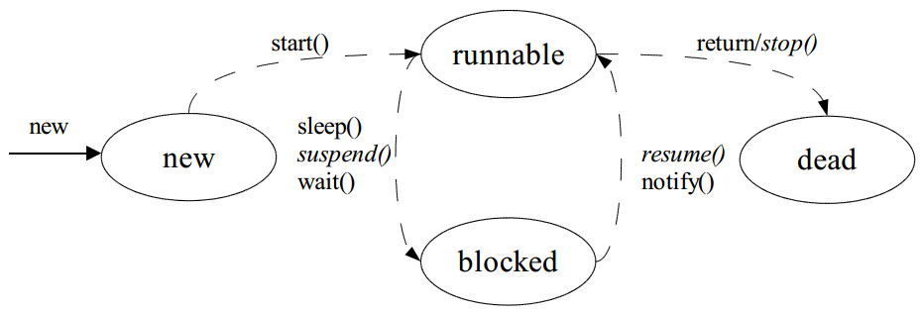
Java Thread Management
suspend() – suspends execution of the currently running thread
sleep() – puts the currently running thread to sleep for a specified amount of time
resume() – resumes execution of a suspended thread
stop() – stops execution of a thread

Slide 40
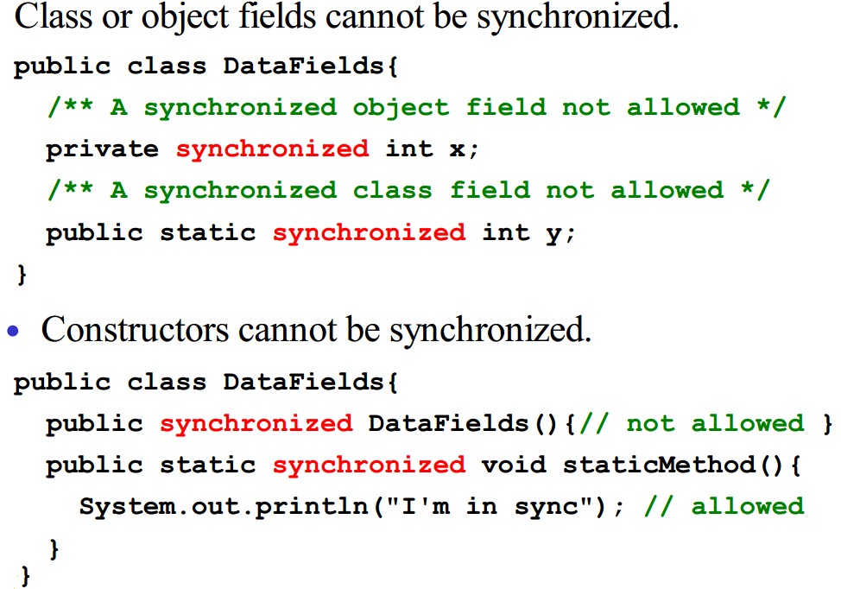
Synchronized Fields and Constructors

Slide 41

Issues
Thread priority
Thread groups
Daemon (unix term)
similar to a service (on Win32)
Deadlock
Very hard to detect logical errors in programs

Slide 42
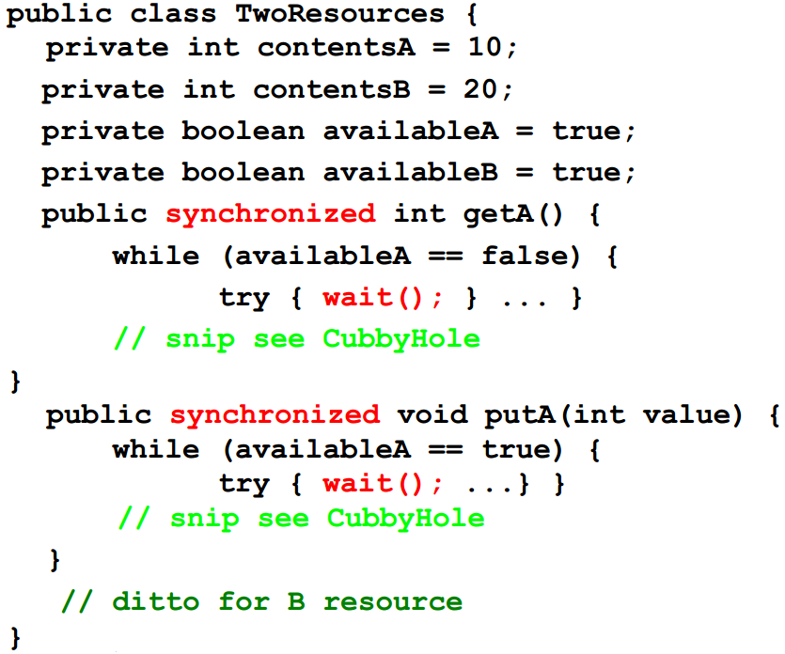
Deadlocks

Slide 43
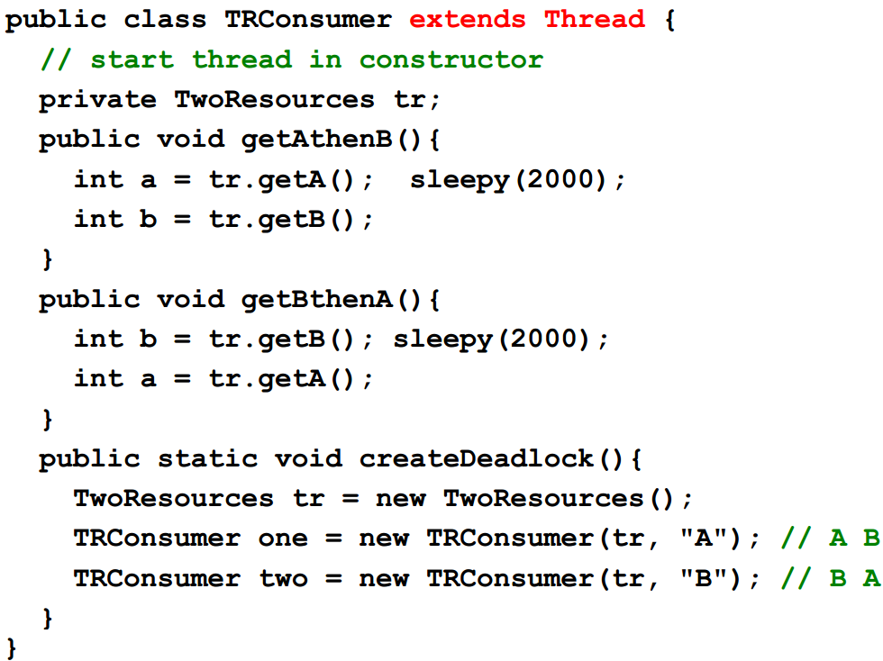
Deadlocks, cont.

Slide 44
Summary
Overview Multithreading with Java
Single-threaded programming: live by all by your self, own everything, no contention for resources
Multithreading programming: suddenly “others” can have collisions and destroy information, get locked up over the use of resources
Multithreading is built-into the Java programming language
Multithreading makes Java programs complicated
Multithreading is by nature difficult, e.g., deadlocks

Slide 45
This Week
Read Associated Chapters
Review Slides
Java Exercises

Slide 46
Exercises
Chapter 29
Exercises 29.1 to 29.4

Slide 47
Questions/Discussion

