Slide 1
Objects and DOM
Web Authoring and Design
Benjamin Kenwright

Slide 2
Outline
What do we mean by Objects and DOM?
Summary
Review/Discussion

Slide 3
DOM
The DOM (Document Object Model) is an interface to the web document provided by the browser manufacturer
Within this model, each element in the HTML document becomes an Object

Slide 4
Nodes
In order to work with the browser and documents, JavaScript uses a hierarchical tree structure of parent and child Objects
The main object is the Document Object, which in turn contains several other child objects
Each Object or element in the document is called a Node in the DOM

Slide 5
Question
What does DOM stand for?

Slide 6
Answer
DOM (Document Object Model)

Slide 7
Tree Structure
The DOM represents a document as a hierarchical tree of nodes, which can have parents, children, and siblings and this determines by its position in the tree structure

Slide 8
Node Types
There are several node types in the tree, each representing different information or markup in the HTML document
Each node type has different properties, methods, data, events, and each may have relationships with other nodes

Slide 9
HTML Document
The Document Object Model provides a uniform representation of the HTML document, and it achieves this by representing the entire HTML document as a tree structure
When a web page is loaded in the browser, it creates a Document Object Model of the web page
Each and every single element in the document will have a corresponding presence in the DOM

Slide 10
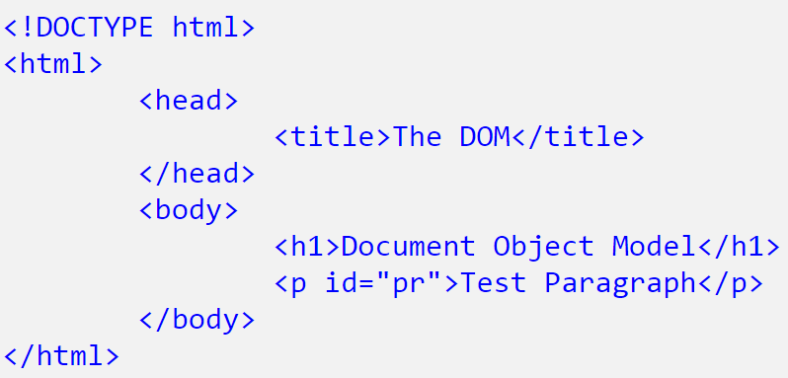
Example

Slide 11
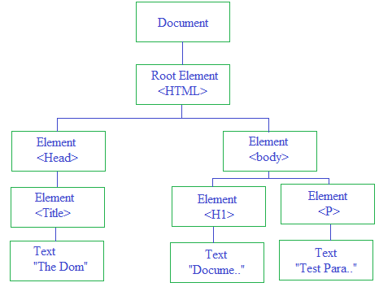
Example Document Object Model

Slide 12
Nodes
Nodes within the DOM are represented by array-like node lists and the individual nodes themselves can be accessed via their index
Using the above tree of nodes, you can access any element in the DOM

Slide 13
Example
document.childNodes[1]
represents the HTMLElement, that is < html > tag.
document.childNodes[1].childNodes[1]
represents HTMLBodyElement, that is < body > tag.
document.childNodes[1].childNodes[1].childNodes[1]
represents HTMLHeadingElement, that is < h1 > tag

Slide 14
DOM Methods
The getElementById() and getElementsByTagName() were the two methods from DOM standard
HTML5 specification adds three new methods for accessing elements, getElementsByClassName(), querySelector(), and querySelectorAll()

Slide 15
getElementbyId()
Typically you want to access an element within the DOM directly and try to do something with it
Javascript provides a document.getElementById() method, which is the easiest way to access an element from the DOM tree structure
It will return the element that has the ID attribute with the specified value.

Slide 16
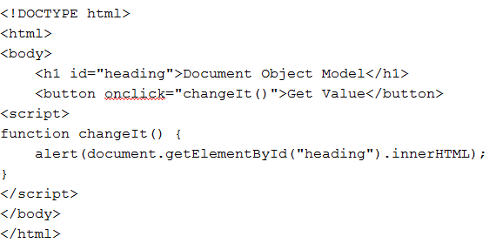
Example

Slide 17
getElementsByTagName()
The getElementsByTagName() is one of the method exposes for accessing nodes directly
This method takes a tag name as argument and returns a collection of all the nodes it finds in the document that are a sort of tag

Slide 18
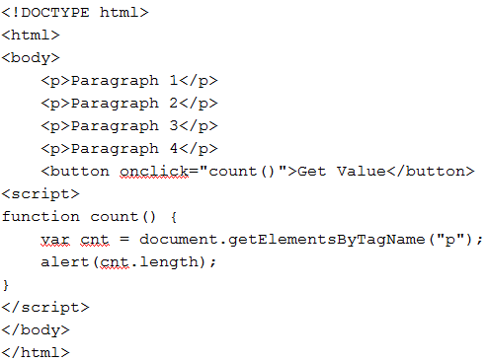
Example

Slide 19
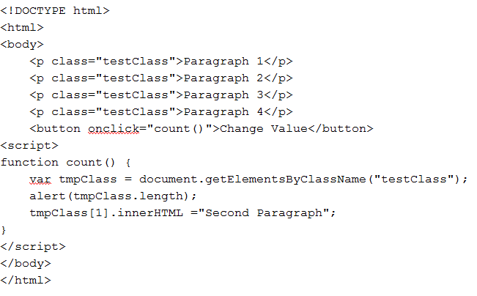
getElementsByClassName()

Slide 20
Summary
Overview of Objects and DOM
Structure of Website
Examples

Slide 21
This Week
Review Slides
Read Associated Chapters
Work through Examples
Setup GitHub Account/Webpage
Exam
Group Project

Slide 22
Questions/Discussion

