Slide 1
CSS Selectors
Web Authoring and Design
Benjamin Kenwright

Slide 2
Outline
Review
What are CSS Selectors?
Different types of Selectors and Syntax
Examples of how to use Selectors
Summary
Review/Discussion

Slide 3
CSS Selectors
CSS selectors are HTML tags to which a CSS style is applied.
This could be any tag like < p > or < h1 >
These are patterns used to select the HTML tags that you want to style.
These patterns may range from simple element names to rich contextual patterns

Slide 4
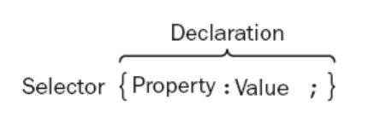
Selector Syntax

Slide 5
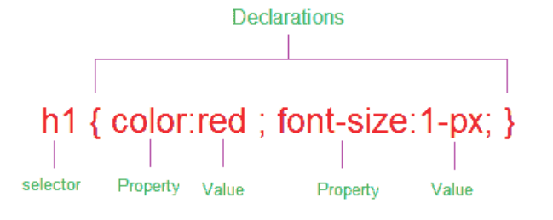
Details
In the following sections, looking at how you can use different types of a selectors to specify which elements a style sheet rule can apply to

Slide 6
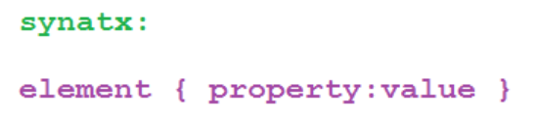

Element Selector or Type Selector
The CSS element Selector or the type selector matches occurrences of those tags specified in the list
e.g.,
Above CSS code sets all paragraph font size as 32.

Slide 7
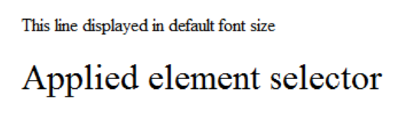
Example Selector
<html>
<head>
<style type="text/css">
p {font-size:32px;}
</style>
</head>
<body>
This line displayed in default font size
<p> Line formatted with element selector </p>
</body>
</html>

Slide 8
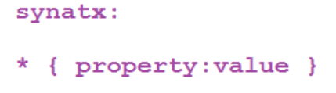

Universal Selector
The universal selector set a value for all elements in the HTML document
e.g.,
Above CSS code set font size =14px to the whole HTML document

Slide 9
Example Universal Selector
<html>
<head>
<style type="text/css">
* {font-size:32px;}
</style>
</head>
<body>
Universal selector set all font size as 22 in this document
</body>
</html>

Slide 10
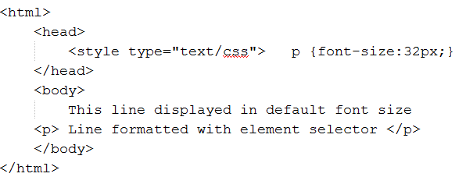
Question
What does the following html/css code do?

Slide 11
Answer
Displays Nothing
Missing closing </script> tag

Slide 12
Grouped Selectors
Whenever a situation that you need to apply the same style property to a number of selectors, then you can group those selectors into one rule by separating them with commas. The selector rule has the same effect to more than one selector at a time

Slide 13
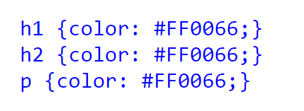

Example Grouped Selectors
Instead of above multiple selectors you can group them as follows:

Slide 14
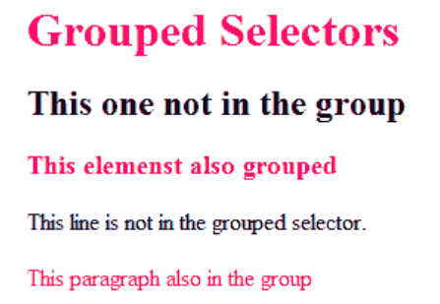
<html>
<head>
<style type="text/css">
h1,h3,p {color: #FF0066;}
</style>
</head>
<body>
<h1>Grouped Selectors</h1>
<h2>This one not in the group</h2>
<h3>This elements also grouped</h3>
This line is not in the grouped selector.
<p>This paragraph also in the group </p>
</body>
</html>

Slide 15
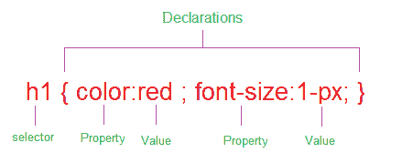
ID Selectors and Class Selectors
Selector is to tell the browser to which style is applied to a specific element in the HTML
Range from simple element names to rich contextual patterns

Slide 16
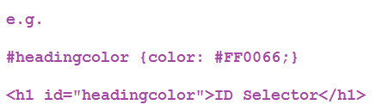
ID selector
ID selectors in CSS allow you to target elements (Tags) by their ID values
ID selectors are unique, so you can apply only to the content of one element
To reference an ID, you precede the ID name with a hash mark (#)

Slide 17
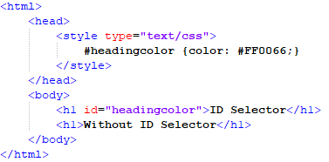
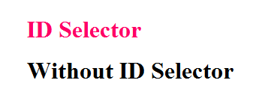
ID Selector Example

Slide 18
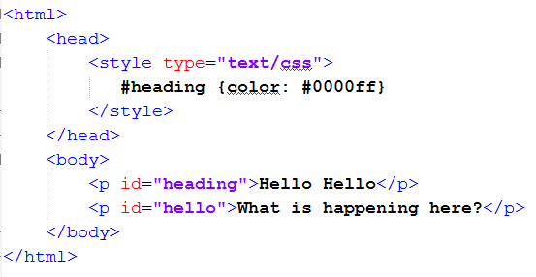
Question
What does the following HTML/CSS do?

Slide 19
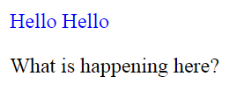
Answer
Blue ‘Hello Hello’
Associated with a valid selector ID

Slide 20

Class Selector
References the class attribute used on HTML elements.
Class selector begins with a dot(.) and followed by a class name

Slide 21
Unlike the id attribute, multiple elements may share same class name, also an element may belong to more than one class

Slide 22

Class in multiple elements
Above code multiple element shared same class name (.textcolor)

Slide 23

Multiple Classes in the same Element
Above code same element implement different class name (.textcolor1 and .textcolor2).

Slide 24
Classes limited to one type of Element
Class Selector, you can limit the scope of the style sheet (CSS) rule to only that type of element
Above code, the selector matches any h1 elements that have a class attribute containing the word "textcolor". If any other element have the class name "textcolor" wont work.

Slide 25
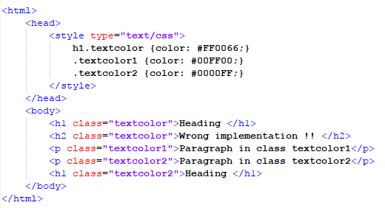
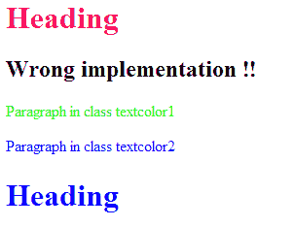
Example

Slide 26
CSS Navigation Menu
Menus should be simple enough for the end user to understand, but also contain the necessary information to guide the end user through the entire website
CSS Menu Bar
Horizontal Menu (CSS Navigation bar)
Vertical Menu (CSS Side Menu)

Slide 27

Horizontal Menu
Options change color when the mouse hovers over the items
Selectable (user can click the buttons)

Slide 28
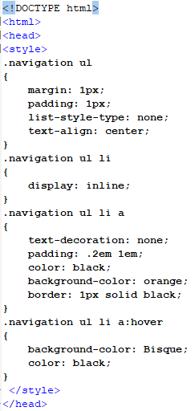
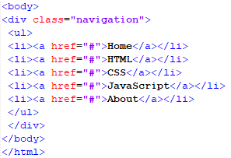
Horizontal Menu

Slide 29
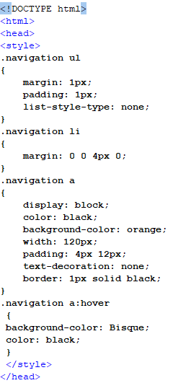
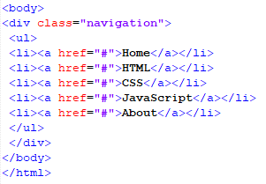
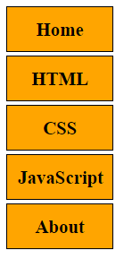
Vertical Menu

Slide 30
Dropdown Menu
CSS dropdown menu provides dynamic and hierarchical view of all main sections on the web page and subsections contained within them. When activated a drops down, it displays a list of values, which allows the user to choose one value from a list

Slide 31
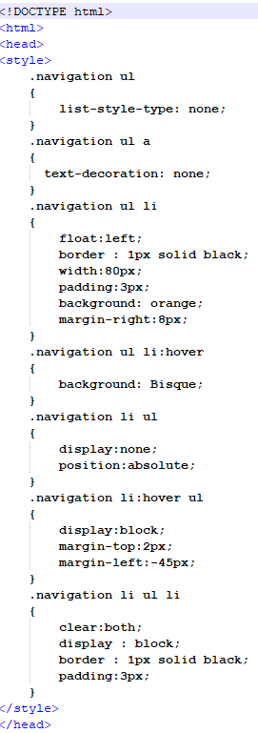
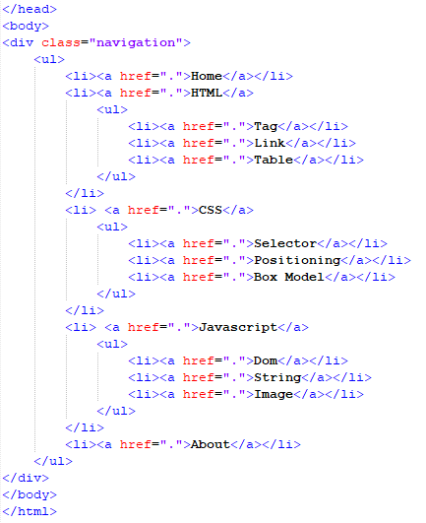
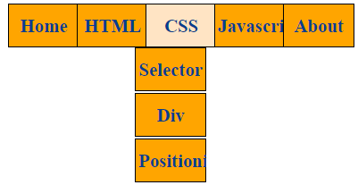

Slide 32
Overlay in CSS
Overlay images/text on top of one another
Add 'triggers' that allow overlays to change (e.g., when mouse is over the image/text)

Slide 33


Image Hover Effects (Image Rollovers)
CSS code shows how to present an Image hover effects

Slide 34
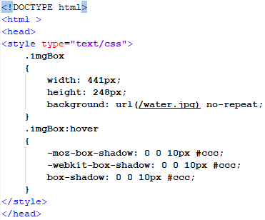


Slide 35


Make A Rollover Image Effect
Image link changes when mouse hovers over the image

Slide 36
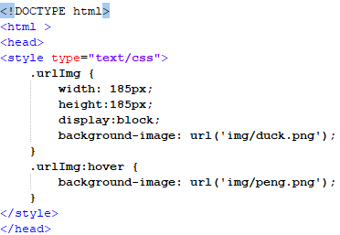


Slide 37

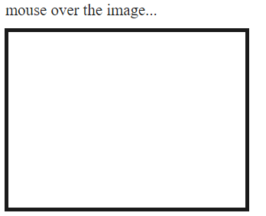
Add color overlay to images

Slide 38
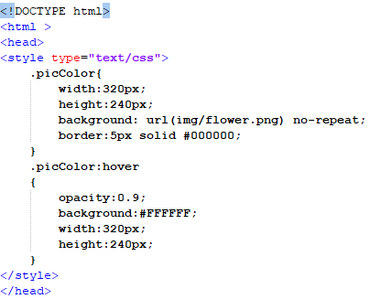


Slide 39

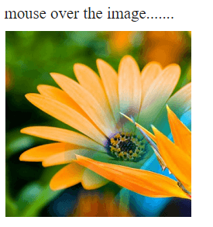
One image on top of another

Slide 40
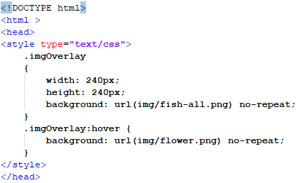


Slide 41

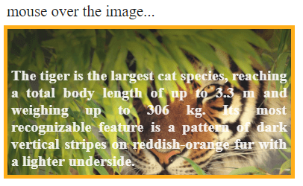
CSS image hover text overlay

Slide 42
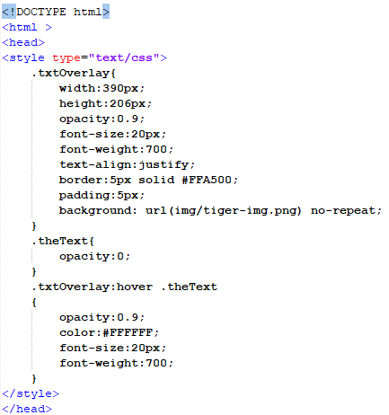
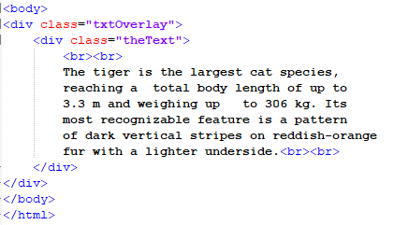

Slide 43
This Week
Review Slides
Read Associated Chapters
Weekly Tasks
Update GitHub Website
Online Quizzes

Slide 44
Summary
Overview of CSS Selectors
Different Selectors
E.g., Universal, Grouped, ..
Selectors in CSS effectively for styling HTML documents
Hands-On/Practical

Slide 45
Questions/Discussion

Slide 46


