Slide 1
Introduction
Object Orientated Analysis and Design
Benjamin Kenwright

Slide 2
Outline
What do we mean by Object Orientated?
Why do we need to analyze and design our solutions?
Give examples
What analysis and design tools are available?
Course structure
Grading/assessment

Slide 3
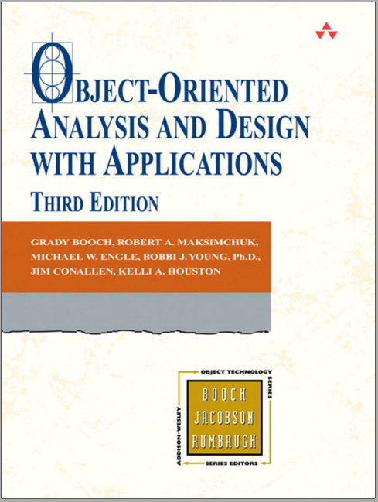
Recommended Book
Object Oriented Analysis and Design with Applications 3rd Edition by Booch
Ebook Available: https://zjnu2017.github.io/OOAD
Complete Reading Chapter 1 Before Next Week

Slide 4
Recommended
Also read around the subject to gain a broad/comprehensive understanding of the topic
Articles, books, online-tutorials, …

Slide 5
Why use Object-Orientation Concepts?
Why use object-orientation?

Slide 6
Why use Object-Orientation Concepts?
Sooner rather than later, you’ll have to work with object-oriented code
Modularity
Scalability
Frameworks
Contributing to open source software
Gives you various ways to think and solve problems
Easier to translate your programming skills into other Object-Oriented languages
Become a more valuable developer

Slide 7
Revision
Review Software Development Methodologies
(Core OO Programming Principles)
What is an object?
What is a class?
What is abstraction?
What is encapsulation?
What is inheritance?
What is an Interface?
What is polymorphism?

Slide 8
Question
What is a Great Software Solution?

Slide 9
Answer
A great software must satisfy the customer
The software must do what the customer wants it to do!
Great software is also
well-designed
well-coded
easy to maintain, reuse, and extend

Slide 10
Question
How do we make Great Software Solutions?

Slide 11
Answer
Apply Object Orientated Analysis and Design Processes
e.g., Make sure your software does what the customer wants it to do
Use OO principles to add flexibility
Strive for a maintainable, reusable design
…

Slide 12
Why do we need Object Orientated Analysis and Design (OOAD)?

Slide 13
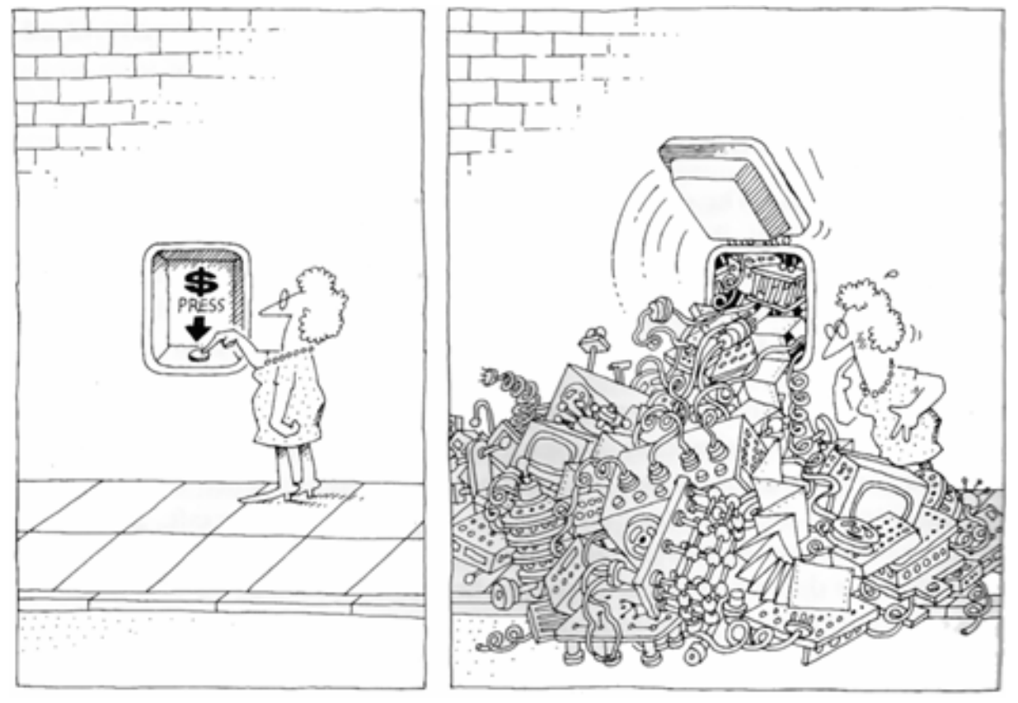
Why we need OOAD?

Slide 14
Why we need OOAD?
Software is inherently complex
Complexity of software systems often exceeds the human intellectual capacity
Helps create illusion of simplicity
Order to Chaos
Add meaningful logic

Slide 15
Object Orientated Analysis and Design
Techniques that allow us to decompose problems/tasks into manageable components
Employs object-oriented methods for organising the complexity of the system
Provides a rich set of models to understand the different aspects of the system under consideration

Slide 16
The primary tasks for the object-oriented `analysis’ (OOA)
Find the objects
Organize the objects
Describe how the objects interact
Define the behavior of the objects
Define the internals of the objects
Common models used in OOA are use-cases and object models

Slide 17
Class Participation
Welcome participation by students
Feel free to interrupt me during lectures to ask questions!
Stupid Questions — No such thing!
No participation leads to “silent tomb” - Boring!
If I speak too fast or you are unsure of something, stop me and ask/tell me to slow down

Slide 18
Class Participation
Quizzes
Discussion/Project
Homeworks
Reading Chapters
Researching Topics
Case studies

Slide 19
Question
Which of the following is the functionality of ‘Data Abstraction’?
a) Reduce Complexity
b) Binds together code and data
c) Parallelism
d) None of the mentioned

Slide 20
Answer
Answer: a
Explanation: An essential element of Object Oriented Programming is ‘Data Abstraction’ which means hiding things. Complexity is managed through abstraction.

Slide 21
Goals
Provide students with knowledge and skills in:
Object-oriented concepts
OO analysis, design, and implementation techniques
Object-oriented design methods
(aka software development life cycles)
Students should view OO software development as a software engineering process that has well-defined stages with each stage requiring specific tools and techniques

Slide 22
Grading
Attendance 10%
Experiments & Discussion 40%
Final Exam 50%

Slide 23
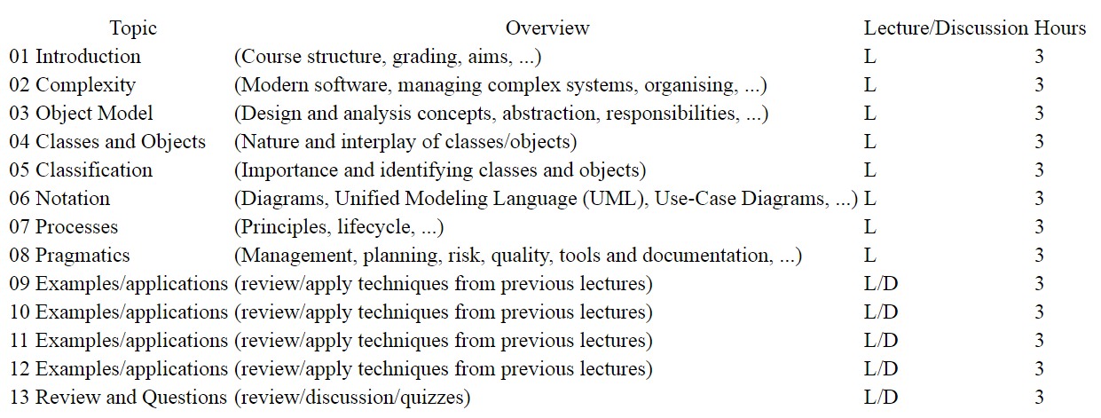
Structure Topics

Slide 24
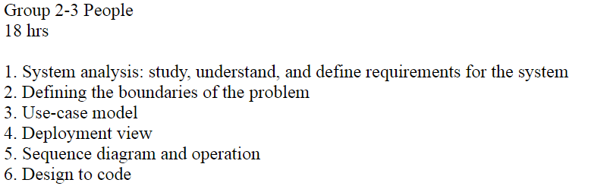
Experiments/Discussion

Slide 25
Contact Details
Questions/Issues
Benjamin Kenwright
email: bkenwright@ieee.org
Open Door Policy
Problems/Help
Within Reason

Slide 26
Question
Which of the following mechanisms is/are provided by Object Oriented Language to implement Object Oriented Model?
a) Encapsulation
b) Inheritance
c) Polymorphism
d) All of the mentioned

Slide 27
Answer
d) All of the mentioned

Slide 28
Question
An object is a combination of data and logic; the representation of some real-world entity
True
False

Slide 29
Answer
a) True

Slide 30
Summary
Clear idea of the goal of this course/topic
Structure of the course
Assessment/grading

Slide 31
This Week
Review Slides
Read Chapter 1
Challenging so Start Early

Slide 32
Questions/Discussion

Slide 33
Optional Revision/Review Slides

Slide 34
Revision
Review Software Development Methodologies
(Core OO Programming Principles)
Why use object-orientation?
What is a class?
What is an object?
What is abstraction?
What is encapsulation?
What is inheritance?
What is an Interface?
What is polymorphism?

Slide 35
What Is a Class?
A class is a blueprint or prototype from which objects are created. This section defines a class that models the state and behavior of a real-world object. It intentionally focuses on the basics, showing how even a simple class can cleanly model state and behavior.

Slide 36
What Is an Object?
An object is a software bundle of related state and behavior. Software objects are often used to model the real-world objects that you find in everyday life.

Slide 37
What is Abstraction?
Abstraction is a process where you show only “relevant” data and “hide” unnecessary details of an object from the user. Consider your mobile phone, you just need to know what buttons are to be pressed to send a message or make a call, What happens when you press a button, how your messages are sent, how your calls are connected is all abstracted away from the user.

Slide 38
What is Encapsulation?
Encapsulation is the process of combining data and functions into a single unit called class. In Encapsulation, the data is not accessed directly; it is accessed through the functions present inside the class. In simpler words, attributes of the class are kept private and public getter and setter methods are provided to manipulate these attributes. Thus, encapsulation makes the concept of data hiding possible.

Slide 39
What Is Inheritance?
Inheritance provides a powerful and natural mechanism for organizing and structuring your software. Classes inherit state and behavior from their superclasses.

Slide 40
What Is an Interface?
An interface is a contract between a class and the outside world. When a class implements an interface, it promises to provide the behavior published by that interface.

Slide 41
What does Polymorphism mean?
Polymorphism is an object-oriented programming concept that refers to the ability of a variable, function or object to take on multiple forms. A language that features polymorphism allows developers to program in the general rather than program in the specific.

