Slide 1
Object Model
Object Orientated Analysis and Design
Benjamin Kenwright

Slide 2
Outline
Submissions/Quizzes
Review Object Orientated Programming Concepts (e.g., encapsulation, data abstraction, ..)
What do we mean by the Object Model?
Why software has Evolved?
Questions & Discussion

Slide 3
Email?
Did everyone get an email from me yesterday (Tuesday)?
Login details quizzes/submissions

Slide 4
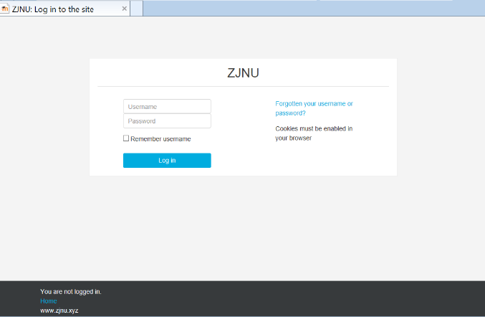
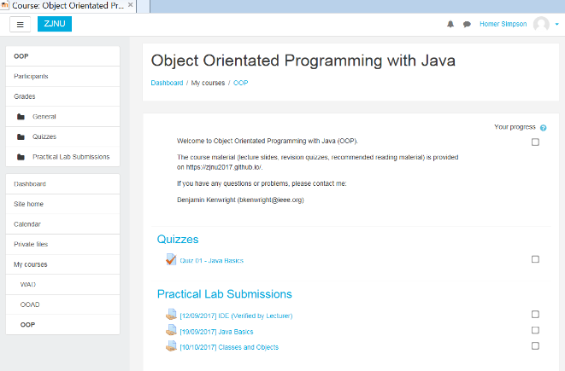
Submissions/Quizzes
Course material (Public)
https://zjnu2017.github.io/
Submissions/Quizzes (Graded/Private)
www.zjnu.xyz
(Login – Student No)
Password Emailed

Slide 5
Why Online Quizzes?
Take the quizzes as many times as you want
Opportunity to `improve’ learn from mistakes (instead of a single pass/fail)
Quizzes contribute to your final mark
10-20 multiple choice questions added each week
Straightforward and help prepare for the final exam

Slide 6
Why Online Project Submissions?
Experiment/project submission should be submitted online
Single .zip for each `task’
Specified this week
Enables you access to your coursework
(e.g., you can review it regularly/backed up)
Lets me provide feedback, guidance and comments which you can review

Slide 7
Revision Question
Requirements change during development?
A. True
B. False

Slide 8
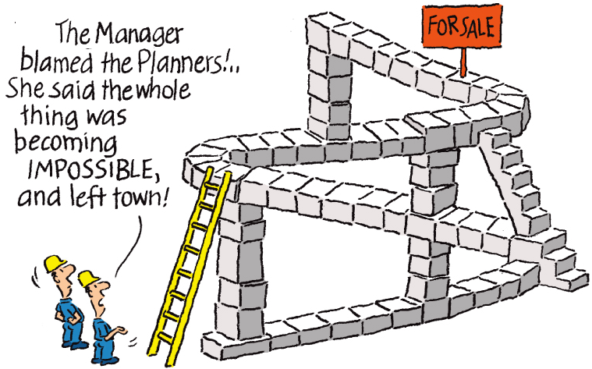
Answer
A. True

Slide 9
Evolution of the Object Model
Where did the Object Model come from?
How has the topology of programming languages changed over time?

Slide 10
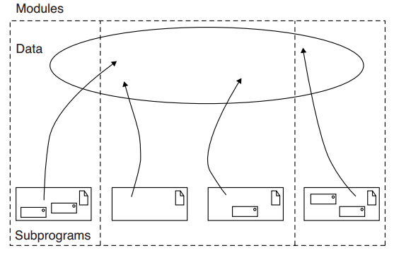
Topology of Early Generation Programming Languages

Slide 11
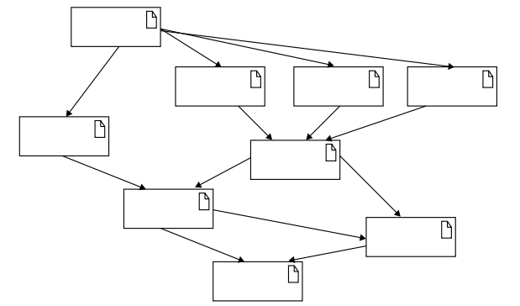
Topology of Small to Moderate-Sized Applications Using Object-Based and Object-Oriented Programming

Slide 12
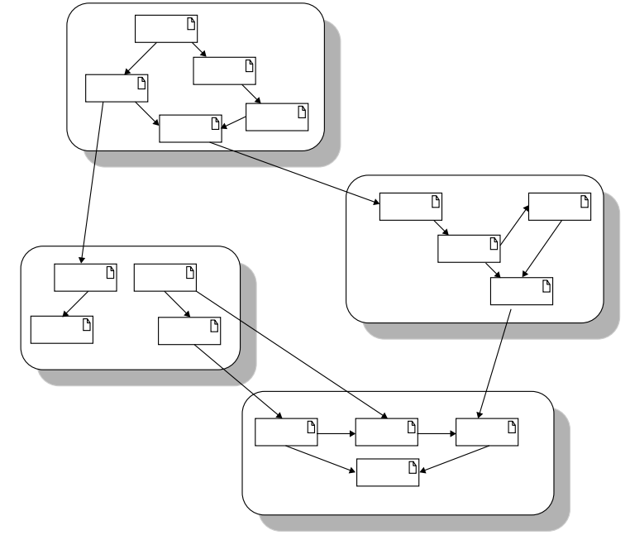
Topology of Large Applications Using Object-Based and Object-Oriented Programming Languages

Slide 13

Discussion Activity
Explain in your own words how software has changed over the last 20 years?
Why software engineering methods have had to change?

Slide 14
Foundation of the `Object Model’
Object-oriented design methods have evolved to help developers exploit the expressive power of object-based and object-oriented programming languages
Classes and Objects as basic building blocks

Slide 15
Question
Object-oriented design methods cause security problems as they don’t use object-based and object-oriented programming languages
True
False

Slide 16
Answer
b) False
Object-oriented design methods have evolved to help developers exploit the expressive power of object-based and object-oriented programming languages

Slide 17
What is Object-Oriented Programming (OOP)?

Slide 18
What is Object-Oriented Programming (OOP)?
Three important parts :
(1) Object-oriented programming uses objects, not algorithms, as its fundamental logical building blocks (the “part of” hierarchy;
(2) each object is an instance of some class; and
(3) classes may be related to one another via inheritance relationships (the “is a” hierarchy).

Slide 19
All Three Elements
A program may appear to be object-oriented, but if any of these three elements is missing, it is not an object-oriented program
For example:
Programming without inheritance is distinctly not object oriented; that would merely be programming with abstract data types

Slide 20
Question
What are the three important parts of Object-Oriented Programming (OOP)?
uses objects; each object is an instance of some class; classes may be related to one another via inheritance
use modules; hierarchical structure; structures must be related to one another via inheritance
hierarchical structure; collection of objects; objects must be related to one another via polymorphism

Slide 21
Answer
A. uses objects; each object is an instance of some class; classes may be related to one another via inheritance

Slide 22
OO Requirements
Language is object-oriented if and only if it satisfies the following requirements:
It supports objects that are data abstractions with an interface of named operations and a hidden local state
Objects have an associated type [class]
Types [classes] may inherit attributes from supertypes [superclasses]

Slide 23
What is Object Oriented Design (OOD)?

Slide 24
What is Object Oriented Design (OOD)?
Two important parts of object-oriented design:
(1) leads to an object-oriented decomposition and
(2) uses different notations to express different models of the logical (class and object structure) and physical (module and process architecture) design of a system

Slide 25
What is Object-Oriented Analysis (OOA)?
Object-oriented analysis is a method of analysis that examines requirements from the perspective of the classes and objects found in the vocabulary of the problem domain

Slide 26
How are OOA, OOD, and OOP related?

Slide 27
How are OOA, OOD, and OOP related?
The products of object-oriented analysis serve as the models from which we may start an object-oriented design
The products of object-oriented design can then be used as blueprints for completely implementing a system using object-oriented programming methods

Slide 28
Object-Orientated Model
Four major elements of this model are:
Abstraction
Encapsulation
Modularity
Hierarchy
By major, we mean that a model without any one of these elements is not object oriented

Slide 29
Object-Orientated Model
The three minor elements of the object model:
Typing
Concurrency
Persistence
By minor, we mean that each of these elements is a useful, but not essential, part of the object model

Slide 30
Discussion Activity
Explain how software within a large company would be developed/managed?
What is important when developing `large’ software project?

Slide 31
Question
The three minor elements of the object model are:
a) Abstraction, Encapsulation, Inheritance
b) Modularity, Persistence, Concurrency
c) Concurrency, Persistence, Typing
d) Persistence, Abstraction, Concurrency

Slide 32
Answer
c) Concurrency, Persistence, Typing

Slide 33
What is the Meaning of Abstraction?

Slide 34
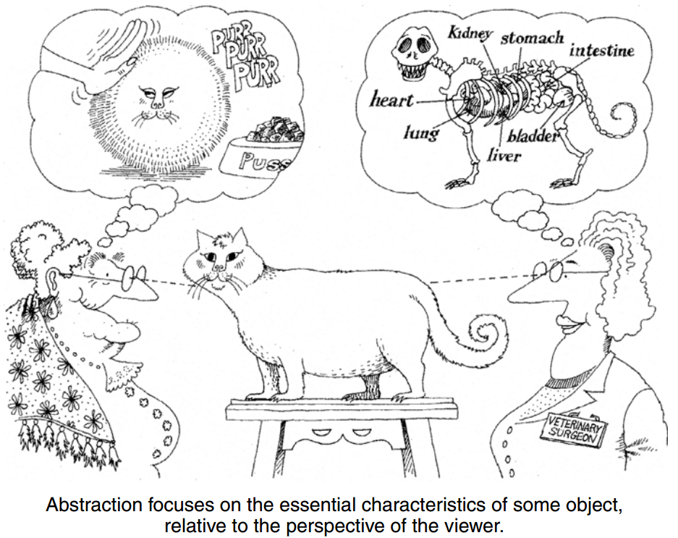
What is the Meaning of Abstraction?

Slide 35
What is the Meaning of Abstraction?
An abstraction denotes the essential characteristics of an object that distinguish it from all other kinds of objects and thus provide crisply defined conceptual boundaries, relative to the perspective of the viewer
Abstraction of an object should precede the decisions about its implementation

Slide 36
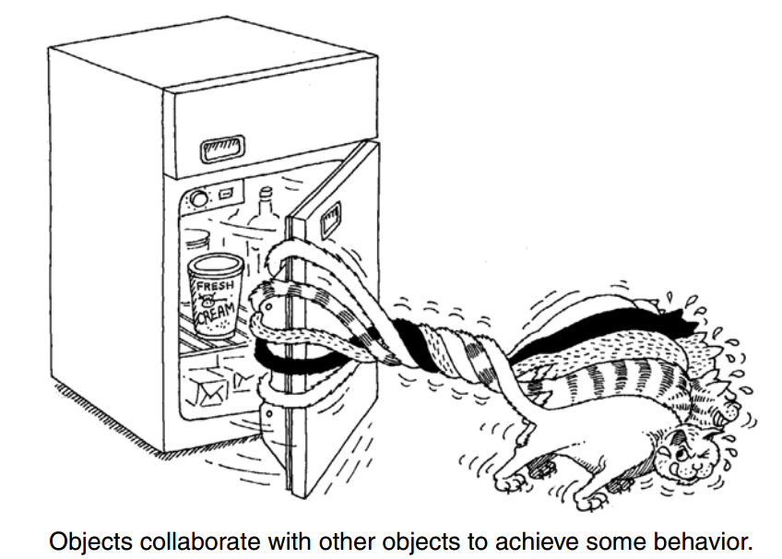
Synergy
No object stands alone;
Every object collaborates with other objects to achieve some behavior

Slide 37
What is the Meaning of Encapsulation?

Slide 38
What is the Meaning of Encapsulation?
Encapsulation is achieved through information hiding (not just data hiding), which is the process of hiding all the secrets of an object that do not contribute to its essential characteristics

Slide 39
Abstraction & Encapsulation
Abstraction and encapsulation are complementary concepts
Abstraction focuses on the observable behavior of an object,
whereas encapsulation focuses on the implementation that gives rise to this behaviour
Encapsulation provides explicit barriers among different abstractions and thus leads to a clear separation of concerns

Slide 40
Abstraction & Encapsulation Cont.
For abstraction to work, implementations must be encapsulated
Each class must have two parts:
an interface and an implementation.
The interface of a class captures only its outside view, encompassing our abstraction of the behavior common to all instances of the class

Slide 41
Question
Abstraction and encapsulation are not complementary concepts
True
False

Slide 42
Answer
b) False
Abstraction and encapsulation are complementary concepts

Slide 43
Question
For abstraction to work, implementations must be encapsulated
True
False

Slide 44
Answer
a) True

Slide 45
What is the Meaning of Modularity?

Slide 46
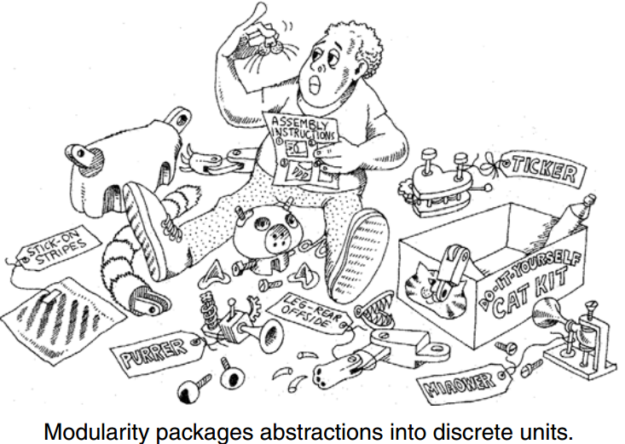
What is the Meaning of Modularity?

Slide 47
What is the Meaning of Modularity?
Act of partitioning a program into individual components can reduce its complexity
Creates well-defined, documented boundaries (or interfaces) within the program
Modules are essential to help manage complexity

Slide 48
Question
Why is modularity important?
Enables us to partitioning a program into individual components can reduce its complexity
Enables us to develop more optimised algorithms
Modularity causes issues with boundaries (or interfaces) within the program

Slide 49
Answer
a) Enables us to partitioning a program into individual components can reduce its complexity

Slide 50
What is the Meaning of Hierarchy?

Slide 51
What is the Meaning of Hierarchy?
Hierarchy is a ranking or ordering of abstractions

Slide 52
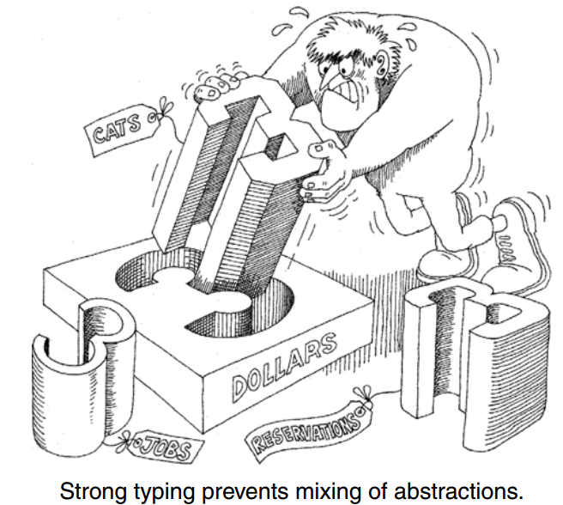
What is the Meaning of Typing?

Slide 53
What is the Meaning of Typing?
Typing is the enforcement of the class of an object, such that objects of different types may not be interchanged, or at the most, they may be interchanged only in very restricted ways
Typing lets us express our abstractions
Strong typing prevents mixing of abstractions

Slide 54
What is the Meaning of Typing?
For example, an object may have both a class and a type. In Smalltalk, objects of the classes SmallInteger, LargeNegativeInteger, and LargePositiveInteger are all of the same type, Integer

Slide 55
Typing
Some important benefits to be derived from using strongly typed languages:
Without type checking, a program in most languages can ‘crash’ in mysterious ways at runtime
In most systems, the edit-compile-debug cycle is so tedious that early error detection is indispensable
Type declarations help to document programs
Most compilers can generate more efficient object code if types are declared

Slide 56
Static and Dynamic Typing
Static typing (also known as static binding or early binding) means that the types of all variables and expressions are fixed at the time of compilation;
Dynamic typing (also known as late binding) means that the types of all variables and expressions are not known until runtime

Slide 57
Benefits of the Object Model
Many people who have no idea how a computer works find the idea of object-oriented systems quite natural
Object model reduces the risks inherent in developing complex systems
Object model produces systems that are built on stable intermediate forms, which are more resilient to change
Object model encourages the reuse not only of software but of entire designs
Object model helps us to exploit the expressive power of object-based and object-oriented programming languages

Slide 58
Summary
Clear idea of Object Model in Object Orientated Analysis and Design
Address the issues of programming-in-the-large
Abstraction, Encapsulation, Modularity and Hierarchy
Typing is the enforcement of the class of an object interchanging (strict rules)

Slide 59
This Week
Review Slides
Read Chapter 3
Online Quizzes
Contribute towards your final grade
Attempt again and again (100%)
Decide on `Groups’
Next week `Allocate’ Project Details

Slide 60
Questions/Discussion

Slide 61
Question
What is software synergy?
a) Object collaborates with other objects to achieve some behaviour
b) Every object stands alone
c) Power of a single method
d) Another term for object orientated techniques

Slide 62
Answer
a) Object collaborates with other objects to achieve some behaviour (i.e., no object stands alone)

Slide 63
Question
Encapsulation focuses on the observable behavior of an object, whereas abstraction focuses on the implementation that gives rise to this behaviour
True
False

Slide 64
Answer
b) False
Abstraction focuses on the observable behavior of an object, whereas encapsulation focuses on the implementation that gives rise to this behaviour

Slide 65
Question
The four major elements of the Object Orientated model are:
a) Encapsulation, Inheritance, Abstraction
b) Abstraction, Encapsulation, Modularity, Hierarchy
c) Abstraction, Modularity, Hierarchy, Inheritance
d) Polymorphism, Scalability, Complexity, Abstraction

Slide 66
Answer
b) Abstraction, Encapsulation, Modularity, Hierarchy

Slide 67
Question
Encapsulation is avoided through information sharing, which is the process of showing all the secrets of an object that do not contribute to its essential characteristics
True
False

Slide 68
Answer
a) False
Encapsulation is achieved through information hiding (not just data hiding), which is the process of hiding all the secrets of an object that do not contribute to its essential characteristics

