Slide 1
Classes and Objects
Object Orientated Analysis and Design
Benjamin Kenwright

Slide 2
Outline
Review Previous Weeks
Object Model, Complexity, ..
What do we mean by Classes and Objects?
Summary/Discussion

Slide 3
Review
Last Week Object Model and Evolution of Software Engineering
Familiar with Chapters 1, 2 and 3
Read Chapter 3 Last Week
Reviewing material regularly
e.g., complexity, object orientated concepts, ..

Slide 4
Revision Question
Write down the four elements that Inherent Complexity derives from?
(5 Minutes)

Slide 5
Answer
Inherent Complexity derives from four elements:
complexity of the problem domain
difficulty of managing the development process
flexibility possible through software
problems of characterizing the behavior of discrete systems

Slide 6
Revision Question
What are the three important parts of Object-Oriented Programming (OOP)?
a) uses objects; each object is an instance of some class; classes may be related to one another via inheritance
b) use modules; hierarchical structure; structures must be related to one another via inheritance
c) hierarchical structure; collection of objects; objects must be related to one another via polymorphism

Slide 7
Answer
a) uses objects; each object is an instance of some class; classes may be related to one another via inheritance

Slide 8
Revision Question
Why is modularity important?
Enables us to partitioning a program into individual components can reduce its complexity
Enables us to develop more optimised algorithms
Modularity causes issues with boundaries (or interfaces) within the program

Slide 9
Answer
a) Enables us to partitioning a program into individual components can reduce its complexity

Slide 10

Building Blocks
When we use object-oriented methods to analyze or design a complex software system, our basic building blocks are classes and objects

Slide 11
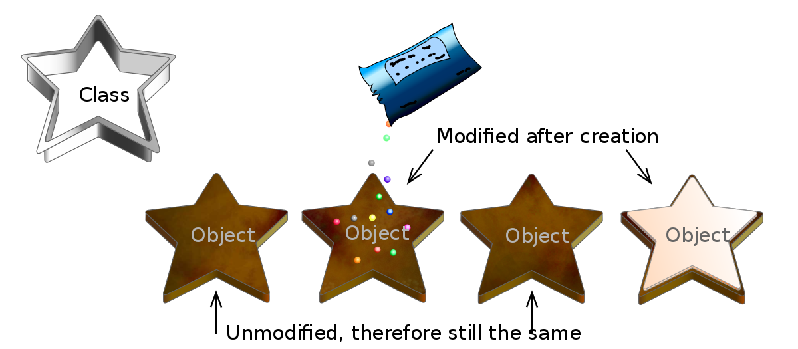
What Is and What Isn’t an Object?

Slide 12
What Is and What Isn’t an Object?
An object is an entity that has state, behavior, and identity. The structure and behavior of similar objects are defined in their common class. The terms instance and object are interchangeable

Slide 14
Question
An object is an entity that has:
state, action, dependencies
identity, state, behavior
c) behaviour, action, state
d) class, state, memory

Slide 15
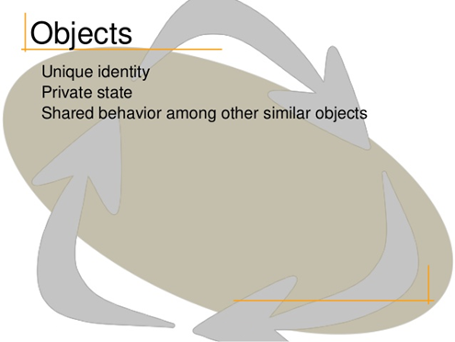
Answer
b) identity, state, behavior

Slide 16
State
The state of an object encompasses all of the (usually static) properties of the object plus the current (usually dynamic) values of each of these properties
Examples of State Properties
Elevators travel up or down
Current floor
Vending machines accept coins
Number of coins deposited
Clocks indicate the current time
The number of minutes since the last hour

Slide 17
Behavior
Behavior is how an object acts and reacts, in terms of its state changes and message passing
Example: Behavior of a car: braking, changing gears, opening doors, moving forwards or backwards, ..

Slide 18
Identity
Identity is that property of an object which distinguishes it from all other objects

Slide 19
Question
State is how an object acts and reacts, in terms of its state changes and message passing
True
False

Slide 20
Answer
b) False
Behavior is how an object acts and reacts, in terms of its state changes and message passing.

Slide 21
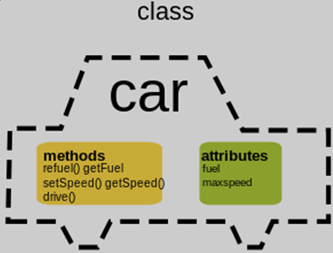
What Is and What Isn’t a Class?

Slide 22
What Is and What Isn’t a Class?
A class is a set of objects that share a common structure, common behavior, and common semantics
A single object is simply an instance of a class
What isn’t a class?
An object is not a class. Objects that share no common structure and behavior cannot be grouped in a class because, by definition, they are unrelated except by their general nature as objects

Slide 23
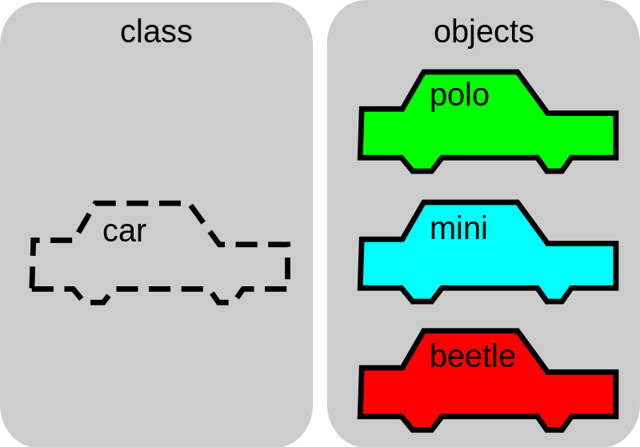
Review

Slide 24
Inheritance

Slide 25
Inheritance
Inheritance is an interesting concept for representing concrete relationships
Including generalization/specialization relationships
A subclass may inherit the structure and behavior of its superclass

Slide 26
Polymorphism
Generally, the ability to appear in many forms. In object-oriented programming, polymorphism refers to a programming language's ability to process objects differently depending on their data type or class. More specifically, it is the ability to redefine methods for derived classes
Helps develop more concise clean error free code
Without polymorphism, the developer ends up writing code consisting of large case or switch statements (conditional logic)
Inheritance without polymorphism is possible, but it is certainly not very useful
Polymorphism and late binding go hand in hand

Slide 27
The Role of Classes and Objects in Analysis and Design
During analysis and the early stages of design, the developer has two primary tasks:
1. Identify the classes that form the vocabulary of the problem domain
2. Invent the structures whereby sets of objects work together to provide the
behaviors that satisfy the requirements of the problem

Slide 28
Measuring the Quality of an Abstraction
How can one know if a given class or object is well designed?

Slide 29
Measuring the Quality of an Abstraction
Five meaningful metrics to measure the quality of abstraction are:
1. Coupling
2. Cohesion
3. Sufficiency
4. Completeness
5. Primitivenes

Slide 30
Question
What are the five meaningful metrics to measure the quality of abstraction?
a) Contracts, Cohesion, Completeness, Primitivenes, Sufficiency
b) Cohesion, Coupling, Sufficiency, Completeness, Primitivenes
c) Coupling , Cohesion, Safety, Completeness, Primitivenes

Slide 31
Answer
b) Cohesion, Coupling, Sufficiency, Completeness, Primitivenes

Slide 32
Interfaces and Implementations
Larger problem is decomposed into smaller problems (e.g., classes)
Binding contract between classes
Interface of a class provides information on what is viewable to the outside (contracted rules)
Interface allows a class to become more formal about the behavior it promises to provide

Slide 33
Interface
The interface of a class is divided into four accessibility levels:
1. Public: a declaration that is accessible to all clients
2. Protected: a declaration that is accessible only to the class itself and its subclasses
3. Private: a declaration that is accessible only to the class itself
4. Package: a declaration that is accessible only by classes in the same package

Slide 34
Advantages of Interfaces
Interfaces solve many problems associated with code reuse in object-oriented programming
Allows the construction of flexible dependencies for a class definition
Dependencies make it easier to maintain or extend the class without breaking the client
Resolves the problem of having tedious or impossible to improve the code
Helps with maintainability and extensibility

Slide 35
Question
Four accessibility levels of interfaces are:
a) public, protected, private, proactive
b) protected, public, package, passive
c) public, private, passive, proactive
d) package, public, protected, private

Slide 36
Answer
d) package, public, protected, private

Slide 37
Relationships
The three primary kinds of relationship between components are:
Association
Inheritance and
Aggregation

Slide 38
Association
A relationship denoting a semantic connection between two classes

Slide 39
Aggregation
A whole/part relationship where one object is composed of one or more other objects, each of which is considered a part of the whole. This relationship is a weak form of containment in that the lifetimes of the whole and its parts are independent

Slide 40
Inheritance
A relationship among classes, wherein one class shares the structure or behavior defined in one (single inheritance) or more (multiple inheritance) other classes. Inheritance defines an “is a” hierarchy among classes in which a subclass inherits from one or more generalized superclasses; a subclass typically specializes its superclasses by augmenting or redefining existing structure and behavior

Slide 41

Discussion Activity
Explain the differences between Aggregation and Inheritance?
(5 Minutes)

Slide 42
Aggregation vs Inheritance
Aggregation: create new functionality by taking other classes and combining them into a new class. Attach an common interface to this new class for interoperability with other code
Inheritance: extend the functionality of a class by creating a subclass. Override superclass members in the subclasses to provide new functionality. Make methods abstract/virtual to force subclasses to "fill-in-the-blanks" when the superclass wants a particular interface but is agnostic about its implementation.

Slide 43
Design Decisions
Criteria to be considered when making class design decisions:
Reusability: Would this behavior be more useful in more than one context?
Complexity: How difficult is it to implement the behavior?
Applicability: How relevant is the behavior to the type in which it might be placed?
Implementation knowledge: Does the behavior’s implementation depend on the internal details of a type?

Slide 44
Question
What are four criteria considered when making class design decisions:
a) reusability, complexity, implementation knowledge, attributes
b) complexity, reusability, applicability, implementation knowledge
c) complexity, scalability, applicability, implementation knowledge
d) performance, scalability, applicability, implementation knowledge

Slide 45
Answer
b) complexity, reusability, applicability, implementation knowledge

Slide 46
Discussion Activity
Explain some of the trade-offs decisions that might be made during the analysis and design of a software project?
(5 Minutes)

Slide 47
What is the Law of Demeter?

Slide 48
What is the Law of Demeter?
The Law of Demeter (LoD) or ‘principle of least knowledge’ is a design guideline for developing software, particularly object-oriented programs
"Only talk to your friends" is the motto
Reducing the dependencies between classes to make your code more flexible (i.e., reduces coupling between objects)
`low-coupling’
Each component should have only limited knowledge about other units

Slide 49
Advantages of LoD
The advantage of following the Law of Demeter is that the resulting software tends to be more maintainable and adaptable
Since objects are less dependent on the internal structure of other objects, object containers can be changed without reworking their callers

Slide 50
Disadvantages of LoD
May also result in having to write many wrapper methods to propagate calls to components; in some cases, this can add noticeable time and space overhead
Trade-off Solution – Not always positive
Augment a number of methods into modules

Slide 51
Summary
Clear understanding of classes and objects
An object has state, behavior, and identity
The structure and behavior of similar objects are defined in their common class
Behavior is how an object acts and reacts in terms of its state changes and message passing

Slide 52
This Week
Review Slides
Quizzes Online
Read Chapter 4
Project
Groups (2-3 People)
Create Version Control Repository
GitHub
Submit Repository Name

Slide 53
Group Project
Design ATM System
i.e., Automated Teller Machine (Cash Machine)
Research & Investigation
Read around the topic
Features/Operations
Custom Details
Bank Database
Security/Validation
Flow Diagrams/Operations/States

Slide 54
Project
Start Early!
Time Management
Evidenced (e.g., Version Control)
Each person must submit report/details/logs
Each team should have a `custom’ solution

Slide 55
Questions/Discussion

Slide 56
Question
Identity is that property of an object which distinguishes it from all other objects
True
False

Slide 57
Answer
a) True

Slide 58
Question
Inheritance create new functionality by taking other classes and combining them into a new class. Attaching common interfaces to this new class for interoperability with other code
True
False

Slide 59
Answer
b) False
Aggregation: create new functionality by taking other classes and combining them into a new class. Attach an common interface to this new class for interoperability with other code

Slide 60
Question
A class is the same as an object. Objects share common structure and behavior as a class because and by definition are related by their general nature as objects
True
False

Slide 61
Answer
b) False
An object is not a class. Objects that share no common structure and behavior cannot be grouped in a class because, by definition, they are unrelated except by their general nature as objects

Slide 62
Question
An object-oriented program consists of many objects. Each object has the same identity, state (attributes, data, and their current values) and behavior (operations)
True
False

Slide 63
Answer
b) False
An object-oriented program consists of many objects. Each object has the same (wrong) identity, state (attributes, data, and their current values) and behavior (operations)

Slide 65
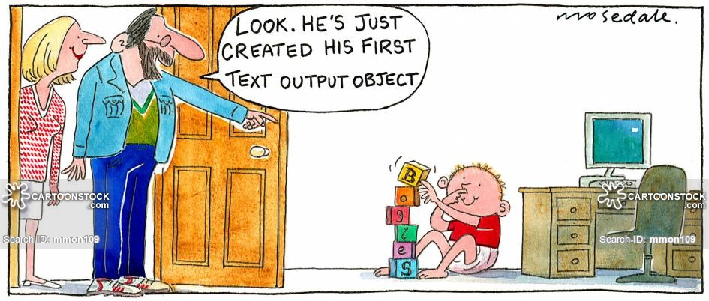
Classes and Objects are the Building Blocks for Analysis and Design Solutions for Complex Systems

Slide 66
Individual Have Different Perspectives/Views – Clear Set of Requirements/Specifications

