Slide 1
Final
Object Orientated Analysis and Design
Benjamin Kenwright

Slide 2
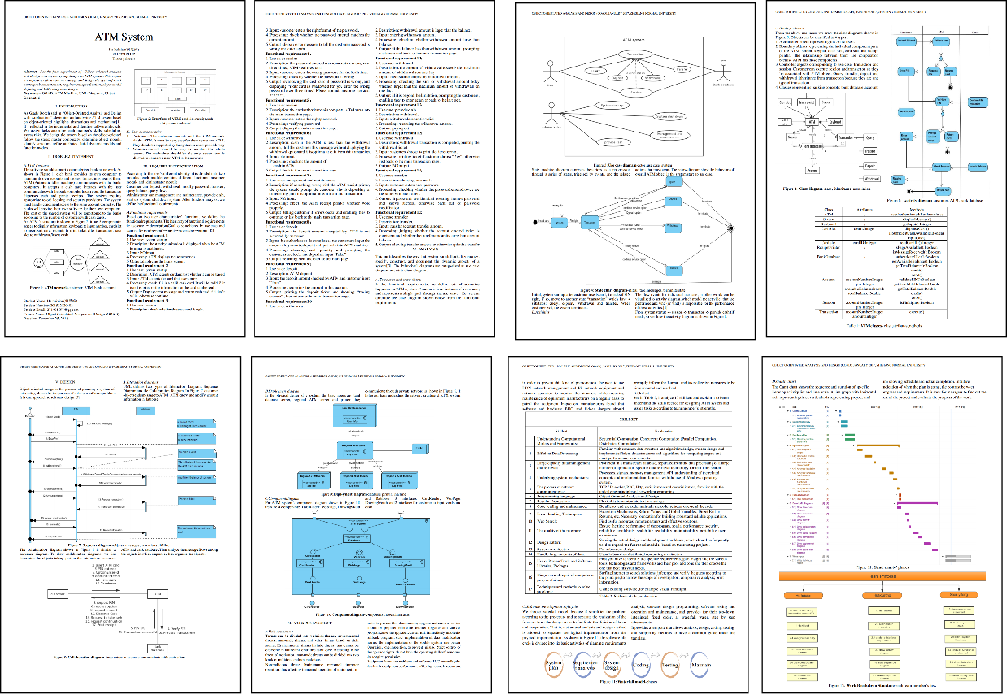
Outline
Review
Exam
Quizzes/Project Dates

Slide 3
Exam
Are you ready?

Slide 4

Coursework

Slide 5
Completed/Grading
Quizzes
Coursework
Last Attendance Record
Marking Sheet
Second person should be able to review your .zip submission and come up with the same mark (Not graded on guessing)

Slide 6
Exam
How much is the final exam worth?

Slide 7
Final Exam
50%
3rd January 2017

Slide 8
Exam - Enough Time?
Finish with enough time to check and recheck your answers
Mix of question types

Slide 9
Review Questions
Review some example questions
Self study to review material
Book, Slides, Quizzes, Crossword, Coursework

Slide 10

Question
Write down the importance features of Inheritance

Slide 11
Answer
Inheritance is one of the most powerful features of object oriented programming. Most important advantages of inheritance are:
Reusability
Saves times and efforts
Closeness with the real world
Easy modification
Transitive Nature of inheritance

Slide 12
Question
Write down what Use case diagrams are used for?

Slide 13
Answer
To model the context of a system by enclosing all the activities of a system within a rectangle and focusing on the actors outside the system by interacting with it
To model the requirements of a system from the outside point of view

Slide 14
Question
Write down what Interaction Diagrams and what are they used for?

Slide 15
Answer
Interaction diagrams depict interactions of objects and their relationships. They also include the messages passed between them.
Interaction diagrams are used for modeling −
the control flow by time ordering using sequence diagrams.
the control flow of organization using collaboration diagrams.

Slide 16
Question
There are two categories of elements in an object-oriented system
Major Elements & Minor Elements
Write down the the four major and three minor elements.

Slide 17
Answer
Major
Abstraction
Encapsulation
Modularity
Hierarchy
Minor
Typing
Concurrency
Persistence

Slide 18
Question
There are two types of typing are − write them down and explain them

Slide 19
Answer
Strong Typing − Here, the operation on an object is checked at the time of compilation, as in the programming language Eiffel
Weak Typing − Here, messages may be sent to any class. The operation is checked only at the time of execution, as in the programming language Smalltalk

Slide 20
Question
Write down the five phases of the XP lifecycle

Slide 21
Answer
Exploration: Determine feasibility, understand key “stories” for the first release, and develop exploratory prototypes
Planning: Agree on the date and stories for the first release
Iterations to release: Implement and test selected stories in a series of iterations. Refine the iteration plan
Productionizing: Prepare supporting materials (documentation, training, marketing), and deploy the operational system
Maintenance: Fix and enhance the deployed system

Slide 22
Question
Write down what the advantages and disadvantages of the Spiral Model

Slide 23
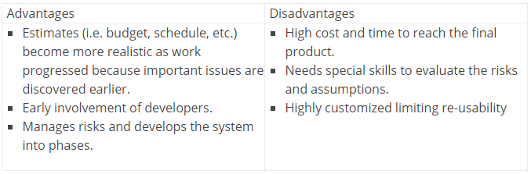
Answer

Slide 24
Question
Write down the advantages and disadvantages of the V-Shaped Model

Slide 25
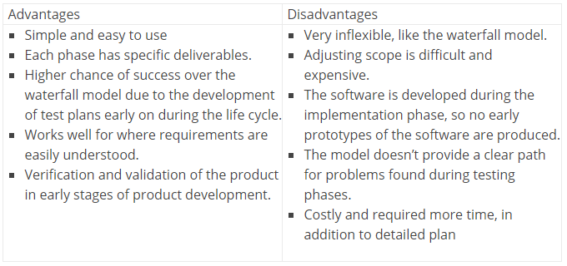
Answer

Slide 26
Discussion
When would you use an Iterative or Incremental approach?

Slide 27
Summary
Example Problems/Solutions
Final Exam (January)
Review Questions

Slide 28
This Week
Review Slides
Coursework
Review Quiz Questions
Review Book
Exam next Week

Slide 29
Questions/Discussion

