Slide 1
Notation Part 2
Object Orientated Analysis and Design
Benjamin Kenwright

Slide 2
Outline
Review
What do we mean by Notation and UML?
Types of UML View
Continue UML Diagram Types
Conclusion and Discussion
Summary

Slide 3
Revision Question
Write down the UML Class Diagram visibility attributes:
Public ___
Private ___
Protected ___
Package ___

Slide 4
Answer
Public (+) Visible to any element that can see the class
Protected (#) Visible to other elements within the class and to subclasses
Private (-) Visible to other elements within the class
Package (~) Visible to elements within the same package

Slide 5
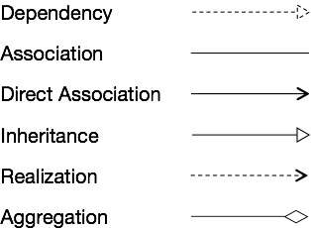

Revision Question
Draw the notations for the different types of relationships

Slide 6
Answer

Slide 7
Question
Is a “Activity Diagram” a static or dynamic system model?
Static (or Structural)
Dynamic (or Behavioral)

Slide 8
Answer
Dynamic (or Behavioral)

Slide 9
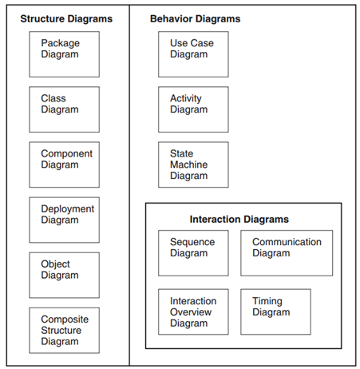
Revision Question
List the various UML Diagram Types

Slide 10
Answer

Slide 11
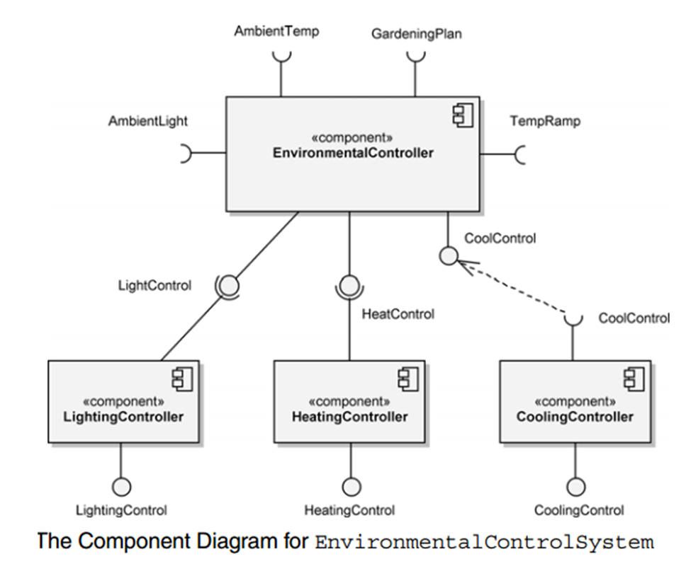
Question
What type of Diagram is this:

Slide 12
Answer
Component Diagram
A component diagram shows the internal structure of components and their dependencies with other components

Slide 13
Question
Draw a simple Activity Diagram?

Slide 14
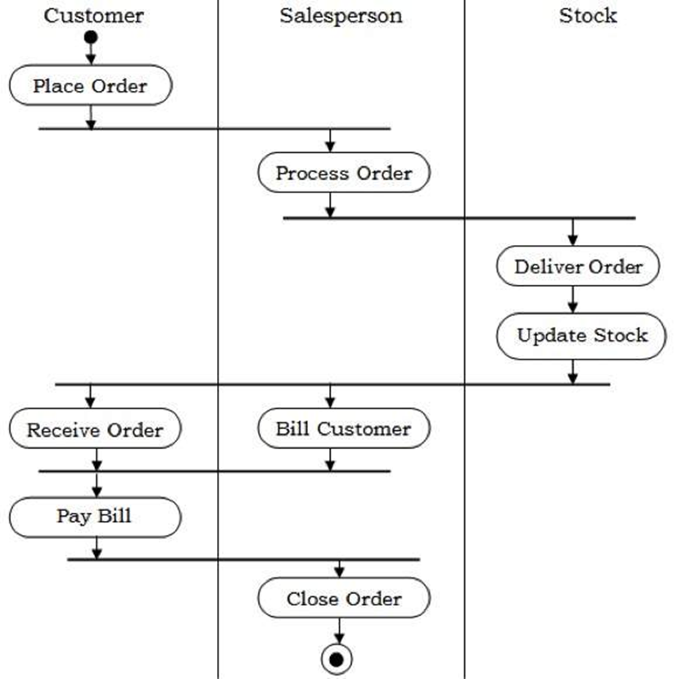
Answer
Example
Activity diagrams provide visual depictions of the flow of activities, whether in a system, business, workflow, or other process

Slide 15
Review
Package Diagrams
Component Diagrams
Deployment Diagrams
Use Case Diagrams
Activity Diagrams
Class Diagrams
Sequence Diagrams
Interaction Overview Diagrams
Composite Structure Diagrams
State Machine Diagrams
Timing Diagrams
Object Diagrams
Communication Diagrams
Last Week

Slide 16
Sequence Diagrams
Package Diagrams
Component Diagrams
Deployment Diagrams
Use Case Diagrams
Activity Diagrams
Class Diagrams
Sequence Diagrams
Interaction Overview Diagrams
Composite Structure Diagrams
State Machine Diagrams
Timing Diagrams
Object Diagrams
Communication Diagrams

Slide 17
Sequence Diagram
A sequence diagram traces the execution of a scenario in the same context as an object diagram. To a large degree, a sequence diagram is simply another way to represent an object diagram

Slide 18
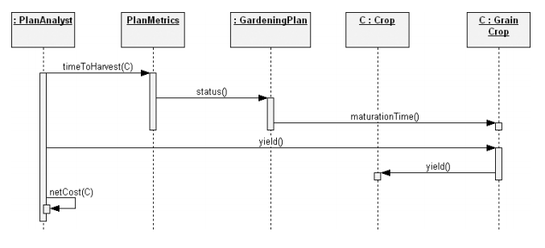
Example

Slide 19
Interaction Overview Diagrams
Package Diagrams
Component Diagrams
Deployment Diagrams
Use Case Diagrams
Activity Diagrams
Class Diagrams
Sequence Diagrams
Interaction Overview Diagrams
Composite Structure Diagrams
State Machine Diagrams
Timing Diagrams
Object Diagrams
Communication Diagrams

Slide 20
Interaction Overview Diagram
Interaction overview diagrams are a combination of activity diagrams and interaction diagrams
Intended to provide an overview of the flow of control between interaction diagram elements

Slide 21
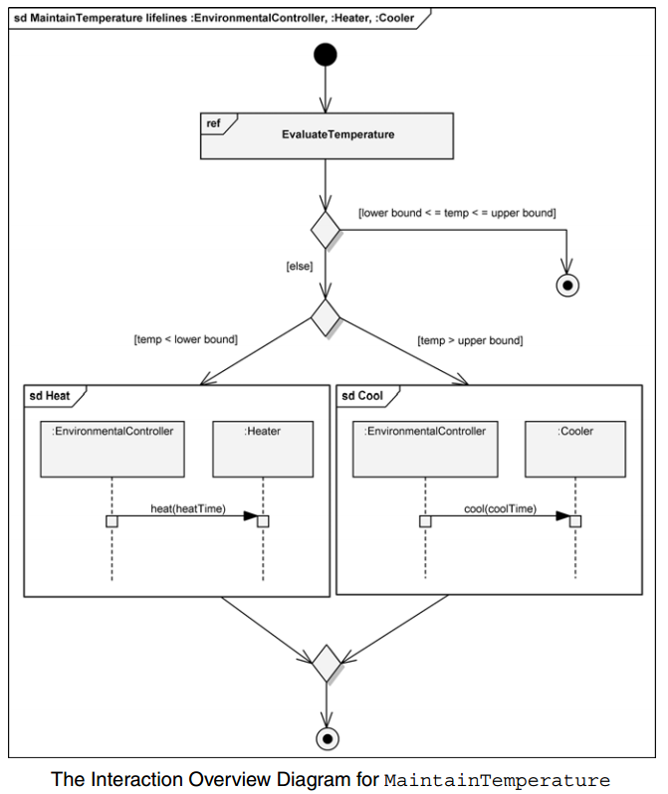
Example

Slide 22
Composite Structure Diagrams
Package Diagrams
Component Diagrams
Deployment Diagrams
Use Case Diagrams
Activity Diagrams
Class Diagrams
Sequence Diagrams
Interaction Overview Diagrams
Composite Structure Diagrams
State Machine Diagrams
Timing Diagrams
Object Diagrams
Communication Diagrams

Slide 23
Composite Structure Diagram
Composite structure diagrams provide a way to depict a structured classifier with the definition of its internal structure.
This internal structure is comprised of parts and their interconnections, all within the namespace of the composite structure.

Slide 24
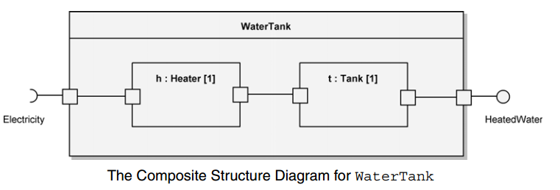
Example

Slide 25
State Machine Diagrams
Package Diagrams
Component Diagrams
Deployment Diagrams
Use Case Diagrams
Activity Diagrams
Class Diagrams
Sequence Diagrams
Interaction Overview Diagrams
Composite Structure Diagrams
State Machine Diagrams
Timing Diagrams
Object Diagrams
Communication Diagrams

Slide 26
State Machine Diagram
A state machine diagram is used to design and understand time-critical systems
A state machine diagram expresses behavior as a progression through a series of states, triggered by events, and the related actions that may occur
These are also known as behavioral state machines

Slide 27
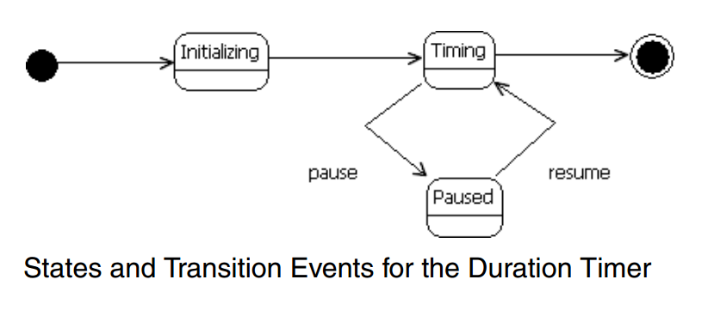
Example

Slide 28
Timing Diagrams
Package Diagrams
Component Diagrams
Deployment Diagrams
Use Case Diagrams
Activity Diagrams
Class Diagrams
Sequence Diagrams
Interaction Overview Diagrams
Composite Structure Diagrams
State Machine Diagrams
Timing Diagrams
Object Diagrams
Communication Diagrams

Slide 29
Timing Diagrams
Timing diagrams are a type of interaction diagram
Their purpose is to show how the states of an element or elements change over time and how events change those states

Slide 30
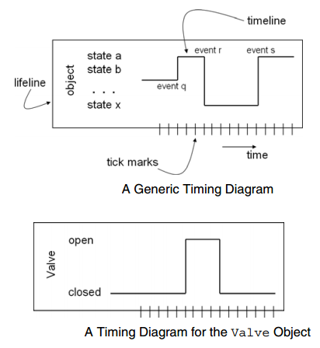
Example

Slide 31
Object Diagrams
Package Diagrams
Component Diagrams
Deployment Diagrams
Use Case Diagrams
Activity Diagrams
Class Diagrams
Sequence Diagrams
Interaction Overview Diagrams
Composite Structure Diagrams
State Machine Diagrams
Timing Diagrams
Object Diagrams
Communication Diagrams

Slide 32
Object Diagram
An object diagram is used to show the existence of objects and their relationships in the logical design of a system
Stated another way, an object diagram represents a snapshot in time of an otherwise transitory stream of events over a certain configuration of objects.

Slide 33
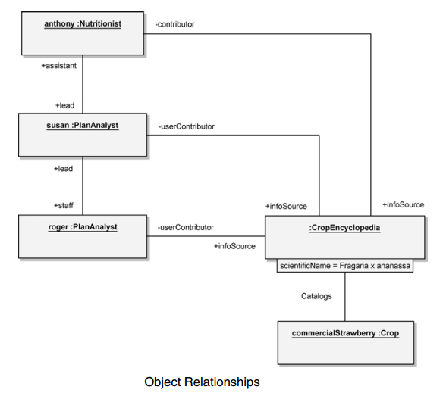
Example

Slide 34
Communication Diagrams
Package Diagrams
Component Diagrams
Deployment Diagrams
Use Case Diagrams
Activity Diagrams
Class Diagrams
Sequence Diagrams
Interaction Overview Diagrams
Composite Structure Diagrams
State Machine Diagrams
Timing Diagrams
Object Diagrams
Communication Diagrams

Slide 35
Communication Diagram
A communication diagram is a type of interaction diagram that focuses on how objects are linked and what messages they pass as they participate in a specific interaction

Slide 36
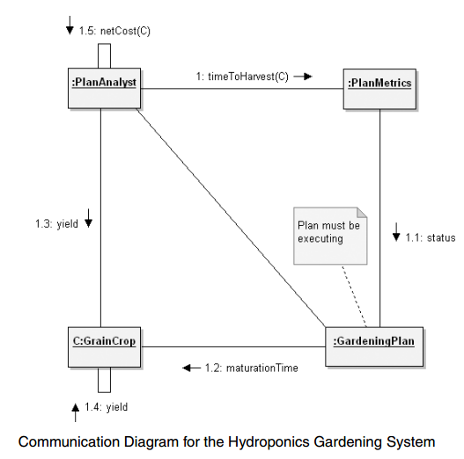
Example

Slide 37
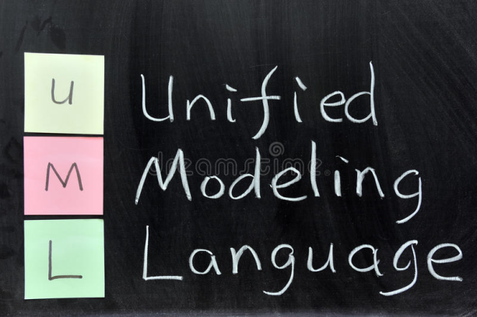
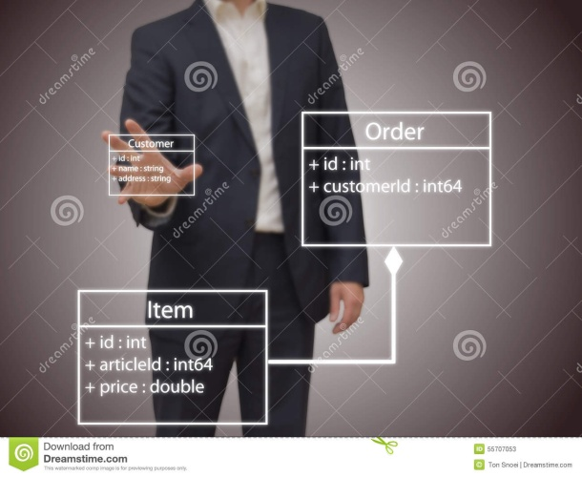
Summary
Clear idea of Notation in Object Orientated Analysis and Design
Visualising System
UML Diagrams (Types)
UML Diagrams

Slide 38
This Week
Review Slides
Read Chapter 6
Online Quizzes
Version Control (GitHub)

Slide 39
Questions/Discussion
Research Task
What was the first object–oriented language?

Slide 40
Revision Question
Name any three object oriented programming languages?

Slide 41
Answer
Example, C++ , java , small talk and C# are most popular object oriented programming languages.

Slide 42
Question
What do we mean by data hiding?

Slide 43
Answer
Data hiding or encapsulation, is the mechanism in which implementation details of a class are kept hidden from the user (or external world)
For example, data hiding concept is supported using the pubic, protected and private keywords which are placed in the declaration of the class

Slide 44
Revision Question
Briefly summarize the importance of using inheritance

Slide 45
Answer
Inheritance is one of the most powerful features of object oriented programming. Most important advantages of inheritance are:
Reusability
Saves times and efforts
Closeness with the real world
Easy modification
Transitive Nature of inheritance

Slide 46
Revision Question
What do you mean by overloading of a function? When do you use this concept? Give an example of function overloading?

Slide 47
Answer
Function overloading is a technique where several function declarations are specified with a same name that can perform similar tasks, but on different data types (distinguished by their number and type of arguments)
Example
int add (int a, int b);
int add (int a, int b, int c);
float add (float a, float b);
Hence, overloaded functions perform different activities depending upon the kind of data sent to them

Slide 48
Revision Question
List the difference between Polymorphism and Overloading?

Slide 49
Answer
Polymorphism
Polymorphism is an important concept of OOPS.
Polymorphism means ability of one object to take many different forms.
Two main types of polymorphism:
Runtime polymorphism
Compile time polymorphism
Overloading
Overloading is the mechanism to implement polymorphism.
Overloading is the mechanism to use the same thing for different purposes.

