Slide 1
Generic Types and Collections
Object Orientated Programming in Java
Benjamin Kenwright

Slide 2
Outline
Review
Essential Generic Type Concepts
Collections with Java
Today’s Practical
Review/Discussion

Slide 3
25th December
Last Day – Quizzes/Exercise Submissions
Grade Taken

Slide 4
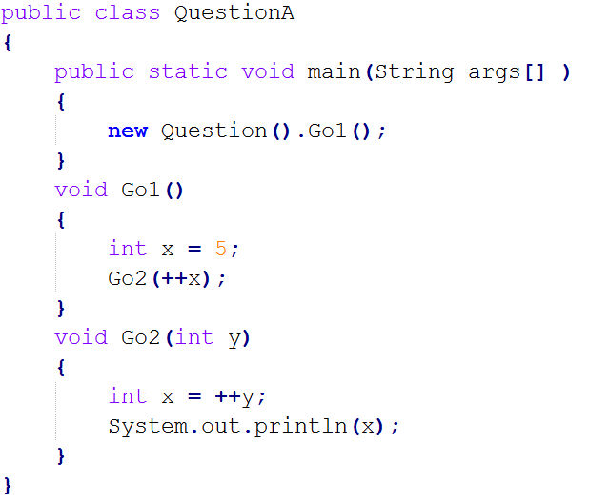
Question
Does the following code compile? What would the output be?

Slide 5

Answer
7

Slide 6
Question
Does the following code compile? What would the output be?

Slide 7

Answer
val:12
3:val

Slide 8
Question
What will the following code print?
a) 1
b) 10
c) 16
d) 31

Slide 9
Answer
c) 16

Slide 10
Question
Does the following code compile? What would the output be?

Slide 11

Answer
96

Slide 12
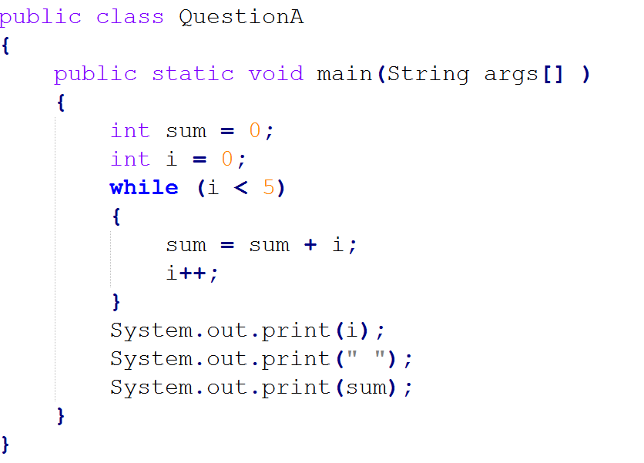
Question
Does the following code compile? What would the output be?

Slide 13
Answer
5 10

Slide 14
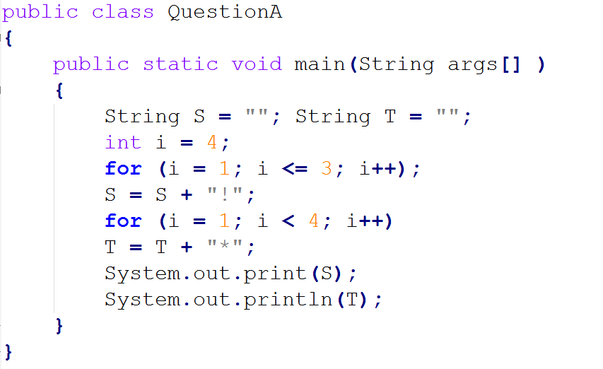
Question
Does the following code compile? What would the output be?
a) (that is, the empty string, printed twice) b) * c) !*** d) !**** e) !!!***

Slide 15
Answer
c) !***

Slide 16
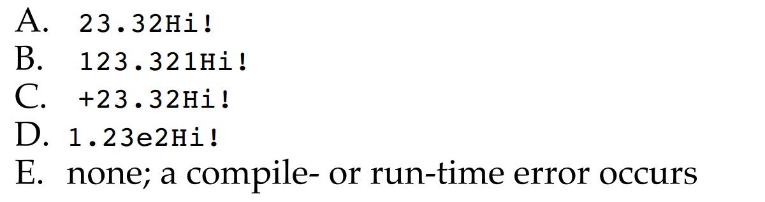
Question
What is the output of the following program?

Slide 17
Answer
B) 123.321Hi!

Slide 18
Generic Types
Generics is the capability to parameterize types
Flexibility to define a class or a method with generic types that the compiler can replace with concrete types

Slide 19
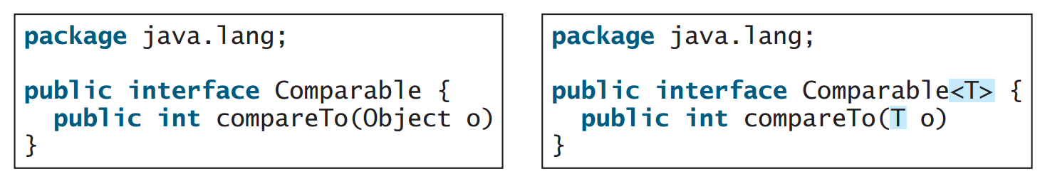
Example
<T> represents the formal generic type
Replaced by an actual concrete type

Slide 20
Why use Generic Types?

Slide 21
Why use Generics?
Identify errors at compile time
Explicit type checking
Robust and reliable programs

Slide 22
Example
Arrays
Create array for `strings':
Only add `strings’ to the array

Slide 23
Example

Slide 24
Writing Generic Class
Specify the ‘Type’ in the class definition
e.g., <E>, <T>, …
Use the Type as needed

Slide 25
Example

Slide 26
Example cont.
Generic Type ‘Integer’
Output 1

Slide 27
Summary
Generic Types with Java
Advantages of Generic Types
Flexibility/Robustness
Incorporate Generic Types into your implementations
Examples

Slide 28
This Week
Read Associated Chapters
Review Slides
Java Exercises

Slide 29
25th December
Remember
Last Day – Quizzes/Exercise Submissions
Grade Taken

Slide 30
Exercises
Exercises 21.1 to 21.2 (Generics)
25.1 to 25.2 (Arrays/Lists)

Slide 31
Questions/Discussion

