Slide 1
GUI Basics
Object Orientated Programming in Java
Benjamin Kenwright

Slide 2
Outline
Essential Graphical User Interface (GUI) Concepts
  Libraries, Implementation, Mechanics, ..
  Abstract Windowing Toolkit (AWT)
  Java Foundation Classes (JFC)
Today’s Practical
Review/Discussion

Slide 3
Graphical User Interfaces (GUI)
Note this is a huge area many books are devoted solely to this topic
Today we will provide an overview on getting started with Java GUIs

Slide 4

Why is the Graphical User Interface (GUI) Important?

Slide 5
Why is the Graphical User Interface (GUI) Important?
Visual feedback/input
Allows higher productivity
Faster learning curve/usability
  Intuitive to the user
Display/show more information/details
  Picture is worth a thousand words
  Allows colour/animations
  Provides more opportunities (e.g., video/games)
…

Slide 6
GUI Overview
To create a Java GUI, you need to understand
  Containers
  Event
  Event Handlers
  Layout managers
  Components
  Special features

Slide 7
AWT and JFC/Swing
Early Java development used graphic classes defined in the
Abstract Windowing Toolkit (AWT).
  See the java.awt packages.
In Java 2, JFC/Swing classes were introduced.
  See the javax.swing packages
Many AWT components have improved Swing counterparts.
  An example, the AWT Button class corresponds to a more versatile Swing class called JButton.
Swing does not generally replace the AWT; still use for AWT events and the underlying AWT event processing model

Slide 8
Containers
A container is a special component that can hold other components.
The AWT class, as well as the Swing class, are containers
Other containers include
  Frames
    A frame is a container that is free standing and can be positioned anywhere on the screen.
    Frames give the ability to do graphics and GUIs through applications
  Dialog boxes
  Panels
  Panes
  Toolbars

Slide 9
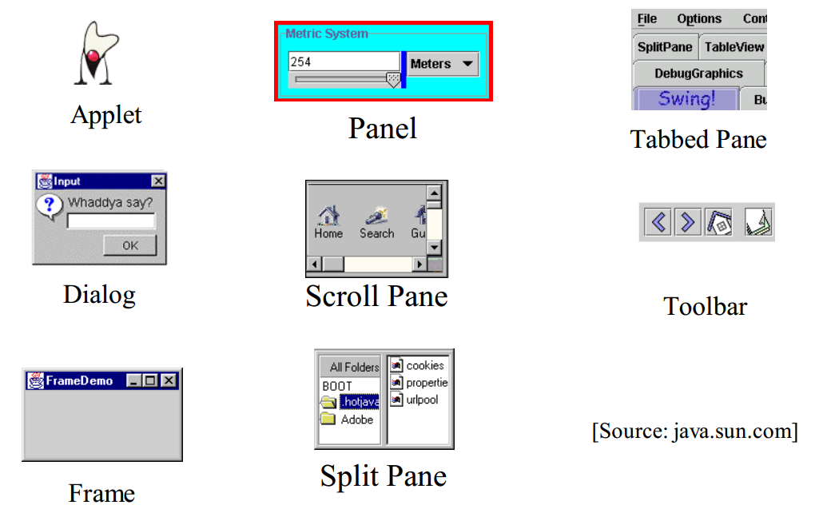
Containers
(Top Level and General)

Slide 10
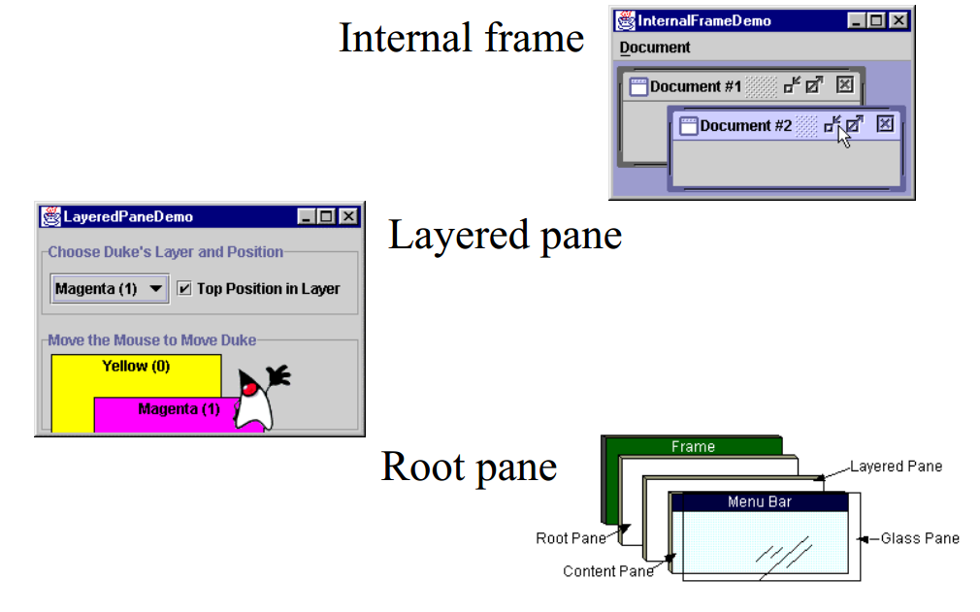
Special Containers

Slide 11
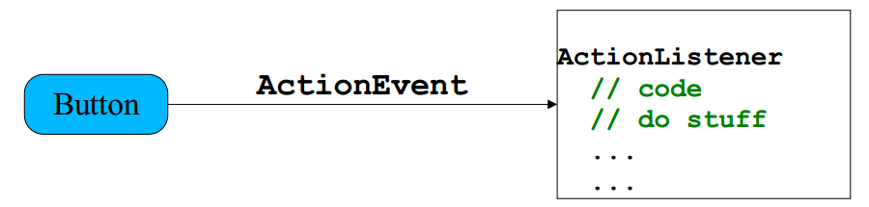
Events
Every time the user types a character or pushes a mouse button, an event occurs
Any object can be notified of the event.
All the objects have to do implement the appropriate interface and be registered as an event listener on the appropriate event source

Slide 12
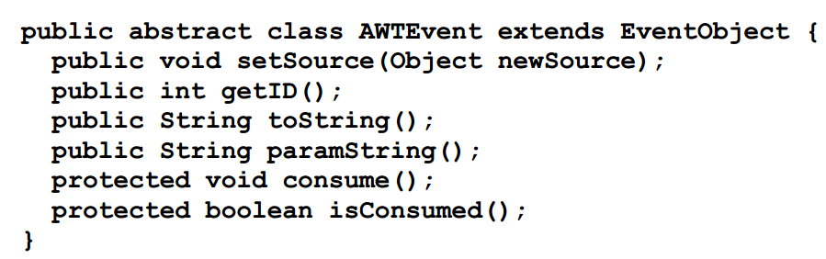
Events, cont.
Several events implemented in java.awt.AWTEvent subclasses (java.awt.Event is deprecated).
  Defines a lot of constants

Slide 13
Events Handlers
In the declaration for the event handler class, one line of code specifies that the class either implements a listener interface (or extends a class that implements a listener interface).
  public class MyClass implements ActionListener
In the event handler class the method(s) in the listener interface must be implemented
  public void actionPerformed(ActionEvent e) { /* code that "reacts" to the event */ }
Register an instance of the event handler class as a listener on one or more components.
  myComponent.addActionListener(myClassInstance)

Slide 14
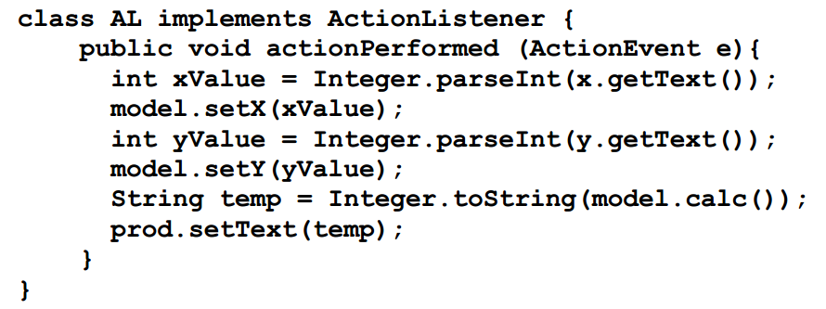
Events Handlers, cont.
Often an event handler that has only a few lines of code is implemented using an anonymous inner class.

Slide 15
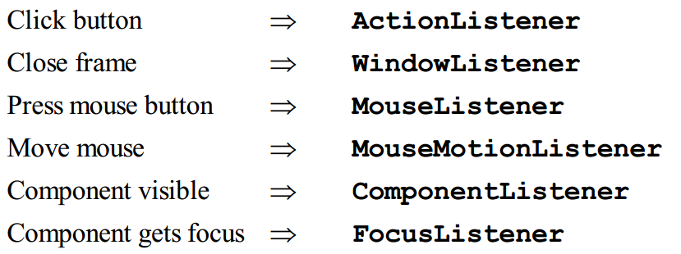
Events Handlers, cont.
SwingApplication has two event handlers.
  Window closing (window events).
    frame.setDefaultCloseOperation (JFrame.EXIT_ON_CLOSE);
Button clicks (action events).
  see previous slide.
Types of events (listeners defined in java.awt.event)

Slide 16
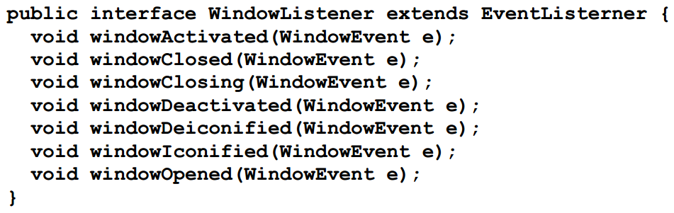
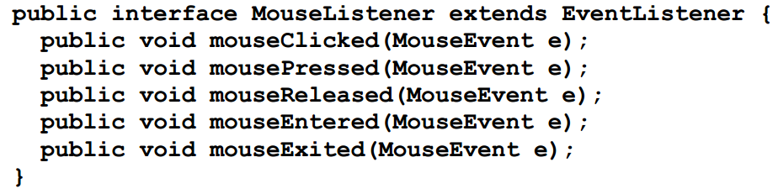
WindowListener and MouseListener

Slide 17
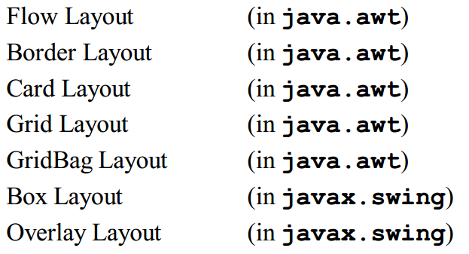
Layout Managers
A layout manager is an object that determines the manner in which components are displayed in a container
There are several predefined layout managers defined in the Java standard class library

Slide 18
Layout Managers, cont.
Every container has a default layout manager, but we can also explicitly set the layout manager for a container
Each layout manager has its own particular rules governing how the components will be arranged
Some layout managers pay attention to a component's preferred size or alignment, and others do not
The layout managers attempt to adjust the layout as components
are added and as containers are resized

Slide 19
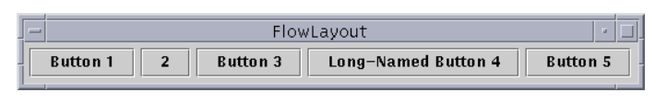
Flow Layout
A flow layout puts as many components on a row as possible, then moves to the next row
Rows are created as needed to accommodate all of the components
Components are displayed in the order they are added to the container
The horizontal and vertical gaps between the components can be explicitly set
Default for JPanel

Slide 20
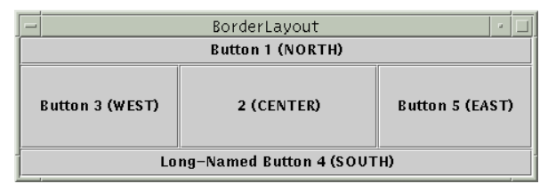
Border Layout
A border layout defines five areas into which components can be added
The default for most GUIs

Slide 21
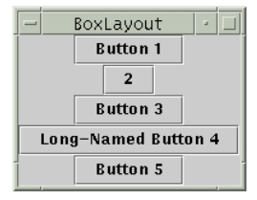
Box Layout
A box layout organizes components either horizontally (in one row) or vertically (in one column)
Special rigid areas can be added to force a certain amount of spacing between components
By combining multiple containers using box layout, many different configurations can be created
Multiple containers with box layouts are often preferred to one container that uses the more complicated gridbag layout manager

Slide 22
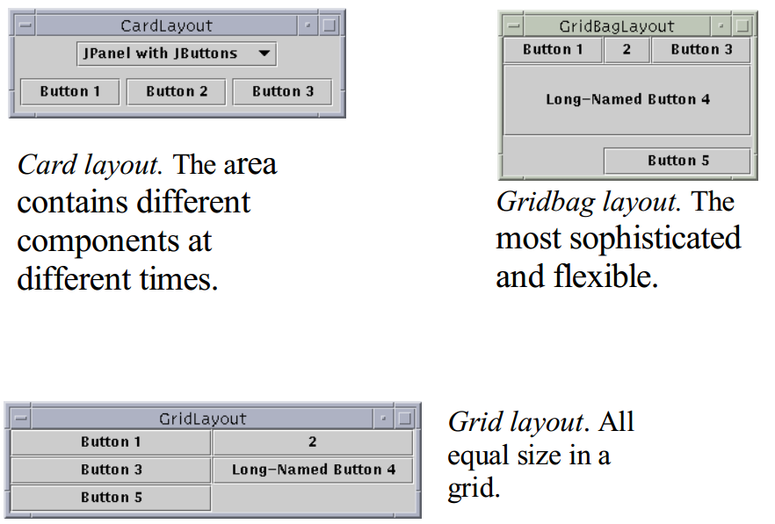
Other Layout Managers

Slide 23
"Atomic" Components
The root in the component hierarchy is JComponent.
The JComponent provides the following functionality to its descendants, e.g., JLabel, JRadioButton, and JTextArea.
  Tool tips
  Borders
  Keyboard-generated actions
  Application-wide pluggable look and feel
  Various properties
  Support for layout
  Support for accessibility
  Double buffering

Slide 24
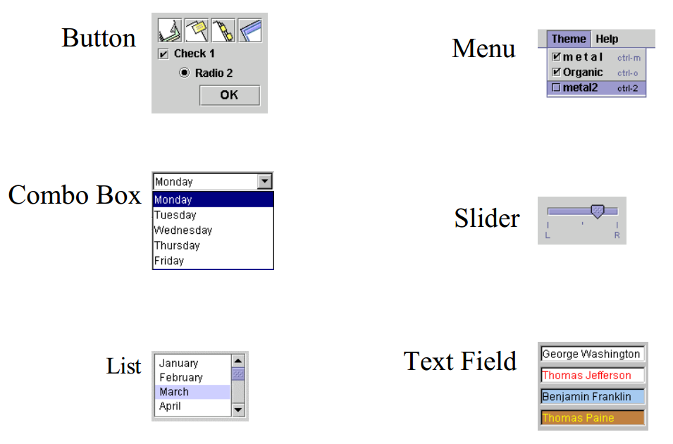
Basic Components

Slide 25
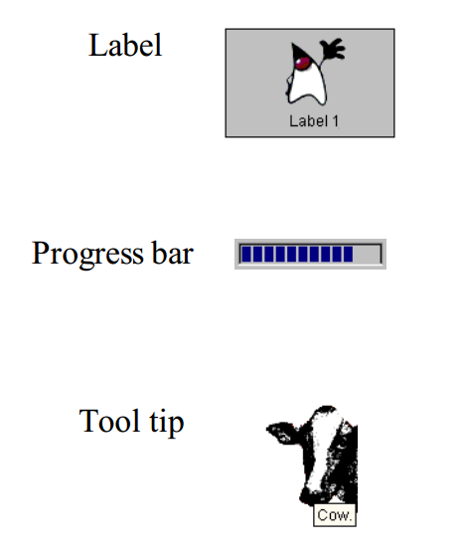
Non-Editable Displays

Slide 26
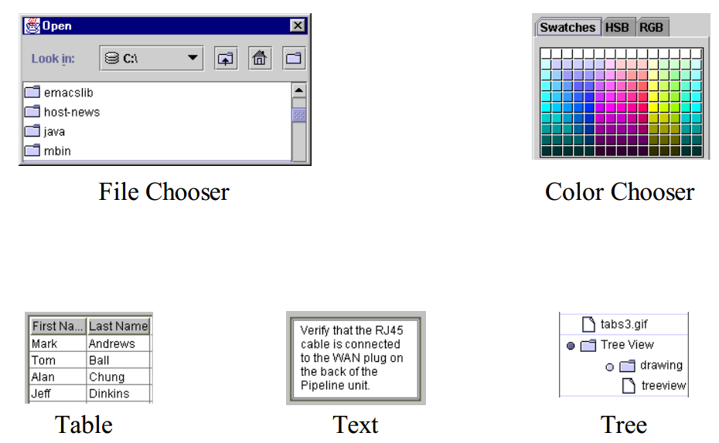
Editable Displays

Slide 27
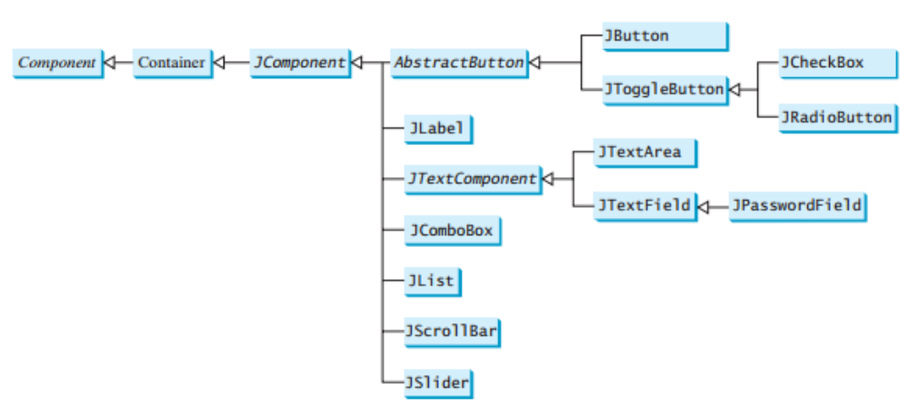
Review Popular GUI Components used to Create User Interfaces (Swing)

Slide 28
This Week
Read Associated Chapters
Review Slides
Online Quizzes
Java Exercises

Slide 29
Summary
Overview Basic GUI Principles
Abstract Windowing Toolkit (AWT)
Java Foundation Classes (JFC)
Hands-On/Practical

Slide 30

Questions/Discussion

