Slide 1
Javascript Forms
Web Authoring and Design
Benjamin Kenwright

Slide 2
Outline
Review
Javascript and Object Orientated Concepts
Javascript and Forms
Summary
Review/Discussion

Slide 3
25th December
Last Day – Quizzes
Grade Taken

Slide 4
Presentation/Demonstration (Individual Project)
1pm – 6pm
Room 24-401
Presentation (slides)
Answer questions

Slide 5
Question
How can you create an Array in JavaScript?

Slide 6
Answer
You can define arrays using the array literal as follows −
var x = [];
var y = [1, 2, 3, 4, 5];

Slide 7

Question
What order does f receive its arguments?
foo bar baz
foo baz bar
bar foo baz
foo baz

Slide 8
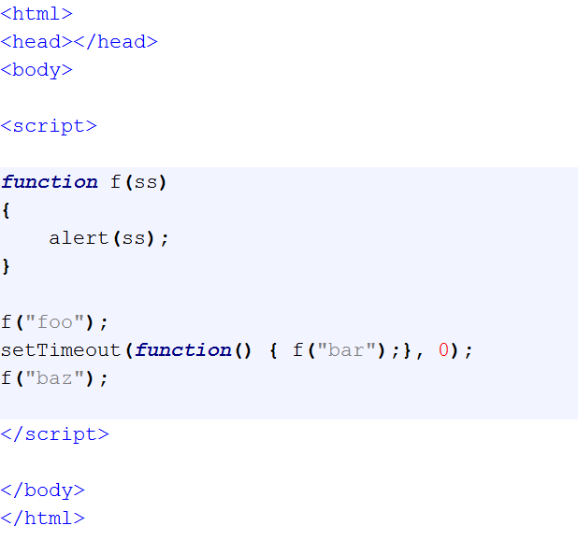
Answer
b) foo baz bar

Slide 9
Question
Which of the following is correct about the expression 1==“1.0” in Javascript?
It returns false. The two values have different types.
It returns true. The two values are converted to strings and are equal.
It returns false. The two values are converted to strings and are not equal.
It returns true. The two values are converted to numbers and are equal.

Slide 10
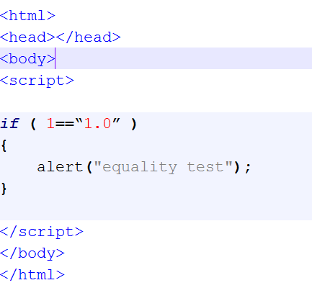
Answer
b) It returns true. The two values are converted to strings and are equal.

Slide 11
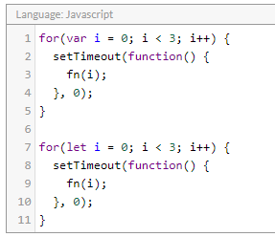
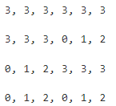
What arguments will fn receive, in order?
a)
b)
c)
d)

Slide 12
Answer
3, 3, ….
Reason:
https://stackoverflow.com/questions/5226285/settimeout-in-for-loop-does-not-print-consecutive-values

Slide 13
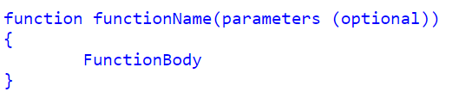
Defining functions
Function Declarations:

Slide 14
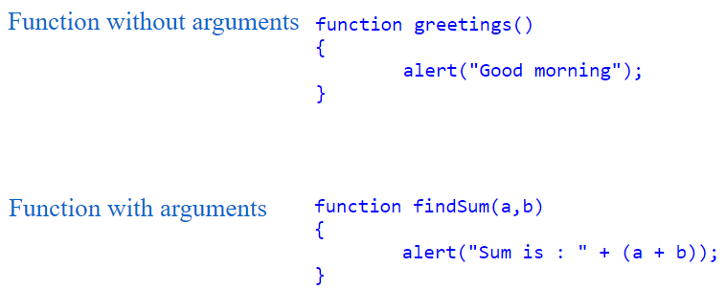
Arguments

Slide 15
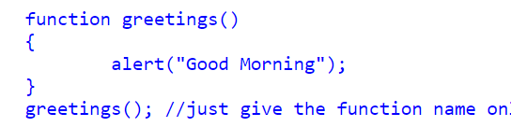
Calling a Function
You can call Javascript functions by simply call the function name

Slide 16
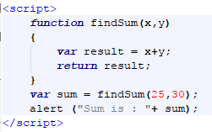
Return Values

Slide 17
Question
Is Javascript an Object Orientated Language?
a) Yes
b) No

Slide 18
Answer
a) Yes
JavaScript is an object oriented programming language

Slide 19
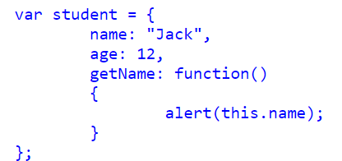
How to create and use objects in Javascript

Slide 20

Call Object function

Slide 21
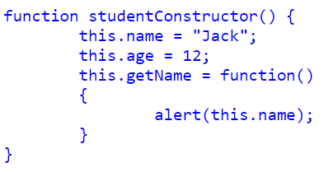
Object constructor

Slide 22

How to create a New Instance from a Constructor

Slide 23
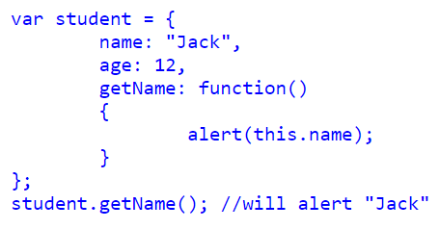
Literal notation in Javascript Object

Slide 24
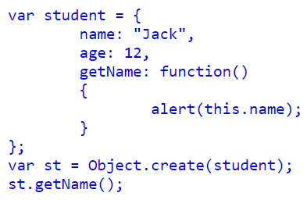
Object.create() in Javascript Object

Slide 25
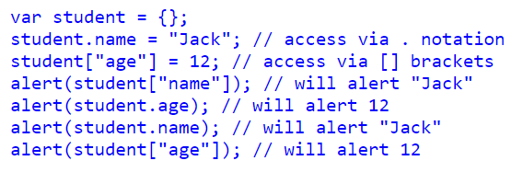
Accessing Object Properties in JavaScript
We can access Object Properties in JavaScript using either the dot(.) notation or the bracket[] notation

Slide 26
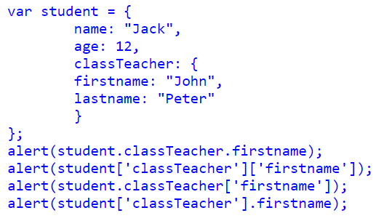
Object contain another Object

Slide 27
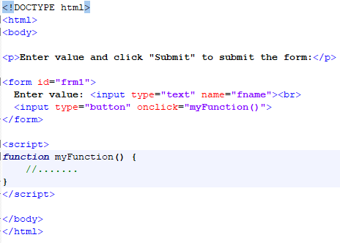
Forms Trigger/Call Javascript

Slide 28
This Week
Review Slides
Read Associated Chapters
Work through Javascript Examples
Update GitHub Account/Webpage
Group Project (Christmas Theme)
Website & Javascript Game
Demonstrate Individual Projects

Slide 29
Summary
Overview of Objects in Javascript
Javascript Forms
Hands-On/Practical

Slide 30
Questions/Discussion
Research (Game Mechanics)
Javascript Key Event Triggers
(e.g., Moving shape left and right when key is pressed)

