Slide 1
Joint Communication and Sensing for NOMA Systems
EE492-PROJECT
Emre SENGİR / 270206023
Prof. Dr. Berna ÖZBEK

Slide 2
OUTLINE
1- Introduction
2- Problem Definition
3- System Model
4- Results & Comments
5- Conclusion
6- References

Slide 3
INTRODUCTION
Objective : Simulating and doing the performance comparison of NOMA empowered JCAS systems with respect to methods, [1] and conventional way.
Problem definition and system parameters.
- Performance evaluations are done in terms of data rates and effective sensing power.
- By comparing these, we will argue about the effectiveness of both methods.
[1] Z. Wang, Y. Liu, X. Mu, Z. Ding and O. A. Dobre, "NOMA Empowered Integrated Sensing and Communication," in IEEE Communications Letters, vol. 26, no. 3, pp. 677-681, March 2022

Slide 4
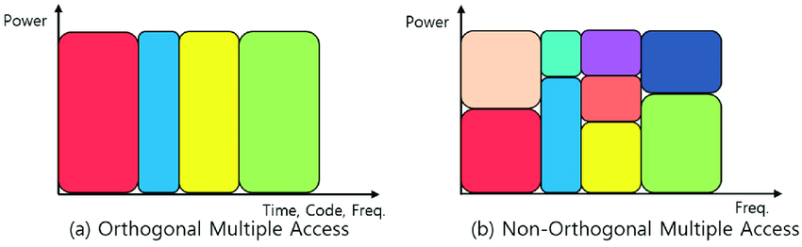
PROBLEM DEFINITION
Joint communication and sensing (JCAS) is remarkable subject in the development of future wireless networks.
It has advantages on sharing same spectrum and infrastructure that can be employed on both communication and sensing.
NOMA in here proposed as a solution to the conventional JCAS applications that faces problem on correlated channels and overloaded regimes.
Figure 1: OMA and NOMA multpilexing scheme. [1]
[2] Cheon, Jinyong & Cho, Ho-Shin. (2017). Power Allocation Scheme for Non-Orthogonal Multiple Access in Underwater Acoustic Communications. Sensors. 17. 2465. 10.3390/s17112465.

Slide 5

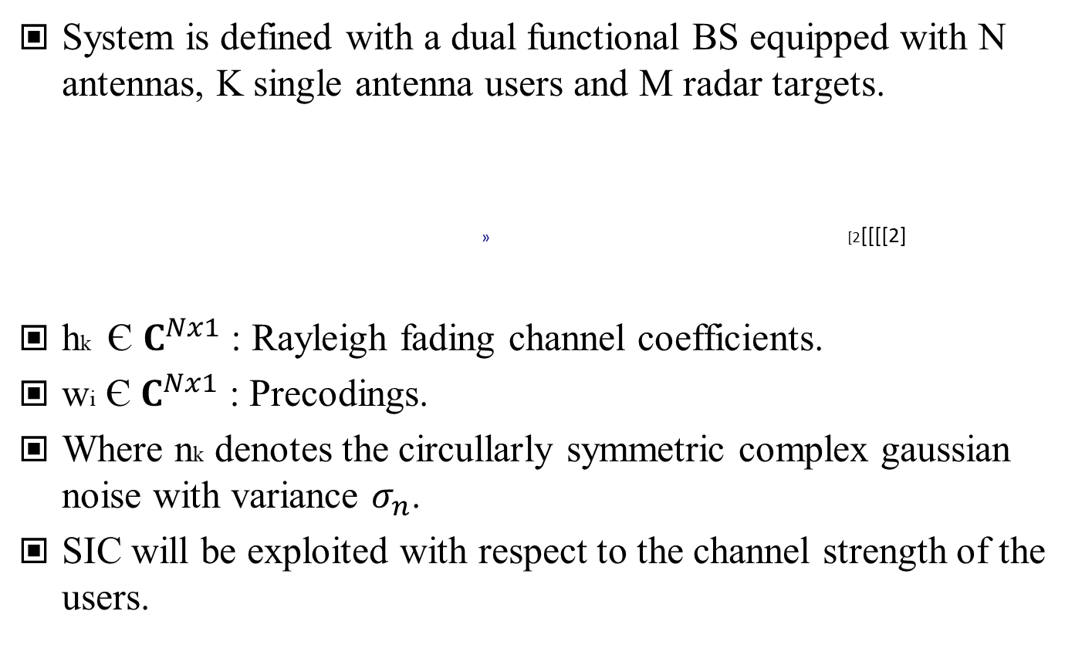
SYSTEM MODEL
System is defined with a dual functional BS equipped with N antennas, K single antenna users and M radar targets.
[2[[[[2]
hk Є $C^{Nx1}$ : Rayleigh fading channel coefficients.
wi Є $C^{Nx1}$ : Precodings.
Where nk denotes the circullarly symmetric complex gaussian noise with variance $σ_{n}$.
SIC will be exploited with respect to the channel strength of the users.

Slide 6


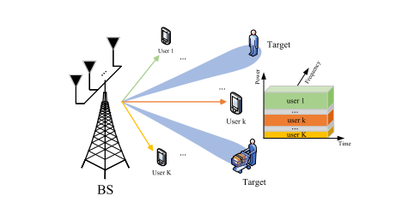
SYSTEM MODEL
Data rates for the weakest and strongest users [2],
Figure 2: System Model. [2]
[1] Z. Wang, Y. Liu, X. Mu, Z. Ding and O. A. Dobre, "NOMA Empowered Integrated Sensing and Communication," in IEEE Communications Letters, vol. 26, no. 3, pp. 677-681, March 2022

Slide 7
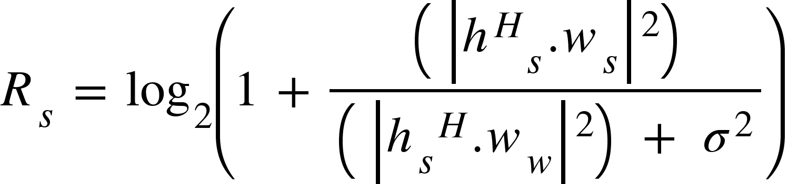
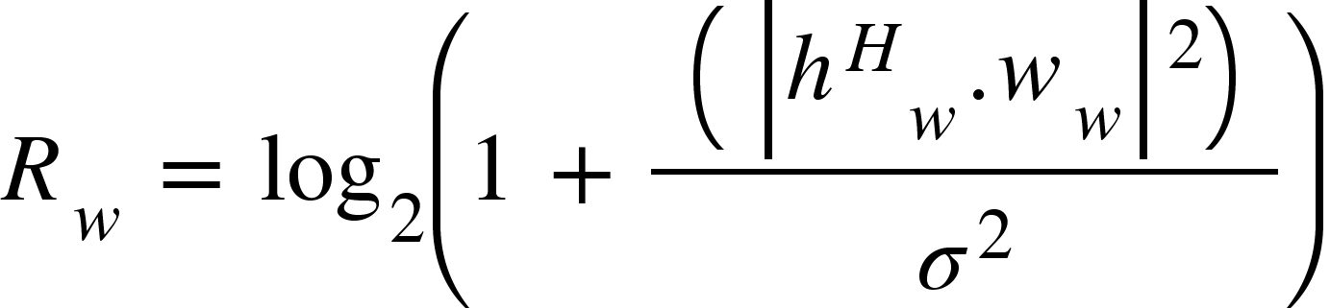
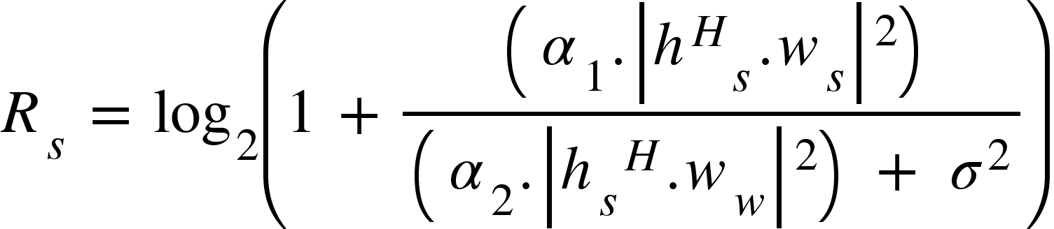
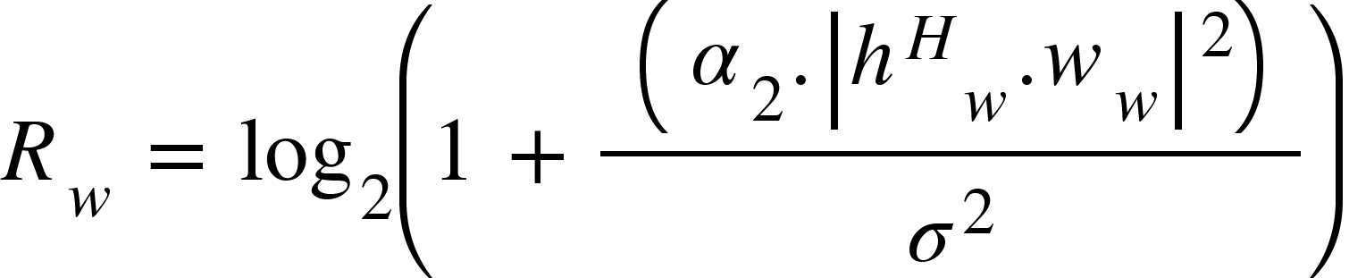
SYSTEM MODEL
Where conventional NOMA has a different type of distrubition with interference from weak user processed as noise on strong user and SIC exploited by weak user.
Power allocated equation are also defined as,

Slide 8
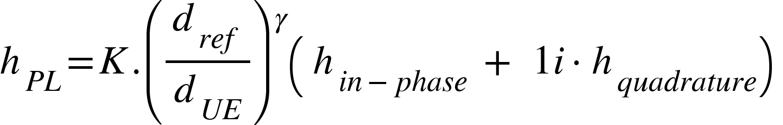
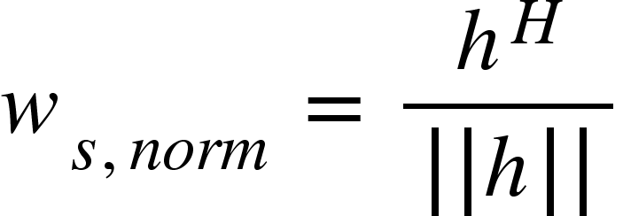
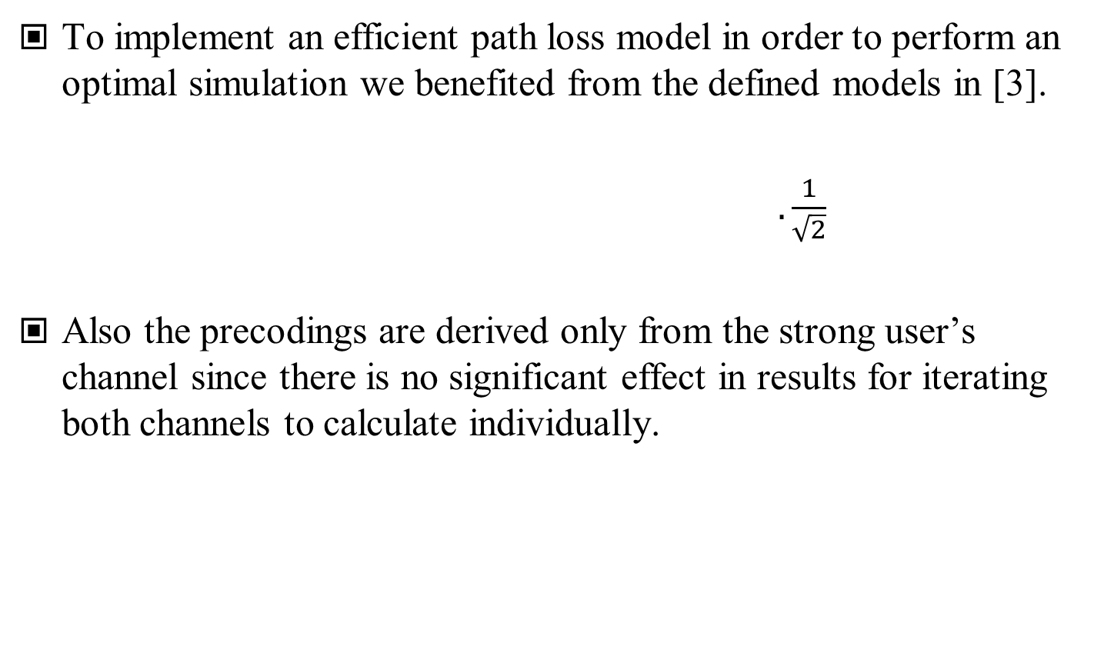
SYSTEM MODEL
To implement an efficient path loss model in order to perform an optimal simulation we benefited from the defined models in [3].
$.\frac{1}{\sqrt{2}}$
Also the precodings are derived only from the strong user’s channel since there is no significant effect in results for iterating both channels to calculate individually.
[3] George Mason University, Path Loss and Link Budget, ECE 732: Mobile Communications, 2018, B.-P. Paris, http://www.spec.gmu.edu/~pparis/classes/notes_732/Lecture_2018_09_04.pdf

Slide 9
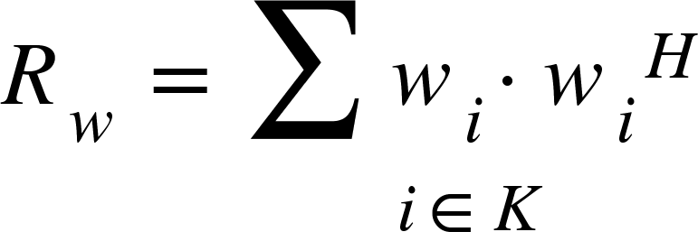
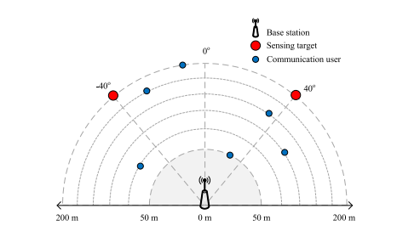
SYSTEM MODEL
In order to analyse sensing, along with the precodings used in received signal for communication purposes, we derived covariance matrix with them and evaluated the power function with respect to ϴm, target directions of steering vector a(ϴm) [4].
Figure 3: Sensing and Communication Model.
[4] P. Stoica, J. Li and Y. Xie, "On Probing Signal Design For MIMO Radar," in IEEE Transactions on Signal Processing, vol. 55, no. 8, pp. 4151-4161, Aug. 2007, doi: 10.1109/TSP.2007.894398.

Slide 10
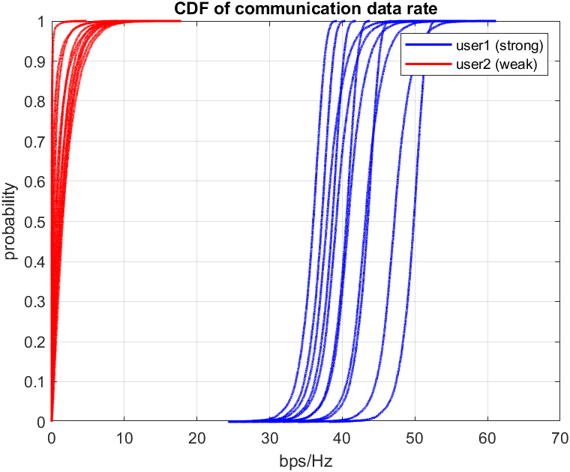
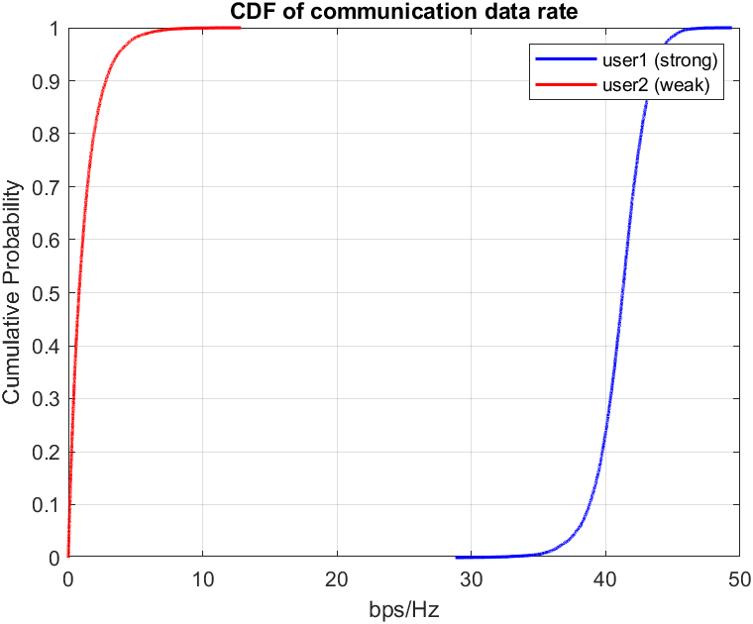
RESULTS
(a) (b)
Figure 4: (a) Model simulated with monte carlo trials according to the [1] we referenced with respect to the distances between 100:1100(strong:green) – 500:1500(weak:red), (b) overall communication throughput.

Slide 11
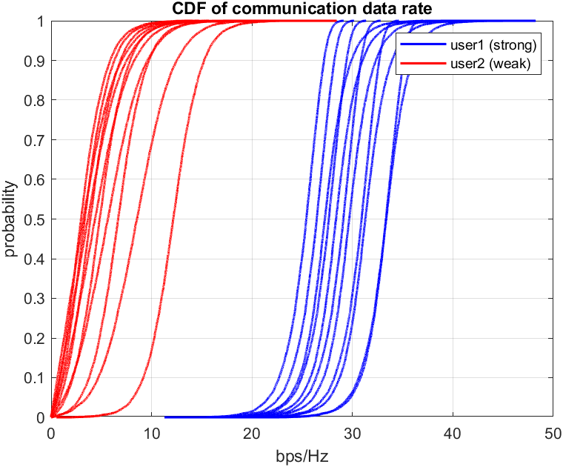
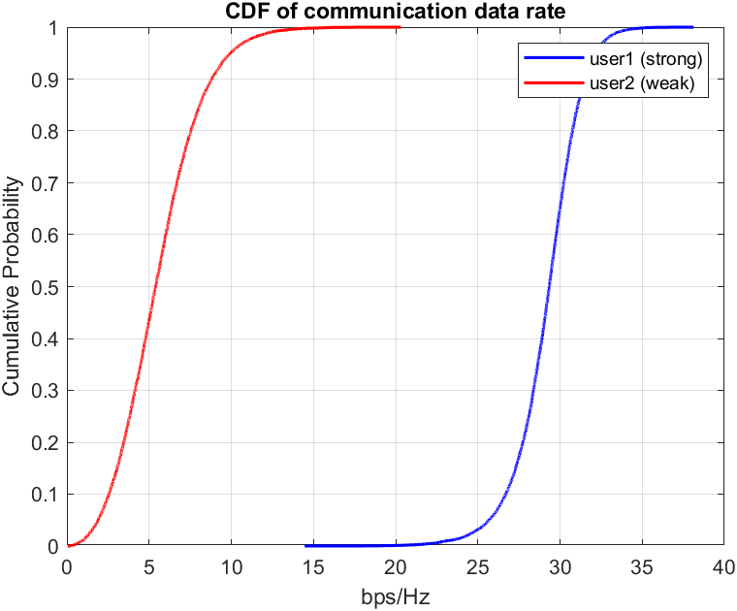
RESULTS
(a) (b)
Figure 5: (a) Model simulated with monte carlo trials in conventional NOMA with respect to the distances between 100:1100(strong:green) – 500:1500(weak:red), (b) overall communication throughput.

Slide 12
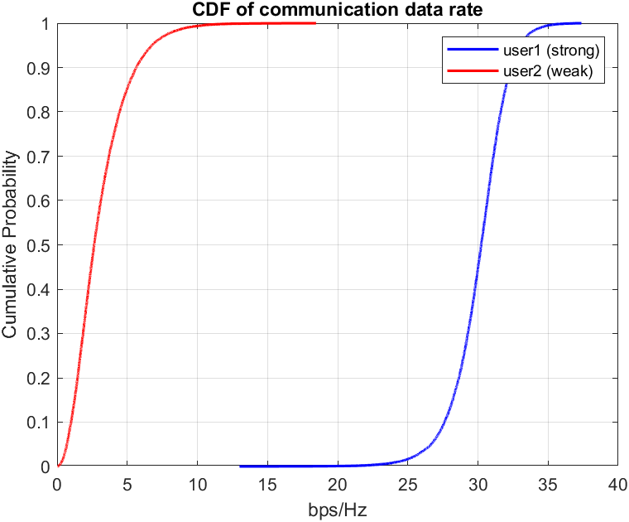
RESULTS
(a) (b)
Figure 6: Power allocated results, (a) equally allocated , (b) strong coefficient 0.9, weak coefficient 0.1 .

Slide 13
MODEL
Recall: Fig. 3.

Slide 14
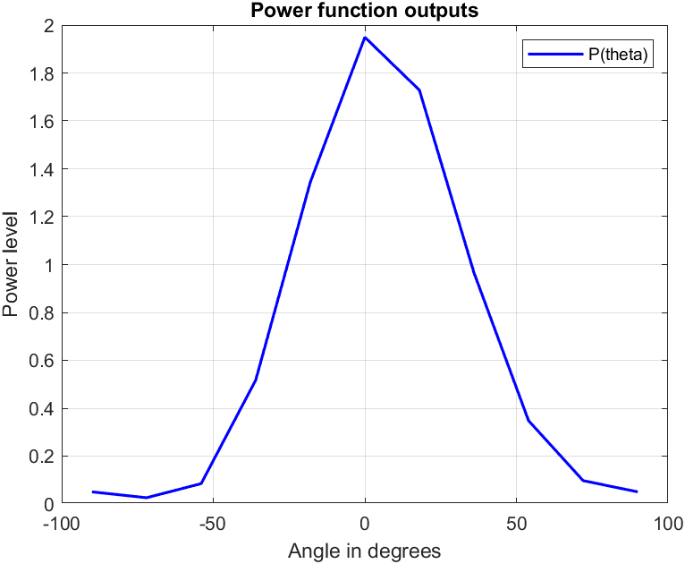
RESULTS
Figure 7: Power function evaluated in different angles, the figure can also be seemed as a map given in Fig. 3.

Slide 15
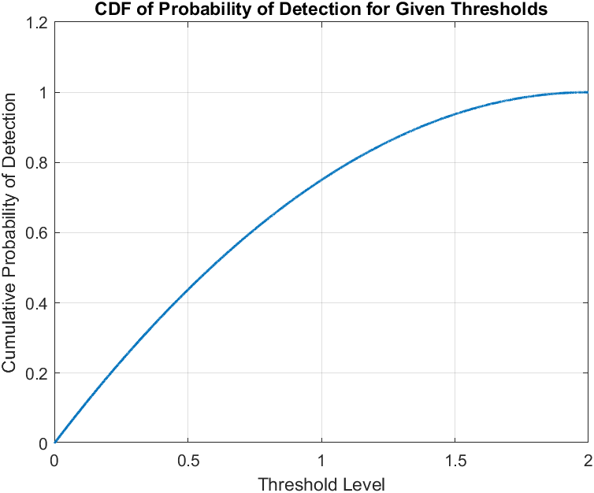
RESULTS
Figure 8: As an output of linear distrubition in power levels, probability of detection distributes similar to a logarithmic function simply indicates that having a large thresholds lower the chance of detection.

Slide 16
CONCLUSION
We performed the analysis of capacities and limitis of a JCAS system with different implementations of NOMA.
Observed the relation between covariance matrix of precodings and steering vector.
In addition to what we have been performed so far in this study, what remains is to optimize these precodings in order to increase effective sensing power while keeping overall communication throughput in utilizable levels.

Slide 17
REFERENCES
[1] Z. Wang, Y. Liu, X. Mu, Z. Ding and O. A. Dobre, "NOMA Empowered Integrated Sensing and Communication," in IEEE Communications Letters, vol. 26, no. 3, pp. 677-681, March 2022
[2] Cheon, Jinyong & Cho, Ho-Shin. (2017). Power Allocation Scheme for Non-Orthogonal Multiple Access in Underwater Acoustic Communications. Sensors. 17. 2465. 10.3390/s17112465.
[3] George Mason University, Path Loss and Link Budget, ECE 732: Mobile Communications, 2018, B.-P. Paris, http://www.spec.gmu.edu/~pparis/classes/notes_732/Lecture_2018_09_04.pdf
[4] P. Stoica, J. Li and Y. Xie, "On Probing Signal Design For MIMO Radar," in IEEE Transactions on Signal Processing, vol. 55, no. 8, pp. 4151-4161, Aug. 2007, doi: 10.1109/TSP.2007.894398.

