Slide 1
Designs and Comparisons of Microstrip and Metamaterial Array Antennas
EE492-PROJECT
Osman KARABAY / 230206008
Ozan EFE / 200206015
Dr. Öğr. Üyesi Fatih YAMAN

Slide 2
OUTLINE
1- Introduction and Description of The Purpose of the Project
2- General Design Procedures
- Design of Microstrip Array Antenna
- Design of Metamaterial Array Antenna
3- Performance Results
- Microstrip Array Antenna
- Metamaterial Array Antenna
4- Performance Comparisons
5- Conclusion

Slide 3
INTRODUCTION-PURPOSES
Objective : Designing and doing the performance comparison of microstrip array and metamaterial array antennas.
Designs of both antennas are done in CST Studio.
- Performance evaluations are done in terms of gain, directivity, S₁₁ parameter and bandwidth of the designed antennas.
- By comparing these, we will decide “which type of antenna is preferrable for which type of application”.

Slide 4
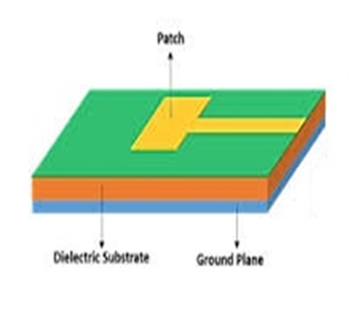
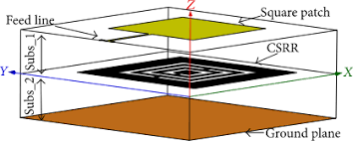
DESIGNED ANTENNAS
Figure1: a- Single Patch Microstrip Antenna b- Single Patch Metamaterial Antenna
In order to increase the performance, we prefer these type of antennas as an array form.
- Metamaterial array antennas have relatively small sizes and improved gain. However, cost of them is higher.

Slide 5
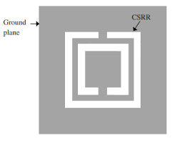
HOW WE ACHIEVE HIGH GAINS ?
Figure1: Square Complementary Split Ring Resonator (CSRR) shapes
Thanks to CSRRs, we reduce/minimize the reflected waves at the resonant frequency. Hence, increase the gain.
In this way, we can achieve improved performance specifications with relatively small sizes.

Slide 6
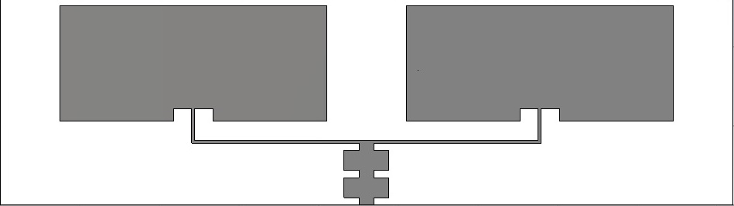
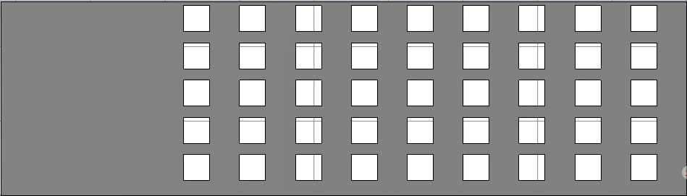
MICROSTRIP ARRAY ANTENNA DESIGN
Figure3: a- Microstrip Array Antenna Patches b- Ground Plane

Slide 7
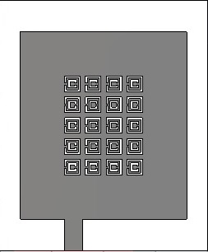
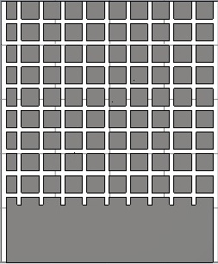
METAMATERIAL ARRAY ANTENNA DESIGN
Figure4: a- Metamaterial Array Antenna Front View b- Ground Plane

Slide 8
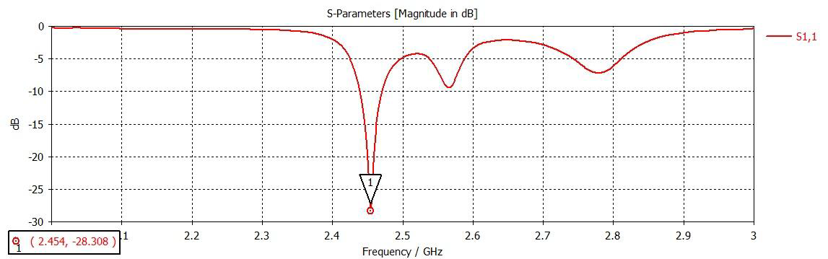
PERFORMANCE EVALUATIONS (Microstrip Array Antenna)
Reflection coefficient of microstrip array antenna
Figure5: S₁₁ parameter of Microstrip Array Antenna

Slide 9
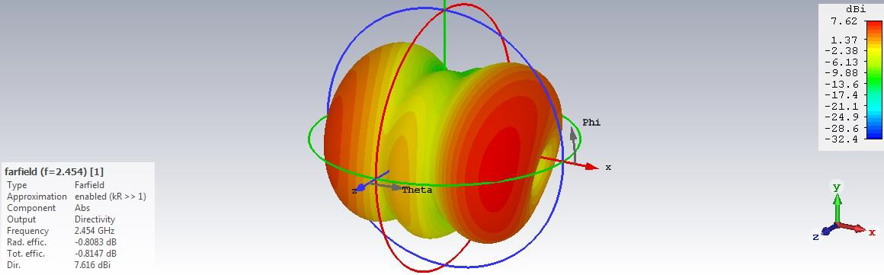
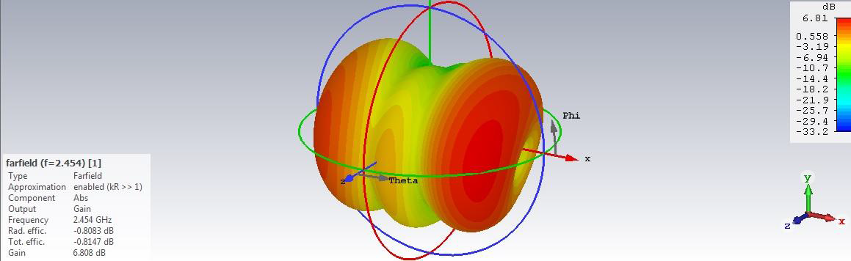
PERFORMANCE EVALUATIONS (Microstrip Array Antenna)
Figure 6: a-Directivity b- Gain of the Microstrip Array Antenna

Slide 10
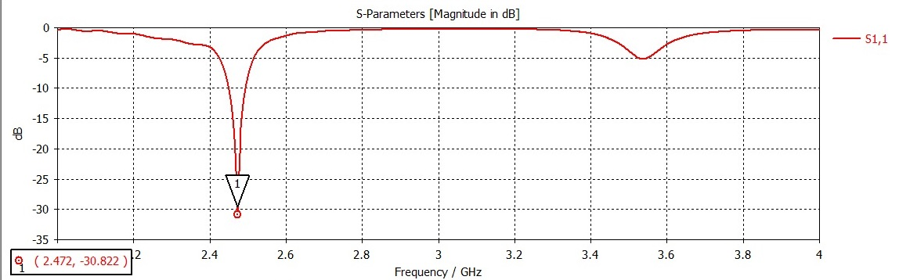
PERFORMANCE EVALUATIONS (Metamaterial Array Antenna)
Figure7: S₁₁ parameter of Metamaterial Array Antenna

Slide 11
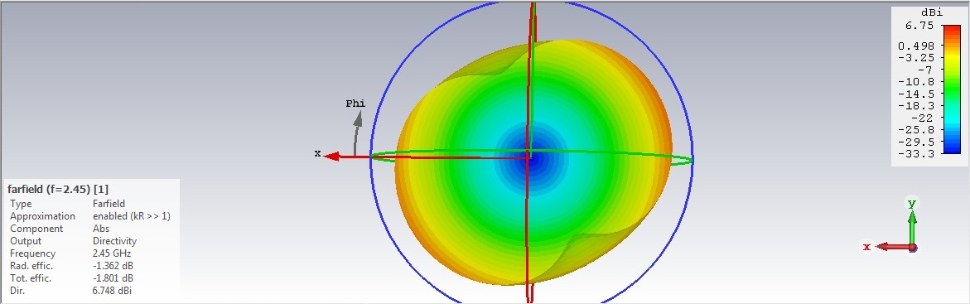

PERFORMANCE EVALUATIONS (Metamaterial Array Antenna)
Figure 8: a-Directivity b- Gain of the Metamaterial Array Antenna

Slide 12
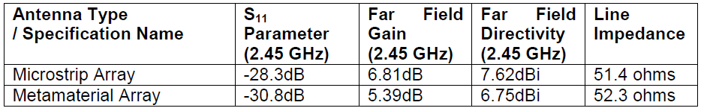
PERFORMANCE COMPARISONS
Table 1: Performance Evaluation Results of Antennas

Slide 13
CONCLUSION
Microstrip array and metamaterial array antennas are designed and performance comparisons are done at the specified resonant frequency 2.45 GHz. After that, resulting specifications which affect the performance of the microwave antennas are reported.
Expected thing is that metamaterial array antenna will have greater gain and directivity values than microstrip array antenna. However, as shown in simulation results even if the bandwidth and S₁₁ parameter is better in metamaterial antenna the gain and directivity are less than microstrip array antenna.

Slide 14
REFERENCES
[1] H. Ö. Yılmaz and F. Yaman, "Metamaterial Antenna Designs for a 5.8-GHz Doppler Radar," in IEEE Transactions on Instrumentation and Measurement, vol. 69, no. 4, pp. 1775-1782, April 2020, doi: 10.1109/TIM.2019.2914131.
[2] Ali, Usman & Ullah, Sadiq & Haroon, Engr. (2016). Design and Analysis of a 2.4 GHz Antenna using Metamaterial Ground Planes for Body Worn Wireless Applications. Bahria University Journal of Information & Communication Technologies (BUJICT). 9.
[3] https://m.eet.com/images/common/rfdesignline/2010/06/C0581Ch3pt2.pdf
[4] Ghuge, M., Khedkar, A. P., & Indulkar, P. A RIVIEW ON GAIN ENHANCEMENT TECHNIQUES OF MICROSTRIP PATCH ANTENNA.
[5] http://www.antenna-theory.com/antennas/patches/antenna.php

