Slide 1

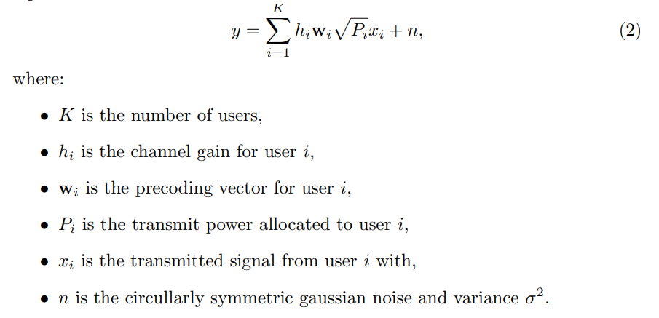
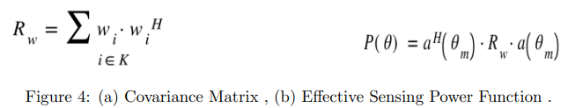
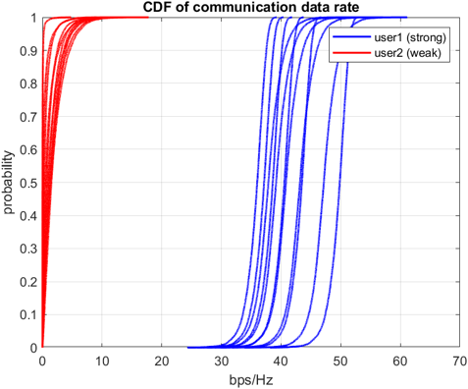
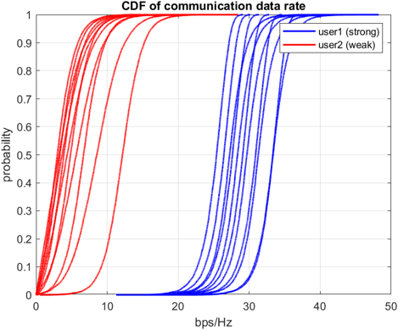
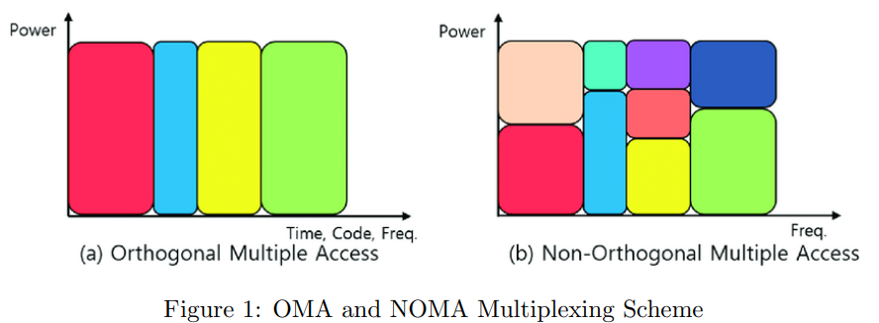
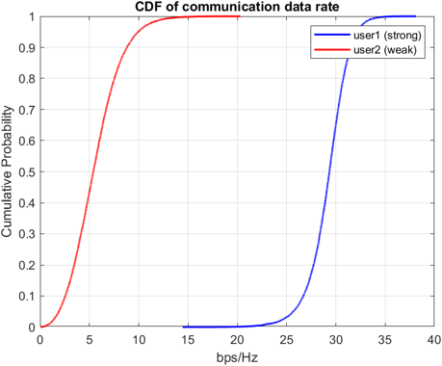
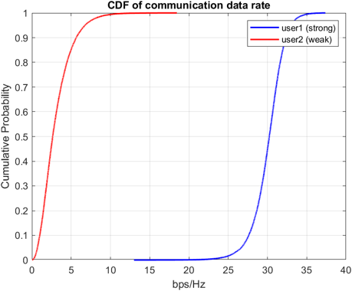


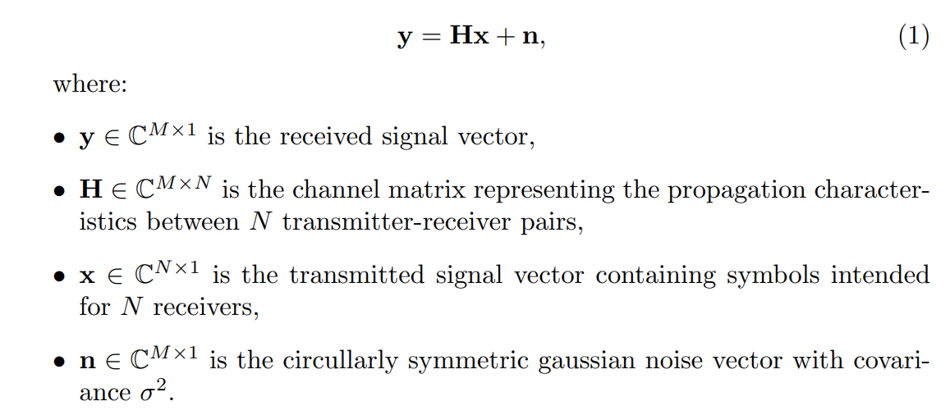
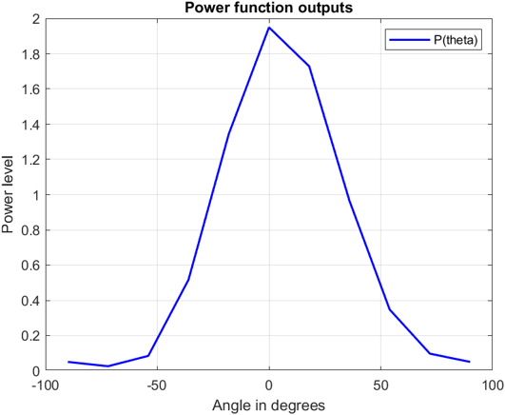
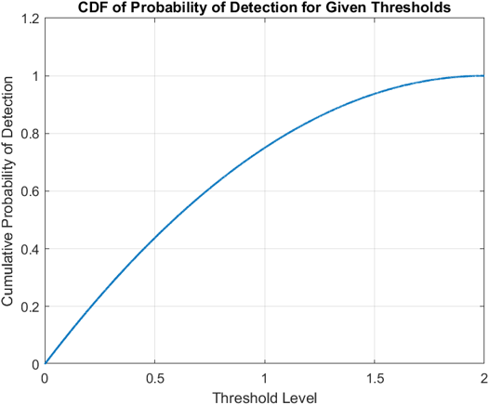
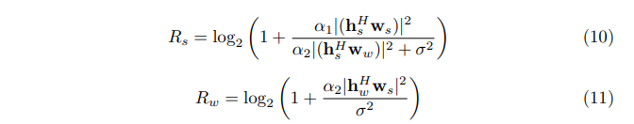

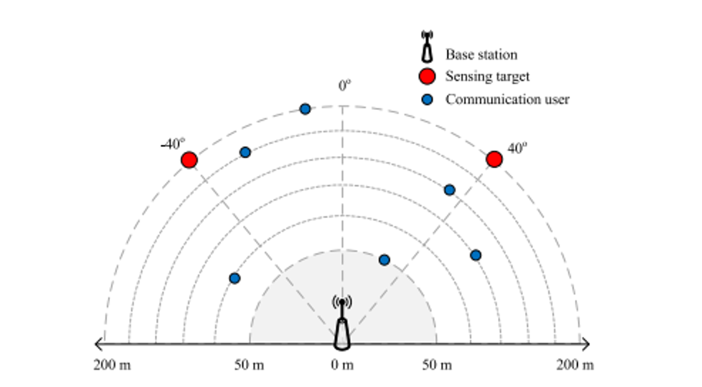
Joint Communication and Sensing for NOMA Systems
Prof. Dr. Berna Özbek
Emre Sengir 270206023
INTRODUCTION
As modern technology advances, JCAS systems are enhancing wireless communications by integrating sensing and communication functions. NOMA-enabled JCAS systems represent a significant leap in future wireless communication and radar sensing. Unlike traditional methods like TDMA and FDMA, NOMA multiplexes users in the power domain, improving spectrum efficiency and user connectivity. Integrating NOMA into JCAS systems offers advantages like effective resource allocation and interference reduction, crucial for high-density user situations and complex sensing tasks, meeting the demands of applications such as autonomous driving and smart cities.
RESULTS
ENGINEERING STANDARTS AND DESIGN CONSTRAINTS
Spectrum Efficiency
Maximize use of frequency bands.
Accurate power allocation to manage interference.
Power Allocation
Balance throughput and sensing functionality.
Use advanced optimization methods like SDR and SCA.
Interference Management
Mitigate interference in dense user environments.
Employ SIC and beamforming techniques.
Computational Complexity
Develop scalable and efficient algorithms.
Ensure real-time processing without delays.
Reliability and Robustness
Maintain performance in varying conditions.
Essential for applications like autonomous driving and smart cities.
PROBLEM FORMULATION & SYSTEM MODEL
JOINT COMMUNICATION AND SENSING (JCAS)
NOMA Empowered JCAS [1]
ENGINEERING STANDARTS AND DESIGN CONSTRAINTS
Joint Communication and Sensing (JCAS) is a framework that integrates
communication and sensing functionalities within a single system. Mathematically, JCAS can be represented as follows:
Conventional NOMA with Power Allocation coefficients
PATH LOSS MODEL [3]
CONCLUSION
Non-Orthogonal Multiple Access (NOMA)
In conclusion, we effectively simulated both models and analyzed communication and sensing results. Simulation results suggest that NOMA-enabled joint communication sensing (JCAS) systems improve communication and sensing throughput significantly. Using NOMA's power domain multiplexing capability, these systems improve spectrum efficiency and user connectivity compared to traditional multiplexing methods like TDMA and FDMA. Using contemporary signal processing and optimization methods enhances the performance of NOMA-JCAS systems, resulting in dependable and efficient communication and sensing operations. NOMA-enabled JCAS systems are a vital technology for future wireless networks, meeting the complicated demands of applications like as autonomous driving and smart cities.
Non-Orthogonal Multiple Access (NOMA) is a multiple access technique
that allows multiple users to share the same time-frequency resources by using
different power levels and precoding vectors. The key principle of NOMA is
to superpose the signals intended for different users in the power domain and
apply successive interference cancellation (SIC) at the receivers.
Mathematically, the received signal y at the base station (or user) can be
represented as:
REFERENCES: [1] Z. Wang, Y. Liu, X. Mu, Z. Ding and O. A. Dobre, "NOMA Empowered Integrated Sensing and Communication," in IEEE Communications Letters, vol. 26, no. 3, pp. 677-681, March 2022
[2] Cheon, Jinyong & Cho, Ho-Shin. (2017). Power Allocation Scheme for NonOrthogonal Multiple Access in Underwater Acoustic Communications. Sensors. 17. 2465. 10.3390/s17112465.
[3] George Mason University, Path Loss and Link Budget, ECE 732: Mobile Communications, 2018, B.-P. Paris, http://www.spec.gmu.edu/~pparis/classes/notes_732/Lecture_2018_09_04.pdf
[4] P. Stoica, J. Li and Y. Xie, "On Probing Signal Design For MIMO Radar," in IEEE Transactions on Signal Processing, vol. 55, no. 8, pp. 4151-4161, Aug. 2007, doi: 10.1109/TSP.2007.894398.

