Slide 1
Joint Communications and Sensing for NOMA systems
Prof. Dr. Berna Özbek
Ar. Gör. İrem Cumalı
Emre Sengir

Slide 2



1st Method
Reffering to the paper [1], Data rates were defined as below for a base station equipped with N-antennas and K single antenna users where their channel strengths’ is in increasing order to K. (user 1 is the weakest).
[1]Nayebi, E., Ashikhmin, A., Marzetta, T. L., & Yang, H. (2015, November). Cell-free massive MIMO systems. In 2015 49th Asilomar Conference on Signals, Systems and Computers (p. 695). IEEE.

Slide 3
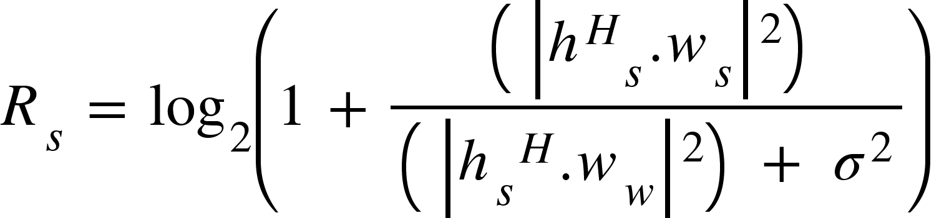
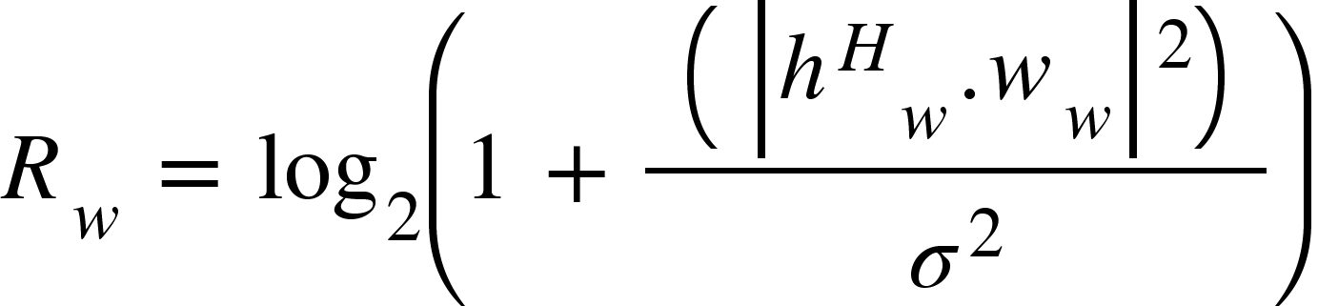
2nd Method
In contradictory to previous method, conventional NOMA data rate equations’ calculated in reverse where interference loaded into the strongest user where weak user applying SIC.

Slide 4
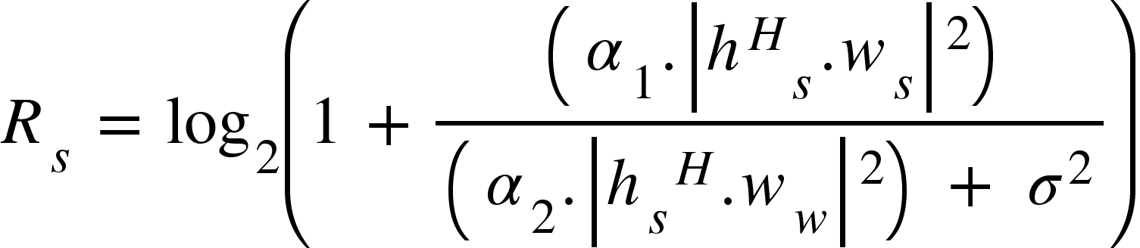
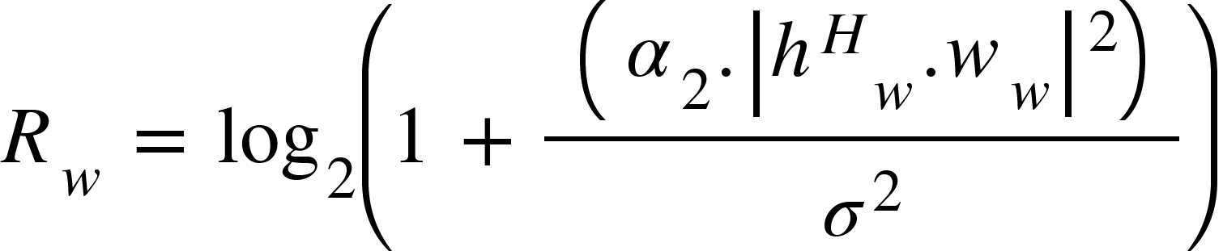
Other Variations
Power Allocation coefficients are added into the equations in various ways to observe their effectness.
In addition, it seemed that path loss couldn’t effectively be imitated in simulation environment MATLAB, another simplified path loss model will also be given.

Slide 5
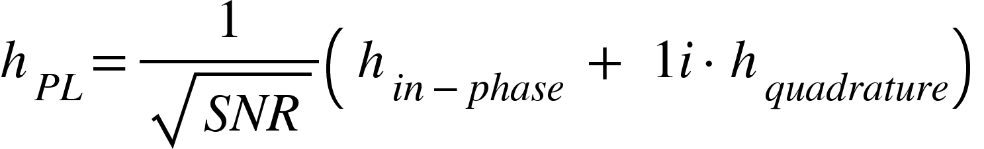
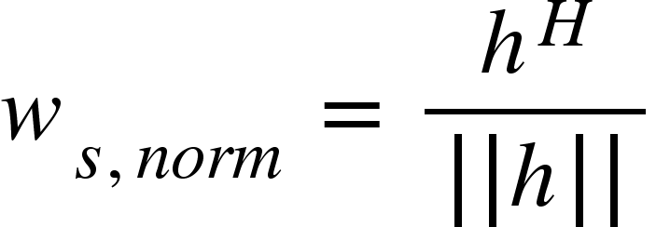
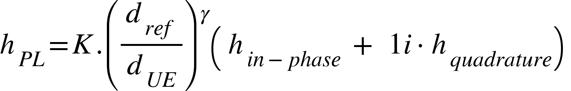

Path Loss and precodings
Two type of equations are applied to the channel coefficients and precodings are calculated in the given way.
$.\frac{1}{\sqrt{2}}$
$.\frac{1}{\sqrt{2}}$ [2]

Slide 6
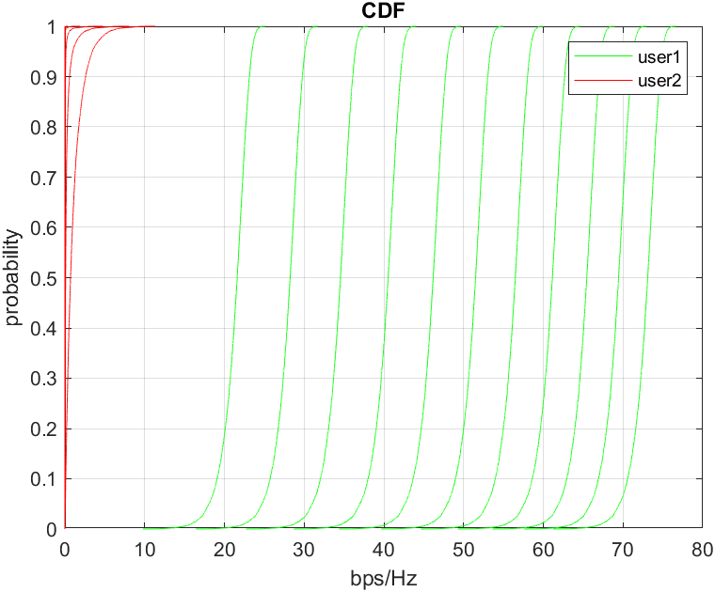
Results in 1st Method
Strong: 10:1:20
Weak: 20:1:30

Slide 7
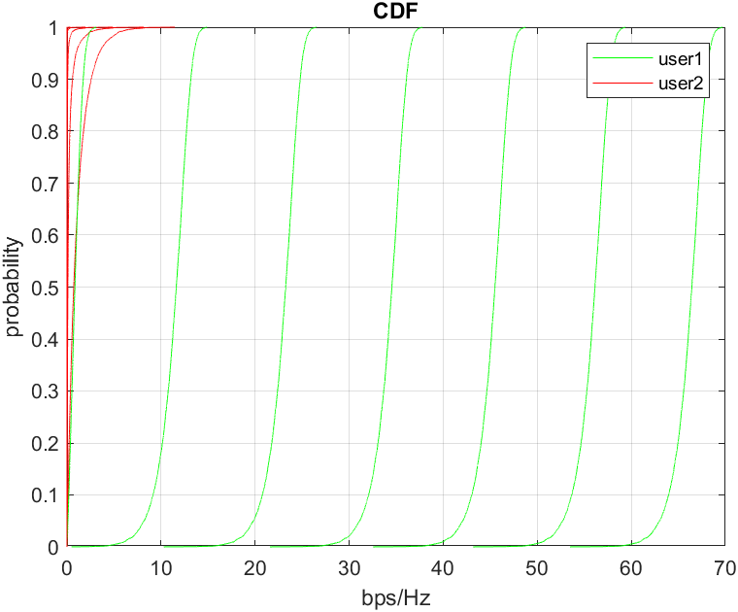
Strong: 30:1:40
Weak: 40:1:50

Slide 8
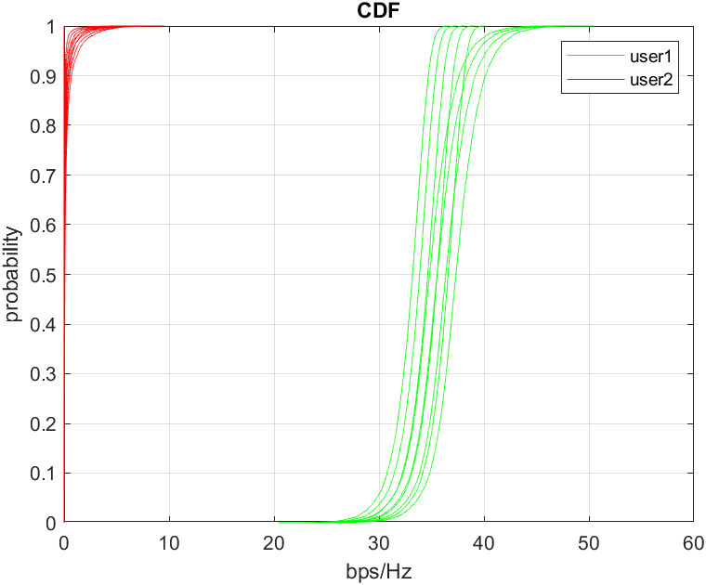
Strong: 1000:100:1900
Weak: 5000:100:5900
ϒ = 4

Slide 9
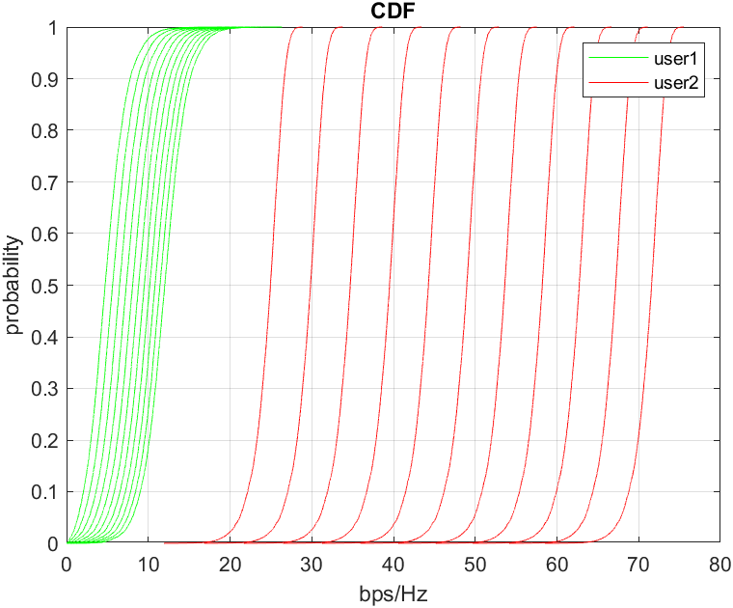
2nd Method
Strong: 10:1:20
Weak: 20:1:30

Slide 10
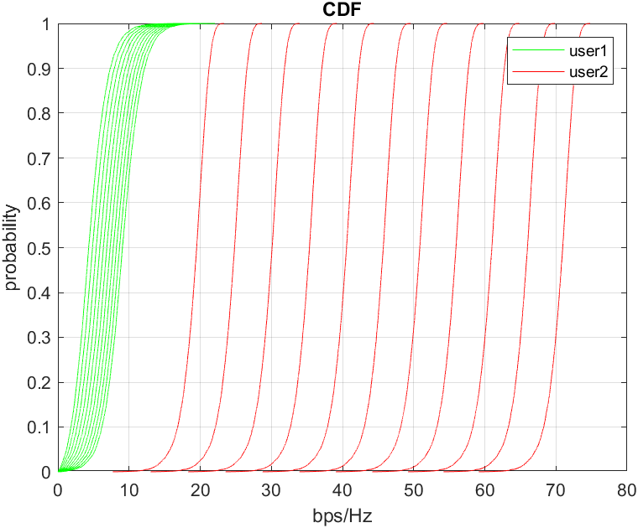
Strong: 30:1:40
Weak: 40:1:50

Slide 11
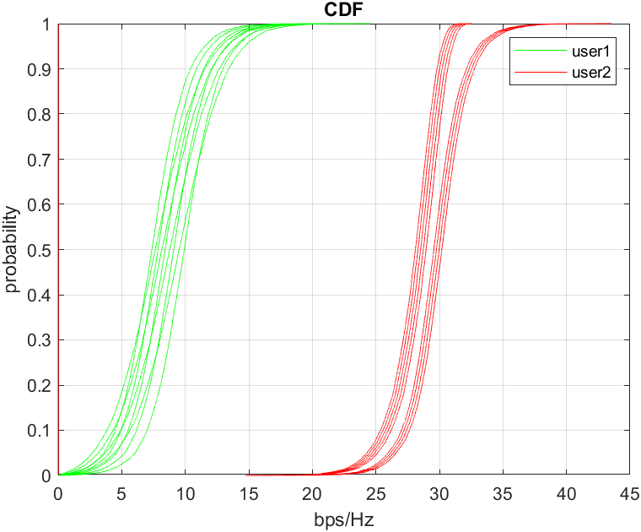
Strong: 1000:100:1900
Weak: 5000:100:5900
ϒ = 4

Slide 12
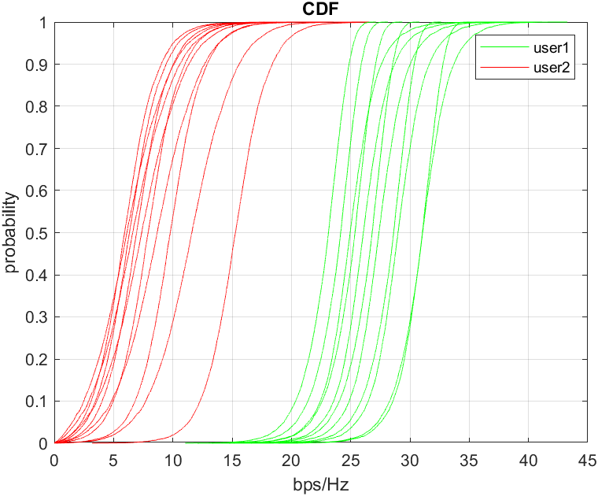
Strong: 100:100:1100
Weak: 500:100:1500
ϒ = 5

Slide 13
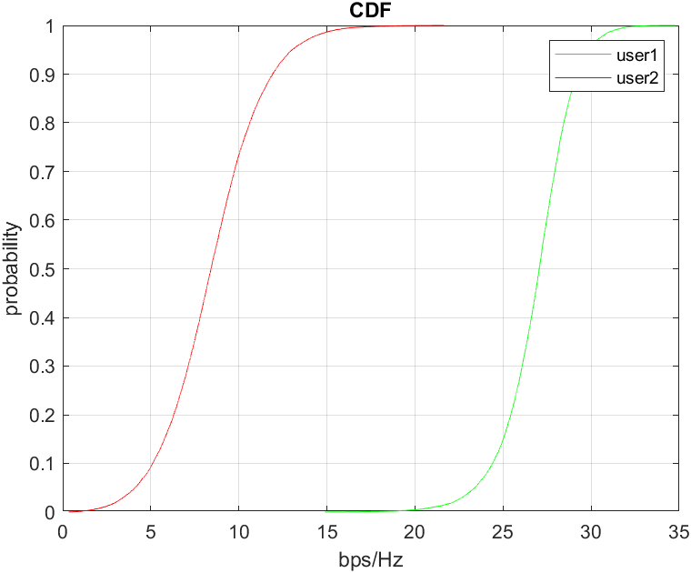
Monte Carlo of Distances

Slide 14
Will be visually improved

Slide 15
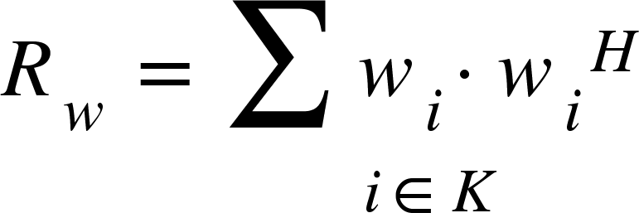
Sensing
Communication waveforms exploited for radar target sensing.
Designing the covariance matrix as requirement ?
Object is the maximizing the sensing power in given equation.

Slide 16
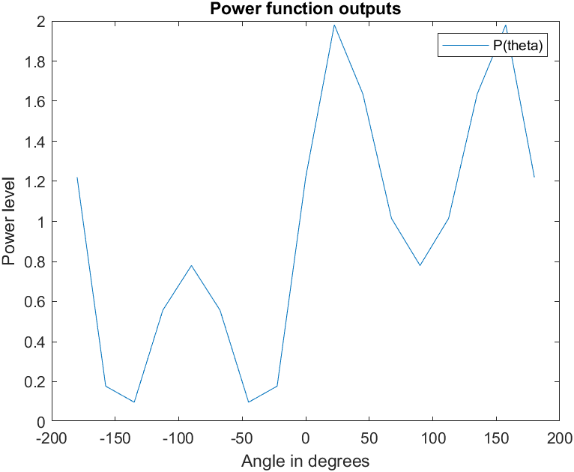
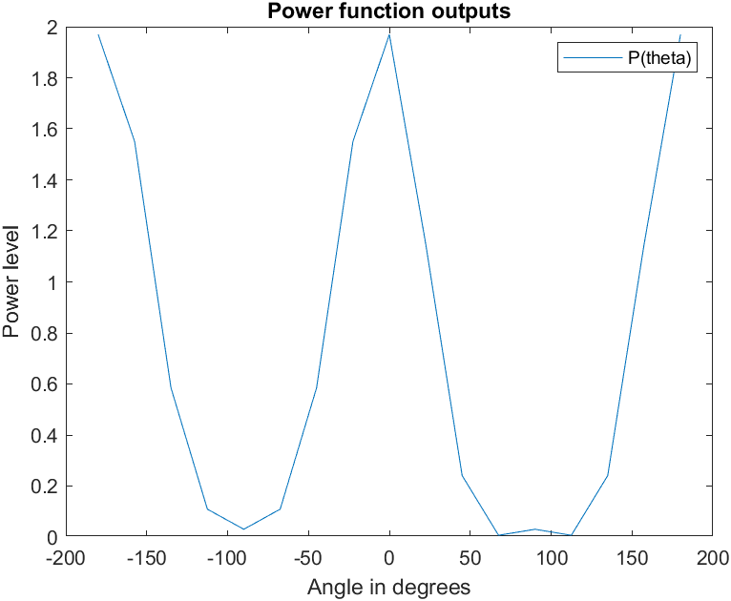
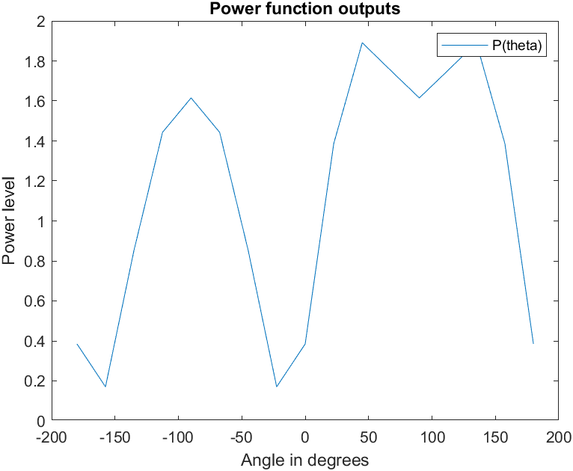
Trials of evaluating the power function

Slide 17
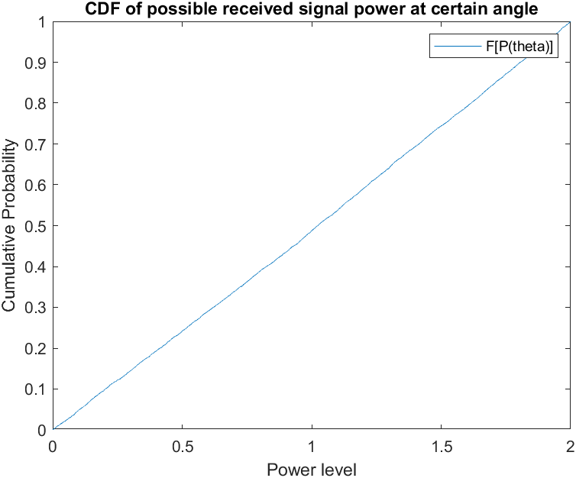
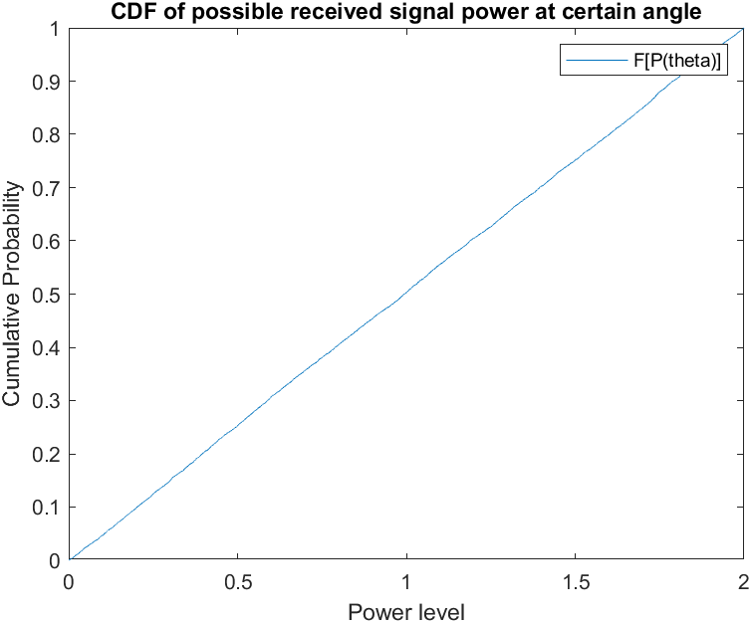
-pi/6
pi

Slide 18
What will be the optimized results ?
How to be optimized ?
Sketch.

Slide 19
References
[1] Nayebi, E., Ashikhmin, A., Marzetta, T. L., & Yang, H. (2015, November). Cell-free massive MIMO systems. In 2015 49th Asilomar Conference on Signals, Systems and Computers (p. 695). IEEE.
[2] George Mason University, Path Loss and Link Budget, ECE 732: Mobile Communications, 2018, B.-P. Paris, http://www.spec.gmu.edu/~pparis/classes/notes_732/Lecture_2018_09_04.pdf

