Slide 1
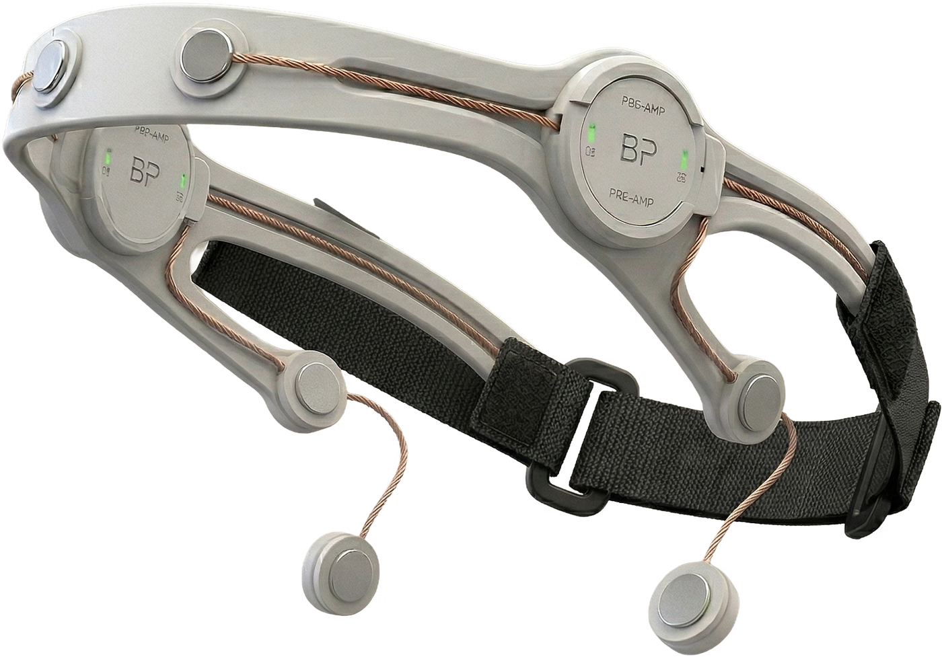

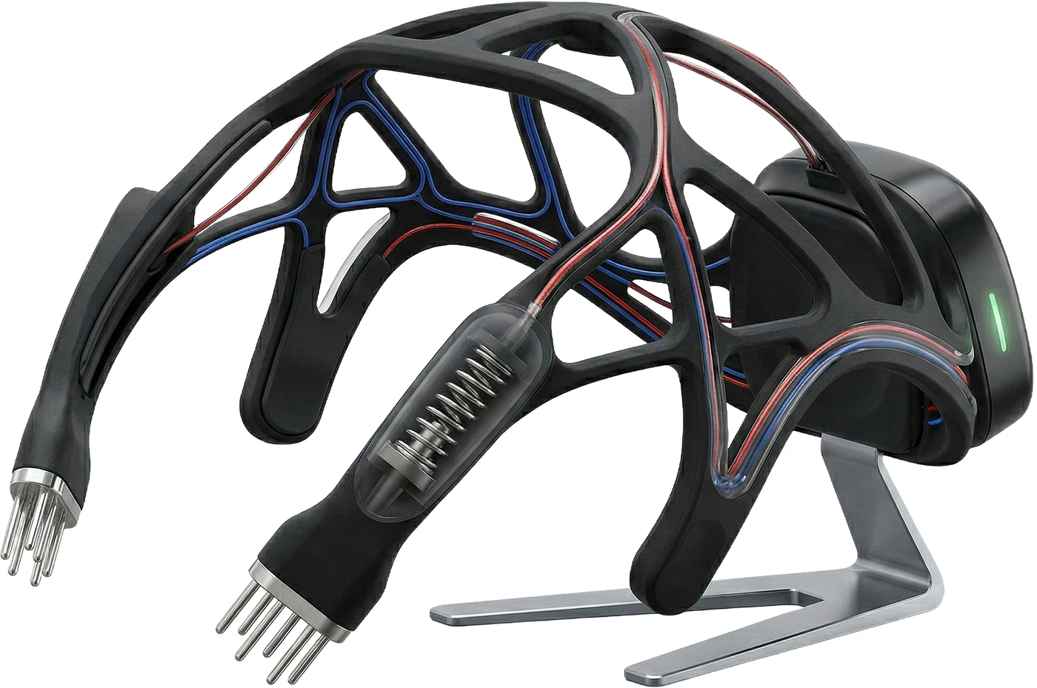
MindSync
Real-time emotional intelligence from the brain
Concept rendering of future consumer device. Current R&D prototype on Slide 4.

Slide 2



The Problem
1.1 billion people
Lack of data in therapy
Emotion “Gap” with AI
worldwide are living with a diagnosable mental disorder.
1 in 10 in India alone.
Therapists rely on physical cues to read a patient's mind.
Today's AI cannot account for human emotions.

Slide 3
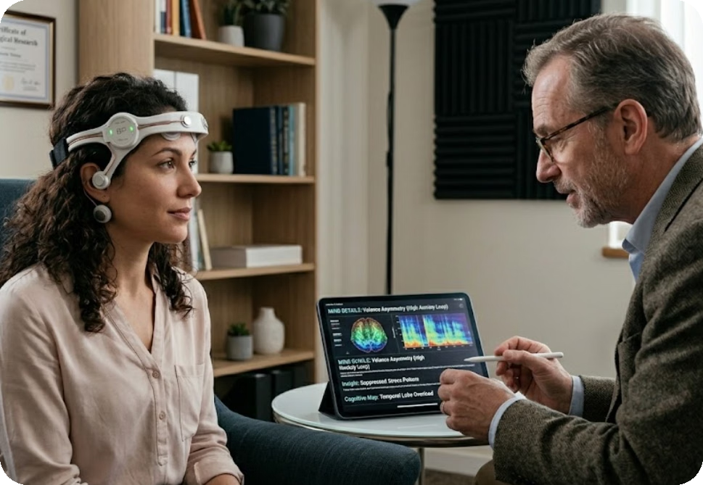
Our Solution
1
Capture
Headset records EEG.
2
Classify
Planned CNN/RNN models estimate Stress, Focus and Calm.
3
Summarize
An LLM turns structured outputs—not raw EEG—into therapist-readable summaries.
Models and clinical utility require validation.

Slide 4
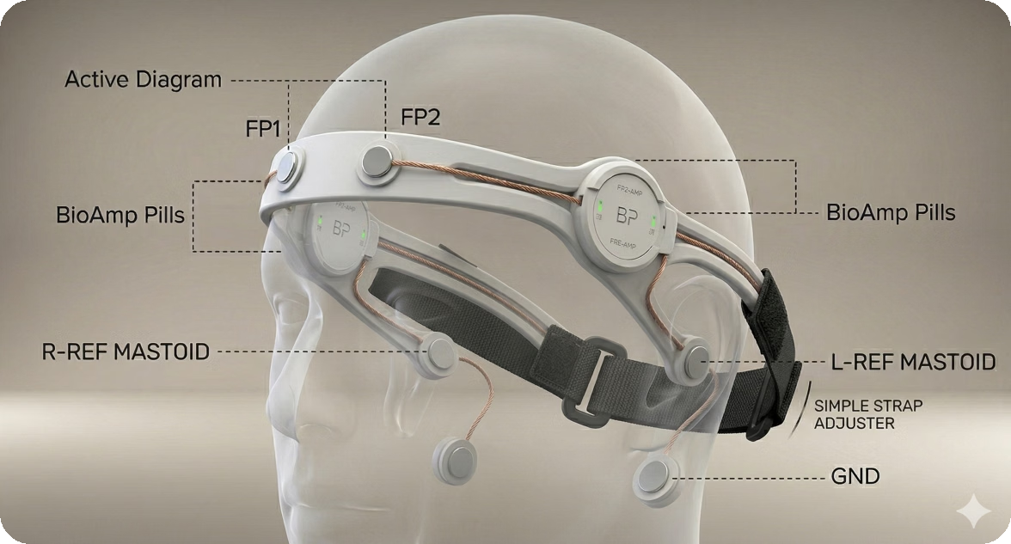
Our Product
PROPOSED STACK
BioAmp EEG
Signal processing
Proprietary CNN/RNN classifiers
Structured state estimates
LLM-generated clinical summaries for therapist review
The LLM does not read raw brain waves. Example output: “Elevated estimated cognitive load.” Stress, Focus and Calm classification remains to be validated; summaries are not diagnoses.

Slide 5
Potential Use Cases (Subject to Validation)
Cognitive Load & Focus Tracking
(For ADHD management and peak-performance tasks)
LLM summaries from ML-classified EEG states
Guided calming techniques like PMR
Early panic attack alerts via continuous monitoring
Objective Anxiety Monitoring
(For exposure therapy and CBT)
Real-time data for medical practitioners' assessments
Periodic stress detection

Slide 6
Competitive Landscape
MindSync is the AI layer for clinicians and personal users for wellbeing, built on affordable wearable EEG.
Feature
MindSync
Ease
Muse
Emotiv
OpenBCI
Neuroelectrics
↑ Clinical workflow
Wearable EEG (≤16 channels)
✓
✓
✓
✓
✓
✕
MindSync (planned)
Clinician dashboard
✓
✕
✕
✕
✕
Ease
AI summaries for therapists
✕
✕
✕
✕
✕
Neuroelectrics
Stress / focus metrics
✕
✕
✓
✕
✕
Brain stimulation (tDCS / tES)
✕
✓
✕
✕
✕
✓
Emotiv
Medical-device status
✓
✕
✕
✕
✓
Muse
OpenBCI
Meditation & sleep neurofeedback
✕
✕
✓
✕
✕
✕
↓ Consumer and research use
Built for Indian clinics
✓
✓
✕
✕
✕
✕
← Hardware-led
AI analytics-led →
BUSINESS MODEL
MindSync
₹80,000 clinic package + SaaS
Ease
Early launch; revenue private
Muse
$250–$400 hardware + $10–$15/mo
Emotiv
Hardware + EmotivPRO SaaS
OpenBCI
Open hardware boards
Neuroelectrics
Research & clinical systems
Tick: stated in the research reports reviewed. Cross: not stated. Gold dot: planned or in development at MindSync. Map positions are indicative.

Slide 7
A software gap in an import-led market
TAM
Global EEG devices market in 2024, heading to $2.4–2.6B by 2031. Wearable headsets are a $164M niche (2026).
TAM
$1.6B
SAM
Indian clinical EEG equipment market. 75⁠–⁠80% is imported (Nihon Kohden, Natus, Cadwell), leaving the software layer open.
SAM
$25–45M
SOM
Year 1 target: 1.5% of about 3,500 private psychiatric and psychology practices in Tier-1 and Tier-2 cities.
50 accounts
SOM
Who buys: psychiatric clinics and psychology practices.
Sources: MindSync competitor market share analysis (industry reports and public filings). India figures and Year 1 account target are estimates, not validated.

Slide 8
Business Model: Clinics First (B2B2C)
Initial wedge: High-end therapists and clinics in Delhi NCR & Bangalore. Consumer launch follows validation.
YEAR 1
YEAR 2+
FUTURE
The Clinical Solution Package
The Recurring Moat
Consumer Version
₹80,000
₹12,000 / year
₹80,000 headset
one-time
SaaS renewal
+ ₹1000/month subscription
1 MindSync EEG Headset
Logistics & Setup
Clinical Onboarding & Doctor Training
1-Year Free Premium App Subscription (Dashboard & AI Summaries)
Continued access to the real-time dashboard, updated AI models, and clinical summaries
High-margin recurring revenue; hardware is already paid for
Planned after clinical validation
Leverages clinic-led referrals to high-net-worth individuals

Slide 9
Go-To-Market Strategy
MONTHS 1–3
MONTHS 4–6
MONTHS 7–12
Clinic Pilots
Validate
Consumer Launch
Sell the ₹80,000 Clinical Solution Package to early-adopter therapists.
15-patient feasibility study. Measure EEG quality, setup time, and therapist utility.
Transition to dry-electrode hardware. Target ₹80,000 + ₹1000/mo. Leverage clinic-led referrals.
Validation-gated timeline: consumer launch depends on study results and applicable regulatory requirements. Continuous R&D throughout; a 15-patient study tests feasibility, not clinical efficacy.

Slide 10
Regulation & Data Privacy
The Regulatory Pathway
Protecting Brain Data
Phase 1: Clinical Decision Support (2026–2027)
Launch strictly as a Wellness & Decision Support Tool. We do not claim to diagnose; we provide objective data to assist the therapist. This lets us start pilots and collect data while certification is pursued.
Phase 2: Medical Device Certification (2027+)
Once we have our 15-patient study data, we will pursue CDSCO (India) and FDA (US) clearances for specific clinical claims.
DPDP Act: Built to comply with India's Digital Personal Data Protection Act.
End-to-End Encryption: Patient brainwave data is encrypted at the hardware and cloud levels.
Explicit Consent: Data is only recorded during active sessions with patient consent.
The Data Moat: Consented, anonymized data is used to train and improve our proprietary AI models.

Slide 11
Unit Economics & Path to Scale
PROOF OF CONCEPT
CONSUMER EXPERIENCE
SCALE TARGET
₹20,000
Wet → Dry
₹15,000
prototype cost
electrodes
target COGS at 1,000 units (unvalidated)
4-channel headset. Excludes GST; indicative component estimate.
Transition from wet Ag/AgCl cups and paste to dry electrodes. Target faster setup and easier repeat use. Signal quality requires testing.
₹65k–₹80k retail implies 76.9%–81.3% hardware margin.
Illustrative margin = (retail price - ₹15,000) / retail price, before taxes, software, distribution, warranty and support. 50%+ margin requires at least ₹30,000 net hardware revenue. Supplier quotes and dry-electrode engineering must validate the target.

Slide 12
Roadmap
Q4 2026
Q2 2027
Q4 2027
2028
Prototype refinement and dashboard MVP
15-patient clinic feasibility study and initial ML training
Clinic pilot packages; seed target Q3 2027: ₹2–3cr
Consumer version after validation; dry-electrode R&D
Continuous R&D ● Q4 2026–2028 and beyond
Improve sensors, signal quality, AI and onboarding through clinical evidence and consumer feedback at every phase.

Slide 13
The Ask: Milestone-Based Grant
₹5,00,000
THREE GRANT-FUNDED OUTCOMES
Working 4-channel EEG prototype
1
To reach our next de-risking milestone—not a full commercialization round.
Initial validation study with 15 patients
2
Initial AI model training
3
Next financing target: ₹2–3 crore Seed Round in Q3 2027, contingent on milestone results.
Human research requires appropriate ethics approval and consent. A 15-patient study establishes feasibility, not clinical efficacy.

Slide 14
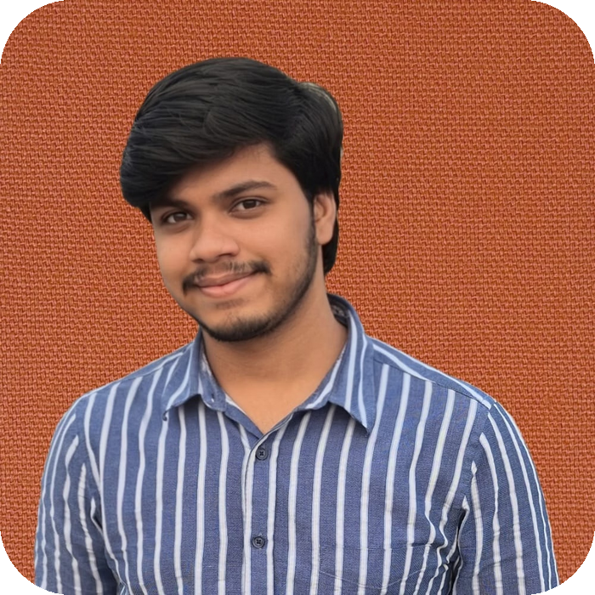
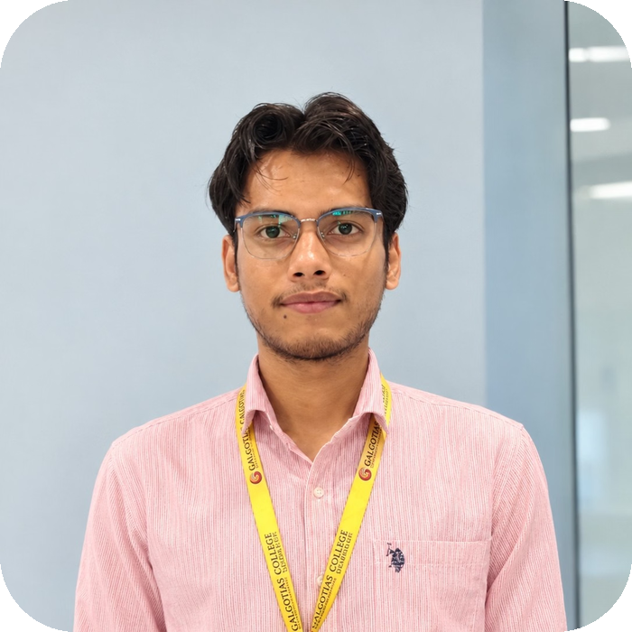

Our Team
Hemendra Harsh
Piyush Bajpai
Clinical Advisory
Electronics, design and team lead
Software and AI model training
Advisory board in formation
Expertise in embedded biosensors and BioAmp integration
Specialized in time-series ML and EEG signal processing
In discussions with psychiatrists to formalize an advisory board and guide clinical study design.

Slide 15
Thank You
MindSync: real-time emotional intelligence from the brain
Hemendra Harsh · Piyush Bajpai

