Slide 1

Primary Key, Foreign Key and Cascading
Amritha Sathiadevan
Nagullas K S
Roopak Mayya
Thejas C S

Slide 2
What are Keys?
Keys are identifiers, be it a field or column.
It helps us access a particular record in the table
In a DB table, keys are always stored in sorted order unlike data in other columns which get stored usually in the order of insertion.
A key can be a single field(data item) or a combination of columns(data items).
We can relate multiple tables using keys.

Slide 3
Types of Keys
There are multiple types of keys in Database systems.
> Primary Key
> Foreign Key
> Candidate Key
> Alternate Key
> Composite Key

Slide 4
Primary Keys
Uniquely identify a record or a row of data in a table
A Unique and Non-Null attribute
Only one Primary Key for a table
Mandatory for every table and can never be changed/updated
CREATE TABLE Employee (
Employee_ID int PRIMARY KEY,
First_name varchar(10),
Last_name varchar(10),
Email varchar(50),
Location varchar(10),
Dept_ID int);
Primary key
Employee_ID | First_name | Last_Name | Email | Location | Dept_ID
1001 | Amritha | Sathiadevan | amritha_sathiadevan@gmail.com | Cochin | 10
1002 | Nagullas | KS | nagullas_ks@gmail.com | Mangalore | 10
1003 | Roopak | Mayya | roopak_mayya@gmail.com | Mangalore | 10
1004 | Samanyu | Mohanty | samanyu_mohanty@gmail.com | Bhubaneswar | 10
1005 | Thejas | CS | thejas_cs@gmail.com | Gadag | 10
Table: Employee

Slide 5
Candidate, Alternate and Composite Keys
Employee_ID | First_name | Last_Name | Email | Location | Dept_ID
1001 | Amritha | Sathiadevan | amritha_sathiadevan@gmail.com | Cochin | 10
1002 | Nagullas | KS | nagullas_ks@gmail.com | Mangalore | 10
1003 | Roopak | Mayya | roopak_mayya@gmail.com | Mangalore | 10
1004 | Samanyu | Mohanty | samanyu_mohanty@gmail.com | Bhubaneswar | 10
1005 | Thejas | CS | thejas_cs@gmail.com | Gadag | 10
‘Employee_ID’ and ‘Email’ are Candidate Keys
Since ‘Employee_ID’ is the Primary Key, ‘Email’ is the Alternate Key
A combination of ‘First_name’ and ‘Email’ is an example for Composite Key

Slide 6

Foreign Key
Foreign key is an attribute which is a Primary key of its parent table, but is included as an attribute in another host table, thus, it establishes a relationship between two tables in a database
Foreign Key must have a corresponding Primary key.
It can have different name than that of Primary key, it enforces referential integrity
Foreign keys play an extremely important role in maintaining accuracy and consistency of data across the database.

Slide 7
Foreign Key
Foreign key
Employee_ID | First_name | Last_Name | Email | Location | Dept_ID
1001 | Amritha | Sathiadevan | amritha_sathiadevan@gmail.com | Cochin | 10
1002 | Nagullas | KS | nagullas_ks@gmail.com | Mangalore | 10
1003 | Roopak | Mayya | roopak_mayya@gmail.com | Mangalore | 10
1004 | Samanyu | Mohanty | samanyu_mohanty@gmail.com | Bhubaneswar | 10
1005 | Thejas | CS | thejas_cs@gmail.com | Gadag | 10
Child Table (Employee)
FK relationship
Features of Foreign key:
It can have duplicate/NULL values unless specified
Constraint is specified on child only
Multiple Foreign key can exist in a table
Parent can not be modified/deleted if child record exists
Department_ID | Department_Name
10 | Data Science
20 | Machine Learning
30 | Artificial Intelligence
Primary key
Parent/Master Table (Department)

Slide 8
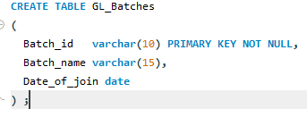
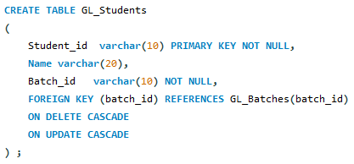
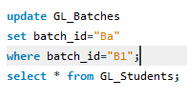

1
2
Cascade
Keyword used with foreign key
‘on update’ or/and ‘on delete’
Cascades changes to all tables with references
Cascade
helps in reducing maintenance effort for the database as the system itself takes care of updating references thus maintaining integrity at all times
Batch id | Batch Name | Date of joining
B1 | Feb-20 | 10-Feb-20
B2 | Sep-20 | 15-Sep-20
B3 | Feb-21 | 08-Feb-21
B4 | Sep-21 | 10-Sep-21
Student_id | Name | Batch id
S1 | Amritha | B3
S2 | Nagullas | B3
S3 | Roopak | B2
S4 | Samanyu | B1
S5 | Thejas | B1
3
Batch id | Batch Name | Date of joining
Ba | Feb-20 | 10-Feb-20
B2 | Sep-20 | 15-Sep-20
B3 | Feb-21 | 08-Feb-21
B4 | Sep-21 | 10-Sep-21
4
Batch id | Batch Name | Date of joining
B2 | Sep-20 | 15-Sep-20
B3 | Feb-21 | 08-Feb-21
B4 | Sep-21 | 10-Sep-21
Student_id | Name | Batch id
S1 | Amritha | B3
S2 | Nagullas | B3
S3 | Roopak | B2
S4 | Samanyu | Ba
S5 | Thejas | Ba
Cascade Referential Integrity
tell SQL Server to perform certain actions whenever a user attempts to delete or update a primary key to which an existing foreign keys points.
Student_id | Name | Batch id
S1 | Amritha | B3
S2 | Nagullas | B3
S3 | Roopak | B2

Slide 9


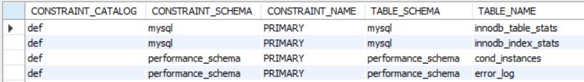
How do Constraints work?
When a key is established, it is updated in multiple places of the database.
The reference(foreign key) also is updated in multiple places.
We can find the constraints in a view called Information_Schema.Table_Constraints. This is a view where we find real time information of all the constraints in the database.
When we add a foreign key and remove the corresponding Primary key, the child table still shows the reference of the foreign key. So this gives incorrect info about the constraints and hence we should always refer to the Table_Constraints to get actual information.

Slide 10
Thank You!

