Slide 1

HYPOTHESIS TESTING USING ABSENTEEISM DATASET
SMDM PRESENTATION – GROUP 9
AMRITHA SATHIADEVAN
NAGULLAS KS
ROOPAK MAYYA
THEJAS CS

Slide 2
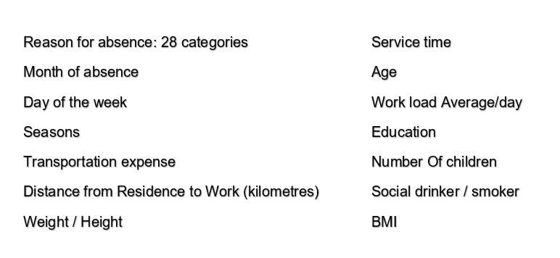
About the Data
The dataset was created with records of absenteeism at work from July 2007 to July 2010 at a courier company in Brazil.
The various attributes for 36 Individual employees are
Source of dataset: UCI Machine Learning Repository: Absenteeism at work Data Set
Dataset has 739 rows and 21 columns

Slide 3

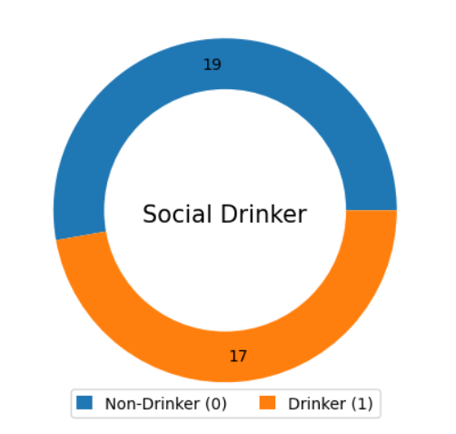
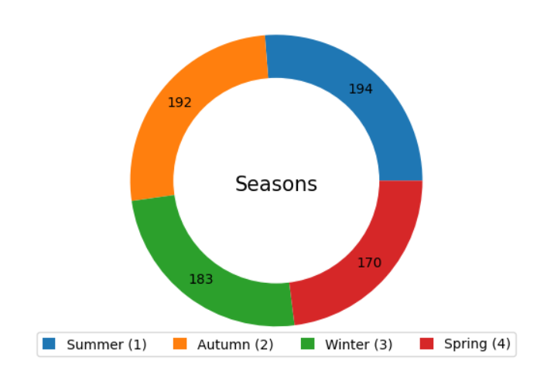
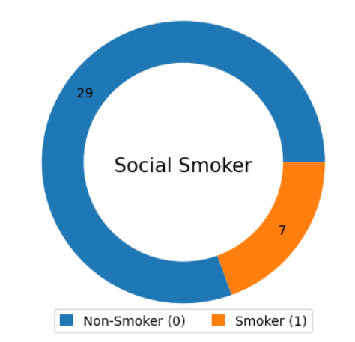
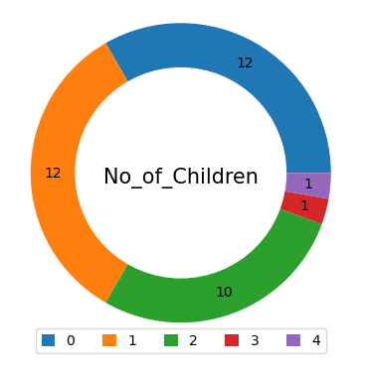
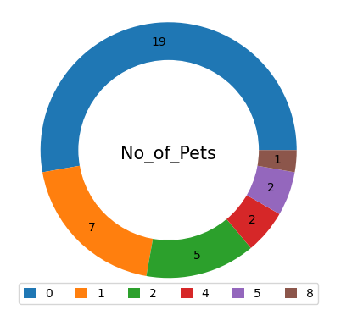
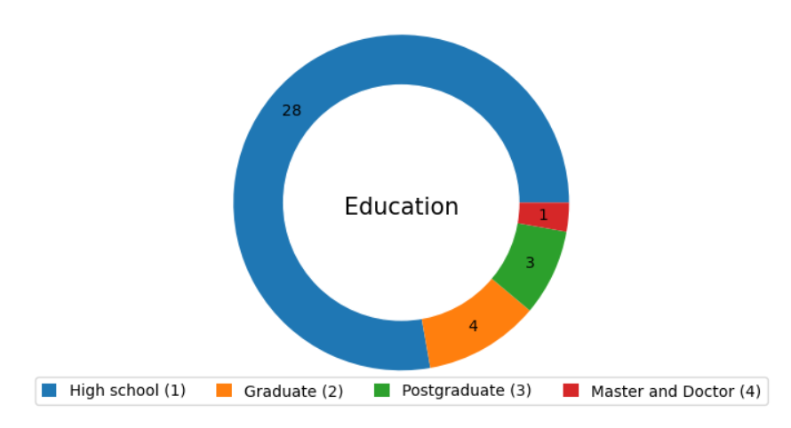
CATEGORICAL DATA

Slide 4
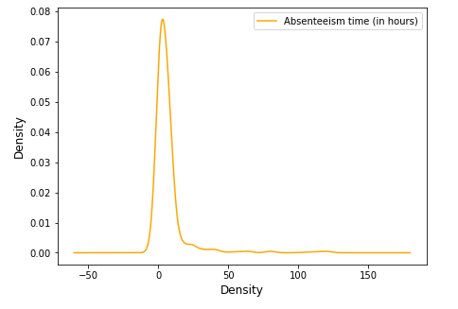
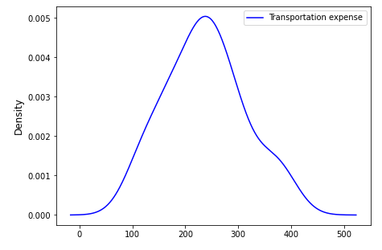
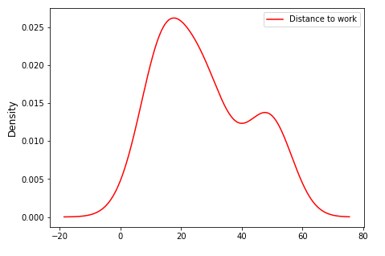
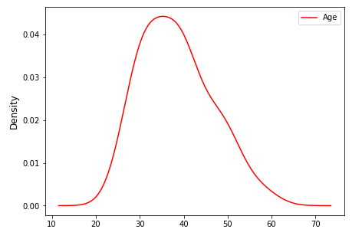
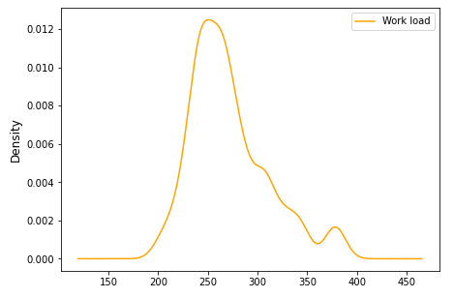
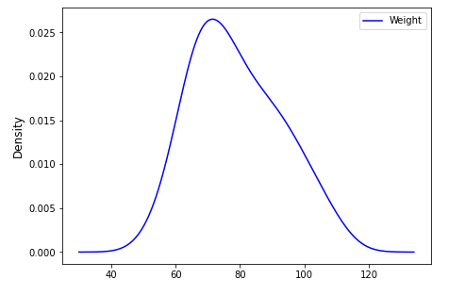
DISTRIBUTION OF CONTINUOUS VARIABLES

Slide 5
SURVEY OBJECTIVES & CLAIMS
The HR department of the company claims that the average transport expense of all employees in the company is less than 200
The average absenteeism across age groups of employees is different
The total absenteeism hours is different for smoker and non-smoker employees
The distribution of absenteeism across 4 quarters is different for employees
A consulting company wants to check if there is difference in medians of absenteeism hours for social drinkers and non-drinkers
The HR department claims that the 50% employees have completed high school (Education = 1), 25% employees are graduates (Education = 2), 20% employees are postgraduates (Education = 3) and 5% employees are doctorates (Education = 4)
A consulting company wants to check if there is any relationship between reason for absence and day of the week

Slide 6

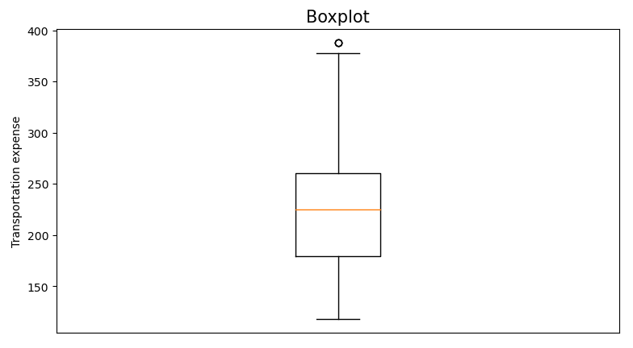
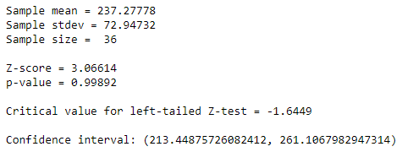
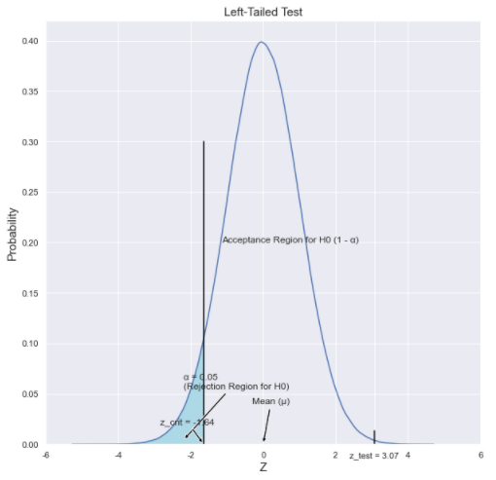
Claim 1: The HR department of the company claims that the average transport expense of all employees in the company is less than 200
Test used: Z-test
Test Result:
Inference:
Here the p-value is greater than alpha (0.05) at 95% confidence interval
The Z-score is greater than the Critical value for a lower-tailed Z-test and it falls in the acceptance region of H₀
The confidence interval does not contain the hypothesized mean
Therefore, we fail to reject the null hypothesis and conclude that the average transport expense of all employees is greater than 200

Slide 7
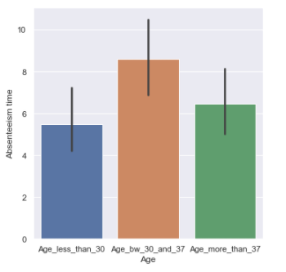



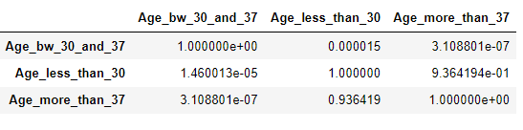
Claim 2: The average absenteeism across age groups of employees is different
Test Used : Kruskal Wallis Test (1 variable ;categorical > 2 groups)
Test Result :
Inference 1: Here P value is less than alpha and test statistics is greater than chi-square critical of 0.05 significance level. Therefore, we can conclude that the average absenteeism value across at least one age group is different.
Inference 2: Though Shapiro shows the distribution of absenteeism is not normal, levene test for different age groups shows a p-value greater than significance level indicating that the variance between groups are comparable
Difference in age group for absenteeism, Test: Posthoc-Conover Test
Absenteeism is different between the below age groups since the p-value of these pairs is less than the 0.05 significant level :
a) age<30 & 30<age>37 b) 30<age>37 & age>37)

Slide 8
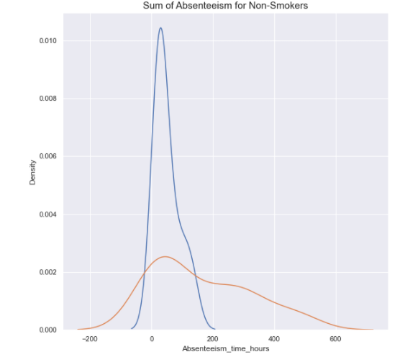

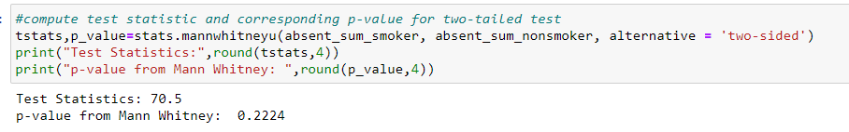
Claim 3: The total absenteeism hours is different for smoker and non-smoker employees
Test Used : Mann Whitney U Test
Test Result :
Inference 1: Here P value is greater than the significance level of 0.05 and so we fail to reject the null hypothesis.
Therefore, we can conclude that there is not enough evidence to show that there is an impact on absenteeism due to smoking habits.
Mann-Whitney test :
As per the Shapiro test, the variable absenteeism is not normally distributed
Categorical variable has 2 groups - smoker and non-smoker
Continuous variable - Absenteeism.

Slide 9
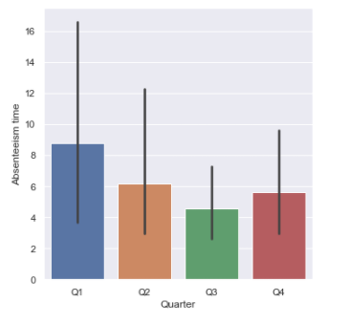

Claim 4: The distribution of absenteeism across 4 quarters is different for employees
Test Used : Friedman Test
Test Result :
Inference 1: Here p value is greater than the significance level of 0.05 and so we fail to reject the null hypothesis.
Therefore, we can conclude that there is not enough evidence to show that there is an impact on absenteeism for the employees across the 4 quarters of the year.
Inference 2 : Levene test for absenteeism across 4 quarters also shows a p-value greater than 0.5 and therefore there is not enough evidence to state that the change in absenteeism is same across the quarters.
Friedman test :
The test is for the same sample across 4 quarters
More than 2 groups for the categorical attribute quarter
Variable being continuous, absenteeism.

Slide 10
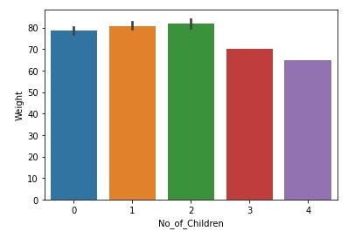
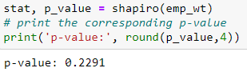


Claim 5: A consulting company wants to study the equality of average weight of employees with different number of children.
Test Used : Shapiro-Wilk test
Test Result :
Test Used : Levene test
Test Result :
P-value for Levene test s greater than 0.05 level of significance and therefore the population variances are equal for people with different number of children
Test Used : One-way Anova test
Test Result :
One-way Anova test :
Assumption of normality is satisfied by Shapiro-Wilk test
Assumption of equality of variance is satisfied by Levene's test
Categorical variable number of children has more than 2 groups
Inference 1: Here p value is greater than the significance level of 0.05 and test statistic falls in the acceptance region of null hypothesis.
Therefore, we can conclude that the number of children an employee has an impact of the weight of the employee.

Slide 11
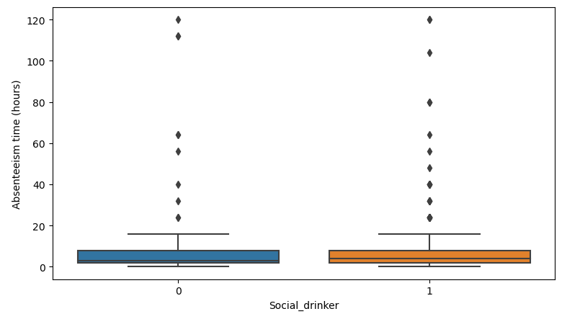

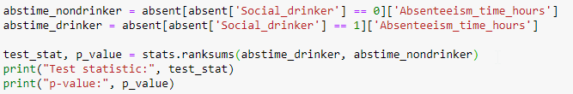
Claim 6: A consulting company wants to check if there is difference in medians of absenteeism hours for social drinkers and non-drinkers
Test used: Wilcoxon Rank Sum test
Test Result:
Inference:
Here the p-value is lesser than alpha (0.05) at 95% confidence interval
Therefore, we reject the null hypothesis and conclude that there is a difference in medians of absenteeism hours among social drinkers and non-drinkers

Slide 12
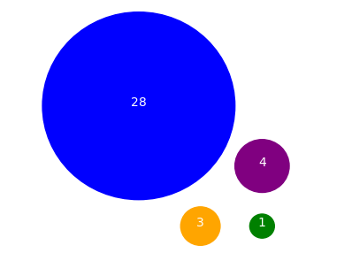


Claim 7: The HR department claims that the 50% employees have completed high school (Education = 1), 25% employees are graduates (Education = 2), 20% employees are postgraduates (Education = 3) and 5% employees are doctorates (Education = 4)
Test used: Chi-square goodness of fit
Test Result:
Inference:
Here the p-value is lesser than alpha (0.05) at 95% confidence interval
The Test statistic is greater than the Critical value for chi-square test and it falls in the rejection region of H₀
Therefore, we reject the null hypothesis and conclude that the number of employees from different education backgrounds is different from the claims made by the HR
Edu 1
Edu 2
Edu 3
Edu 4
Value counts of employees with education

Slide 13
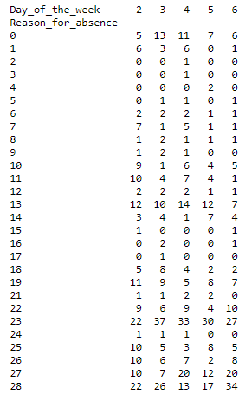
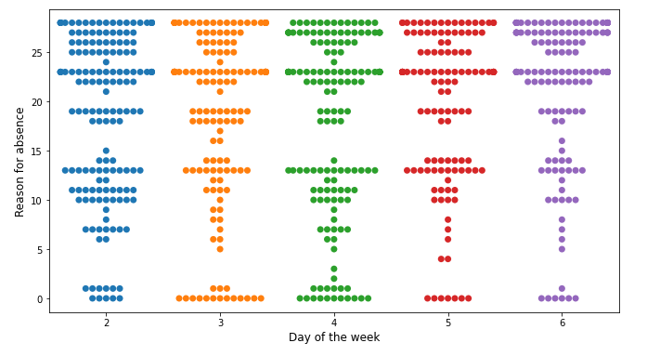

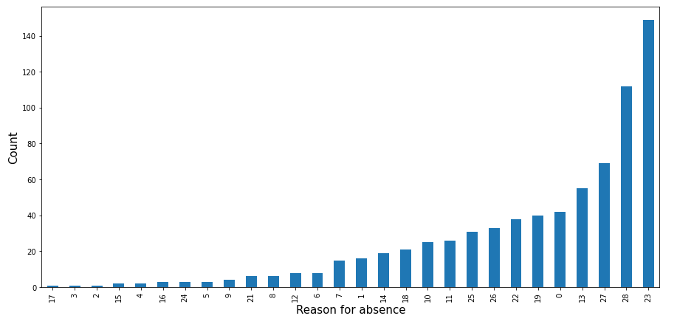
Claim 8: A consulting company wants to check if there is any relationship between reason for absence and day of the week
Test used: Chi-square test for independence
Test Result:
Inference:
Here the p-value is greater than alpha (0.05) at 95% confidence interval
The Test statistic is lesser than the Critical value for chi-square test and it falls in the acceptance region of H₀
Therefore, we fail to reject the null hypothesis and conclude that there is no relationship between the reason for absence and day of the week
Crosstab
23 – Medical consultation
28 – Dental consultation
27 – Physiotherapy
13 – Muskoskeletal & connective tissue disease
25 – Laboratory examination
26 – Unjustified absence

Slide 14
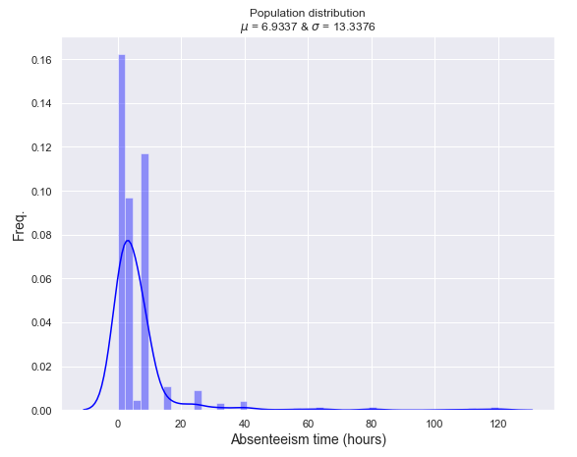
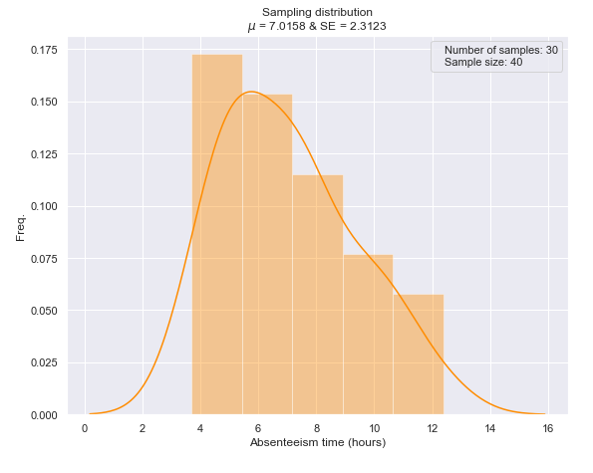
CLT SIMULATION OF ABSENTEEISM TIME

Slide 15
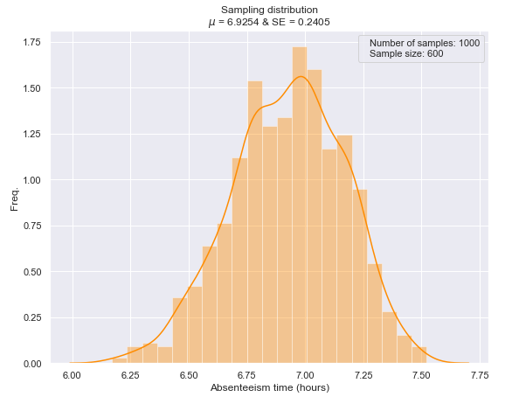
CLT SIMULATION OF ABSENTEEISM TIME

Slide 16
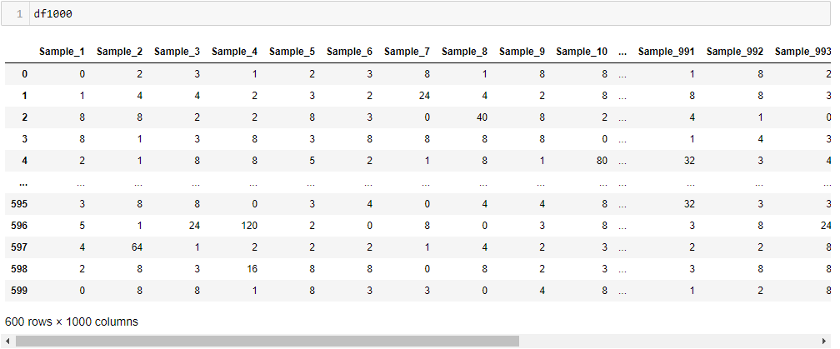
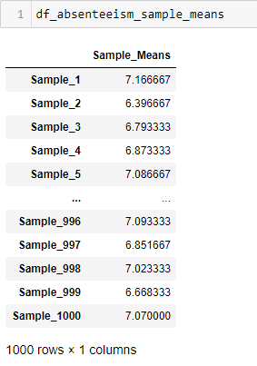
DATA GENERATED FOR CLT SIMULATION OF ABSENTEEISM TIME
Creating the dataframe of sample means for the 1000 samples from df1000
Creating the dataframe (df1000) of 1000 normal samples each having sample size 600

Slide 17
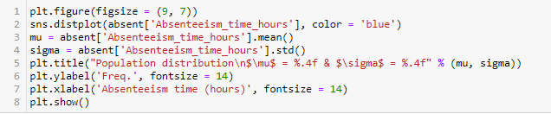
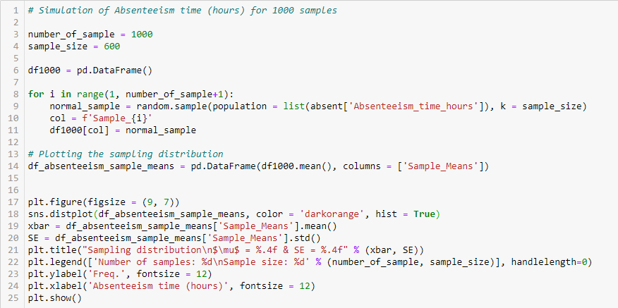
PYTHON CODE FOR CLT SIMULATION

