Slide 1
Introduction: Gradient Boosting Decision Tree
19/05/08
DTM1: Takuto Sato

Slide 2

Background
What is Gradient Boosting Decision Tree (GBDT)
“Gradient Boost” + “Decision Tree”
Gradient Boost is one of the ensemble methods
Decision Tree is one of the supervised learning methods
Popular in Data science competitions
Purpose of this presentation
I introduce this method as a useful tool
There are several packages you can use quickly So 比較手法，モデル構築の第一手として有用
中身を知っているパッケージユーザーになりましょう
GBDTはメディア系の非構造データは苦手（why） あまり使う機会がなかったらごめん

Slide 3
Note: Winning Solutions of Kaggle competitions in 2018/11 ～
Title | Sponsor | Date | Content | Note
Microsoft Malware Prediction | Microsoft | 19/3/13 | Regression by PC tabular data | The 2nd used GBDT(LightGBM)
Humpback Whale Identification | Kaggle | 19/2/28 | Animal image classification | Almost all used NN(1st used SEnet154)
Elo Merchant Category Recommendation | Elo | 19/2/26 | Regression by Banking tabular data | 5th and 7th used GBDT(LightGBM)
Quora Insincere Questions Classification | Quora | 19/2/10 | Text data classification | Almost all used NN(1st used Single Bi-LSTM)
Human Protein Atlas Image Classification | Human Protein Atlas | 19/1/10 | Image classification | Almost used CNN
PLAsTiCC Astronomical Classification | LSST Project | 18/12/17 | Astronomy tabular data classification | The 1st used GaussianProcess with GBDT(LightGBM), and 2nd used ensemble of NN +GBDT
Google Analytics Customer Revenue Prediction | RStudio | 18/11/30 | Regression by tabular data | The 1st use GBDT(LightGBM)
https://www.kaggle.com/sudalairajkumar/winning-solutions-of-kaggle-competitions

Slide 4
Note: Winning Solutions of Kaggle competitions in 2018/11 ～
Title | Sponsor | Date | Content | Note
Microsoft Malware Prediction | Microsoft | 19/3/13 | Regression by PC tabular data | The 2nd used GBDT(LightGBM)
Humpback Whale Identification | Kaggle | 19/2/28 | Animal image classification | Almost all used NN(1st used SEnet154)
Elo Merchant Category Recommendation | Elo | 19/2/26 | Regression by Banking tabular data | 5th and 7th used GBDT(LightGBM)
Quora Insincere Questions Classification | Quora | 19/2/10 | Text data classification | Almost all used NN(1st used Single Bi-LSTM)
Human Protein Atlas Image Classification | Human Protein Atlas | 19/1/10 | Image classification | Almost used CNN
PLAsTiCC Astronomical Classification | LSST Project | 18/12/17 | Astronomy tabular data classification | The 1st used GaussianProcess with GBDT(LightGBM), and 2nd is Ensemble of NN +GBDT
Google Analytics Customer Revenue Prediction | RStudio | 18/11/30 | Regression by tabular data | The 1st use GBDT(LightGBM)
・Tabular dataに対してはGBDTが未だファーストチョイス
その中でもLightGBM一強の様子？
・画像，言語を扱う場合はNNが使われる．
https://www.kaggle.com/sudalairajkumar/winning-solutions-of-kaggle-competitions

Slide 5
Outline
Background
Introduction of GBDT
Structure
How to train
Characteristics
Recent progress
XGboost
LightGBM
CatBoost
Summary

Slide 6

Intro: Structure
GBDT is a collection of decision tree
各木の出力を重み付け加算して単一の出力を返す（回帰/分類どっちでも）
Trees are not trained independently, but sequentially in “gradient boosting” manner
T: Tree
O: Output of tree
α: Weight of output
Input
GBDT
・・・
T₁
T₂
T₃
T_{n}
Decision
Tree
O₁
O₂
O₃
O_{n}
1
2
3
4
× α₁
× α₂
× α₃
× α_{n}
+
Final output

Slide 7
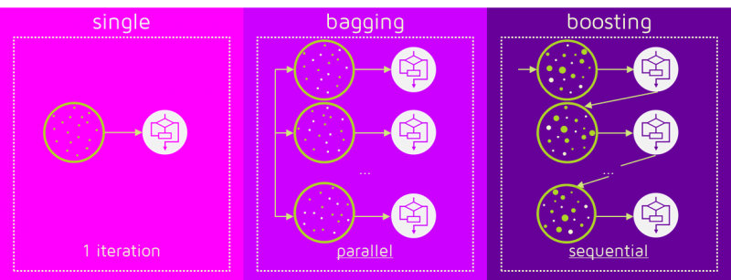
Intro: What is gradient boosting
“Boosting” is one of the ensemble method
Bagging: build many independent predictors parallelly
Boosting: build subsequent predictors to cover the mistakes of the previous predictors
“Gradient Boosting” is one of the boosting method It uses gradient information of previous predictors to build the new predictor
What is the difference between Bagging and Boosting? [URL]

Slide 8
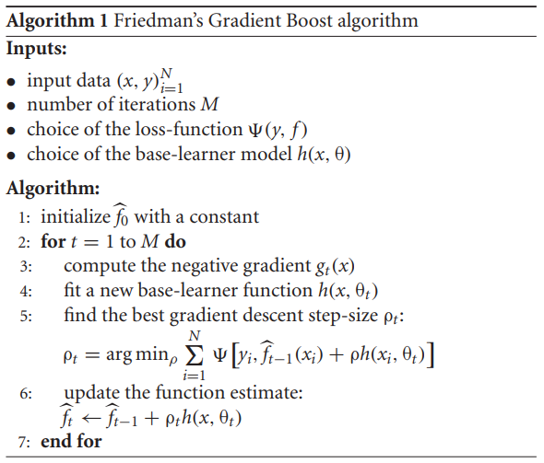


Intro: Algorithm of gradient boosting
From [1]
Input data:
x: explanatory variables (vector)
y: object variables (i.e. label)
Number of iteration:
It is corresponding to the number of predictors
Loss-function ψ (psi)
It is chosen based on the target task
i.e.
when y is continuous
when y is categorical
Base-learner model:
(Maybe) Anything ok if we can get gradient of it
Decision tree is often used because Friedman[1] proposed a modification named gradient tree boosting to improve its training efficiency
※Θ is model parameter
[1] Jerome H. Friedman, “Greedy Function Approximation: A Gradient Boosting Machine, ” 2001.

Slide 9
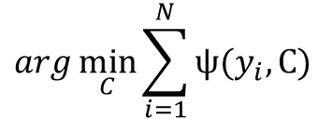
Intro: Algorithm of gradient boosting
From [1]
Initial function
Constant value is calculated by below:
$$arg\min_{C}{\sum_{i=1}^{N}{ψ(y_{i}, C)}}$$
[1] Jerome H. Friedman, “Greedy Function Approximation: A Gradient Boosting Machine, ” 2001.

Slide 10
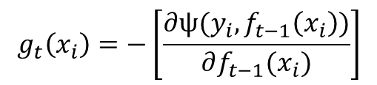
Intro: Algorithm of gradient boosting
From [1]
Initial function
Negative gradient is calculated by:
$$g_{t}\left(x_{i}\right)=−\left[\frac{∂ψ(y_{i}, f_{t−1}\left(x_{i}\right))}{∂f_{t−1}(x_{i})}\right]$$
[1] Jerome H. Friedman, “Greedy Function Approximation: A Gradient Boosting Machine, ” 2001.

Slide 11
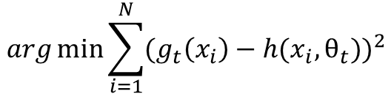
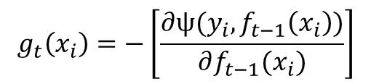
Intro: Algorithm of gradient boosting
From [1]
Initial function
New base-learner
$$g_{t}\left(x_{i}\right)=−\left[\frac{∂ψ(y_{i}, f_{t−1}\left(x_{i}\right))}{∂f_{t−1}(x_{i})}\right]$$
“Fit” means below:
In naïve implementation, h(x, θ) is trained by
treating g_{t}(x) as objective variable
$$arg\min_{}{\sum_{i=1}^{N}{{(g_{t}\left(x_{i}\right)−h(x_{i},θ_{t}))}^{2}}}$$
[1] Jerome H. Friedman, “Greedy Function Approximation: A Gradient Boosting Machine, ” 2001.

Slide 12

Intro: Algorithm of gradient boosting
From [1]
Initial function
New base-learner
Decide how much distance we move along the gradient
I do not know why this process is needed in every t
(It is said that fixed ρ does not work)
[1] Jerome H. Friedman, “Greedy Function Approximation: A Gradient Boosting Machine, ” 2001.

Slide 13

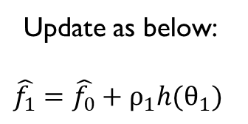
Intro: Algorithm of gradient boosting
From [1]
Initial function
New base-learner
$$\hat{f_{1}}$$
Update as below:
$$\hat{f_{1}}=\hat{f_{0}}+ρ_{1}h(θ_{1})$$
[1] Jerome H. Friedman, “Greedy Function Approximation: A Gradient Boosting Machine, ” 2001.

Slide 14






Intro: Algorithm of gradient boosting
From [1]
$$ρ_{1}h(θ_{1})$$
$$ρ_{2}h(θ_{2})$$
$$ρ_{3}h(θ_{3})$$
$$\hat{f_{1}}$$
$$\hat{f_{2}}$$
$$\hat{f_{3}}$$
・・・
Repeat to M !
[1] Jerome H. Friedman, “Greedy Function Approximation: A Gradient Boosting Machine, ” 2001.

Slide 15
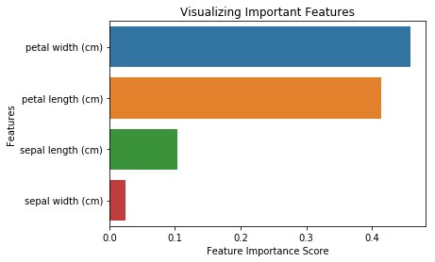
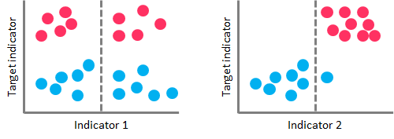
Intro: Characteristic1 – Feature Importance
Decision Tree, Random Forest and GBDT can calculate feature importance
Importance is computed based on how much the features contribute when each tree is built, it is an index named Gini impurity
Scikit-learn packages of above tree methods use Gini impurity as importance (Caution: Some random forest packages used other index (OOB) as importance)
High Gini impurity
(Bad split on tree branch)
Low Gini impurity
(Nice split on tree branch)
Example of Feature importance
https://towardsdatascience.com/the-complete-guide-to-decision-trees-28a4e3c7be14

Slide 16
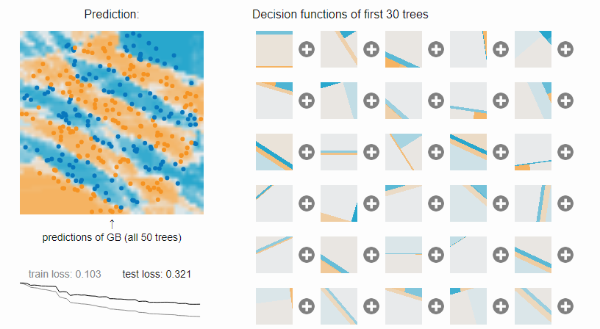
Intro: Characteristic2 – Decision Boundary
決定境界は必ず矩形になる．曲線は表現できない．
Ensembleすると矩形の重ね合わせで（一応）複雑な境界の表現が可能に
ただし，線形分離可能なデータに対してはうまくフィッティングできない この場合，有効な特徴量を自分で作成しておくほかない
Gradient Boosting
Interactive Playground
[URL]

Slide 17
Outline
Background
Introduction of GBDT
Basic structure
How to train
Characteristics
Recent progress
XGBoost
LightGBM
CatBoost
Summary

Slide 18
Recent Progress
精度・速度の改善が進行
即ライブラリ公開
CatBoost
By Yandex
(NIPS 2018)
[URL]
LightGBM
By Microsoft
(NIPS 2017) [URL]
XGBoost
By Washington University
(KDD 2015)
[URL]
Natural GBDT
(2001)
Library:
Scikit-learn[URL]
H₂O[URL]

Slide 19
XGBoost

Slide 20
LightGBM

Slide 21
CatBoost

Slide 22
Packages

Slide 23
Outline
Background
Introduction of GBDT
Basic structure
How to train
Characteristics
Recent progress
XGboost
LightGBM
CatBoost
Summary

Slide 24
Summary

Slide 25
END

Slide 26

Appendix

Slide 27
Intro: How to train a decision tree
学習データを部分集合に分割するためのif-thenルールを構築していく
アルゴリズムによってif-thenを構築するために利用する情報が変わる
CART: Gini impurity
ID3, C4.5, C5.0: Information Gain (Quinlan)
ナイーブな実装では，分岐を作るたびに各特徴量の各分岐法則（いわゆる閾値）を 総なめしてベストな分岐ルールを選ぶため，特徴量の次元が増えるほど学習が遅くなる
基本的に過学習しやすい上，学習データのちょっとした変化で 構築される木の構造が大きく変わったりする（判別結果の分散が大きい）
この不安定さを補うためにアンサンブルされてきた

Slide 28
Intro: Basic structure
GBDT is a series of decision tree
Key factors:
① What is “Gradient Boosting” ?
② How to train GBDT
③ Characteristics of GBDT
Input
・・・
T₁
T₂
T₃
T_{n}
GBDT
Decision
Tree
O₁
O₂
O₃
O_{n}
1
2
3
4
× α₁
× α₂
× α₃
× α_{n}
+
Final output
T: Tree
O: Output of tree
α: Weight of output

